Slide 1
Student Learning Experience (SLE)
Materials linked from the June 10, 2021 Faculty Senate meeting.
Robin Pappas, Chair
Advancement of Teaching Committee
June 10, 2021 Faculty Senate Meeting

Slide 2
Overview
SLE Pilot Resources
AOT Recommendations
Motion to replace eSET

Slide 3
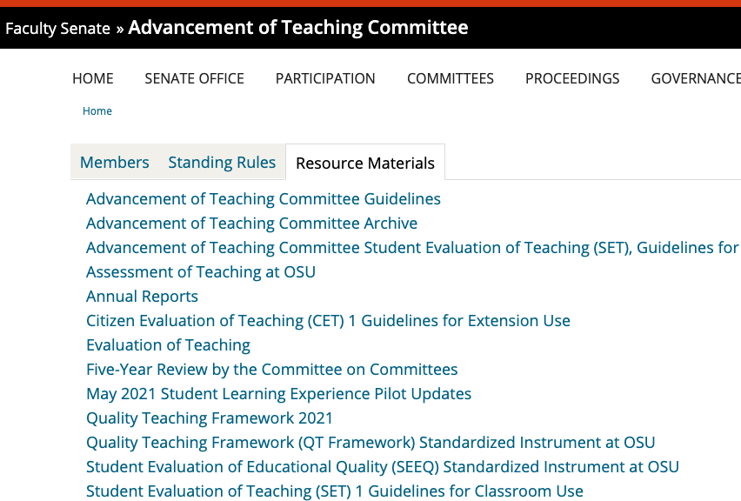
SLE Pilot Resources

Slide 4
SLE Pilot Resources

Slide 5
Implementation: Initial Recommendations
QT SLE to be implemented for all teaching faculty beginning AY2022/Summer 2021
Focus on engaging faculty/students, report findings Spring 2022, release revised SLE AY2023
Q1/Q2 included during AY2022 (and transition period, as determined by P&T)
Faculty Senate P&T to determine specific implementation policies
Notes:
Re; second bullet: engagement and revision will include fine-tuning options for formative assessment to complement the end of term evaluation instrument; will work with department chairs on how to use the new data and how to use it well, etc.147

Slide 6
Evaluating Teaching: Addressing Remaining Concerns
Response rates: Communicate and encourage practices that increase response rates
Persistent bias: Create formal mechanisms for addressing bias in feedback instruments (UO example)
Holistic, balanced data for teaching evaluation: (OTER recommendation) Include portfolio of data (e.g., teaching portfolios, self-reflection, peer review, etc.) in periodic review and P&T evaluations

Slide 7
Evaluating the SLE
Listening sessions, focus groups with students and faculty (AY 2022)
Survey of faculty re: interpretation/utility of data (Winter 2022)
Analysis of quantitative properties of survey (Winter 2022)
(spring data too late for report to Faculty Senate)
Monitor response rates
Next evaluation cycle 2024-2025
Notes:
Re: 3rd bullet point: (e.g., we built it on three factors, does a factor analysis of the data support a three factor structure; what is the internal reliability ((Cronbach's alpha)) of each of the three subscales)

Slide 8
Motion to Replace eSET with QT SLE
The OSU Faculty Senate moves to replace the electronic Student Evaluation of Teaching (eSET) with the Quality Teaching Student Learning Experience (QT SLE) instrument for student feedback on courses, starting in academic year 2022. Questions 1 and 2 from eSET will also be included in the student feedback tool throughout AY2022.

Slide 9
Questions? Robin.pappas@oregonstate.edu

