Slide 1
Faculty Senate Meeting
Selina Heppell, FS President
June 2021
Faculty Senate

Slide 2
Bandwidth

Slide 3
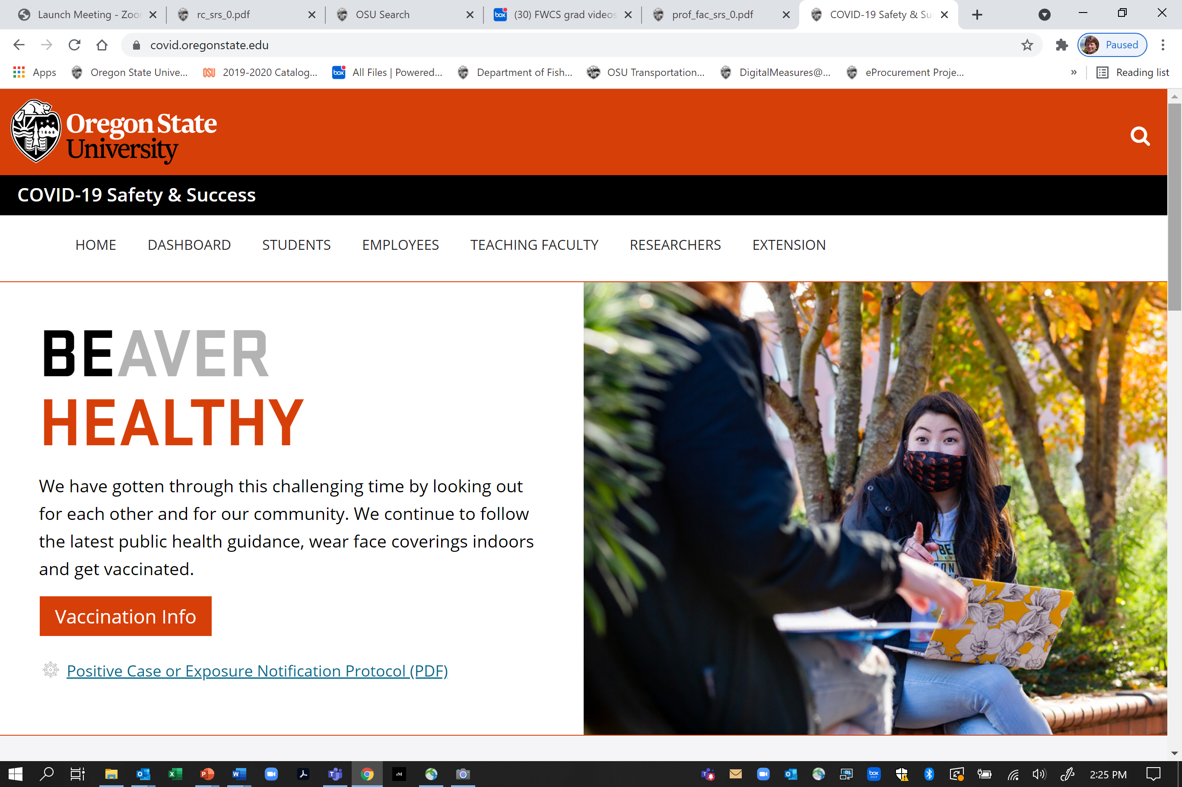
COVID status updates https://covid.oregonstate.edu/

Slide 4
On-going discussions – Call for Commitment to Action
Excellent brainstorming and feedback from Senators and our constituents
Input from variety of program leaders and faculty across campus indicates a need for better alignment of objectives
Continued discussion to identify best path forward to support existing programs, provide administration with clear recommendations that have broad support

Slide 5
Today’s agenda
Proposed Creation of Faculty Senate Committees
Curricular Proposals
Consideration of Degree Candidates
Public Safety – Meet Chief Anderson
Provost’s Report
Ad Hoc Committee Recommendations for Presidential Search
Student Learning Experience/eSET tool replacement
Professor of Teaching
Standing Rules Revisions
Pulse Survey 6.0 results

Slide 6
Chat and Voting
Please remember that public comments to the Chat are part of the Senate meeting records -personal chats are not recorded
Only Senators are permitted to vote – if you are visiting today, please do not participate in the polls.
Voting results provided today are preliminary until the Senate staff completes a review of voter ID

Slide 7
Consideration of Degree Candidates

Slide 8
Curricular Proposals

Slide 9
Standing Rules Revisions

Slide 10
New Senate Committees

Slide 11
Carbon Commitment Committee
Developed from work of ad hoc committee developed by Faculty President Jon Dorbolo
Keith Jayawickrama, Shelly Signs, Vickie Nunnemaker

Slide 12
Carbon Commitment Committee
Proposed Standing Rules
The Carbon Commitment Committee advocates for OSU to meet the goals of the Carbon Commitment signed by President Ed Ray in 2007 and promotes lasting changes to policies affecting OSU's carbon footprint. The Committee supports the OSU Sustainability Office in furthering the objectives of the Carbon Commitment; seeks to motivate faculty, staff and students to contribute to the carbon reduction mission; and helps develop recommendations for achieving carbon neutrality. The Committee’s main focus is on measurable, tangible reduction of OSU’s carbon emissions at its various locations throughout the State.
Achieving the objectives set by the Carbon Commitment requires action and collaboration by all parts of Oregon State University. The Carbon Commitment Committee provides faculty leadership to support effective engagement by all faculty and their home units.
The Committee shall consist of at least one (and up to two) voting member(s) from the following: each Faculty Senate apportionment unit, Division of Extension and Engagement and the Sustainability Office. Individuals may represent two units where their position fits in both units. Two students, one undergraduate and one graduate, shall also serve as voting members on the Committee. The Committee shall have a minimum of 10 members with the total voting membership not to exceed 25. An ex-officio, non-voting member may be from the OSU Foundation.

Slide 13
Professional Faculty Interests Committee
Developed from work of ad hoc committees in 2020 and 2021 and long-time need to have Senate input on professional faculty advancement, affairs and interests
After much discussion, Professional Faculty Interests was chosen as most descriptive and comprehensive title for the committee
Vicki Ebbeck, Justin Fleming, Jeff Malone, Vickie Nunnemaker, Heather Horn

Slide 14
Professional Faculty Interests Committee
Proposed Standing Rules
The work of the Professional Faculty Interests Committee addresses the interests of professional faculty at OSU. Purview of this Committee includes receiving concerns, conducting data collection and analysis, exploring necessary changes and formulating and recommending potential initiatives. The committee makes recommendations to the OSU Faculty Senate and works collaboratively with campus partners, as well as other committees when appropriate.
The Committee is composed of nine members representing the broad spectrum of professional faculty job families including an off-campus member each from Extension and OSU-Cascades. There shall be no more than two members from the same job family. Additionally, there shall be one ex-officio, non-voting member representing the Professional Faculty Leadership Association appointed annually by the Professional Faculty Leadership Association President.

Slide 15
Professor of Teaching Task Force

Slide 16
OSU Presidential Search Ad Hoc Committee Recommendations

Slide 17
Student Learning Experience

Slide 18
Pulse Survey 6.0 results

Slide 19
Public Safety

Slide 20
Provost’s Report

Slide 21
I make a motion to engage faculty with expertise in fields of gender and sexuality in the creation and report outs of faculty pulse surveys moving forward.

