Slide 1
Update from
Advancement of Teaching Committee
Faculty Senate Meeting
October 14, 2021
Devon Quick, AOT chair
Robin Pappas, past AOT chair
Notes:
PRoviding feedback here, no motions

Slide 2
New Terminology
SLE = Student Learning Experience Surveys, replaces eSET

Slide 3
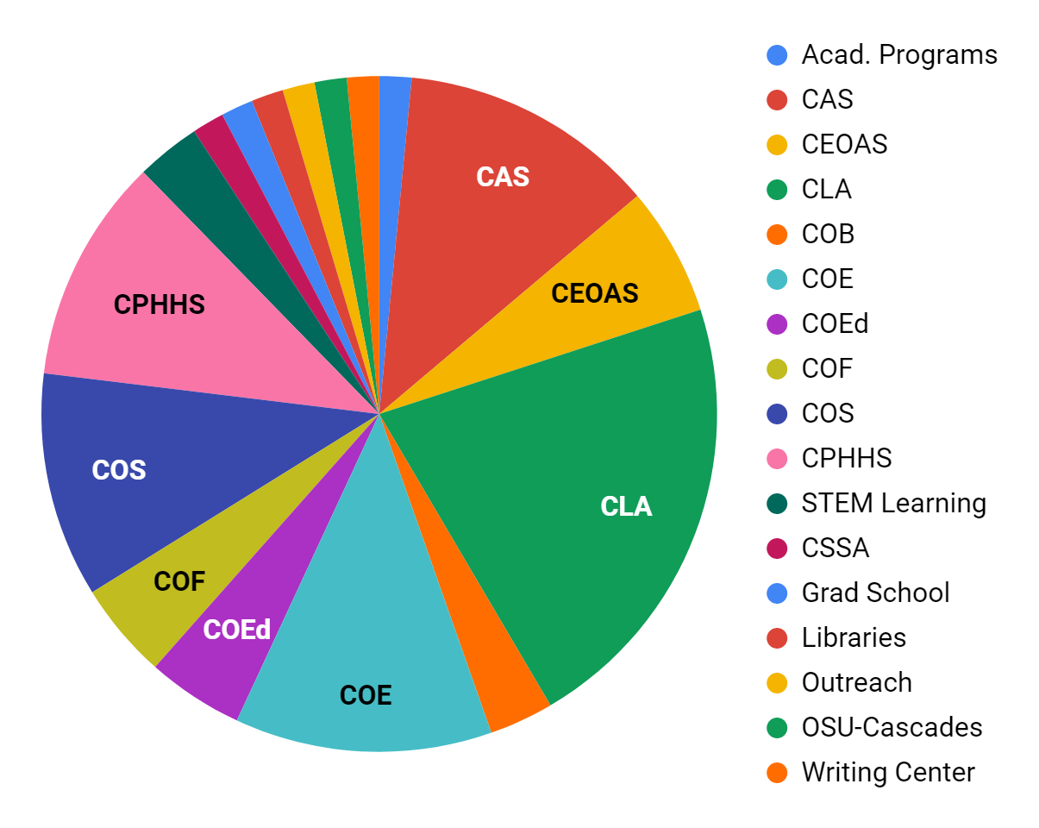
OTER report issued to Faculty Senate; Faculty Senate asks for new eSET questions
Faculty Senate asks for examination of eSET
Data & recommendation presented to Faculty Senate
COVID
Mar 2019
Oct 2019
Mar 2020
May 2021
April 2019
Feb 2020
Sept 2020
Jun 2021
OTER group meets
Quality Teaching Framework accepted by Exec. Comm.
SLE Pilot initiated
SLE Pilot begins, data collected Fall & Winter terms, including feedback from students and faculty
New SLE approved by Faculty Senate; keep questions 1 & 2; Questions revised over summer
Notes:
Question revision was informed by student feedback
Revised by faculty feedback

Slide 4
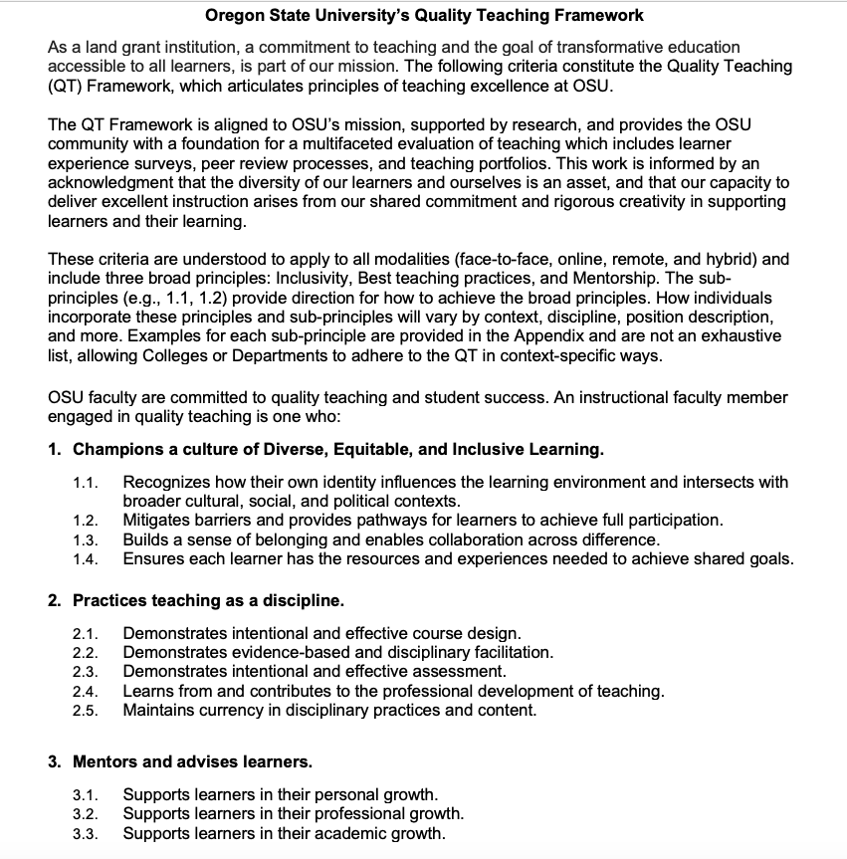
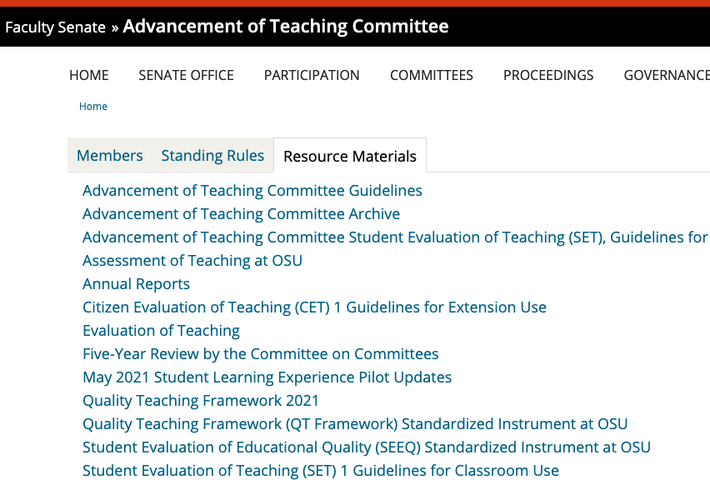
All questions are aligned to Quality Teaching Framework

Slide 5
The questions: Inclusivity
1 = Completely Disagree, 2 = Mostly Disagree, 3 = Slightly Disagree, 4 = Slightly Agree, 5 = Mostly Agree, 6 = Completely Agree
My instructor modeled and promoted inclusivity.
The course materials were accessible.
I felt like I belonged in this class.
This course was structured so that I could work effectively with others who were different from me.
I had the necessary resources to achieve the course learning outcomes.
Course learning activities helped me connect to the content.

Slide 6
The questions: Teaching as a discipline
1 = Completely Disagree, 2 = Mostly Disagree, 3 = Slightly Disagree, 4 = Slightly Agree, 5 = Mostly Agree, 6 = Completely Agree
This course was well organized.
Course activities gave me the chance to show my progress towards course learning outcomes.
Feedback on test, assignments, and/or graded activities informed my thinking and learning.
Directions and expectations for tests, assignments and/or graded activities were clear.
Tests, assignments and/or graded activities matched the course learning outcomes.

Slide 7
The questions: Mentorship
1 = Completely Disagree, 2 = Mostly Disagree, 3 = Slightly Disagree, 4 = Slightly Agree, 5 = Mostly Agree, 6 = Completely Agree
My instructor addressed students' non-academic needs.
I had opportunities to develop professional skills.
I had opportunities to become a better learner.

Slide 8
The questions: Open Ended
Please comment on how the course positively supported your learning.
Please comment on how the course could better support your learning.

Slide 9
Feedback from students on the questions
Did you understand all the questions in today's survey? If not, please explain.
Is there anything important about your learning experience that was not captured by these questions? If so, please explain.

Slide 10
Now what?
Now | Midterm course survey & guidance
By the end of this term | Guidance for how to improve response rates Guidance for faculty & administrators on how to interpret new data
Ongoing | Collect feedback from faculty, students about instrument, data & use; revise instrument
By the end of this year | Work with Faculty Senate P&T and Office of Faculty Affairs to develop new policy for how to interpret new data, inform P&T Examine Peer Review & Teaching Portfolios

Slide 11
Where can I see these documents?

Slide 12
Who can I talk to about things?
Your AOT Committee:
Devon Quick, devon.quick@oregonstate.edu
Robin Pappas, robin.pappas@oregonstate.edu
Jeewon Cho, jeewon.cho@bus.oregonstate.edu
Amanda Kibler, amanda.kibler@oregonstate.edu
Sam Johnson, sam.johnson@oregonstate.edu
Regan Gurung, regan.gurung@oregonstate.edu
Brooke Howland, brooke.howland@oregonstate.edu
Elizabeth Holzenthal, holzente@oregonstate.edu

