Slide 1
Mike O’Malley
Remembering
Husband, Father, Friend and Colleague
October 8, 1957 – July 1, 2021

Slide 2

Mike O’Malley

Slide 3
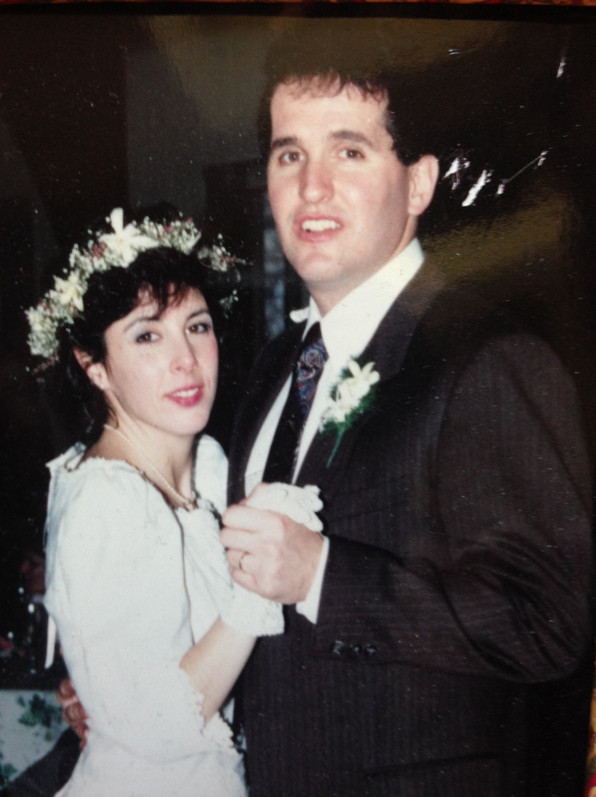
Mike O’Malley

Slide 4

Mike O’Malley

Slide 5

Mike O’Malley

Slide 6
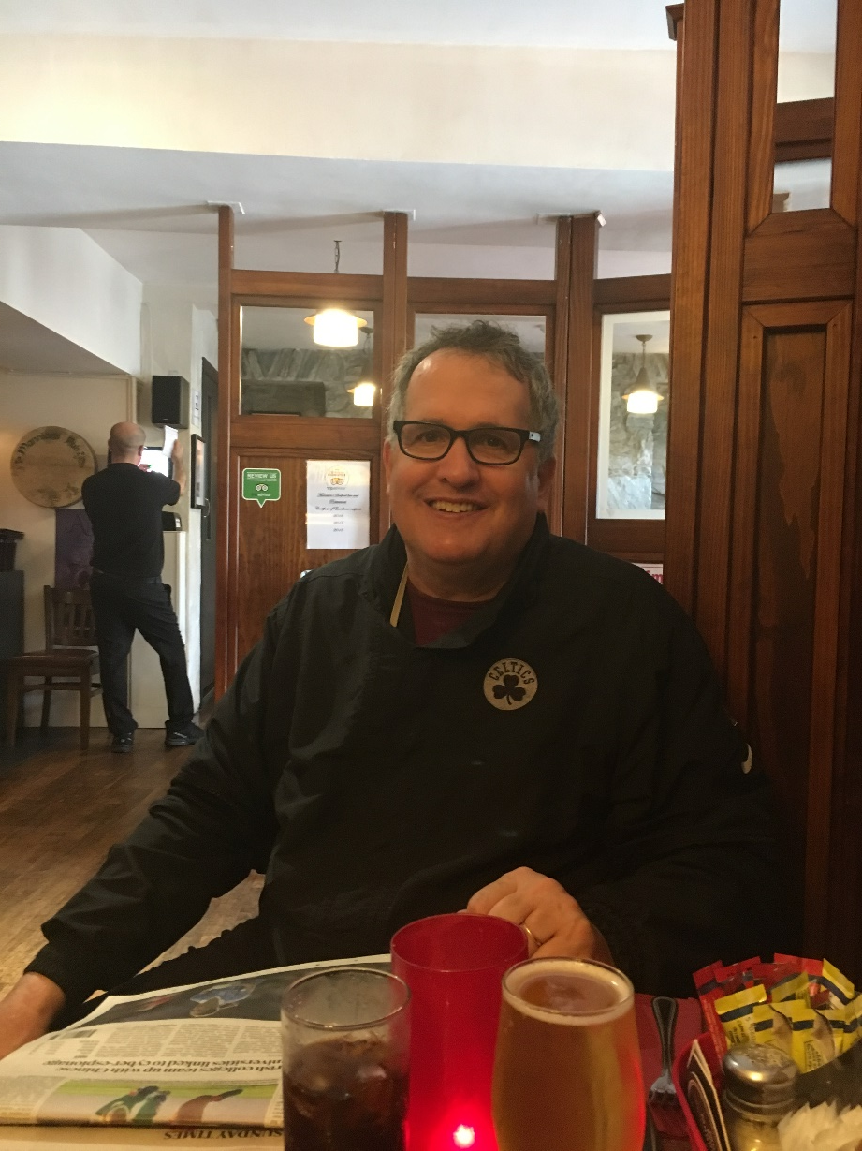
Mike O’Malley

Slide 7
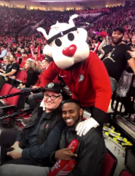

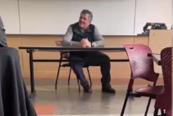
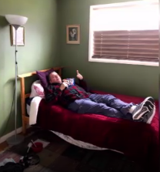
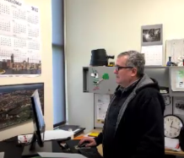
Mike O’Malley

Slide 8
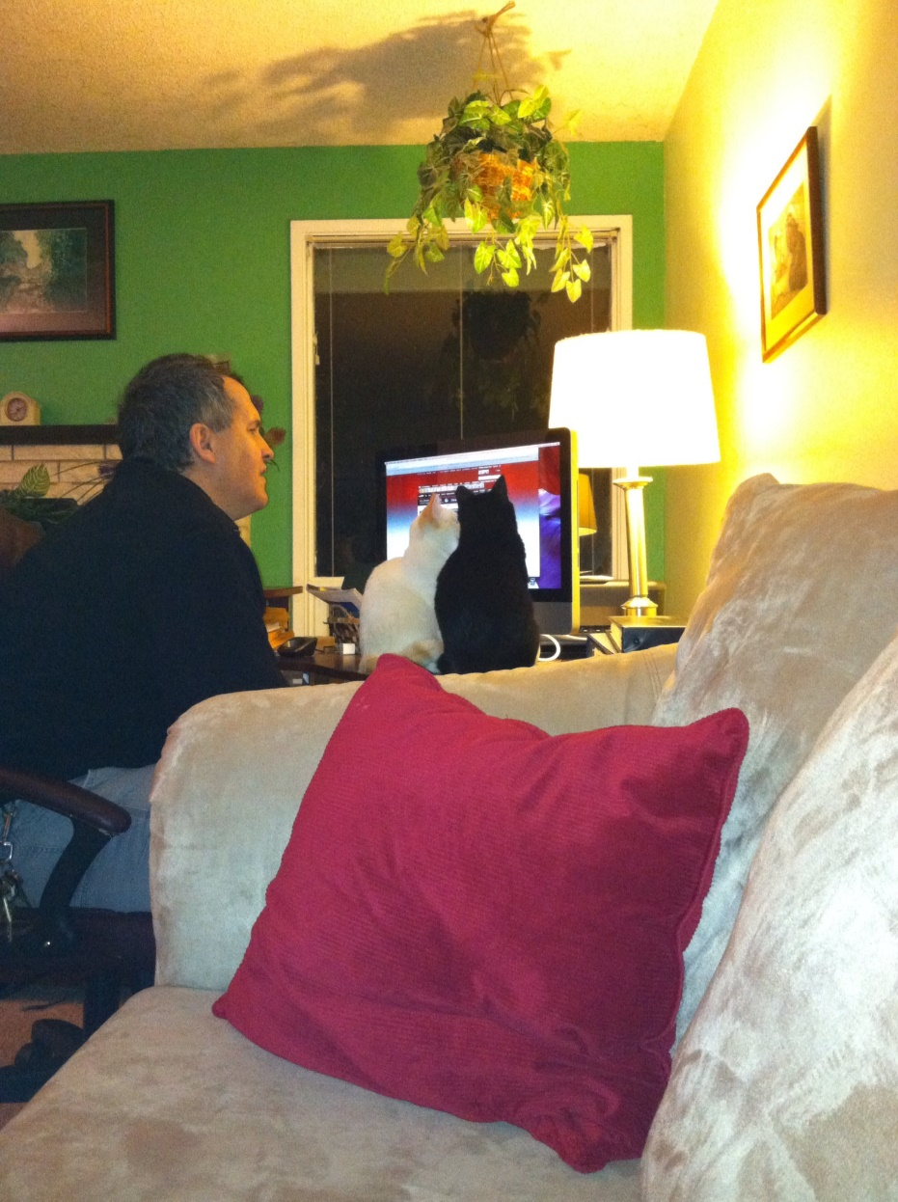
Mike O’Malley

Slide 9
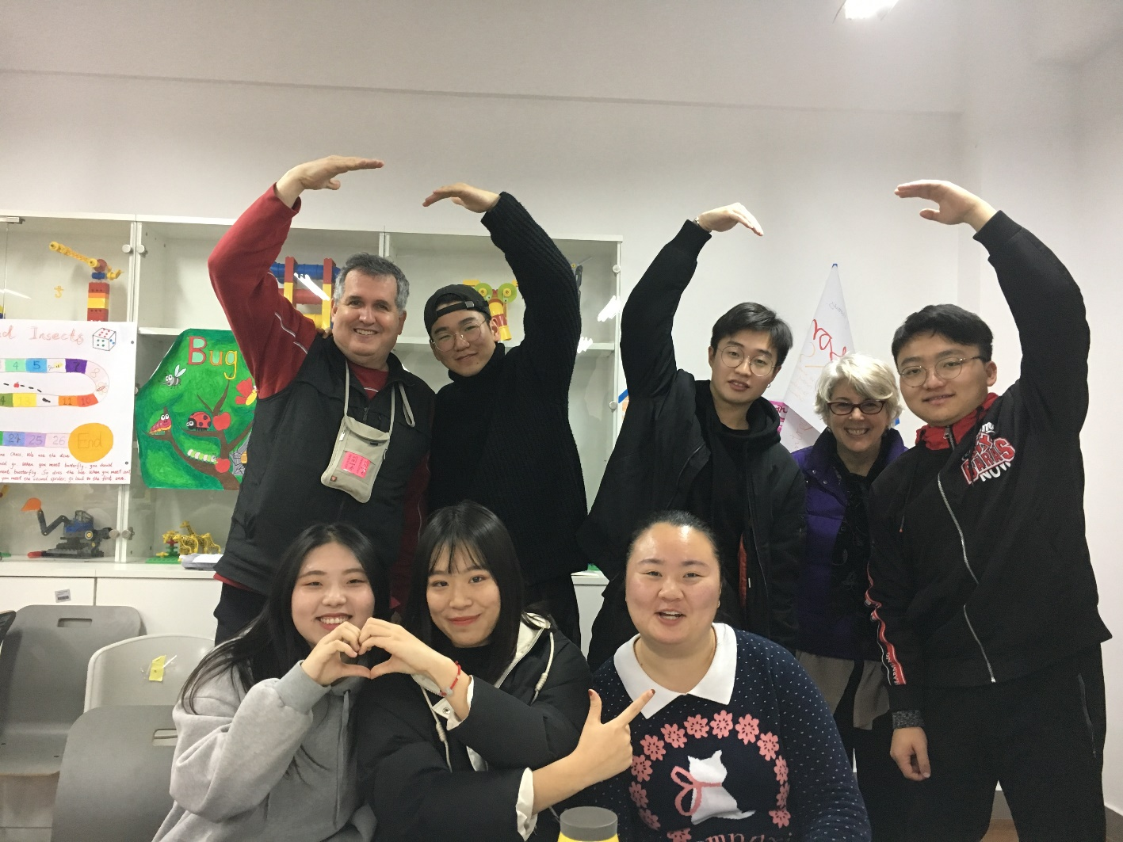
Mike O’Malley

Slide 10
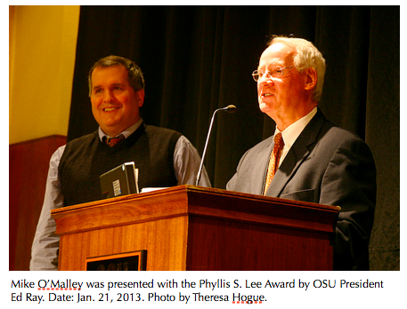
Mike O’Malley

Slide 11
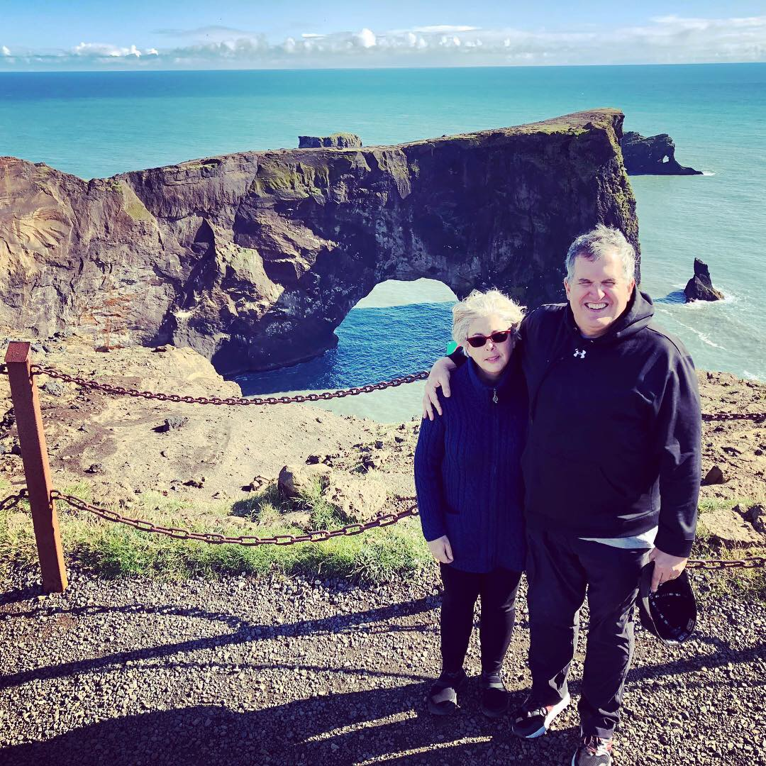
Mike O’Malley

Slide 12
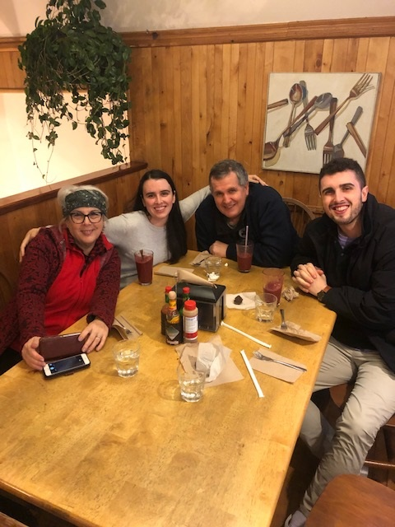
Mike O’Malley

Slide 13

Mike O’Malley

