Slide 1
Faculty Senate Meeting
Selina Heppell, FS President
October 2021
Faculty Senate

Slide 2

Land Acknowledgement
Let it be acknowledged that Oregon State University in Corvallis, OR is located within the traditional homelands of the Mary's River or Ampinefu Band of Kalapuya. Following the Willamette Valley Treaty of 1855 (Kalapuya etc. Treaty), Kalapuya people were forcibly removed to reservations in Western Oregon. Today, living descendants of these people are a part of the Confederated Tribes of Grand Ronde Community of Oregon (https://www.grandronde.org) and the Confederated Tribes of the Siletz Indians (https://ctsi.nsn.us).
https://asosu.oregonstate.edu/land-rec

Slide 3
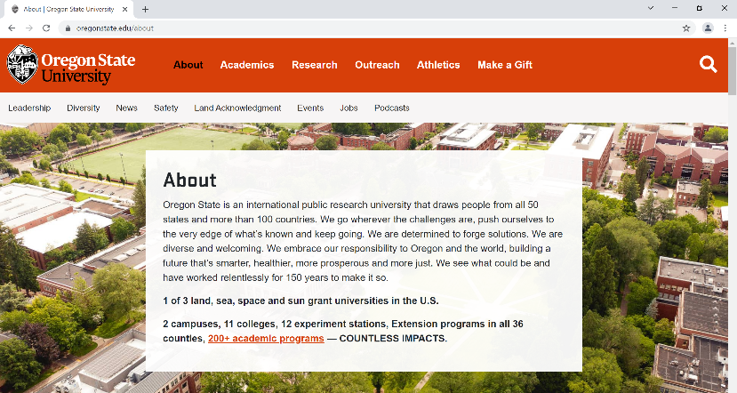
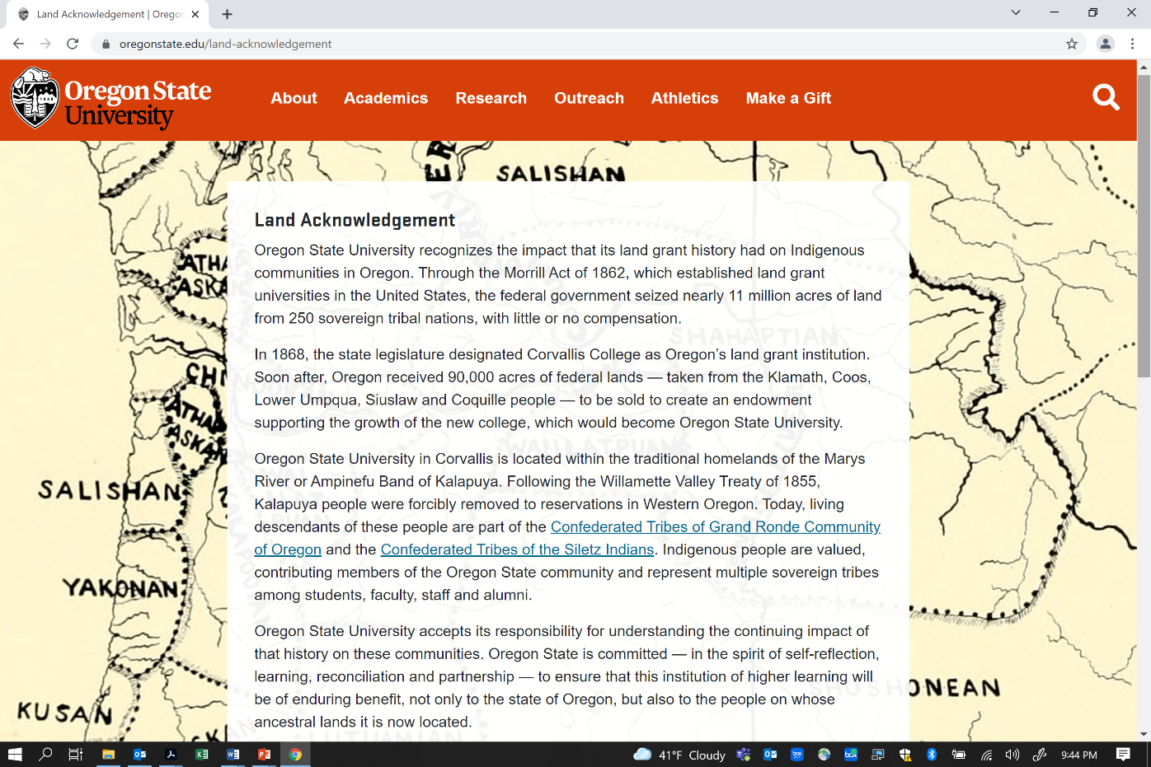

Slide 4
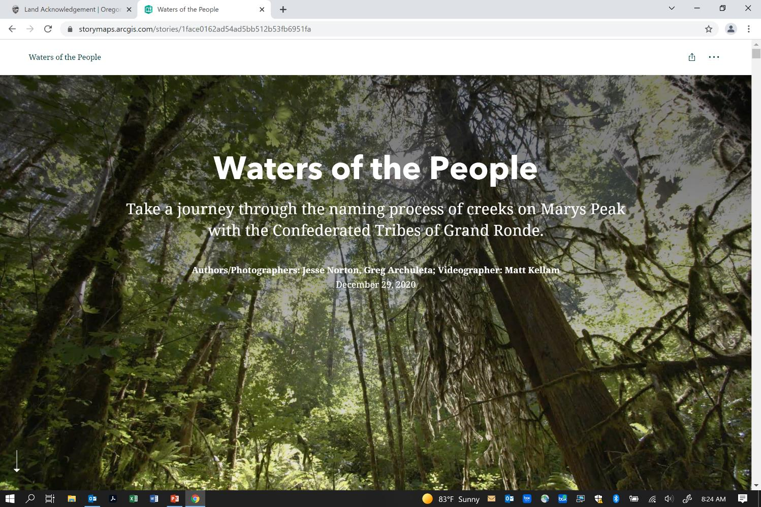
https://storymaps.arcgis.com/stories/1face0162ad54ad5bb512b53fb6951fa

Slide 5

A new day, with new possibilities……
This Photo by Unknown Author is licensed under CC BY

Slide 6

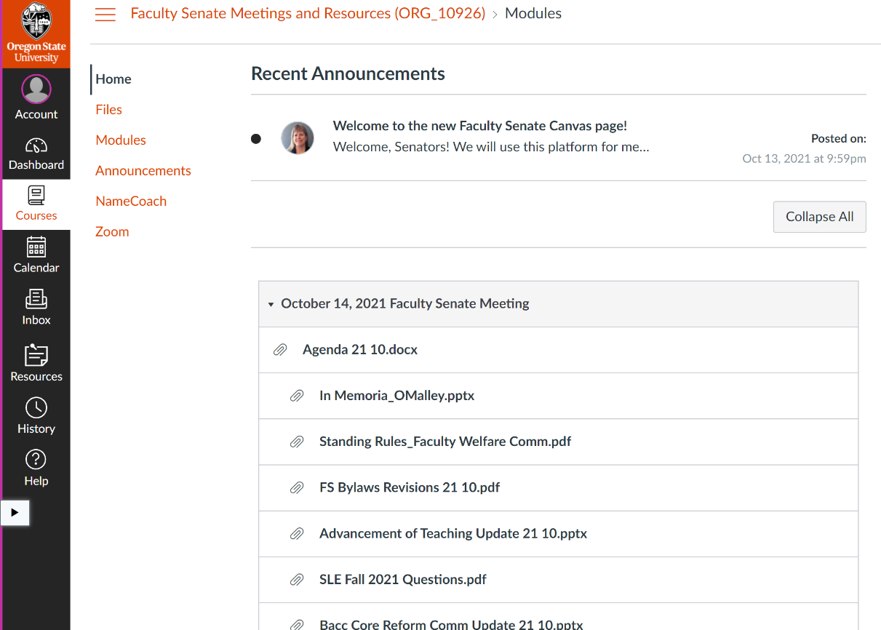
We are on Canvas!
This Photo by Unknown Author is licensed under CC BY

Slide 7
Faculty voices have been heard
COVID-related policies and guidelines
Faculty COVID testing on campus
Microphone upgrades and hybrid learning assistance
Student vaccination and mask enforcement
Building ventilation review and mitigation
Communication with unit leaders
Some larger classrooms to reduce densities
Field trip and classroom management guidance
Concise communications, clarification of policies
Employee proof of vaccination - forthcoming
Accommodation request guidelines for remote work – forthcoming
Presidential Search
Finalists come to campus
More faculty on the search committee
Updates later today!

Slide 8

Thank you and Welcome
Board of Trustees Faculty Position – thank you, Mike Bailey, and welcome Inara Scott
Faculty Senate Committees – many thanks to our chairs and members who are rotating off, and welcome to many new faces!

Slide 9
Ongoing projects – Partnerships
Board of Trustees
Presidential search
Regular updates and communications
Office of Academic Affairs
Transfer issues and common course numbering
Curriculum consistency and campus communications
Bacc Core reform
Office of Faculty Affairs
Professional Faculty promotion ladders
Professor of Teaching rank
Promotion and Tenure – handbook updates, promotion criteria
Cross-cutting
Anti-racism in the curriculum
Faculty Mentors Program
Shared Governance website
Operationalizing the Quality Teaching Framework

Slide 10
Reminders and updates
Next Senate meeting will be on November 18 due to Veteran’s Day holiday on the 11th
Canvas should be used for all courses
Student ONID emails are no longer forwarded to personal accounts
We will need to change our passwords regularly, for security
Fall Family Weekend November 12-14 – some COVID restrictions will apply
https://families.oregonstate.edu/family-weekends/parent-and-family-weekends
Meet President Johnson - November 17 from 2:30-4:00 and December 9 from 1:00-2:30
https://oregonstate.qualtrics.com/jfe/form/SV_37QH8TgOtF10AGG
Faculty concerns, feedback, and ideas are welcome – send me an email! FS.President@oregonstate.edu

Slide 11
Upcoming elections
State and Local Elections – remind your students to vote!
Faculty Senate Elections (for new Senators – all faculty vote)
Everyone is on the ballot, if eligible
Respond to survey to decline nomination or indicate a strong interest in serving. Deadline to respond is November 3.
Split appointment? Respond to survey by October 22 to choose your apportionment unit.
Faculty Senate Leadership Elections
President Elect, Inter-institutional Faculty Senate (IFS), Executive Committee (EC)
Candidates will be announced in November
All faculty vote for President-elect and IFS
Only Senators vote for EC

Slide 12

National Transfer Student Week
October 18th – 22nd
Follow the link to see which are scheduled during National Transfer Student Week:
beav.es/NTSW *Capitalization matters
Register to attend “Supporting Transfer Student Success: Five Key Practices” | October 15, 9:30 -11:00am beav.es/Ux2
Download NTSW Zoom background | beav.es/o7m
Interested in getting involved? | Contact event coordinator or Erin Bird beav.es/NTSW or erin.bird@oregonstate.edu
For accommodations related to a disability, please contact the event coordinator listed for each activity.
Sponsored by the Transfer Advisory Council; Erin Bird (erin.bird@oregonstate.edu)

Slide 13

Oct. 26 10 a.m.
Register at: https://tinyurl.com/OSUCarbonNeutral

Slide 14
Today’s agenda (on Canvas)
Welcome and Updates from Provost Feser
Action Items – Faculty Senate Committees
Special Reports:
Board of Trustees update on upcoming Presidential Search
Faculty Pulse Survey 7.0 results
Committee Reports:
Bylaws Revisions (vote next month)
Student Learning Experience/eSET tool replacement update
Bacc Core Reform Update
Breakout rooms – Faculty Senate Issues and Priorities for 2021-22
Remembering Mike O’Malley

Slide 15

Chat and Voting
Remote participants can use the Chat for questions if they are unable to use a microphone. Please remember that public comments to the Chat are part of the Senate meeting records (personal chats are not recorded).
Voting will be through the Canvas page, which is a “course” only accessible to Senators and their proxies

Slide 16
Remembering Mike O’Malley

Slide 17
Action Items – Faculty Senate Committees

Slide 18
Proposed Abolishment of the Computing Resources Committee The Executive Committee is proposing to abolish the Computing Resources Committee since OSU now has a much more robust and responsive University Information and Technology group than in prior years. Initially, a large component of this committee was to allocate the Technology Resource Fees (TRF), but that task was taken over by a dedicated TRF Committee in 1998. Recent committee feedback has been that they do not have enough to do.
Motion to abolish the Computing Resources Committee

Slide 19
Proposed Consolidation of Faculty Senate Committees The Executive Committee is proposing to combine the Faculty Economic Welfare and Retirement Committee and Faculty Status Committee to create the Faculty Welfare Committee. Proposed Standing Rules
Motion to combine the Faculty Economic Welfare and Retirement Committee and Faculty Status Committee to create the Faculty Welfare Committee

Slide 20
Faculty Consultative Group Revisions If C.1. is approved, the Faculty Consultative Group document will also need to be revised by Faculty Senators to indicate the new committee title.
Motion to revise the Faculty Consultative Group document to indicate the new committee title.
Note: Blue text indicates the proposed insertion and strike-through text indicates the proposed deletion:
“The FCG is comprised of the Faculty Senate Executive Committee (EC) along with the chairs of the Curriculum Council, the Faculty Status Committee Faculty Welfare Committee and the Budgets and Fiscal Planning Committee. The Faculty Senate President chairs the FCG and the President-elect serves as vice-chair.”

Slide 21
Provost’s Report
Welcome and Updates from Provost Feser

Slide 22
Provost’s Report
Committee Reports:
Bylaws Revisions (vote next month)
Student Learning Experience/eSET tool replacement
Bacc Core Reform Update

Slide 23
Proposed Revisions to Faculty Senate Bylaws
On behalf of the Executive Committee, President Selina Heppell will outline proposed revisions to the Bylaws. Senators will have one month to review the proposed revisions, which are scheduled to be voted on November 18. If you have questions about the proposed revisions, please contact Vickie Nunnemaker in the Faculty Senate Office.

Slide 25
Provost’s Report
Special Reports:
Board of Trustees update on upcoming Presidential Search
Faculty Pulse Survey 7.0 results

Slide 27


Breakout Rooms
Randomized groups in person and on Zoom
Discuss Senate priorities for 2021-22
“Quiz” will be on the Canvas page to upload your group’s ideas

