Slide 1
Julie Green
Remembering
Artist, Professor, Friend
September 22, 1961 – October 12, 2021

Slide 2
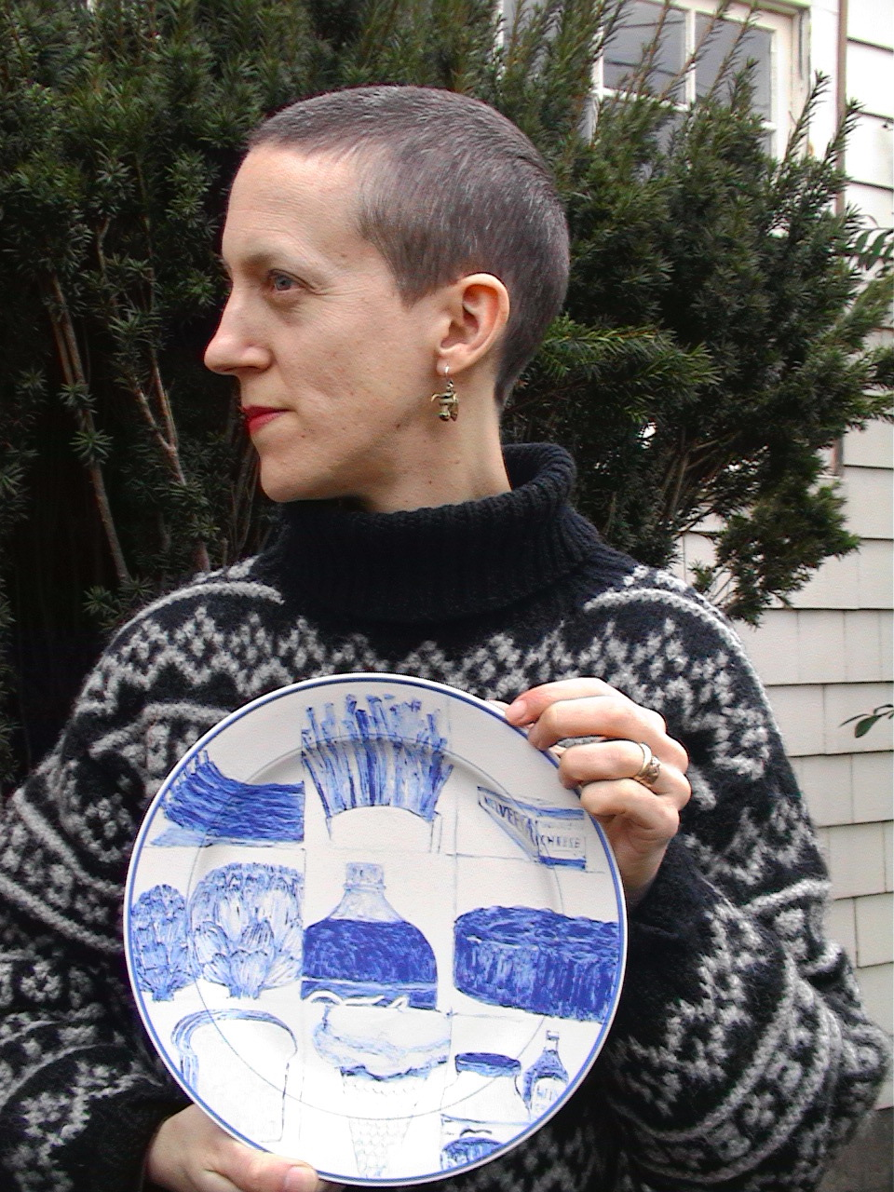
Julie Green

Slide 3
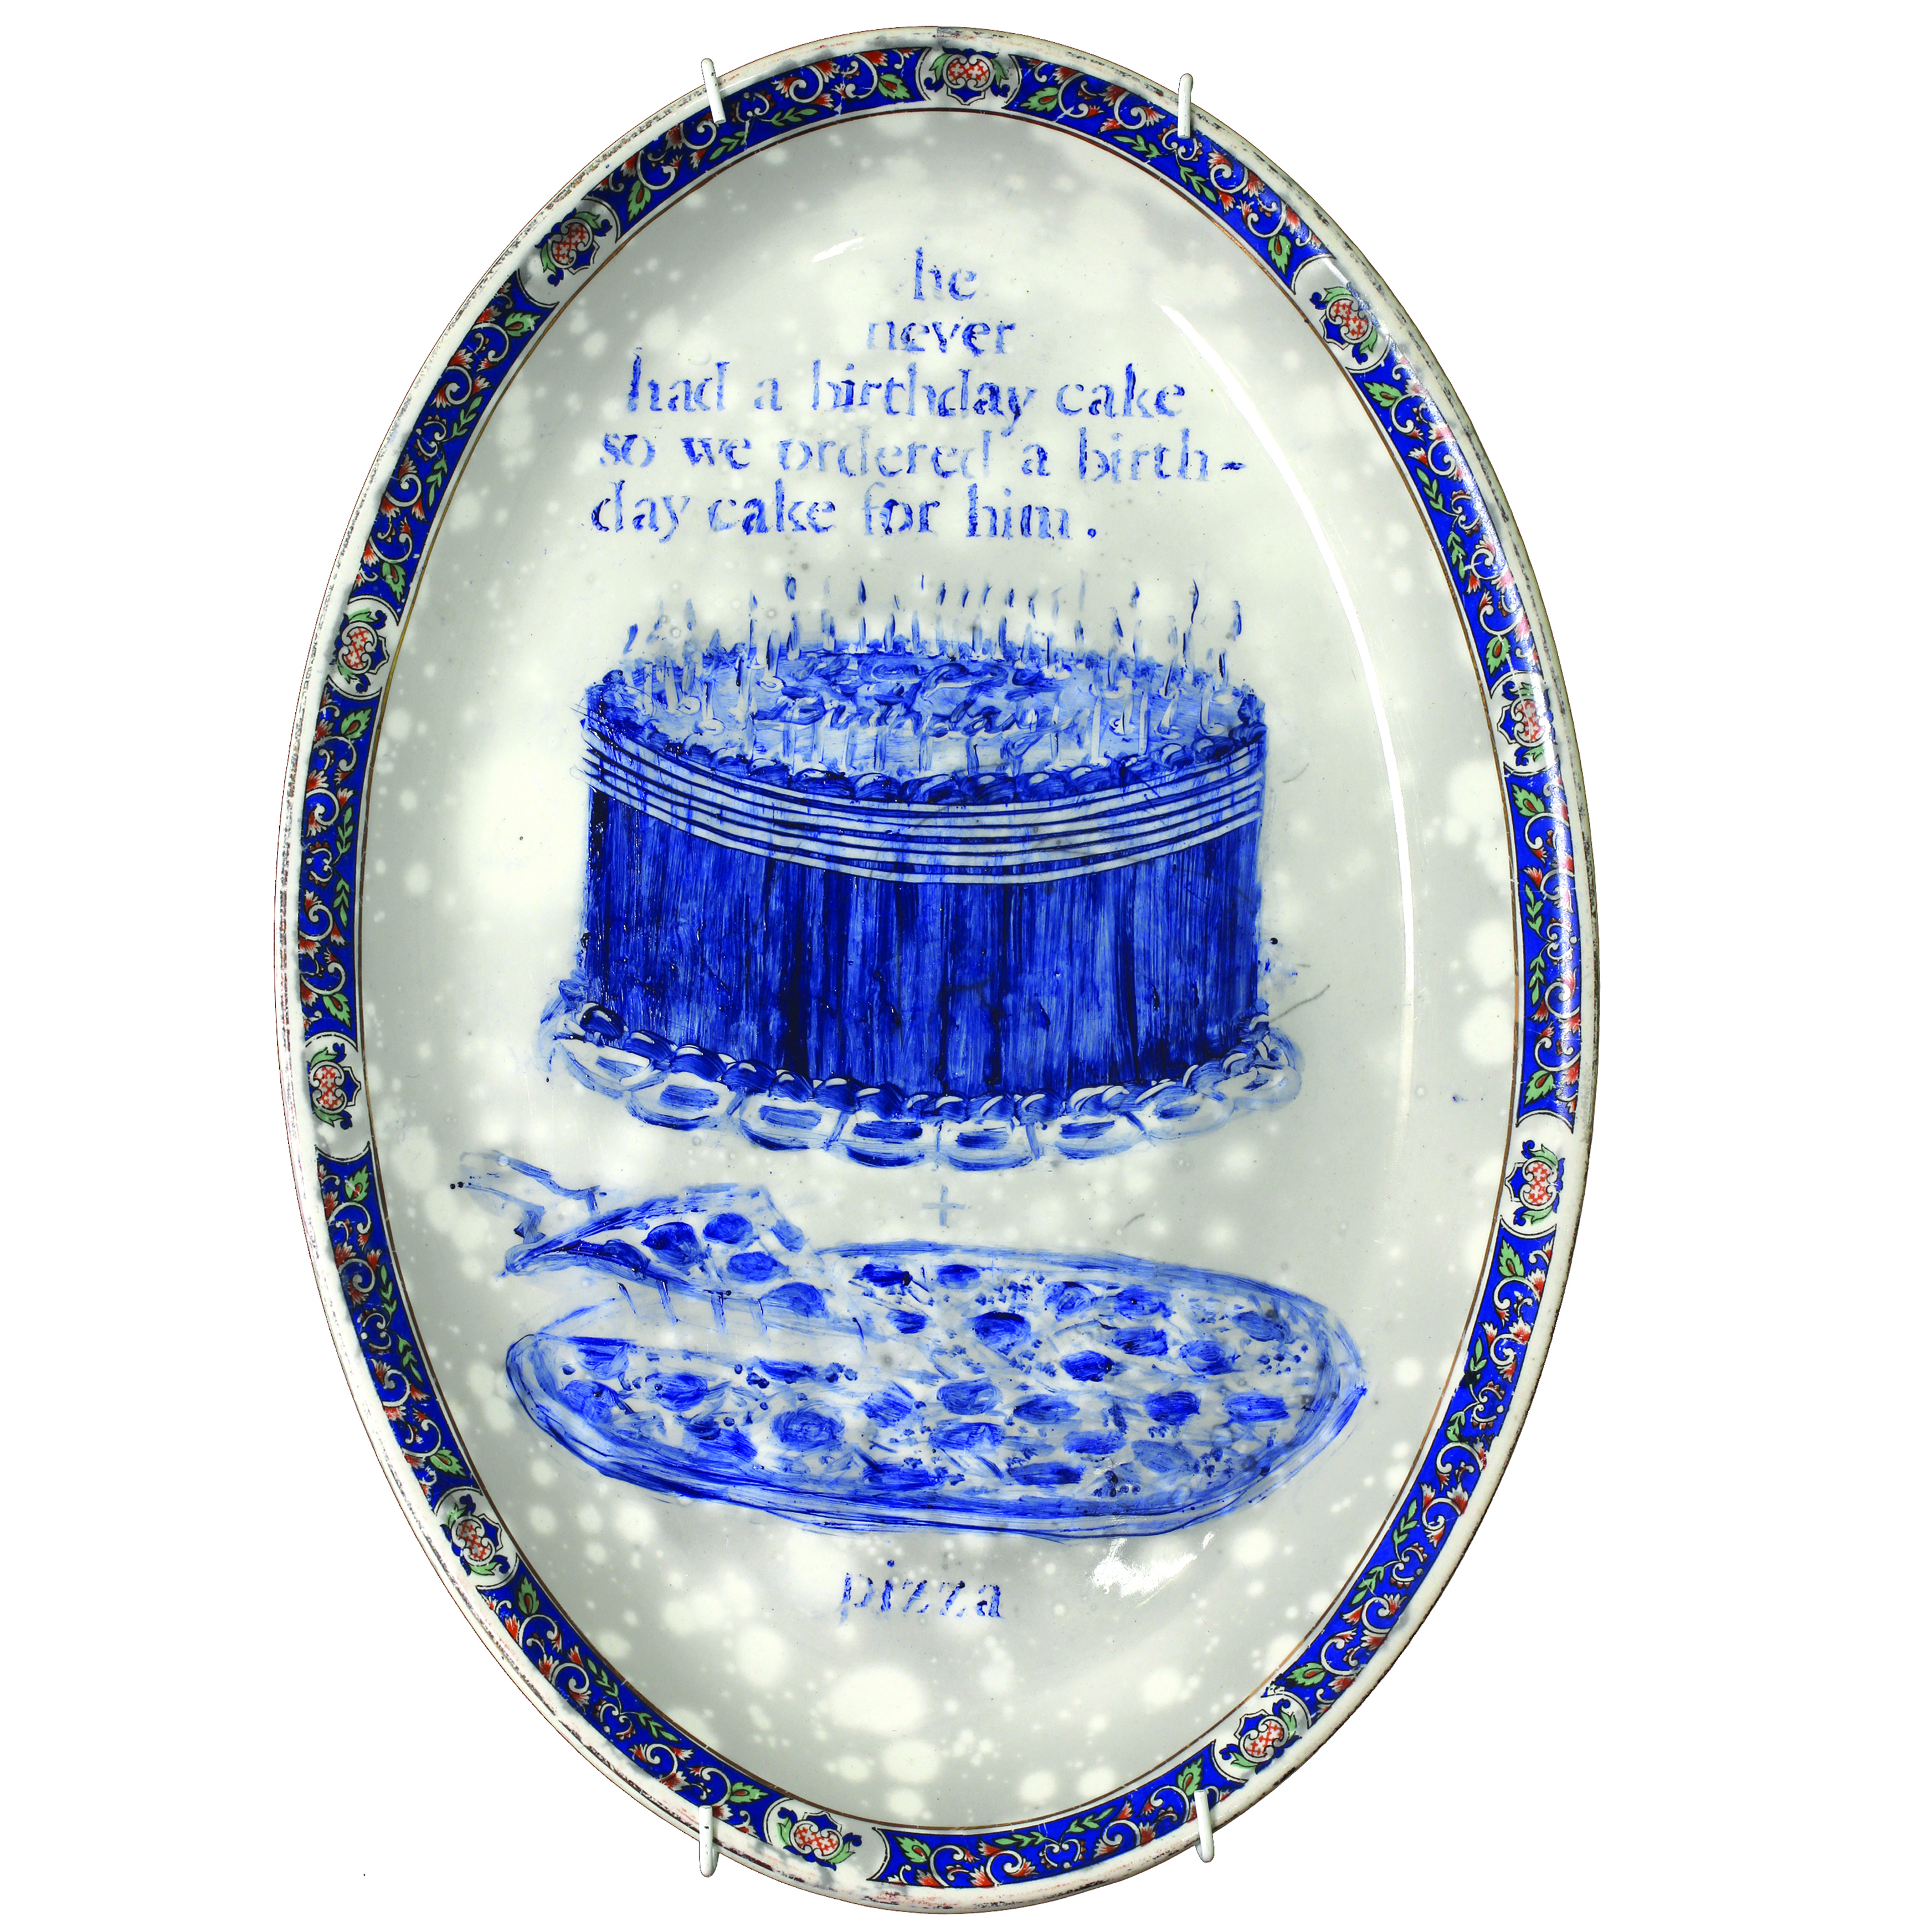
Julie Green

Slide 4
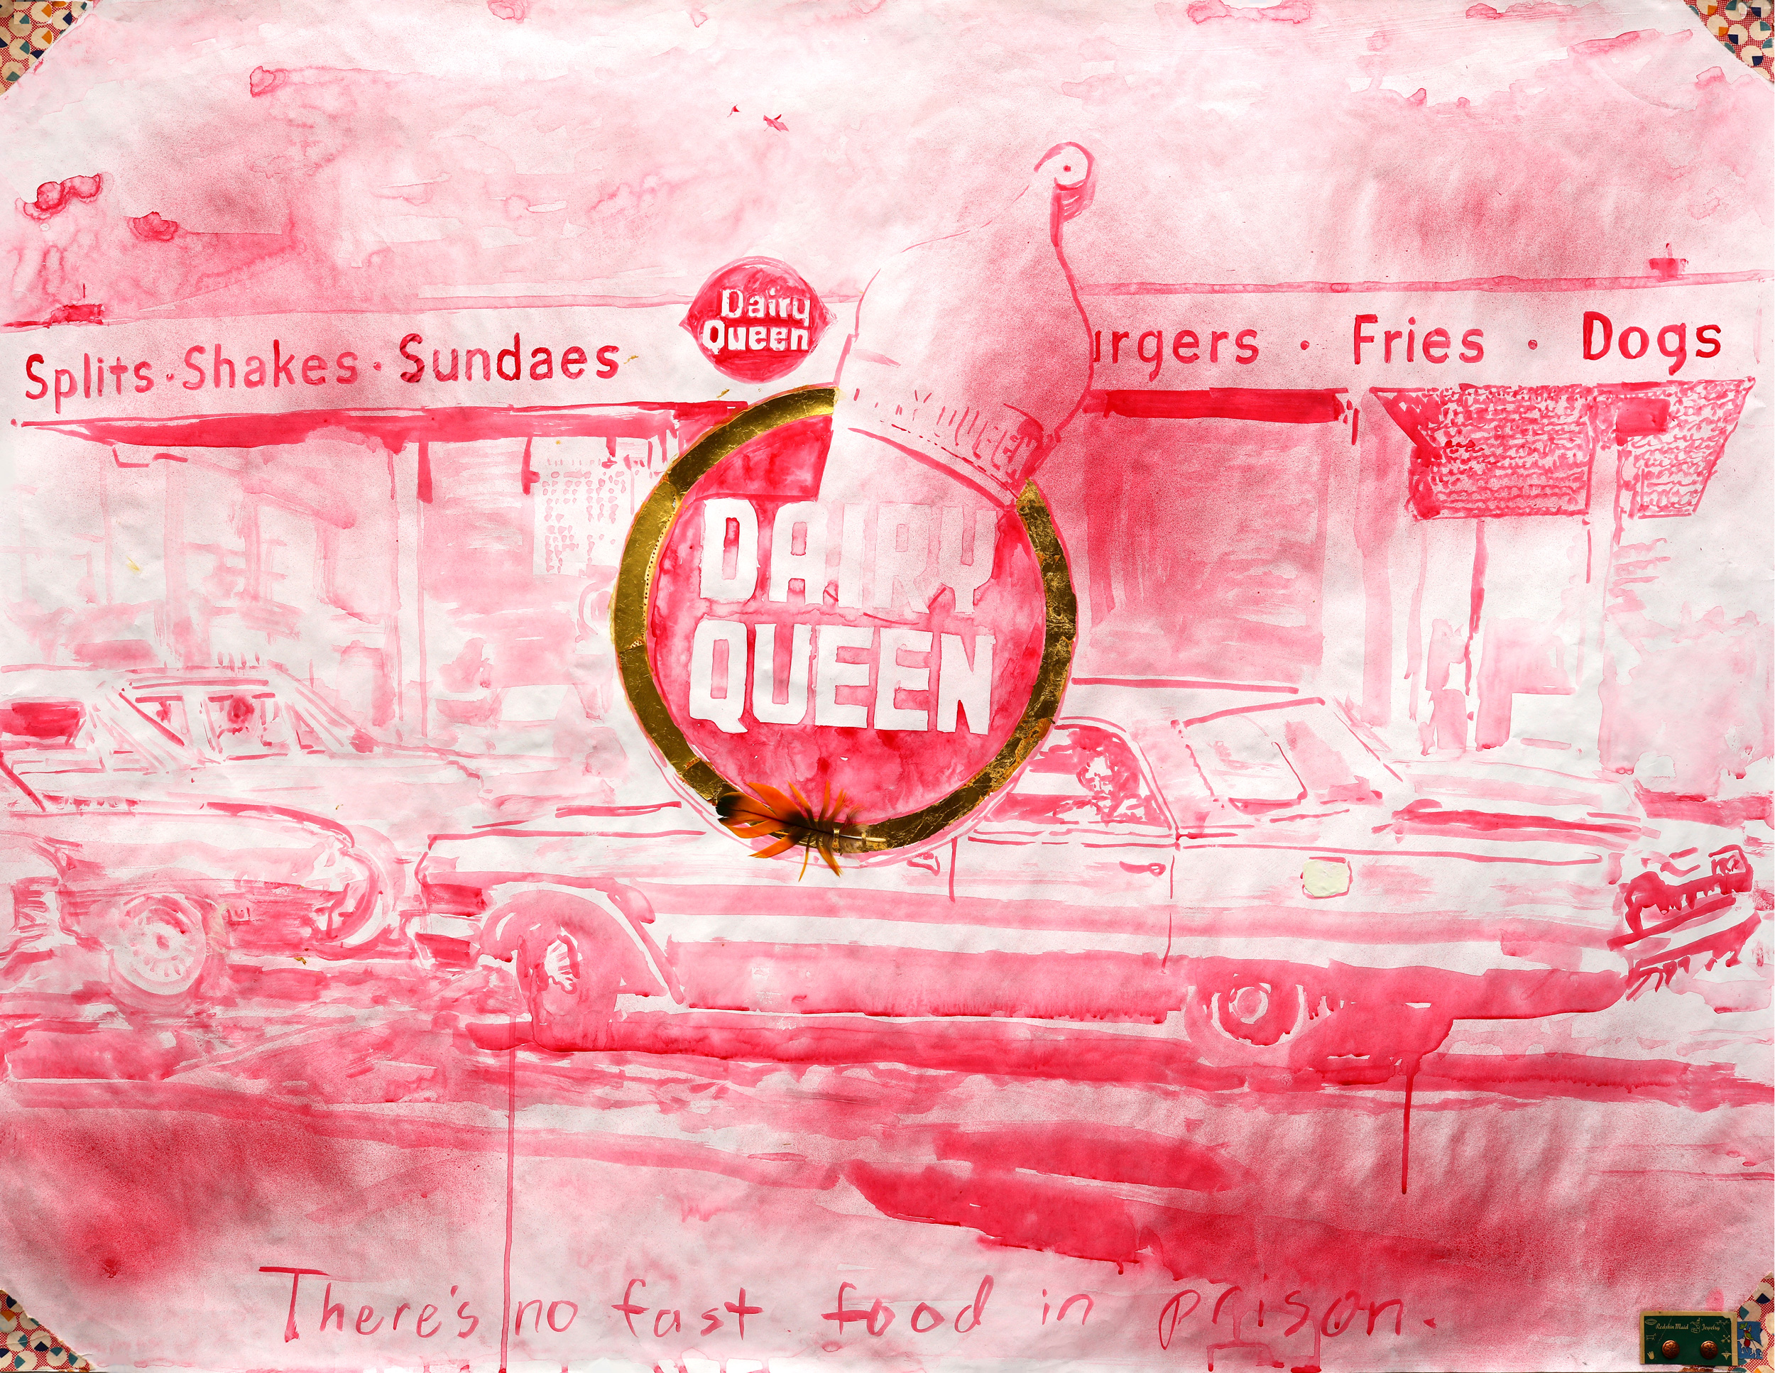
Julie Green

Slide 5
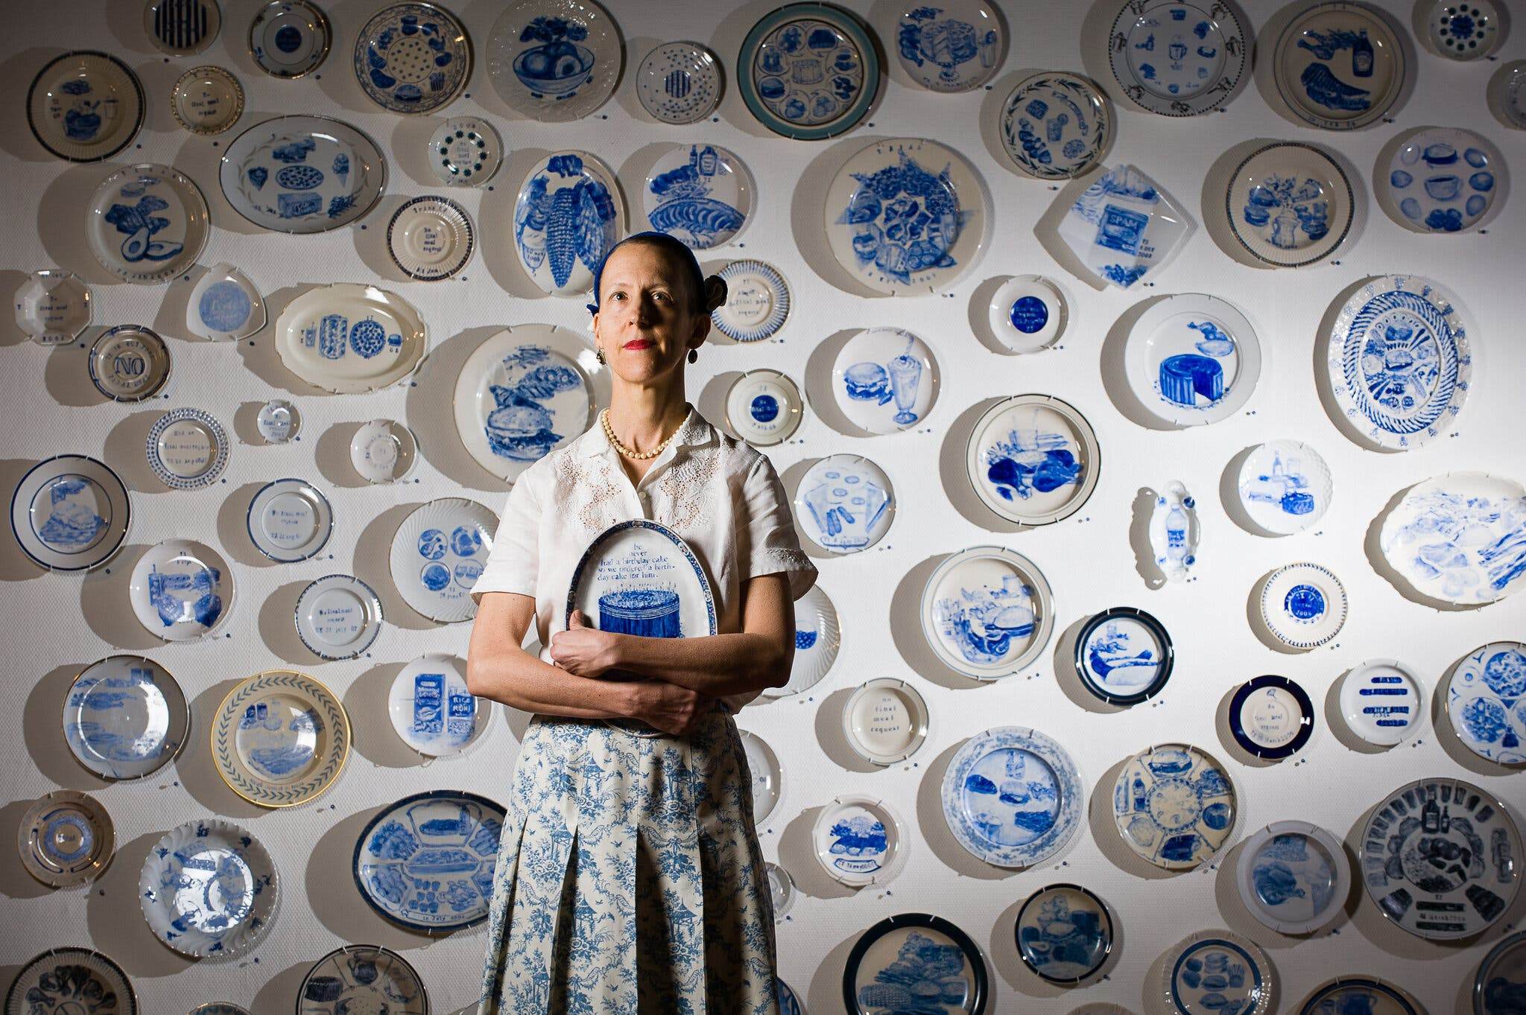
Julie Green

Slide 6
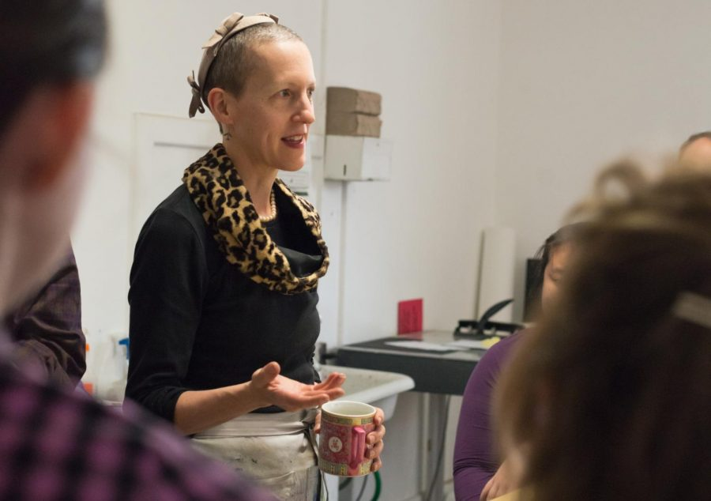
Julie Green

Slide 7
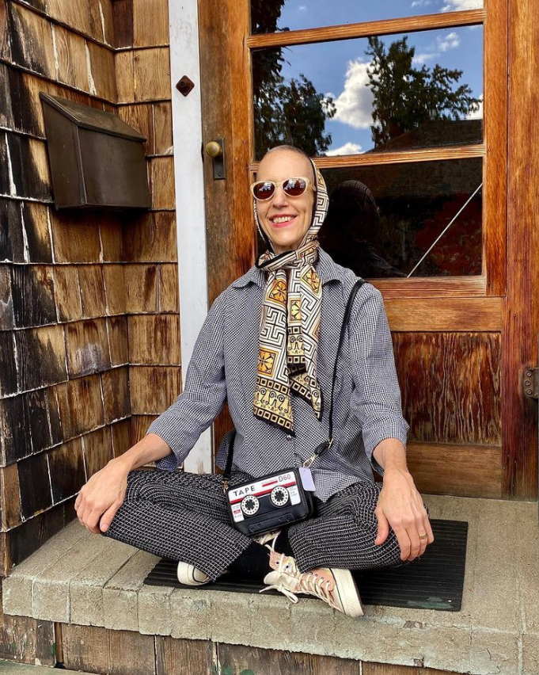
Julie Green

