Slide 1
Proposal to Add Student Bill of Rights to University Syllabi
Materials linked from the December 9, 2021 Faculty Senate agenda.
Presented by Office of Advocacy

Slide 2
Gabriel Bendat
is a Peer Advocate in the office. He is a third-year studying Environmental Economics and Policy with a minor in Environmental Sciences.
Ava Thomas
Andrew Harker
is a Peer Advocate in the office. She is a third-year studying Biochemistry and Molecular Biology on the Advanced Biochemistry track, with a minor in Toxicology.
is a Peer Advocate in the office. He is a third-year studying Mechanical Engineering and a minor in Spanish.

Slide 3
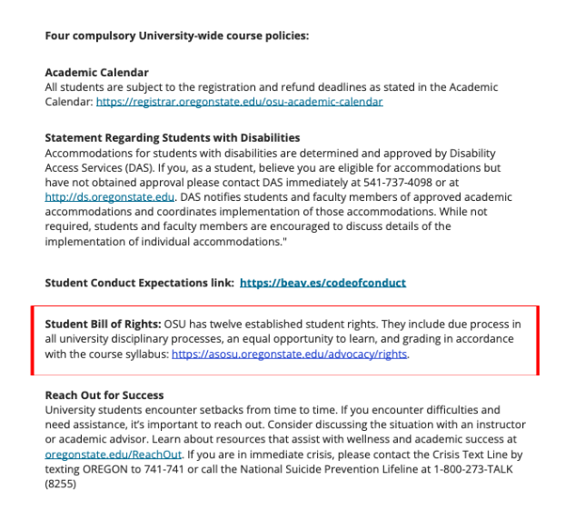
Request
We ask that university syllabi include a hyperlink to the OSU Student Bill of
Rights. Specifically, after the Student Conduct Expectations link, we ask that syllabi include:
Student Bill of Rights: OSU has twelve established student rights. They include due process in all university disciplinary processes, an equal opportunity to learn, and grading in accordance with the course syllabus: https://asosu.oregonstate.edu/advocacy/rights
Screenshot above from Oregon State University Syllabus – Minimum Requirements > Resources > Syllabus templates: On campus

Slide 4
Background
The Student Bill of Rights was created in 2017 through a collaborative effort under Shared Governance with Faculty Senate, ASOSU, and University Leadership. Faculty Senate President Jon Dorbolo signed it into effect after being approved by the general body.
The Office of Advocacy serves all OSU students. Our data and experience shows that students' experiences on campus improve when they are:
Aware of their rights
Prepared for conduct meetings
Supported through conduct processes

Slide 5
Reasons for Request
Three of the rights in the Student Bill of Rights are especially pertinent to syllabi:
Right #8 offers students “...due process in all university disciplinary processes”
Right #9 offers students "...an equal opportunity to learn and to participate and benefit from the academic community"
Right #12 offers students to “...be graded in accordance with the course syllabus and the quality of their work.”
Given that the Student Conduct Expectations are listed in syllabi, it is equitable to communicate to students that they have due process rights if they receive an allegation of a conduct violation.

Slide 6
Statement of Impact
Including the Student Bill of Rights in course syllabi:
Reinforces the concept of a syllabus acting as a written agreement between faculty and students
Protects students and faculty
Reminds faculty of their responsibility to follow their syllabus
Improves course transparency and clarity
Demonstrates OSU’s commitment to student success

Slide 7
Outreach
While forming this request, we reached out to faculty from many offices on campus and student leaders.
Key findings:
Offices across campus saw merit in our proposal and gave positive feedback
Most faculty were unaware of the Student Bill of Rights
Offices that support historically underserved students were happy to endorse the proposal, including EOP and TRiO

