Slide 1
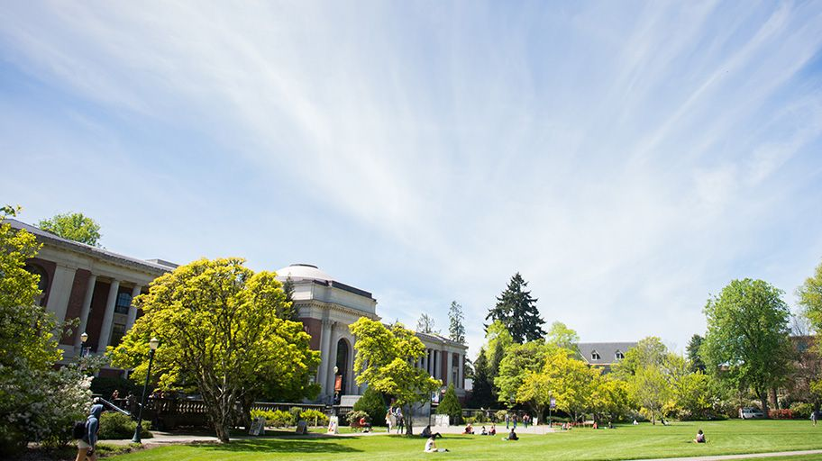
Presidential Search Process & Timeline Meeting of the Faculty Senate December 9, 2021

Slide 2
Presidential Search Committee Named
Julie Manning, search chair
Patty Bedient
Julia Brim-Edwards
Maria Chávez-Haroldson
Bob Cowen
Marissa Cuno
Taha Elwefati
*Lauren Gwin
*Kim Kirkland
*Kate MacTavish
*Erika McCalpine
Maija Pham
Alan Sams
Michael Schill
Eric Schoenstein
**Scott Vignos
*Virginia Weis
Presidential Search Website Launched
*Trained Search Advocate **Search Advocate for Presidential Search
Notes:
In mid-November, the Chair of the Board appointed the Presidential Search Committee to assist the Board in the search.
With input from across campus and the community, the Board appointed a dynamic, diverse committee that represents OSU’s values and culture and knows the university well.
As you can see here, the committee is made up of OSU trustees, faculty, students, administrators, staff, and alumni – CLICK link for Presidential Search Committee to show roles of each member
Additionally, we are finalizing the selection of an additional member of the committee
NOTE SEARCH ADVOCATE: Scott Vignos, interim vice president and chief diversity officer, is serving in the role of search advocate AND as a fully-participating (voting) member of the search committee.

Slide 3
Executive Search Firm Selected
The Presidential Search Firm Selection Committee was chaired by Trustee Preston Pulliams and included:
Trustee Michele Longo Eder
Gigi Bruce, Chief Assistant to the Provost
Steve Clark, Vice President, University Relations and Marketing
Kevin Gable, Professor of Chemistry
Cathy Hasenpflug, Chief Human Resources Officer
James Thomas, Analyst Programmer, Institutional Analytics and Reporting
Scott Vignos, Interim Vice President and Chief Diversity Officer
After considering written materials, the committee interviewed firms and conducted reference checks.
The committee unanimously recommended use of the firm Isaacson, Miller, and the Board Chair approved this recommendation.
Notes:
A separate presidential search firm selection committee was convened to recommend an executive search firm to assist the board’s recruitment and review of candidates for president.
The committee was chaired by Trustee Preston Pulliams.
Pulliams is the president of Gold Hill Associates, a community college president search firm.
After considering written materials submitted in response to a public request for proposals, the committee interviewed search firms and conducted reference checks on the finalists.
In mid-November, the committee unanimously recommended use of the firm Isaacson, Miller, and the board chair approved this recommendation.
Isaacson, Miller has a long history of working with Oregon State University on executive searches. For example, support has been provided to OSU by Isaacson, Miller on searches for the following positions:
Provost
Vice Provost for Student Affairs
Vice Provost for Information and Technology
Dean of Libraries
Dean of the College of Agricultural Sciences

Slide 4
Search Process Update
Search committee evaluates and interviews candidates; makes a recommendation of semifinalists to the Board Chair.
In executive session, the Board Chair makes an independent recommendation on semifinalists for consideration by the Board.
The Board conducts interviews of selected semifinalists in executive session.
The Board determines finalists in executive session and announces them in public session.
Finalists make visits to OSU. Visits to include university-wide public forums and meetings with stakeholder groups.
Notes:
Faculty may have questions about the additional step added to the search process to include the Board Chair making an independent recommendation on semifinalists for consideration by the Board

Slide 5
Search Working Timeline
Mid-October – November | Search firm selection committee formed and firm selected.
Mid-October – November | Search committee solicitation and announcement made.
Early – Mid-January | Board, search committee and firm statewide listening sessions conducted.* Leadership profile and selection criteria created.
January – mid-February | Position recruitment conducted.*
Late February – Mid-March | Candidate screening conducted.
Late March – Early May | Search committee reviews candidates. Background checks and due diligence conducted. Finalists determined and announced. Finalists visit the university.* Feedback from community and stakeholders considered by the Board.
Late May | Selection of a new president by the Board.
June | Presidential transition begins.
Early to Mid-July | New president begins service, or as soon as possible thereafter.
Notes:
*The working timeline will likely be updated after Board discussion at Dec. 10 Board Meeting and may be refined with input from Isaacson, Miller

Slide 6
Next Steps
Board, search committee and firm conduct statewide listening sessions
Creation of leadership profile and selection criteria
Search committee trainings
Refinement of timeline with attention to opportunities for public engagement and feedback from stakeholders and the community
Notes:
Based on that updated timeline, here are immediate next steps.

