Slide 1
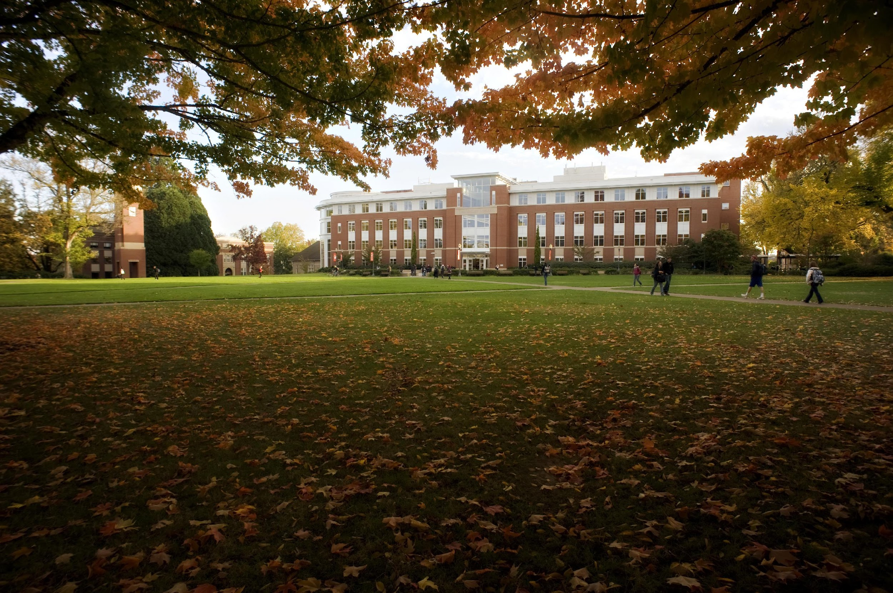
Open and Sustainable Scholarship
Materials linked from the March 10, 2022 Faculty Senate agenda.

Slide 2
Open and Sustainable Scholarly Communication Committee
The Provost asked the SVP for Faculty Affairs and the University Librarian to establish a committee to engage the OSU community in discussions about sustainable access to scholarly communication.
Created in consultation with the chair of the Faculty Senate Library Committee at the end of 2019.
Working group and advisory committee began meeting in spring 2020.
Charge
Define OSU’s commitment to open scholarship.
Develop a set of reasonable principles that position OSU to negotiate aggressively with publishers to secure licensing agreements that benefit OSU researchers.

Slide 3
What is unsustainable about the status quo?
More than 40% of OSULP’s annual expenditures go to maintain serials subscriptions.
Despite more and more content available open access, costs for serials continue to rise by 5%-6% every year.
For-profit publishers use their control of major journals to demand terms and conditions that restrict authors’ and libraries’ rights to share research openly or easily.
From 2015-2020, OSU researchers paid $1M in open access fees (APCs) to publish in subscription journals. To access this content, the library pays these journals again.
Publishers’ pricing models for APCs are neither transparent nor equitable.
For-profit publishers are rebranding as data analytics companies, and actively working to control the infrastructure of research, beyond publications.

Slide 4
> 50%

Slide 5
What they want
Multi-title packages
Multi-year deals
User data
Exclusive rights
No rights of ownership
Non-disclosure agreements

Slide 6
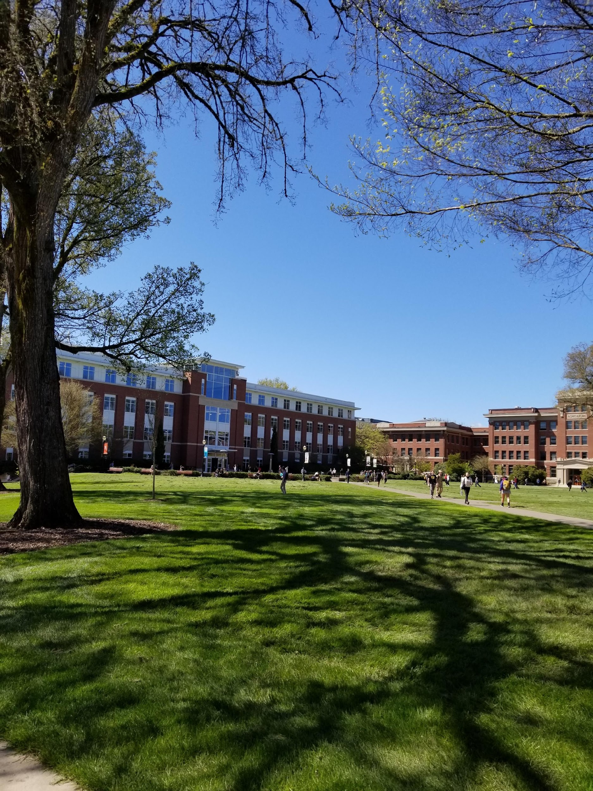
Broad access to content
Open Access
Author’s Rights
Fair Use and Sharing
Preservation and Accessibility
Research Support
Protections for user data
What we need
Transparent pricing based on value added

Slide 7
Transparency

Slide 8
the ability to walk away

Slide 9
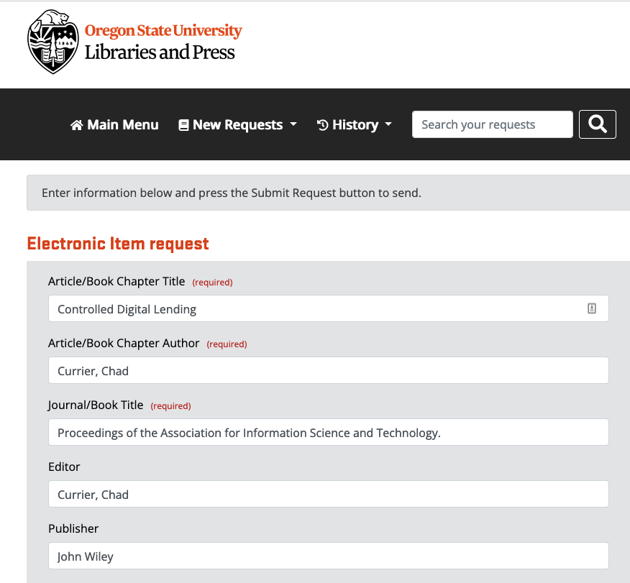
On demand borrowing
90% of interlibrary loan requests are filled within 13 hours

Slide 10
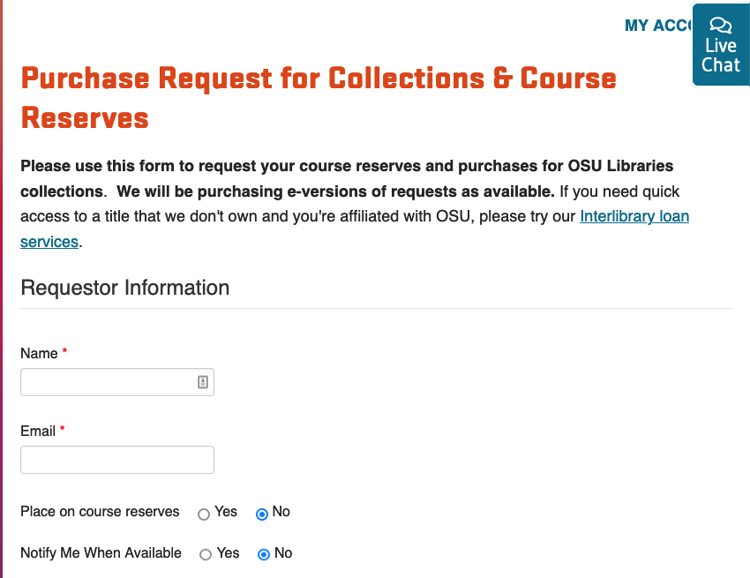
On demand purchasing
OSULP was one of the only academic libraries to provide uninterrupted interlibrary loan and document delivery services during the pandemic.

Slide 11
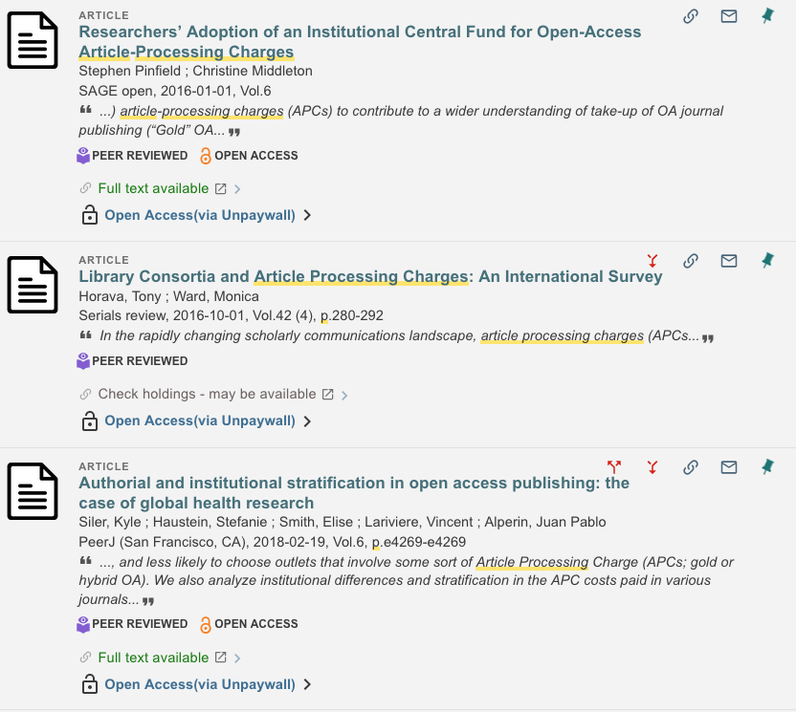
Discovery infrastructure

Slide 12
OA is moving the needle.
Publishers are looking for ways to maintain their control of the market as the amount of content available OA grows.
Read and publish agreements are coming.
Libraries can’t do this alone.
If we continue to allow for-profit publishers/data analytics firms to set the terms of how and where we publish, OSU will continue to fall further and further behind.
Why now ?

Slide 13
questions?

