Slide 1
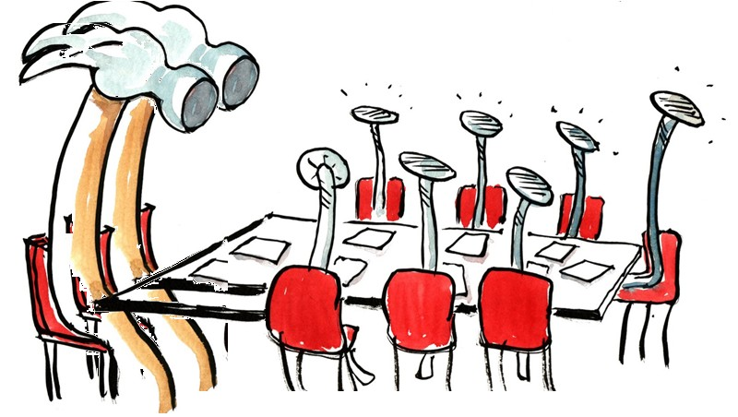
program proposalS
FOR REVIEW BY FACULTY SENATE
Amy Koehlinger and Ping-Hung (“Ping”) Hsieh, Curriculum Council
May 12, 2022

Slide 2
Program Changes for Faculty Senate Approval
Earth Sciences Undergraduate Major (BS, HBS)
Renewable Materials Undergraduate Major (BS, HBS)
Fisheries and Wildlife Science Undergraduate Major (BS, HBS)
Biochemistry and Molecular Biology Undergraduate Major (BS, HBS)
Approved by the following Faculty Senate Groups:
Budgets & Fiscal Planning Committee
Curriculum Council

Slide 3
Inactivate Undergraduate Major
Earth Sciences Undergraduate Major (BS, HBS) - Key 524 Justification: Replaces options within the Earth Sciences Major with three independent undergraduate majors (Climate Science, Geology, and Oceanography) Climate Science Undergraduate Major and the Geology Undergraduate Major have already been approved and the Oceanography Undergraduate Major is nearing the end of the approval process

Slide 4
Undergraduate Major Rename
Renewable Materials Undergraduate Major (BS, HBS) - Key 49 Rename Renewable Materials Major (BS, HBS) to Wood Innovation for Sustainability Major (BS, HBS) Justification: New name more closely aligns with the curriculum the program offers Clarifies the programmatic focus of wood

Slide 5
Undergraduate Major Rename
Fisheries and Wildlife Science Undergraduate Major (BS, HBS) - Key 178 Rename Fisheries and Wildlife Science Undergraduate Major (BS, HBS) toFisheries, Fisheries, Wildlife, and Conservation Sciences Undergraduate Major (BS, HBS) Justification: Renames BS degree to match department name Acknowledges the evolution of field to a broader emphasis around the scientific study of species and their habitats to promote evidence-based conservation and management

Slide 6
Change Undergraduate Major
Biochemistry and Molecular Biology Undergraduate Major (BS, HBS) - Key 587 Extends BS degree in Biochemistry and Molecular Biology to OSU-Cascades Justification: This degree is a popular alternative to the Biochemistry & Biophysics undergraduate major with strong enrollment Rapidly growing central Oregon medical and biotech industry workforce needs are not being met by available degree programs BMB majors will choose options either in Advanced Molecular Biology, Computational Molecular Biology, or Pre-Medicine/Biochemistry and Molecular Biology, depending on prospective employment

Slide 7
Other Change Proposals: Informational
Change Program Requirements
6 Nuclear Engineering Graduate Major (MENG, MS, PhD)
11 Radiation Health Physics Graduate Major (MHP, MS, PhD)
13 Forest Ecosystems and Society Graduate Major (MF, MS, PhD)
33 Sustainable Natural Resources Graduate Certificate
40 Urban Forestry Graduate Certificate
51 Art and Design Option
53 Management and Marketing Option
54 Science and Engineering Option
68 Biomedical Sciences Graduate Option
203 German Undergraduate Major (BA, HBA)
211 Spanish Undergraduate Major (BA, HBA)
212 Spanish Minor
218 Contemplative Studies Minor
219 Psychology Undergraduate Major (BA, BS, HBA, HBS)
222 Asian Studies Minor
253 Advanced Manufacturing Graduate Option
276 Electrical and Computer Engineering Graduate Minor
280 Computer Science Graduate Major (MEng, MS, PhD)
316 Public Health Graduate Certificate
325 Public Health Practice Graduate Option
509 Health Management and Policy Graduate Certificate
591 Biology Undergraduate Major (BS, HBS)
592 Ecology Option
593 Genetics Option
Change Program Requirements (Cont’d)
594 Marine Biology Option
596 Pre-Dentistry/Biology Option
597 Pre-Education Biology Option
598 Pre-Medicine/Biology Option
599 Pre-Veterinary Medicine Option
600 Biology Minor
601 Marine Biology and Ecology Minor
602 Zoology Undergraduate Major (BS, HBS)
650 Biological and Ecological Engineering Graduate Major (MENG, MS, PhD)
653 Physical Therapy Professional Major (DPT)
680 Global Learning Certificate
715 Outdoor Products Undergraduate Major (BS, HBS)
Inactivation
390 Ocean, Earth and Atmospheric Sciences Graduate Minor
New Minor and Options
775 Indigenous Studies Minor
789 Sports Business Option
796 General Public Health Option

Slide 8
Other Change Proposals: Informational
Miscellaneous Requests
18 College of Liberal Arts – Change College Requirements
167 New Subject Code DSI Design for Social Impact
183 Mass FE and FOR Prereq Minimum Grade Change
185 New Subject Code BIS Business Information Systems
187 New Subject Code SCLM Supply Chain and Logistics Management

