Slide 1
Faculty Senate Meeting
May 2022
Erika McCalpine, President

Slide 2
Asian American and Pacific Islander Heritage Month
Asian and Pacific American Heritage month was the idea of former congressional staffer Jeanie Jew who first approached Rep. Frank Horton about the idea of designating a month to recognize Asian Pacific Americans, following the United States’ bicentennial celebration in 1976.
President Jimmy Carter signed a joint resolution for the celebration on Oct. 5, 1978. In 1990, George H.W. Bush signed a bill passed by Congress to extend Asian American Heritage Week to a month. On May 14, 1991, a public law was passed unanimously by congress and then signed by Bush, proclaiming May 1991 and May 1992 as Asian and Pacific American Heritage Month. By 1992, May was officially designated as Asian Pacific American Heritage Month.
The month of May was chosen because it commemorates the migration of the first immigrants from Japan to the United States on May 7, 1843, and to celebrate the completion of the transcontinental railroad by over 20,0000 Asian immigrants on May 10, 1869.

Slide 3
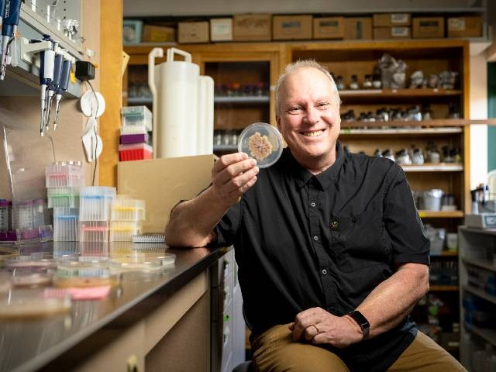
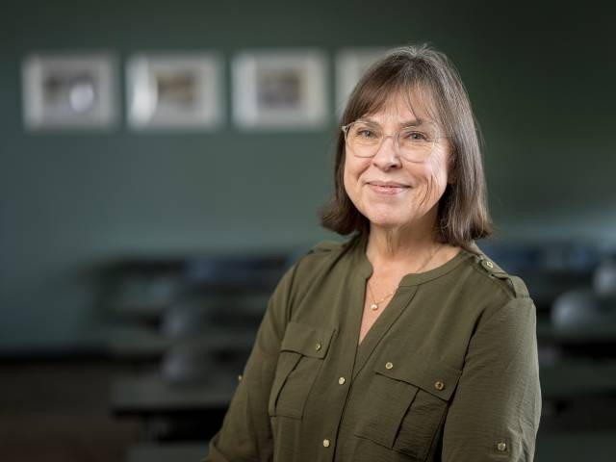
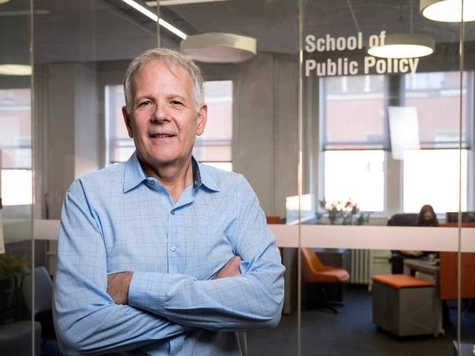
Celebrating Our New Distinguished Professors
Michael Freitag, PhD
Distinguished Professor of Biochemistry and Biophysics
College of Science
Kathryn Higley, PhD
Distinguished Professor of Nuclear Science and Engineering
College of Engineering
Brent Steel, PhD
Distinguished Professor of Public Policy
College of Liberal Arts

Slide 4
Chat Guidelines
Our meetings are public, and many visitors attend, including faculty, staff, students, administrators and occasionally, the media. Given these meetings are open to anyone’s attendance, it means that the chat is also public and can be seen and read by anyone in attendance. We, as the Senate, cannot control how anyone responds to something said in the chat, nor what anyone does based on information read in the chat. However, it is our responsibility to make sure our meetings are run in a manner that is transparent and respectful to everyone who participates.
Please remember:
To keep public chat conversations limited to what is being discussed on the Senate floor. Private chats are available and are not public.
Members of the Executive Committee do monitor the chat.
Please continue to post helpful links to documents or information related to the topic being discussed on the Senate floor, and to assist Senators in need of information.

Slide 5
Informational Items
When you are attending via Zoom, at the start of every Senate meeting, please change your name on Zoom to your name and apportionment unit (not college or work unit). For example, Senator McCalpine, Cascades. If you are a guest, please enter your name, then guest. For example, Erika McCalpine, Guest.
For those attending in person, Senators should check off their name on the roster outside the meeting room. Guests should print their name at the end of the roster.
When you have a question or comment, raise your Zoom hand. Once called upon, please state your name and apportionment unit before asking your question or making your comment. If attending in person, please go to one of the mics in the room, or a mic will be passed to you. You must speak into the mic for your comment to be recorded.
Due to regularly scheduled band competitions, the Faculty Senate will meet in Kidder 202 in May.

Slide 6
Bacc Core Reform Special Session
The Faculty Senate will host a special session to discuss Baccalaureate Core Reform on May 20th at 3PM. It will be held via a hybrid format. This session will be held in LINC 100 and via Zoom.
Please alert faculty in your apportionment units so that we can have optimal attendance.
Today, we will hear from the Baccalaureate Core Reform Committee, and they will present their recommendations. We will have the special session on May 20th and, if all goes as planned, vote on the recommended model at the Senate meeting in June.
Please listen intently to today’s presentation and read the report that has been provided before the special session. Many common questions are answered in the report.
On behalf of the Faculty Senate, I would like to thank the Baccalaureate Core Reform Committee for their service. A special thank you goes to co-chairs John Edwards and Lori Kayes for their leadership. Countless hours were spent in meetings, researching, in road shows, analyzing data, and preparing for this presentation. We appreciate your service to the Faculty Senate.

