Slide 1

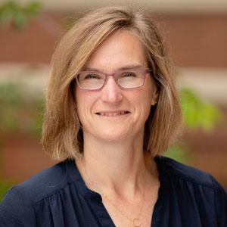
OSU Board of Trustees 101
Mike Bailey
mjb@cs.oregonstate.edu
This is all public information – there is nothing “secret” here
I am merely the previous faculty member on the Board.
Inara Scott is the current faculty member on the Board, but she is tied up right now, so here I am.
BOT101.2023.pptx

Slide 2
In the Beginning … (pre-2014)
Responsible to the HECC, Legislature, and the citizens of Oregon
Oregon University System (OUS)
EOU
OIT
OSU
PSU
SOU
WOU
UO

Slide 3
Then, in 2013, along came SB 270
(all 117 pages of it!)
Each of the seven public universities will have its own Board of Trustees.
Each Board will have 11-15 members.
Those members will include one from the staff, one from the students, and one from the faculty. These are called "members", not "representatives".
Board members represent the citizens of Oregon, not their individual constituencies.
Each member’s term is 4 years, except for the three members from the university, who each will have a 2-year term.
Each Board member can serve, at most, two consecutive full terms.
The university nominates more than enough potential Board members and sends the list to the Governor.
The Governor selects from that list and passes her selection along to the Oregon Senate Executive Appointments Committee for approval.
The full Oregon Senate votes on final approval of the Governor’s selection.

Slide 4
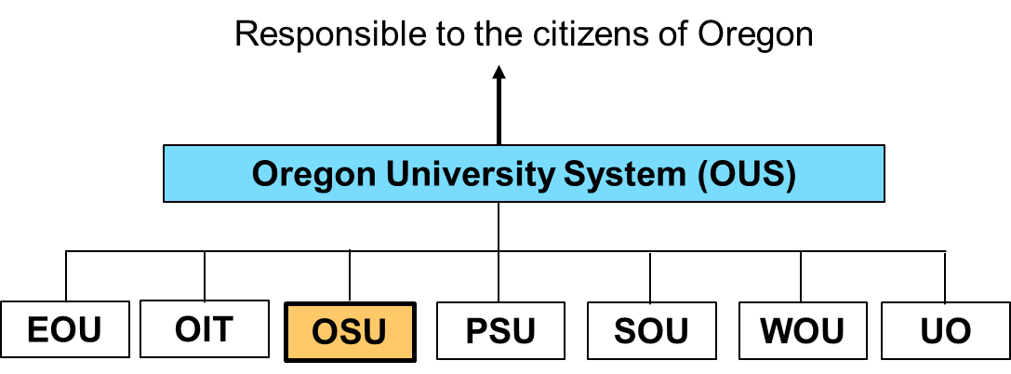
Now (2014 and beyond)
Responsible to the HECC, Legislature, and the citizens of Oregon
BOT
BOT
BOT
BOT
BOT
BOT
BOT
EOU
OIT
OSU
PSU
SOU
WOU
UO

Slide 5
Faculty Member Selection Process
“Why I Want This Position”
Oregon Senate Executive Appointments
Committee
EC
Governor
Whew!
Oregon Senate

Slide 6
Board Meeting Process
The Board meets ~ once per quarter (SB 270 specifies this, too), typically for two full days. (Received permission to make this "four times per year".)
The Board has three subcommittees: Academic Strategies, Executive & Audit, and Finance & Administration.
There are subcommittee meetings on Thursday and the full Board meeting is on Friday.
All meetings (full Board and Board subcommittees) are subject to Oregon’s Open Meetings Law: widely announced ahead of time, open to the public -- both in-person and via phone.
There is a very strict definition of what is a “meeting”.
There can be subcommittee meetings in-between the quarterly meetings – they, too, are open.
Full Board meetings and the on-campus subcommittee meetings are typically held in the MU Horizon Room when possible and/or Zoom.
At the meetings, there are multiple opportunities for public comments.

Slide 7
Current Issues
Tuition
Financials: State budget, current OSU budget, self-support budgets, capital planning, 10-year financial forecast
Student Success
Retention
Risk / Compliance

Slide 8

Financial Issues to be Aware Of
Tuition provides ~70% of OSU’s revenue.
PERS and PEBB increases are essentially unfunded mandates by the state.
Percent of in-state students vs. out-of-state; currently ~70%-30%; it is allowed by the Board to go as low as 60%-40%.
Can we/should we cut into OSU’s Fund Balance? (OSU tries to hold a 10% fund balance.)
OSU’s Moody’s credit rating (Aa3) affects our borrowing interest rate, and is affected by many things, including our fund balance. (Everything seems to be connected here.)
Can we be/should we be cutting significant expenses. (Where?)

