Slide 1
An Innovative Branch Campus: OSU-Cascades
January 12, 2023

Slide 2
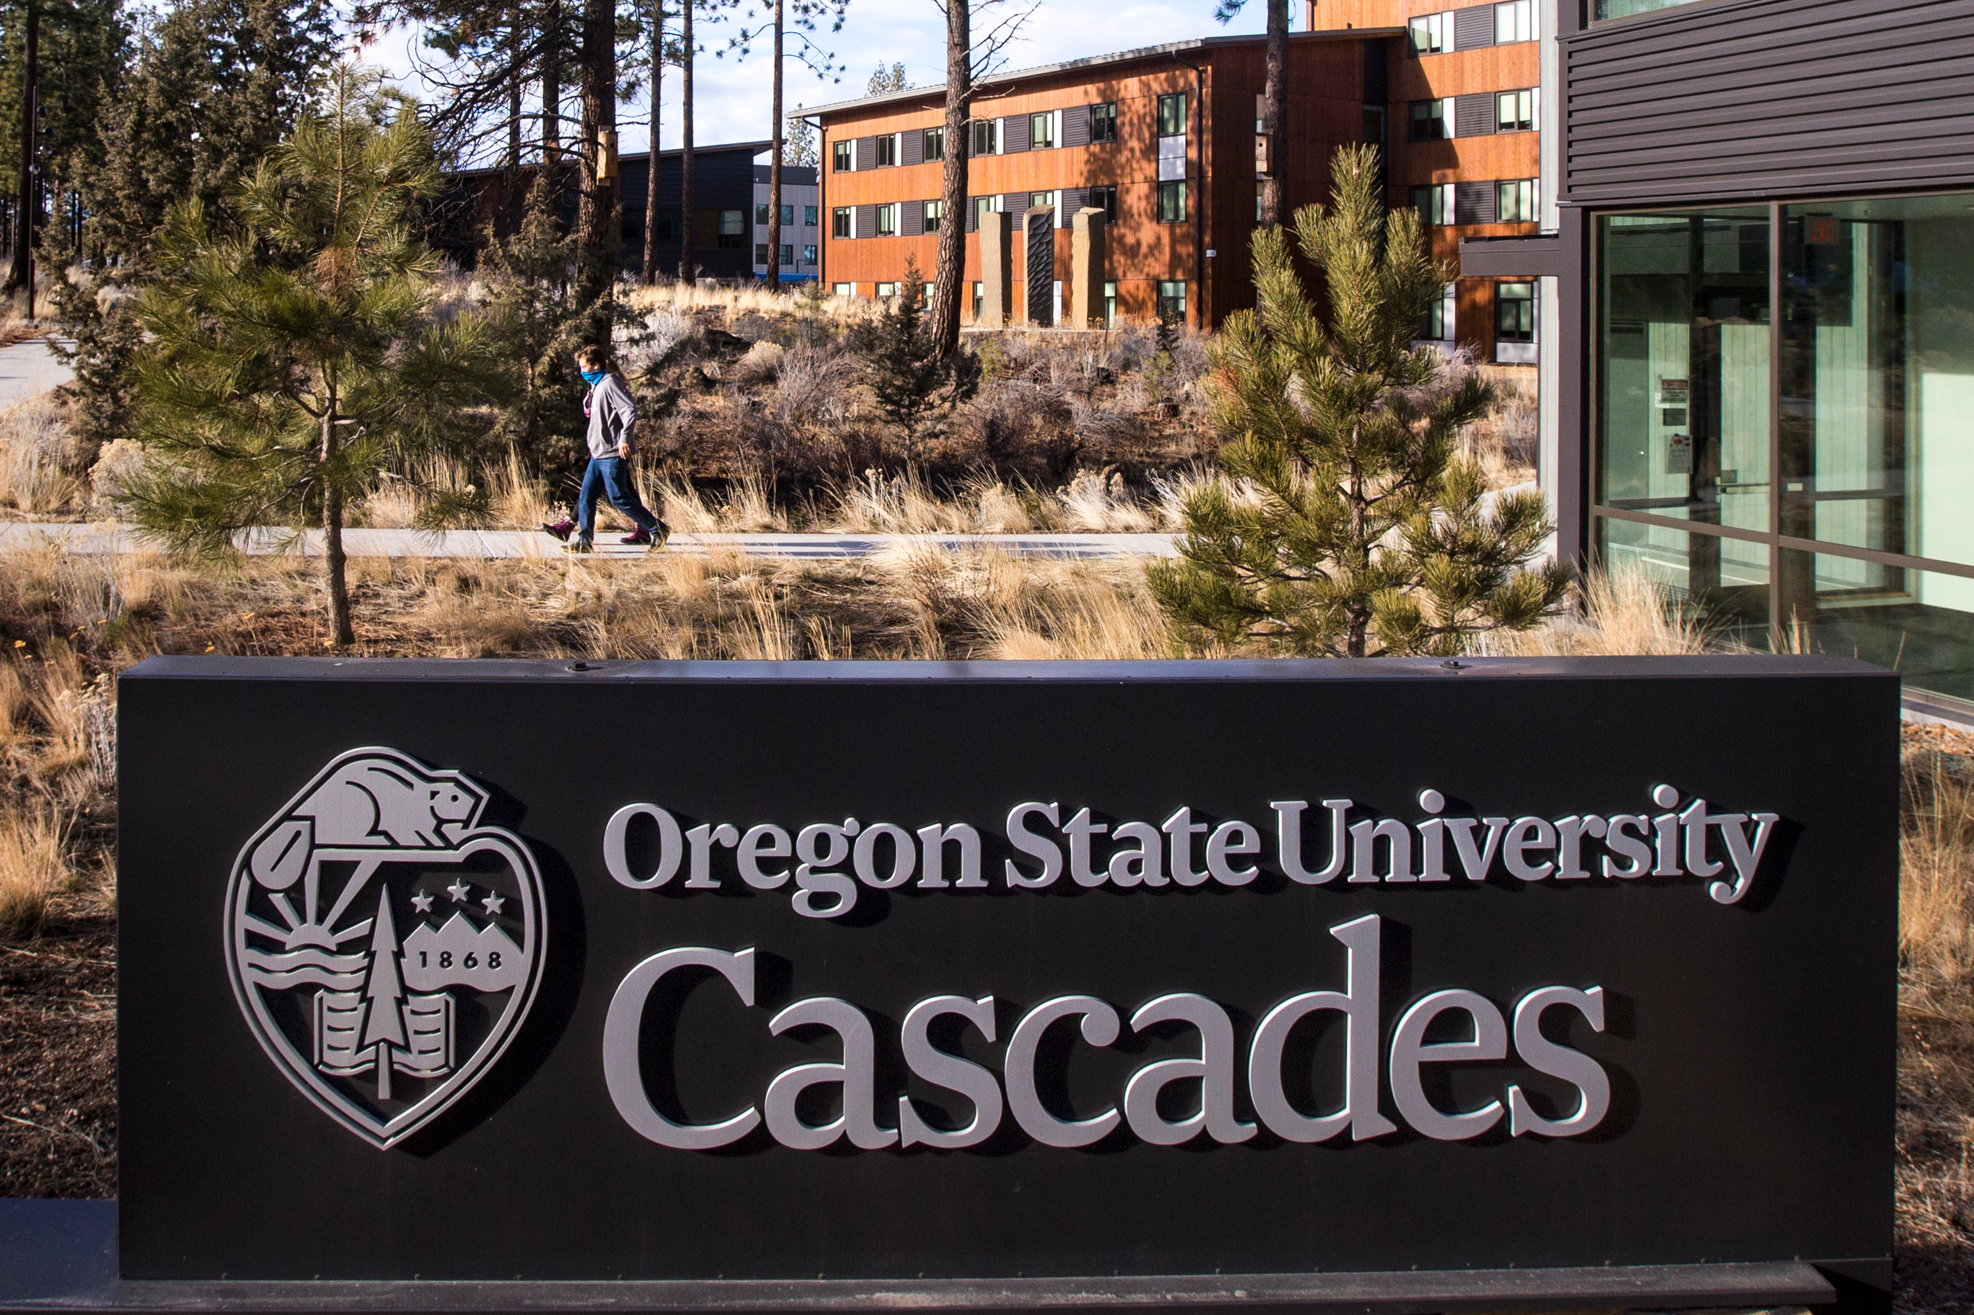
Agenda
Introduction
Cascades Edge
Innovation District
Momentum

Slide 3
Building a 4-Year University in Central Oregon
Develop OSU-Cascades as a highly innovative branch campus that brings the mission of OSU as a Research-1, land-grant university to Central Oregon students and stakeholders while also creating an option for students who are seeking a small university experience.

Slide 4
ONE OSU
OSU is one University with three campuses: Corvallis, Bend, Ecampus (It also has multiple sites such as Hatfield, the Portland Center and extension sites throughout the state)
OSU-Cascades is a university-wide priority.
The ultimate success of OSU-Cascades requires leaders throughout the organization
Proactive engagement
Collaboration

Slide 5
“Building” a University
Academic degree programs
Student programming
Physical buildings
Community engagement

Slide 6
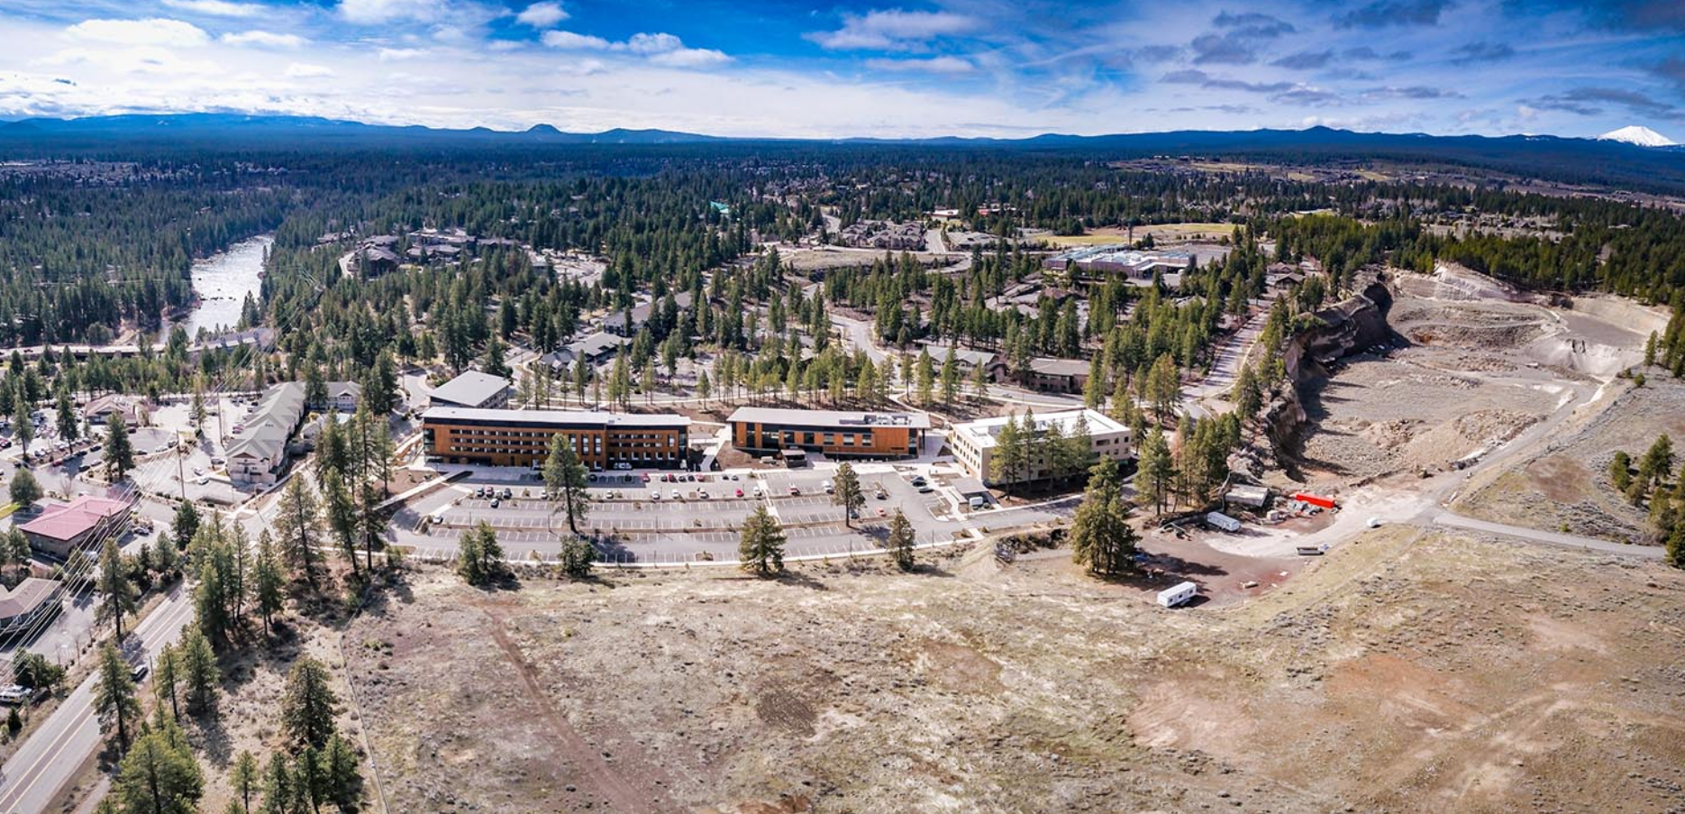
Initiatives

Slide 7
“College graduates can no longer rely on their degree to accurately signal their fitness for a job. Instead, they will need to clearly spell out the competencies they have acquired.” – Chronicle of Higher Ed
Students and parents are concerned about:
Finding a career the student is passionate about.
Going down the wrong path and “wasting” time and money.
The cost of college, its ROI and student debt.
Entering a good career once they graduate. Not being underemployed.
Once in college:
Students are not encouraged (by external forces) to EXPLORE.
Many college students do not access the career services office.
There can be gaps among different student populations.
There are gaps among different majors.

Slide 8
Where will your path take you? Let’s explore together. Cascades Edge is career development built into your coursework every term – at no additional cost. It’s our commitment to helping you find a future that inspires you and providing the tools to get there.

Slide 9
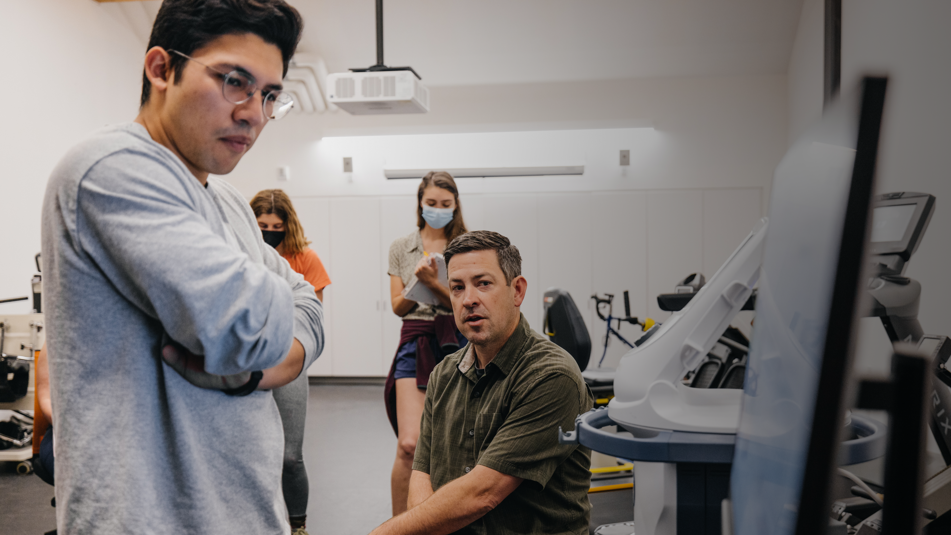
Badging for Skills Employers are Looking for
Career & Self Development
Communication
Critical Thinking
Equity & Inclusion
Leadership
Professionalism
Financial
Literacy
Teamwork
Technology

Slide 10
Physically Building a Campus

Slide 11
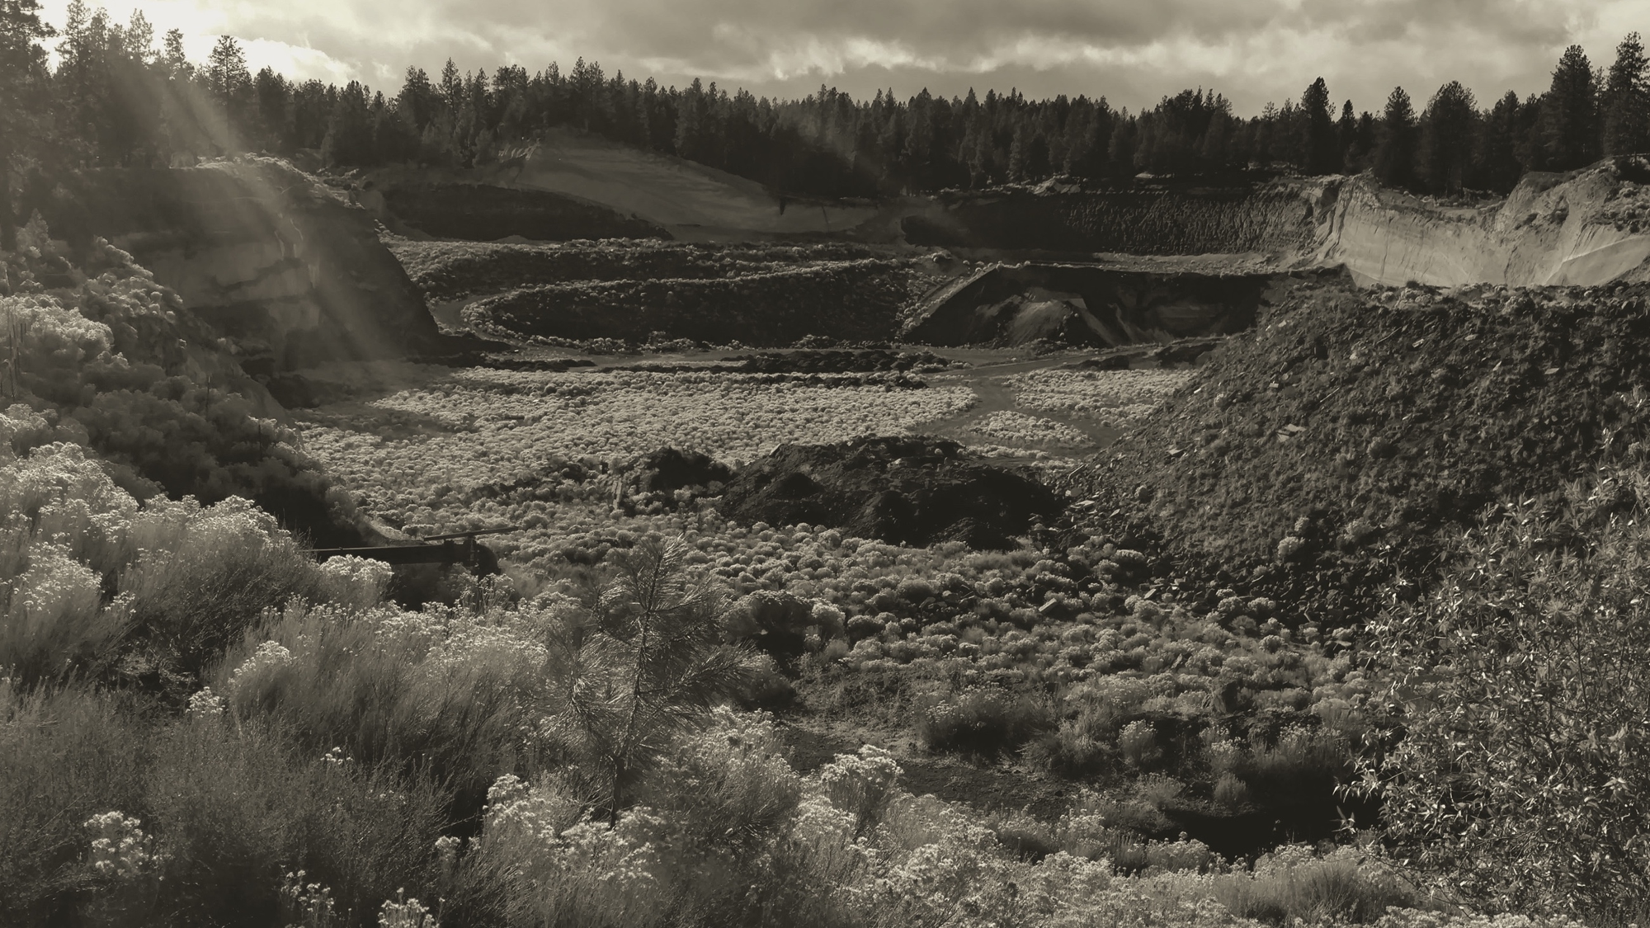
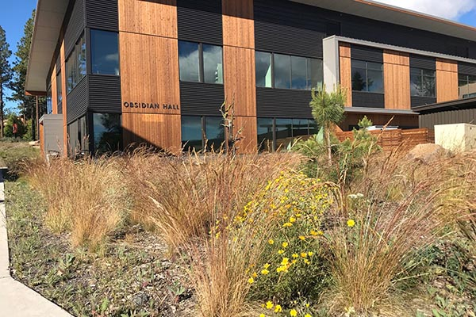
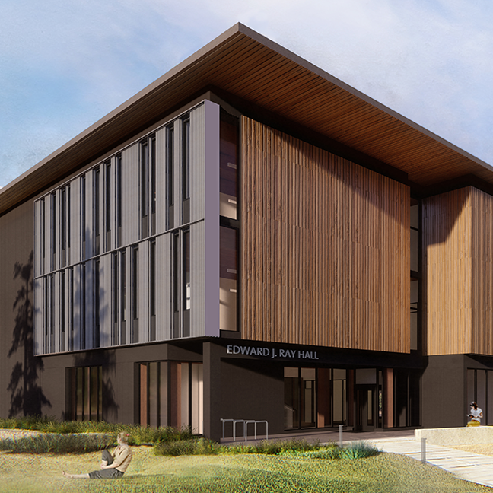
Campus Timeline
OSU-Cascades Expansion to Four-Year University Approved
Remediation of 118-acre
Mine and landfill started
Beginning of remediation for Innovation District
First ID building to open
2001
2012
2016
2019
2021
2023
2024
2026
OSU-Cascades Opened on COCC Campus
10-acre campus opened
Edward J. Ray Hall opened
Student Success Center to open
Notes:
Since 2015, when the detail planning for the OSU-Cascades LRDP began, we held 22 public meetings between Nov 10, 2015 and Nov 15, 2017. We engaged through a public application process 4 advisory committees based on core campus themes, including Heath and Wellness, Sustainability, Arts and Culture and Community Integration. We then held community meetings around topical areas as identified by the community to be of specific concern or relevance for future campus development, including housing, transportation and parking, and overall plan alternatives.
We have published all of the materials are on our website. Over 1500 attendees participated in these public meetings.
In addition to our own hosted events, we happily participated in meetings that were hosted by other entities such as City Club, Bend 2030, Bend Livability Conference, Bend Parks and Rec or NAs.
What you see in the master plan and on our website is the culmination of that effort

Slide 12
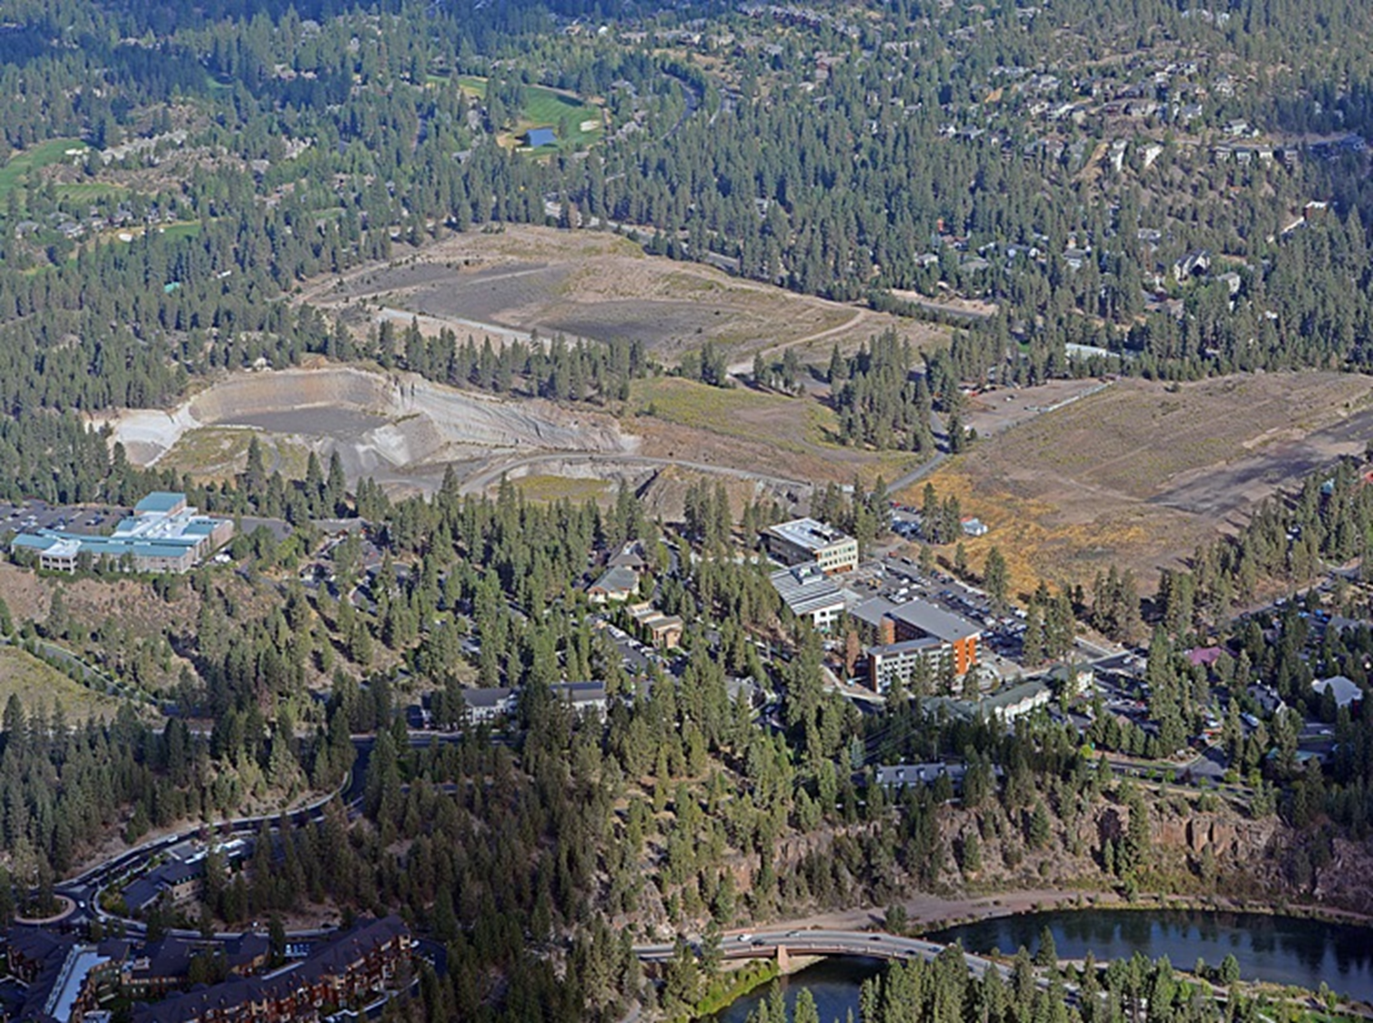
Mt. Washington
Deschutes County Landfill
Simpson
Bend Parks & Rec
56-Acre Site
Chandler
Century
Notes:
OSU-Cascades has designed a master plan that is:
128 acres, reclaiming a 56 acre pumice mine and a 72 acre dmeoltion landfill and incorporating our current 10 acre campus
Designed to accommodate 5,000 students of which 40% will ulitmately be residential students
A walkable/ bikeable campus
Integrated into the community
Focused on our values for resiliency and inclusivity, and
Flexible to evolving pedagogy over time
The master plan plans for slow/incremental growth over the next 15 to 20 years; we anticipate reaching approximately 3400 students (currently 1804 students) in 2034
Our growth will be dependent on two primary factors: Demand and funding
Just as it took many steps to get to where we are today, we have many steps to complete before we see full maturation of campus.
Anticipated next academic building to open in Fall 2021

Slide 14
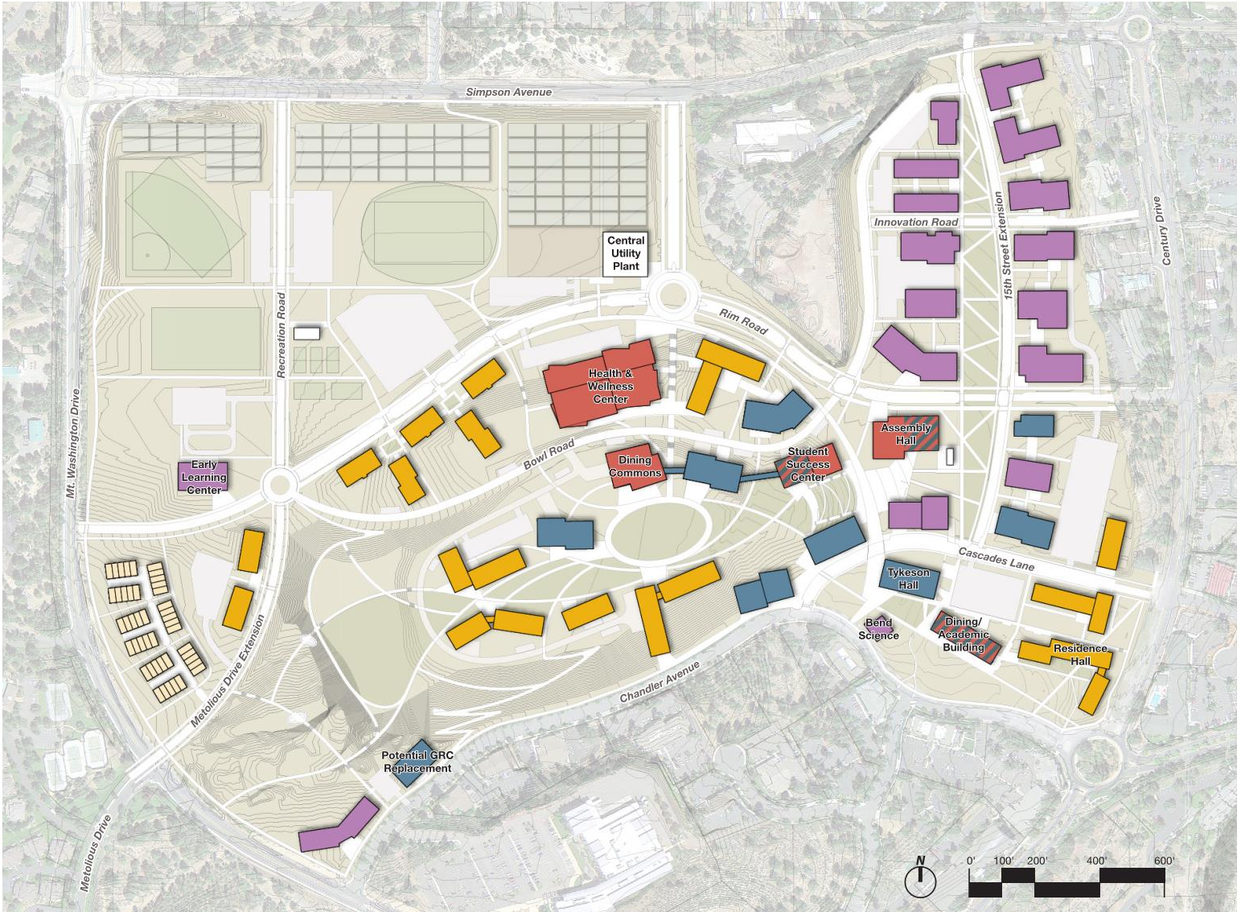
Campus Districts
Notes:
The master plan is designed around 4 key districts, residential (middle market housing for $45-90K household incomes), recreation, core campus (academic, student housing and student life) and the innovation district.
I wanted to touch briefly on the innovation district. This new area will be the physical handshake between the university and our local private sector. We will integrate middle market housing, university research and public or private partners in a mixed use district. Imagine a software dvelopment company that is ready to grow to it’s own physica footprint or interested in relocating from the Bay integrated with our computer science faculty, hring OSU-C interns and future full time employees, and collaborating on product ideas.
EcoNW estimates the incremental economic benefit of the Innovation District is another $282M for Deschutes County per year once fully developed.

Slide 15
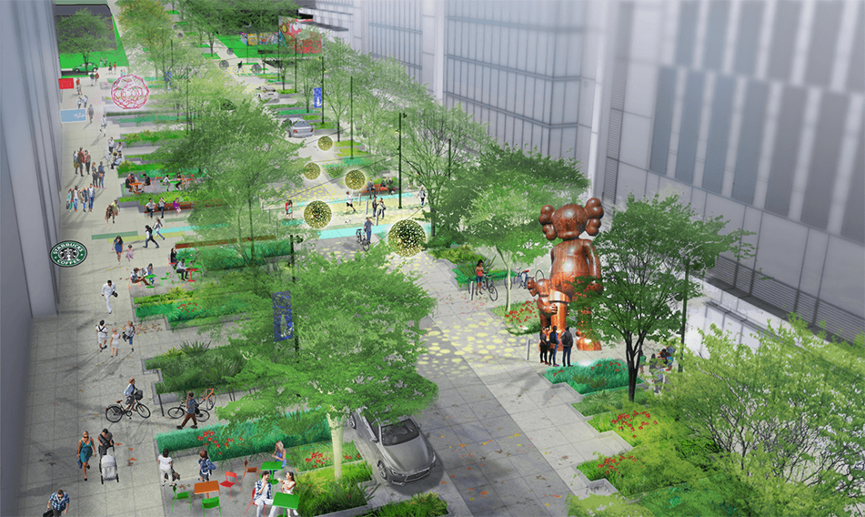
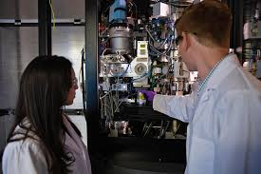
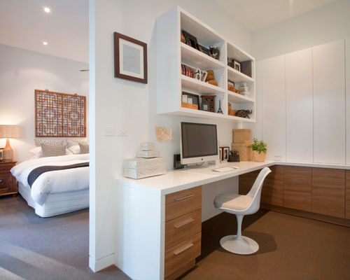
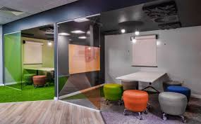
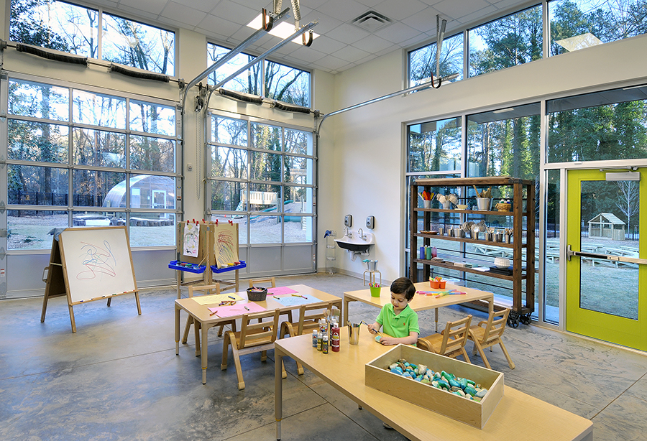
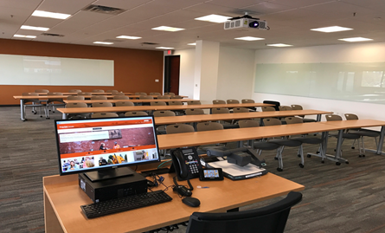
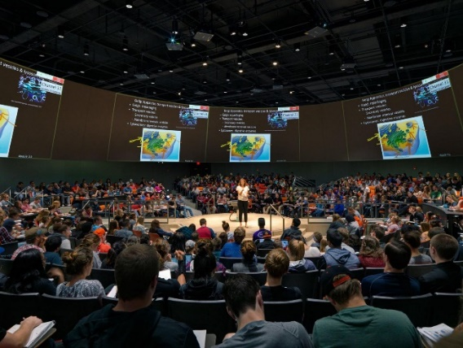
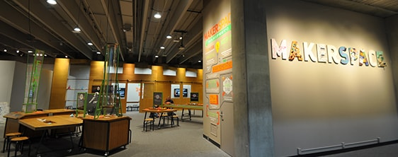
OSU-Cascades Innovation District
Town square
Advanced Research
Workforce Housing
Commercial office space
Core services
Instructional Space
Presentation Space
Creation space
Notes:
The innovation district, at a conceptual level, will prioritize district space based on the region’s traded sector, top employers and manufacturing and OSU-C academic competencies.
Mixed use including housing and a cluster of support services
Tech companies, biosciences, outdoor products innovation lab
Conference services and potentially a hotel
Health services – PT clinic
A sculpture garden and maybe an interactive science center
Childcare for employers
Access to transportation options
Academic buildings
By co-locating, we can not only serve the economic, cultural and research needs of the region, we can offer an even higher quality educational experience. Students will have on campus access to high impact learning opportunities, including research, internships, externships, practicums, service opportunities and more.
Let’s imagine a bio-sciences company building that first innovation district building. OSU-C might have research labs within the building, university and private sector researchers discuss new techniques over coffee in the lunchroom, there is shared equipment for both, and student interns are working under the supervision of PhDs in industry and faculty.
Or in the health care industry Physical Therapy clinic run by a partner community health care provider with DPT practicum students right on campus.

Slide 16
48,000
OSU-Cascades Innovation District
36,000
48,000
43,000
Development Use | Phase 1 | Phase 2 | Total
Commercial/Retail/LI | 115,500 | 513,200
Housing | 45,000 | 45,000
Assembly | 40,000 | 0
University research | 55,000 | 54,000
Total | 255,500 sf | 600,200 | 855,200
33,000
45,000
61,000
42,000
50,400
45,000
64,800
54,000
40,000
27,500
33,000
55,000
55,000
OSU-Cascades Innovation District in Master Plan in City of Bend does not include blue, yellow or red spaces – different traffic counts
45,000
Notes:
High technology (software and hardware)
Biotechnology (pharma and medical device)
Recreational/outdoor equipment and apparel
Brewing and distilling
Food products
Aerospace
Tourism/hospitality - ecotourism

Slide 17
Momentum
Student Success Center
Innovation District
Growth in Academic Programs
Growth in Student Programming

Slide 18
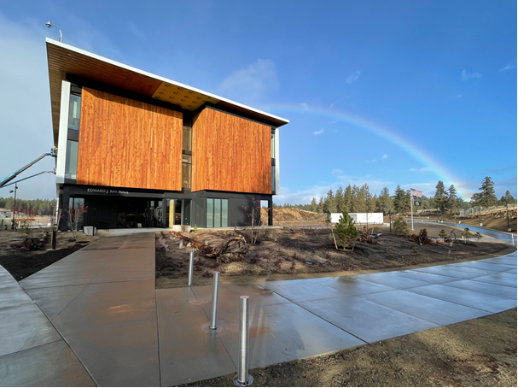
THANK YOU
Questions?

