Slide 1
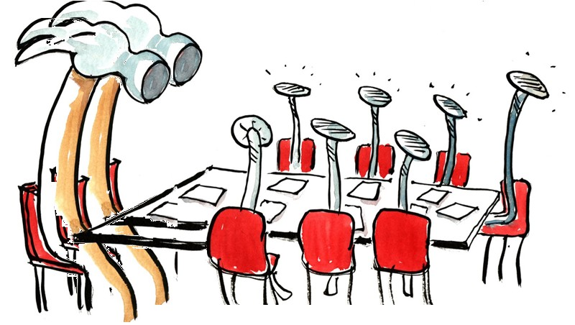
program proposal
FOR APPROVAL BY Faculty senate
Eric B. Ianni and Ping-Hung (“Ping”) Hsieh, Curriculum Council
June 8, 2023

Slide 2
Program Changes for FS Review
Science and Technology of Alcoholic Beverages Certificate: New Program Proposal
Approved by the following Faculty Senate Groups:
Budgets & Fiscal Planning Committee
Curriculum Council
Executive Committee

Slide 3
Science and Technology of Alcoholic Beverages Certificate
Agricultural Sciences, Ecampus
CIM Key #725 – New Program Proposal
The Department of Food Science and Technology (FST) proposes a new, 27-credit, undergraduate certificate program that compares and contrasts the various sectors of the alcoholic beverages industry from a science and technology perspective.
The certificate delivers education across the whole range of alcoholic beverages rather than specific categories, and students acquire a better understanding of the general, over-arching principles of alcohol production.
A number of related courses have already been converted into Ecampus offerings (e.g., FST251, FST437/537) with the expectation of completing our rolling program of full Ecampus development.

Slide 4
Information Items —
Change Graduate Option |  |  | Change Undergraduate Minor
2 | Robotics Graduate Major (MEng, MS, PhD) |  | 726 | Industrial Engineering Minor
754 | Artificial Intelligence Graduate Major (Meng, MS, PhD)
Change Undergraduate Major |  |  | Change Undergraduate Option
255 | Industrial Engineering Undergraduate Major (BS, HBS) |  | 407 | Environmental Agriculture Option
412 | Applied Ecology Option Change Undergraduate Major |  | 409 | Conservation, Resources, and Sustainability Option
414 | Environmental Sciences Undergraduate Major (BS, HBS) |  | 548 | Health Promotion and Health Behavior Option

