Slide 1
Bill Loges
Remembering
Father, Mentor, Friend
Associate Professor of New Media Communications and Sociology, College of Liberal Arts
Passed June 6, 2023

Slide 2
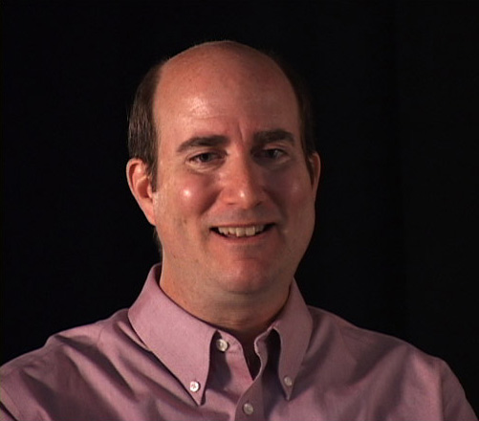
Bill Loges

Slide 3
