Slide 1



Faculty Senate 101 Kate MacTavish
January 11, 2024

Slide 2


Slide 3
OSU Faculty Senate – Who We Are and what we do
132 elected Senators represent ~5000 faculty across the state
Representation by apportionment group
Each College, the combined ROTC staff, off-campus Extension Faculty, Student Affairs, Associated Faculty, OSU-Cascades, Hatfield Marine Science Center, and Library are apportionment groups
Valued partner in Shared Governance
Shared governance ≠ shared decision-making, but does mean that administration seeks our input, weighs it carefully, and reports back to us on their final decisions
Our primary purview = academic mission, but our collective knowledge informs a wide range of processes and policies at the University
Work extensively with Office of Academic Affairs, Office of Faculty Affairs
Strong Senate = seat at many tables = opportunities for faculty input

Slide 4
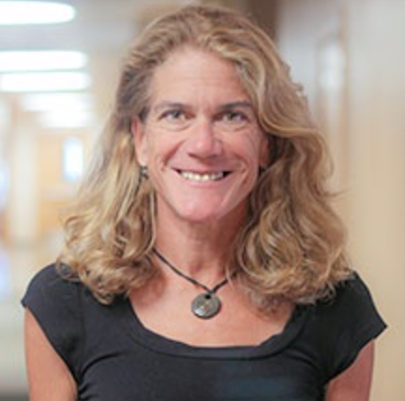
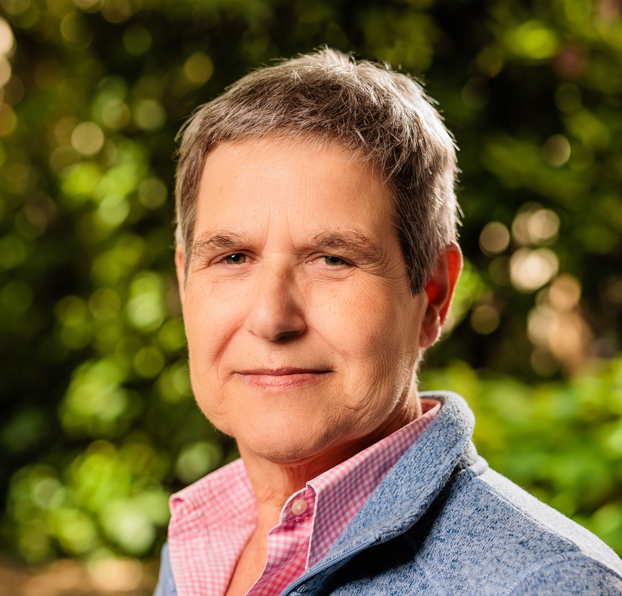
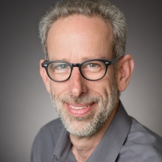
Senate Leadership – 2024
Kate MacTavish
Health
Immediate Past President
Yvette Spitz
Earth, Ocean,
& Atmospheric Sciences
President
Andrew Valls
Liberal Arts
President-Elect

Slide 5
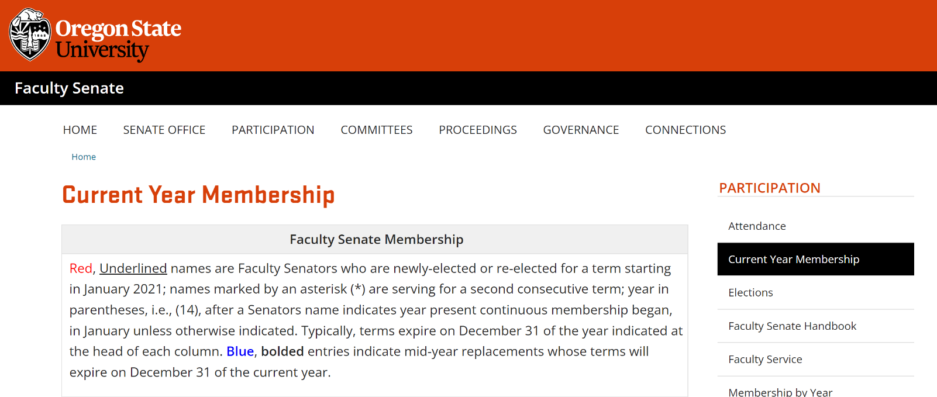
How did you get here?
https://senate.oregonstate.edu/current-year-membership
An inclusive nomination process
ALL eligible faculty are included on the nomination ballot
Opportunity to decline or express strong interest in serving
Election by apportionment unit
Nomination ballot sent to all faculty, by apportionment unit
Faculty are put on the election ballot based on nomination votes received
Election ballot sent to all faculty, by apportionment unit
Tiebreaker votes and replacements
And now you are here!

Slide 6
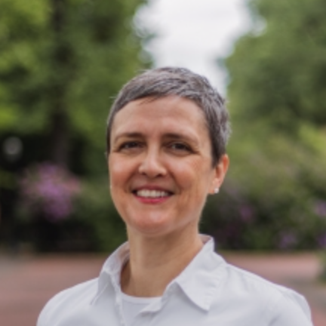


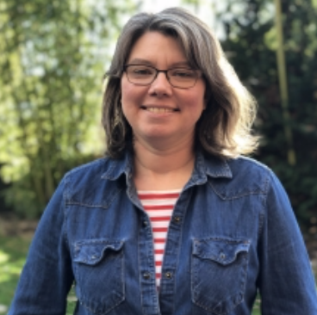

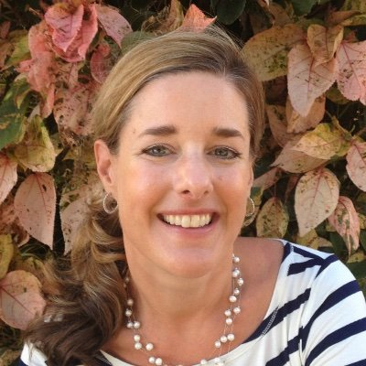
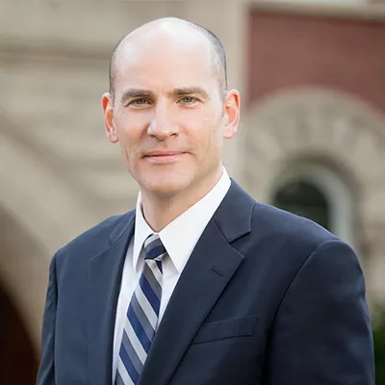
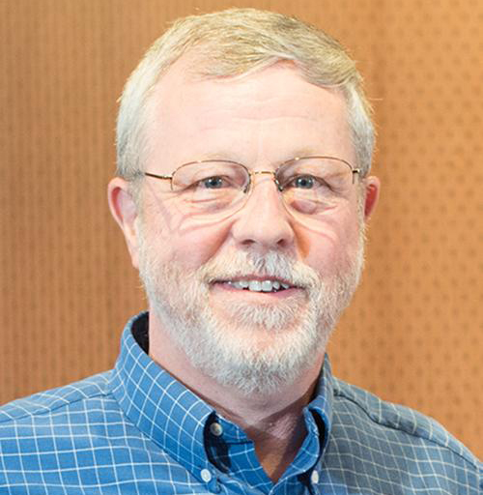
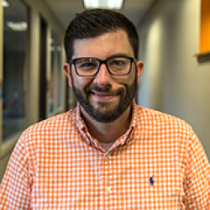
Senate Leadership – 2024
Jennifer Alix-Garcia
Agricultural Sciences
John Bailey
Forestry
Mike Bailey
Engineering
Kathy Becker-Blease
Liberal Arts
Bruce Dugger
Agricultural Sciences
Jessica DuPont
Ecampus
Ed Feser, Ex-Officio Non-voting
Provost
Bob Mason, IFS
Science
Jordon Zardinejad
OSU-Cascades

Slide 7
Your role as a faculty senator
Represent your College/Apportionment Unit
Attend and actively engage in FS meetings is expected
FS meets second Thursday 3-5pm each month during academic year
Information on Canvas
Can’t make a meeting? Appoint a proxy by contacting the Senate Office so that person has access to the Canvas site for information and voting
Be in touch with your constituents
Keep them informed and engaged
Talk with fellow Senators and your unit leadership about ways to do this

Slide 8
Faculty Senate Meetings
Meetings are IN-PERSON
Zoom webinar access for those who are physically unable to attend
Webinar access does not allow for name changes after you have entered the meeting – make sure your first and last name is set before entering the session. Chat is not enabled.
Review information on Canvas prior to meeting
Agenda
Action Items = vote. Usually first agenda items, after opening remarks from the Senate President
Curriculum proposals
Changes to bylaws or standing rules
Motions, referendums, etc. – usually discussed at prior meeting(s)
Special Reports
New Business

Slide 9
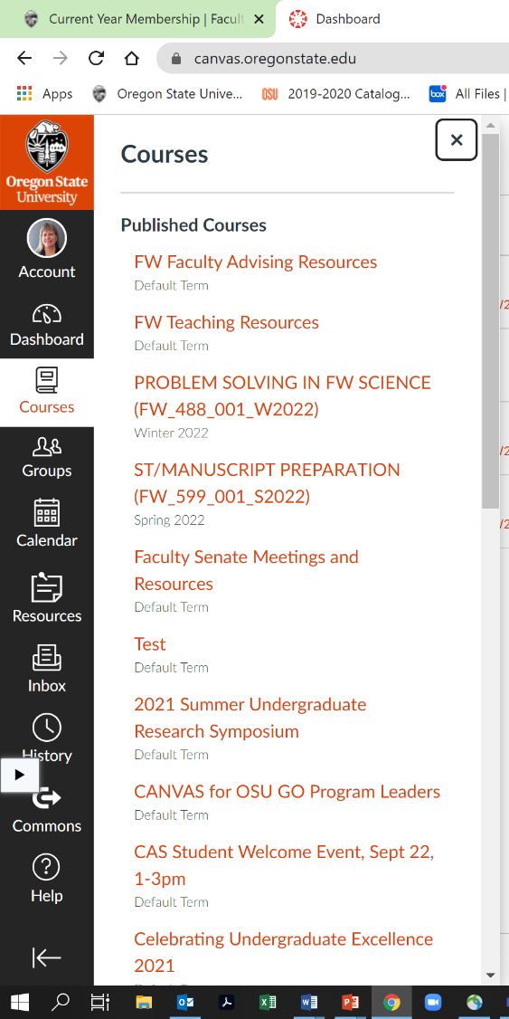
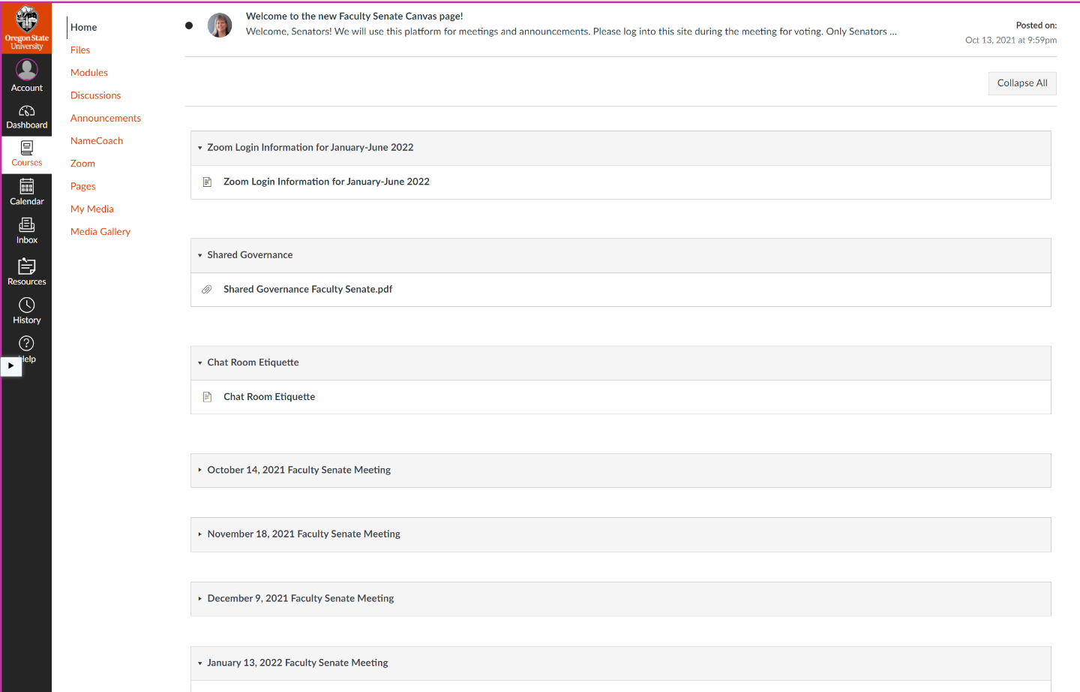
Using Canvas

Slide 10
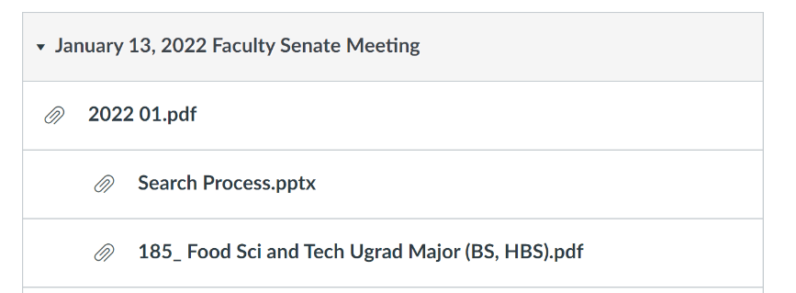
Slide Heading – Font is Stratum2 Black, size 36
Using Canvas
Meeting information will include agenda, slide presentation(s), links, and relevant documents.
Font is Kievit Offc, size 20

Slide 11
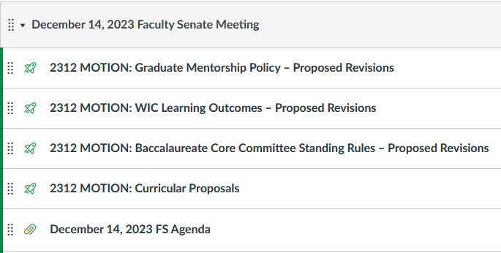
Slide Heading – Font is Stratum2 Black, size 36
Voting in Canvas
When it is time to vote, REFRESH your browser and a “quiz” link will appear
Font is Kievit Offc, size 20

Slide 12
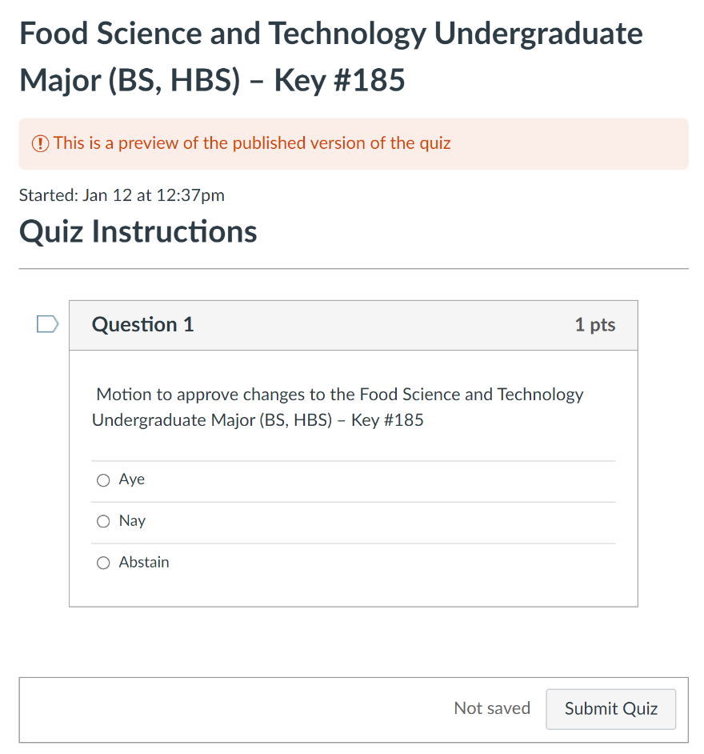
Slide Heading – Font is Stratum2 Black, size 36
Voting in Canvas
Vote and click “submit quiz”
If you have any issues and cannot vote, email your vote to Vickie.Nunnemaker@oregonstate.edu or Caitlin.Calascibetta@oregonstate.edu
Votes at the meeting are NOT final until they’ve been checked (only Senators or their proxies can vote) and late votes are tallied
Final results are posted on the FS website and in the Senate Newsletter
Font is Kievit Offc, size 20

Slide 13
Action Items – Curriculum Review and Voting
Faculty Senate votes on program proposals
Many steps, many committees, and much discussion before proposals get to the Senate floor
Faculty Senate Curriculum Council reviews and approves program proposal
Executive Committee (EC) reviews and approves, meets with presenters
BUT don’t think of these votes as “rubber stamp”. Senate = last opportunity to ask questions, and not all proposals pass.
Review proposals in advance via Canvas links
Curriculum Council, Core Education Committee, and/or Graduate Council review and approve course proposals as well

Slide 14
Action Items – Motions from the floor
During discussions on Action Items, Senators can offer amendments to Motions or additional motions
New Business issues that may result in motions or resolutions should be sent to the Senate Office in advance to facilitate review and discussion
This improves understanding of the motion by Senators and ensures proper recording

Slide 15
Faculty Senate Committees
Interinstitutional Faculty Senate
Executive Committee
Faculty Senate Standing and Ad Hoc Committees

Slide 16
Committees and Councils
Yvette Spitz

Slide 17
Standing Committees & Councils
Academic Standing Committee
Academic Requirements Committee
Academic Standing Committee
Administrative Appointments Committee
Advancement of Teaching Committee
Budgets and Fiscal Planning Committee
Carbon Commitment Committee
Core Education Committee
Faculty Grievance Committee
Faculty Recognition and Awards Committee
Faculty Welfare Committee
Graduate Admissions Committee
Library Committee
Online Education Committee
Professional Faculty Interests Committee
Promotion and Tenure Committee
Student Recognition and Awards Committee
Undergraduate Admissions Committee
Academic Advising Council
Curriculum Council
Diversity Council
Graduate Council
Honors College Council
Research Council
Total of 18 committees and 6 councils
Do most of the Faculty Senate’s work!
EC liaisons facilitate communication and decision-making
Membership Election
Committee Interest Form sent in the spring to identify new members
EC meets to work out committee assignments and leadership (chair) changes
Careful consideration of representation and diversity

Slide 18
Other Committees and Groups
Nomination of the Candidates to Faculty Senate office followed by Election by the Senators
Executive Committee
Interinstitutional Faculty Senate
Other Committees: meet upon request and membership selected by EC committee
Faculty Consultative Group
Faculty Mediators
Faculty Panels for Hearing Committee
Past Presidents Council

Slide 19
Ad Hoc Committees and Task Forces
Appointed by Faculty Senate leadership, often in partnership with the office of the Provost
Examples: Bacc Core Reform Committee, Anti-Racism Task Force, Professional Faculty Review Committee, Professor of Teaching Task Force
Specific tasks, deadlines

Slide 20
Faculty Senate President/President-Elect/Past President Serve on Many University Committees (e.g., 2023)
Athletic Admissions Committee – President-Elect, President
Campus Planning Committee – President-Elect, President, Immediate Past President
Compliance Executive Committee – President-Elect, President
Core Education Steering Committee – President, Core Education Core Team – President-Elect
Executive Policy and Standards Committee- President
Pathways to Community- President
President and Provost Leadership Council (OID)- President
Undergraduate Education Council – President
Undergraduate Student Success Committee- President
University Cabinet – President
Early Care and Education Workgroup- President
Presidential Transition Team- President
Senate Leadership and Provost Office – President and President-Elect
Reports to the Board of Trustees - President

Slide 21
Operations, Activities and Resources of the Faculty Senate Office
Vickie Nunnemaker, Faculty Senate Staff

Slide 22
Robert’s Rules of Order
Michael Beachley

Slide 23
Robert’s Rules of order
Robert’s Rules of Order is a manual of parliamentary procedures that governs most organizations with boards of directors. Robert’s Rules of Order are a provision of each of the SMPS chapter’s bylaws normally stated as the following:
“The rules contained in the most recent edition of Robert’s Rules of Order shall provide the rules of procedure for the Chapter where they are not inconsistent with the provisions of the Articles of Incorporation or these bylaws.”

Slide 24
Types of Motions
Main Motion: Introduce a new item
Subsidiary Motion: Change or affect how to handle a main motion (vote on this before main motion)
Privileged Motion: Urgent or important matter unrelated to pending business
Incidental Motion: Questions procedure of other motions (must consider before the other motion)
Motion to Table: Kills a motion
Motion to Postpone: Delays a vote (can reopen debate on the main motion)

Slide 25
Every motion has 6 steps
1. Motion: A member rises or raises a hand to signal the chairperson.
2. Second: Another member seconds the motion.
3. Restate motion: The chairperson restates the motion.
4. Debate: The members debate the motion.
5. Vote: The chairperson restates the motion, and then first asks for affirmative votes, and then negative votes.
6. Announce the vote: The chairperson announces the result of the vote and any instructions.
If the board is in obvious agreement, the chairperson may save time by stating, “If there is no objection, we will adopt the motion to…” Then wait for any objections. Then say, “Hearing no objections, (state the motion) is adopted.” And then state any instructions. If a member objects, first ask for debate, then vote and then announce the vote.

Slide 26
Slide Heading – Font is Stratum2 Black, size 36
Requesting Points
of Something
Point of Order: Draws attention to a breach of rules, improper procedure, breaching of established practices, etc.
Point of Information: A member may need to bring up an additional point or additional information (in the form of a nondebatable statement) so that the other members can make fully informed votes.
Point of Inquiry: A member may use point of inquiry to ask for clarification in a report to make better voting decisions.
Point of Personal Privilege: A member may use point of personal privilege to address the physical comfort of the setting such as temperature or noise. Members may also use it to address the accuracyof published reports or the accuracy of a member’s conduct.
Font is Kievit Offc, size 20
Certain situations need attention during the meeting, but they don’t require a motion, second, debate or voting. It’s permissible to state a point during a meeting where the chairperson needs to handle a situation right away. Board members can declare a Point of Order, Point of Information, Point of Inquiry, or Point of Personal Privilege.

Slide 27
Tips and reminders
Robert’s Rules of Order, which is also widely known as parliamentary procedure, was developed to ensure that meetings are fair, efficient, democratic and orderly. A skilled chairperson allows all members to voice their opinions in an orderly manner so that everyone in the meeting can hear and be heard. The following tips and reminders will help chairpersons to run a successful and productive meeting without being run over or running over others.

Slide 28
Tips and reminders
Follow the agenda to keep the group moving toward its goals.
Let the group do its own work; don’t overcommand.
Control the flow of the meeting by recognizing members who ask to speak.
Let all members speak once before allowing anyone to speak a second time.
When discussions get off-track, gently guide the group back to the agenda.
Model courtesy and respect and insist that others do the same.
Help to develop the board’s skills in parliamentary procedure by properly using motions and points of order.
Give each speaker your undivided attention.
Keep an emotional pulse on the discussions.
Allow a consensus to have the final authority of the group.

Slide 29
Action | What to Say | Can Speaker be Interrupted | Need a Second? | Can this be debated? | Can this be amended? | Votes Noted
Introduce main motion | “I move to…” | No | Yes | Yes | Yes | Majority
Amend a motion | “I move to amend the motion by…” | No | Yes | Yes | Yes | Majority
Move item to committee | “I move that we refer the matter to the committee.” | No | Yes | Yes | No | Majority
Postpone item | “I move to postpone the matter until…” | No | Yes | Yes | No | Majority
End debate | “I move the previous question.” | No | Yes | Yes | No | Majority
Object to procedure | “Point of order.” | Yes | No | No | No | Chair’s Ruling
Recess the meeting | “I move that we recess until…” | No | Yes | No | No | Majority
Adjourn the meeting | “I move that we adjourn the meeting.” | No | Yes | No | No | Majority
Request information | “Point of information.” | No | Yes | No | No | No Vote
Overrule the chair’s ruling | “I move to overrule the chair’s ruling.” | Yes | Yes | Yes | No | Majority
Extend the allotted time | “I move to extend the time by ___ minutes.” | No | Yes | No | Yes | 2/3
Enforce the rules or point out incorrect procedure | “Point of order.” | Yes | No | No | No | No Vote
Table a motion | “I move to table…” | No | Yes | No | No | Majority
Verity voice vote with count | “I call for a division.” | No | No | No | No | No Vote
Object to considering some undiplomatic matter | “I object to consideration of this matter…” | Yes | No | No | No | 2/3
Take up a previously tabled item | “I move to take from the table…” | No | Yes | No | No | Majority
* Reconsider something already disposed of | “I move to reconsider our action to…” | Yes | Yes | Yes | No | Majority
Consider something out of its scheduled order | “I move to suspend the rules and consider…” | No | Yes | No | Yes | 2/3
Close the meeting for executive session | “I move to go into executive session.” | No | Yes | No | No | Majority
*A member may make a motion to reconsider something that was already disposed; however, the reconsidered motion may not be subsequently reconsidered. A motion to reconsider must be made during the same meeting and can extend to a meeting that lasts for more than one day.

Slide 30

OSU Faculty Senate
January 11, 2024

