Slide 1

Faculty Senate Carbon Commitment Committee Report and Call to Action
Laura Rees (Associate Professor, College of Business),
Brandon Trelstad (Sustainability Office),
Perry Hystad (Associate Professor, College of Health)
On behalf of the Faculty Senate Carbon Commitment Committee
Faculty Senate Meeting – May 9, 2024

Slide 2
Agenda
Introduction and update on our progress
Who are we?
FY2023 OSU Greenhouse Gas Report highlights
Ongoing work at OSU
Comparing OSU progress to other universities
Limits to our progress
The ask: Specific calls to action
Engaging with colleges/units – Provost, Finance & Administration
Faculty Senate contributions going forward

Slide 3
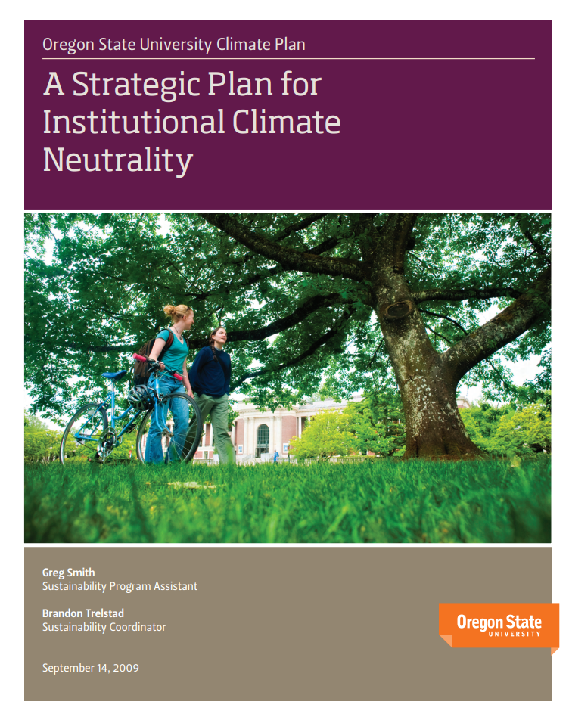
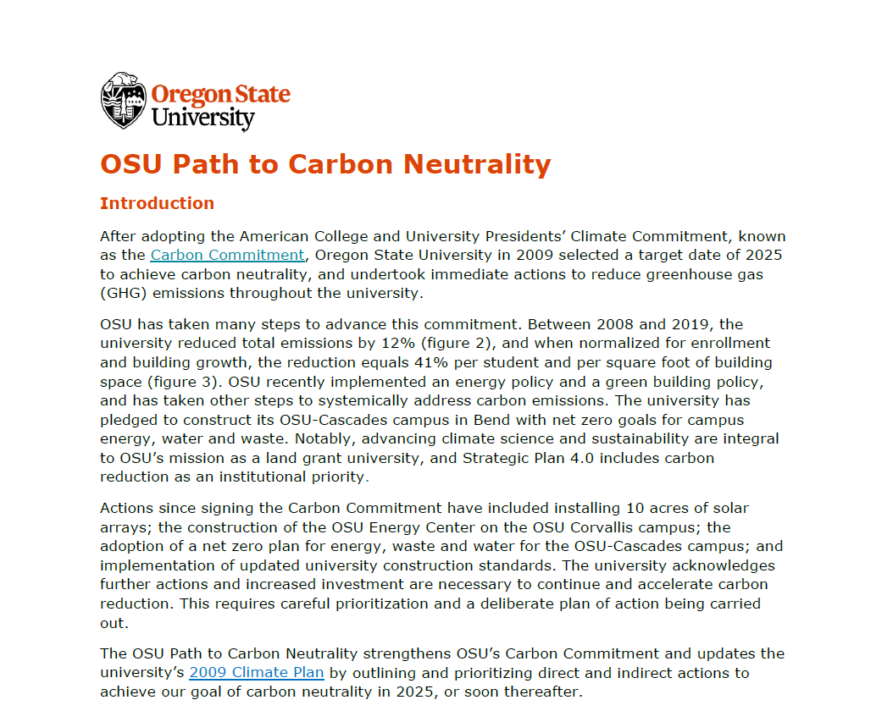
Slide Heading – Font is Stratum2 Black, size 36
Who Are We?
OSU commitment to carbon neutrality by 2025
Now expressed as the Path to Carbon Neutrality
A menu of 9 priority areas
Faculty Senate ad hoc committee created in 2018 to give faculty a voice & support the work of the Sustainability Office – Carbon Commitment Committee (C3)
Currently 23 members from 17 units

Slide 4
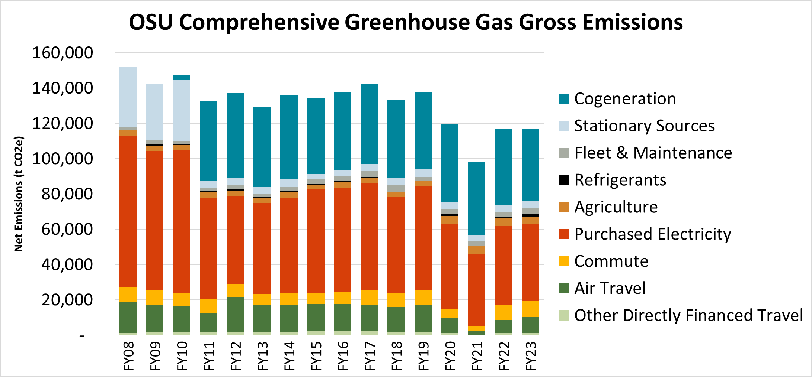
Slide Heading – Font is Stratum2 Black, size 36
FY2023 OSU Greenhouse Gas Report Highlights
117,258 metric tonnes (t) CO₂e
Per FTE student: 4.1 t CO₂e
Per 100 sq. ft. building space (typical single-user office): 1.107 t CO₂e
Progress is happening, but too slowly!
We will not achieve zero carbon emissions in the foreseeable future

Slide 5
How universities are progressing in emissions reduction
Institution | % GHG Emissions reduction per year
 | Overall | Per square foot | Per student
Oregon State University (2008-22) | 1.61% | 3.52% | 3.52%
Portland Community College (2006-22) | 2.23% | 3.19%
University of Oregon (2004-22) | 1.93% |  | 2.38%
UC Berkeley (2008-22) | 3.09% | 1.60% | 2.23%
Colorado State University (2010-22) | 1.89%
University of Michigan (2010-22) | 2.10% | 3.25%
OSU: 22.6% reduction from 2008-22 ≈ 60 years to carbon neutrality at this rate

Slide 6
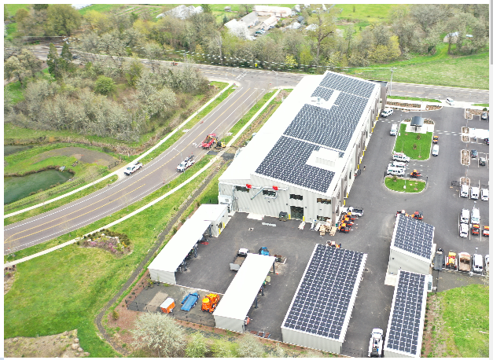
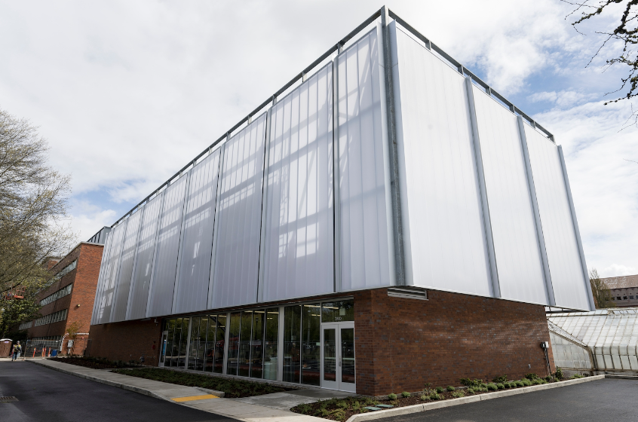
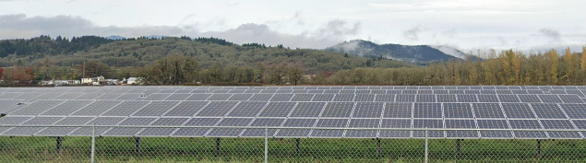
Ongoing Work at OSU: Examples
Solar: 3 MW ground-mounted + 500 kW roof-mounted complete. Another 2 MW roof-mounted in next two years
Heating / cooling efficiency: New energy engineer saving over $215k/year in existing buildings in first full year of position. District energy planning is underway, as are upgrades to Magruder, Richardson, and others
Major Capital projects: renovations such as Cordley, LaSells and Withycombe save 10-30% energy, on average
Beyond OSU: HB2021 – GHG in retail electricity in Oregon, <80% baseline by 2030, 100% by 2040. OSU benefits from the grid being de-carbonized

Slide 7
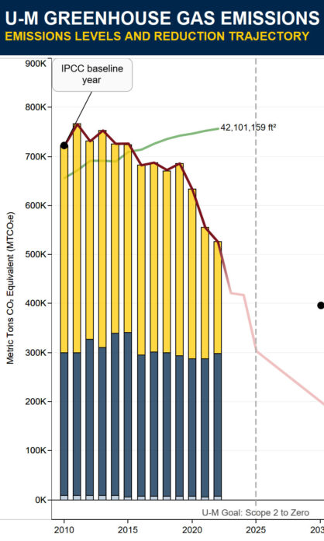
Case Study: University of Michigan
University of Michigan
28% decrease in GHG (39% decrease per sq. foot) from 2010 - 2023
Reducing GHG from purchased electricity to zero in 2025
Planning to build 25 MW of solar photovoltaics across all U-M campuses
Purchased / ordered 58 battery-electric vehicles and 4 electric buses
Discontinued direct investments in companies that are the largest contributors to GHG
Shifted natural resource investments to sustainable energy ($420M in two years), other investments to help build sustainable economy
$300 million in green bonds
Vision 2034: climate action, sustainability, and environmental justice as one of 4 key areas

Slide 8
Limits to Our Progress: What Is Holding Us Back?
How do we support advancing the strategic plan in a low/no-carbon way?
Requires new mindsets
E.g.: growth in infrastructure & buildings – increases carbon footprint
Funding allocation – very limited (<0.1 % total OSU budget spent specifically on emissions reduction, mostly in solar)
Time – years to implement, years to see results
Lack of moral intensity & ethical urgency influences tradeoff calculations
Potential for harm challenging to capture – magnitude, probability, immediacy, & concentration of effect
Social pressure unclear – consensus, priorities, & felt proximity to problem

Slide 9
What Needs to Be Done: Engaging with Colleges & Units
Provost, Finance & Administration, & C3 – ongoing discussions on strategy & implementation
Unit participation is essential – multi-pronged approach to expedite emissions reductions in conjunction with Central Administration initiatives
E.g. unoccupied office space emissions to heat/cool = 1.1 tons per 100 sq. ft.
Carbon Reduction Contacts – new roles within colleges & Division of Research and Innovation
Develop path forward based on unit-level greenhouse gas inventories
Focus on discrete actions, measurable change – narrow, specific goals
Identify & manage cultural / other factors – units have control
Public progress dashboards, annual updates to Provost

Slide 10
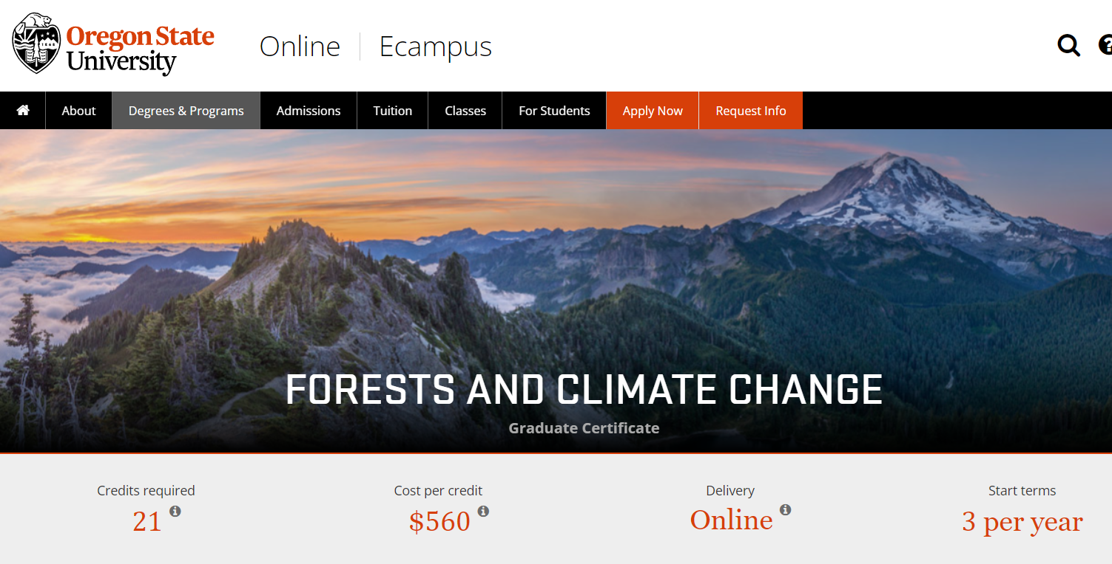
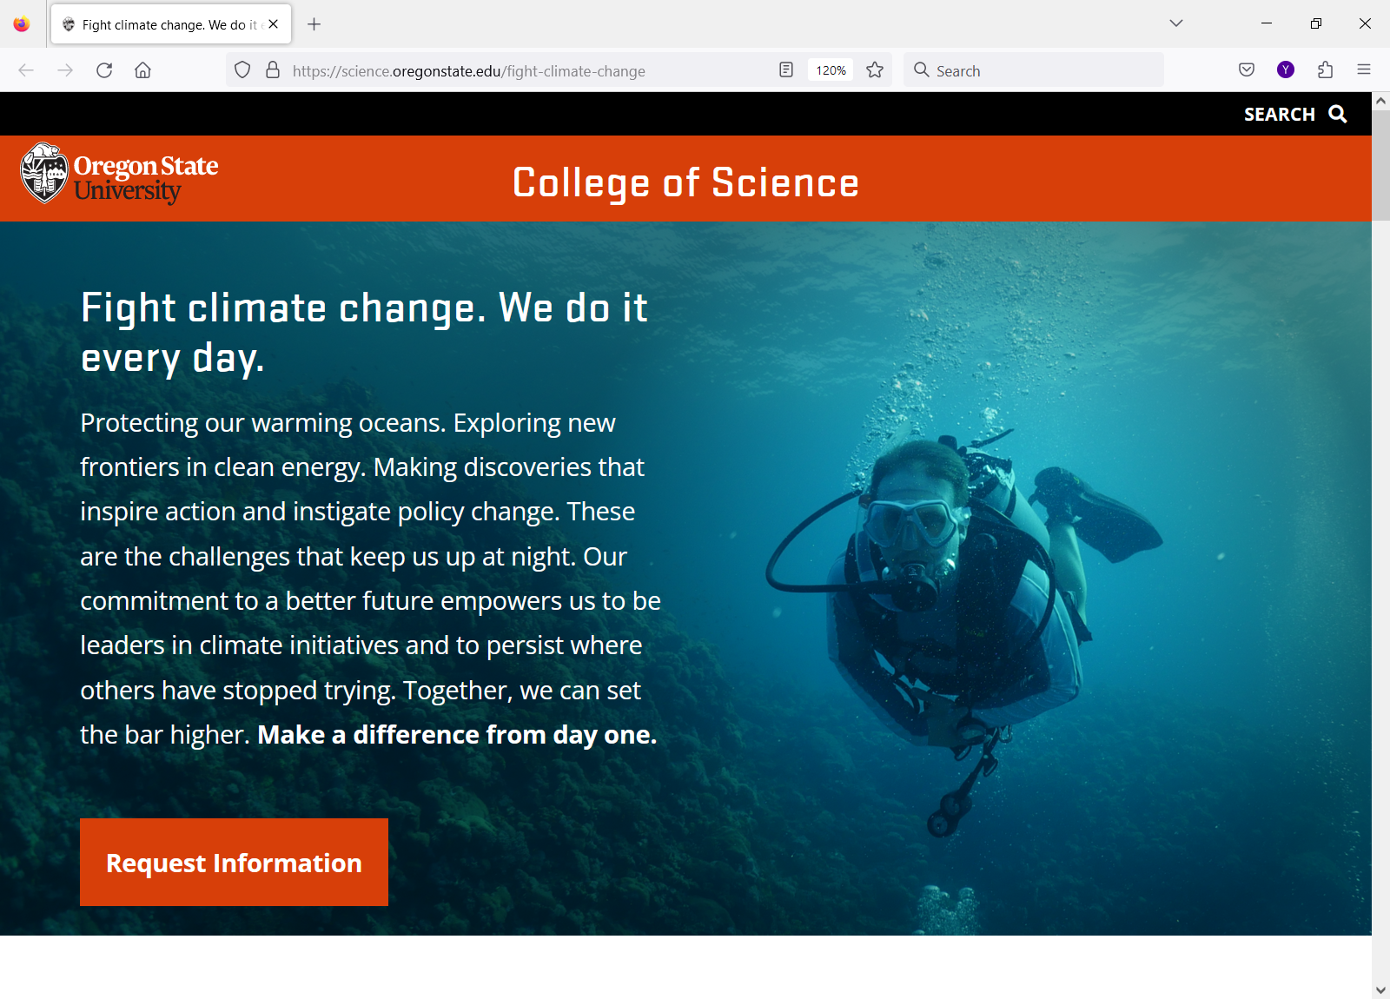
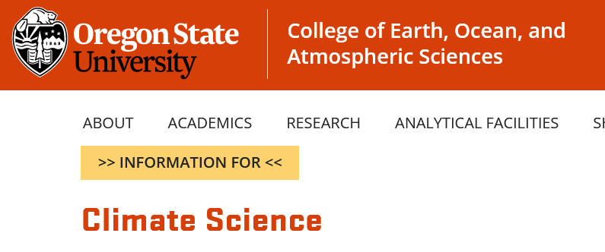
OSU Aggressively Markets Our Climate Research & Teaching. We Should Put Comparable Emphasis on Reducing the Carbon Footprint of Our Operations

Slide 11
What Needs to Be Done: How Faculty Senate Must Help!
Communicate
Advocate
Recognize
Engage
Ask questions, share information & ideas, communicate via resolution
Demand change from OSU, your unit, your colleagues, & yourself
Every job is a climate job…but students doubt our conviction
Action at all levels is needed, and adds up – doing nothing is not pro-climate
This is as urgent a moral & ethical situation as the current generation has faced

Slide 12
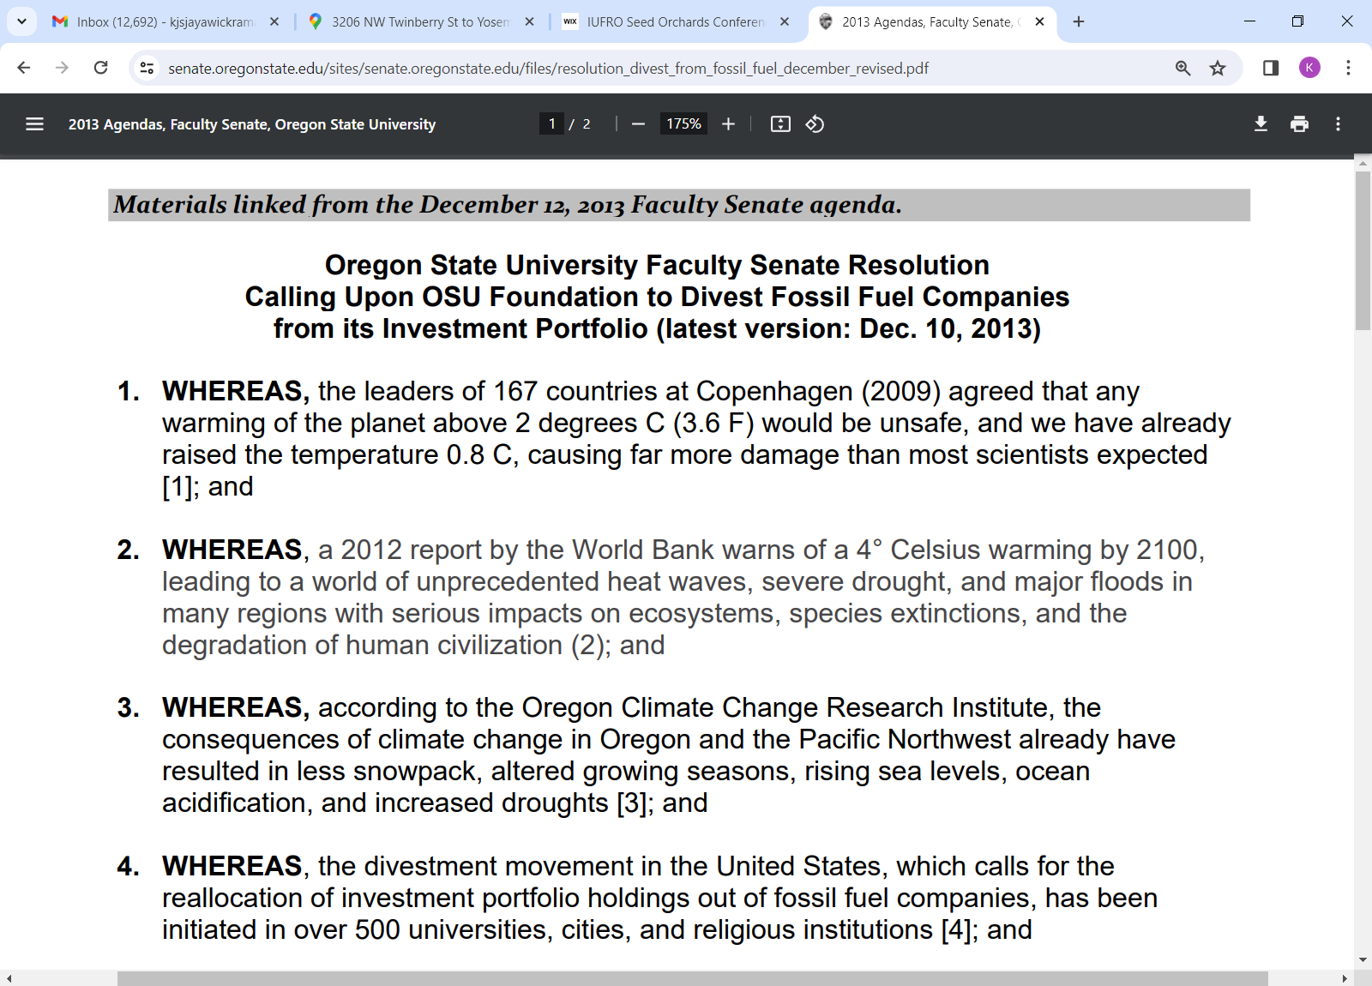

Immediate Request: Faculty Senate Resolution
We ask Faculty Senate to pass a resolution urging OSU Leadership to invest in faster, more substantial, and more public actions to achieve carbon neutrality
E.g., organizational or budget model changes, as needed
Prosperity cannot be widely shared without significant, consistent, and increased climate action

