Slide 1
Core Education
Faculty Senate Update
May 9, 2024
McKenzie Huber, Director of Core Education

Slide 2
Acknowledgements

Slide 3
Statement of Intent Submissions by Category (and CIM Submissions)
Category | Course Count | Category | Course Count | Category | Course Count
Writing Foundation | 1 (1) | Social Science | 34 (12) | Writing Elevation | 6 (2)
Quantitative Literacy and Analysis | 9 (6) | Scientific Inquiry and Analysis | 54 (20) | Difference, Power, and Oppression Advanced | 53 (2)
Arts and Humanities General | 24 (5) | Difference, Power, and Oppression Foundations | 30 (2) | Seeking Solutions | 40 (1)
Arts and Humanities Global | 24 (4) | Transitions | 3 (2) | Writing Intensive Curriculum* | 4 (1)
Communication, Media, and Society | 9 (4) | Beyond OSU I and II | 34 (3)
*WIC Courses granted legacy status from the Bacc Core to Core Ed; new WIC courses or changes to existing WIC courses are fully reviewed through CIM​
Adequate CIM submissions
Waiting for CADI & CIM submissions
CIM Submissions Needed

Slide 4
Course Adaptations and Design Institutes (CADI)
Dates
Spring 2024:
June 7, 10, 11, 13, 26
Summer 2024 - Final CADI dates to have courses incorporated in the Core Education Launch
September 16, 19, 25
All Core Ed Categories
(including Beyond OSU)
Beyond OSU CADIs
SOI Deadline | CADI Dates
June 1 | June September
SOI Deadline | CADI Dates
July 1 | September

Slide 5
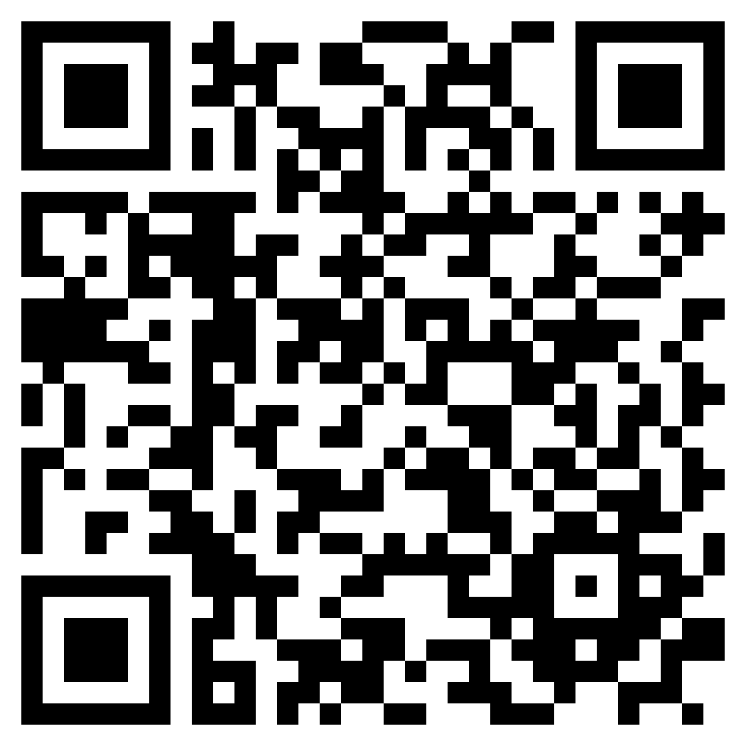
DPO Academies
Schedule & Registration
Academy Structure
Foundations: 15 hours
Advanced: 6 hours
Summer 2024 – Space Still Available!
Foundations: June 17-18; 20-21
Advanced: June 17-18
Fall 2024
Foundations: Fridays, 9am-Noon, Weeks 2, 4, 6, 8, 10
Advanced: Fridays, 10am-Noon, Weeks 0, 1, 3

Slide 6
CIM Submission Deadlines
Recommendations
Program change proposals – Early - Mid Fall 2024
Core Ed course proposals – Mid - Fall 2024
Deadline -- March 1, 2025
Approval deadline for both Core Education course proposals and Core Education-related program change proposals.
  All Core Education courses, regardless of Bacc Core standing, must be approved in CIM by March 1, 2025, to be included in the 2025-26 catalog.
  Similarly, updated program requirements necessary to reflect Core Education must be approved in CIM by March 1, 2025, to be included in the 2025-26 catalog.

Slide 7
Call to Action
Submit courses to CIM within three months of attending the CADI
Attend June and September CADIs specifically for:
Seeking Solutions
DPO Foundations and Advanced
Beyond OSU I and II
Writing Elevation
All other outstanding SOIs

