Slide 1

Program proposalS FOR APPROVAL BY Faculty senate
Eric B. Ianni and Jim Coakley, Curriculum Council
May 9, 2024

Slide 2
Programs for FS Approval
Supply Chain and Logistics Management
New Graduate Major, College of Business
Management Undergraduate Major
Name change to Organizational Leadership, College of Business
Gerontology Certificate
Name change to Aging Studies, College of Health
Informational Items
New/Changed Academic Programs and Courses
New/Revised Curricular Policies

Slide 3
New Graduate Major
Master of Science Supply Chain & Logistics Management: CIM Key 850
Reviewed and approved by the following Faculty Senate Groups:
Budgets & Fiscal Planning Committee: Apr 2, 2024
Graduate Council: Apr 15, 2024
Curriculum Council: Apr 29, 2024
Executive Committee: May 7, 2024

Slide 4
New Graduate Major
Master of Science Supply Chain & Logistics Management: CIM Key 850
Corvallis and Ecampus
Based on existing courses in SCLM option, certificate
Growing demand for graduate degrees in supply chain
STEM-designated

Slide 5
Name Change in Undergraduate Major
Management to Organizational Leadership: CIM Key 457
Reviewed and approved by the following Faculty Senate Groups:
Budgets & Fiscal Planning Committee: Apr 30, 2024
Curriculum Council: May 6, 2024
Executive Committee: May 7, 2024

Slide 6
Name Change in Undergraduate Major
Management to Organizational Leadership: CIM Key 457
Corvallis and Ecampus
Organizations are moving away from the use of the term “Manager” towards “Leader” in job titles
Organizational Leadership also better reflects the approach taken in the courses in this major
Provides clarity – “management” hard to distinguish from “business administration”

Slide 7
Name Change in Undergraduate Certificate
Gerontology to Aging Studies: CIM Key 507
Reviewed and approved by the following Faculty Senate Groups:
Budgets & Fiscal Planning Committee: Apr 30, 2024
Curriculum Council: May 6, 2024
Executive Committee: May 7, 2024

Slide 8
Name Change in Undergraduate Certificate
Gerontology to Aging Studies: CIM Key 507
Corvallis and Ecampus
Goal is to increase enrollment – students not familiar with term “gerontology”
Adjusting learning outcomes and coursework

Slide 9
Request Faculty Senate Approval
Supply Chain and Logistics Management
New Graduate Major, College of Business
Management Undergraduate Major
Name change to Organizational Leadership, College of Business
Gerontology Certificate
Name change to Aging Studies, College of Health

Slide 10
Information Items – Curricular Policies
Special workflow for changes to undergraduate majors/minors/options due to implementing CoreEd
All majors will need to update curriculum
Revised non-credit course policy (XXX 001 – 006)
Common assessment practices (vs for each course)
Moved to generalized learning outcomes for each course (vs pick from a list)

Slide 11
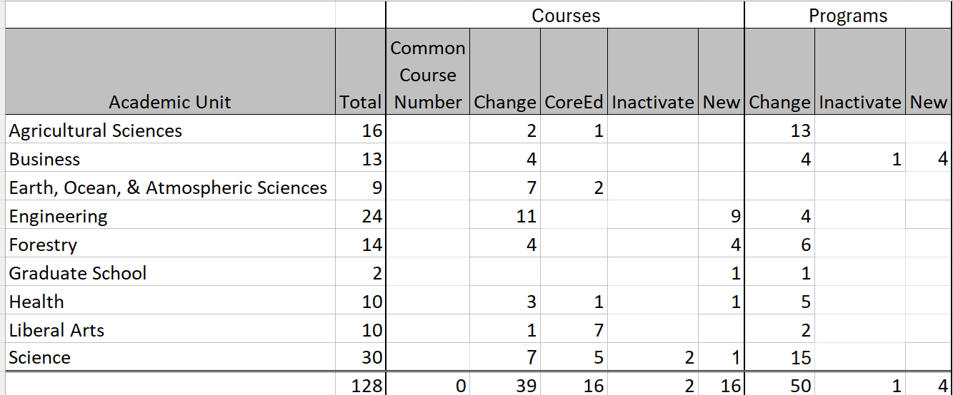
Information Items - Academic Programs Proposals Reviewed and Approved Since Apr 11

