Slide 1
Fall Preparations Free EXPRESSION, Activism AND ENGAGEMENT
October 10, 2024
Notes:
Must be in Slide Master mode to swap out photos.

Slide 2
Agenda
What We’re Hearing and Seeing
Preparing and Leading: Free Speech, Expression and Academic Freedom
Activism/Protest Planning and Response
Action Plan – Israel & Gaza Community Engagement
Discussion
Notes:
Dan

Slide 3
Our Environment
Volatile national political environment
Volatile media and social media environments
Prevalence of binary thinking (with us/against us)
General distrust of higher education and institutional actors
Fear of the consequences of engagement (“saying the wrong thing”)
Notes:
Dan

Slide 4
Our Role as Educators
We must…Create learning and working environments that allow for diverse opinions and viewpoints to flourish.
So that we can…Collectively navigate the discomfort that inevitably accompanies grappling with views differing from our own.
Enabling the…pursuit of deeper understanding of issues, ideas and perspectives that advance OSU’s mission of promoting economic, social, cultural and environmental progress for the people of Oregon, the nation, and the world.
Activism is a normal and expected part of higher education
Colleges and universities exist for one reason above all: to promote learning…They need the noisy, teeming pluralism of living communities that search for truth.
Cass R. Sunstein, Harvard Law
Notes:
Dan

Slide 5
Assets
Strong internal collaboration
Thoughtfully designed and tested policies and practices that are consistent with our values
Expertly staffed, situationally tested teams
Active communication with shared governance partners
Significant guidance and professional development opportunities on relevant topics
A community of educators
Knowledgeable teaching and research faculty on relevant topics
Diverse student and employee bodies
Notes:
Dan

Slide 6
Free Speech, Expression and Academic Freedom

Slide 7
Free Expression and Academic Freedom Committee
Opportunities for OSU community members to explore rights and responsibilities associated with free expression and academic freedom in higher education settings.
Increased capacity for the university community to engage in dialogue, debate, deliberation and productive disagreement on significant topics.
Awareness of university policies, practices and resources supporting free expression and academic freedom.
Opportunities to explore the relationship between advancing OSU’s commitment to diversity, equity and inclusion and safeguarding free expression and academic freedom.
Notes:
Scott

Slide 8
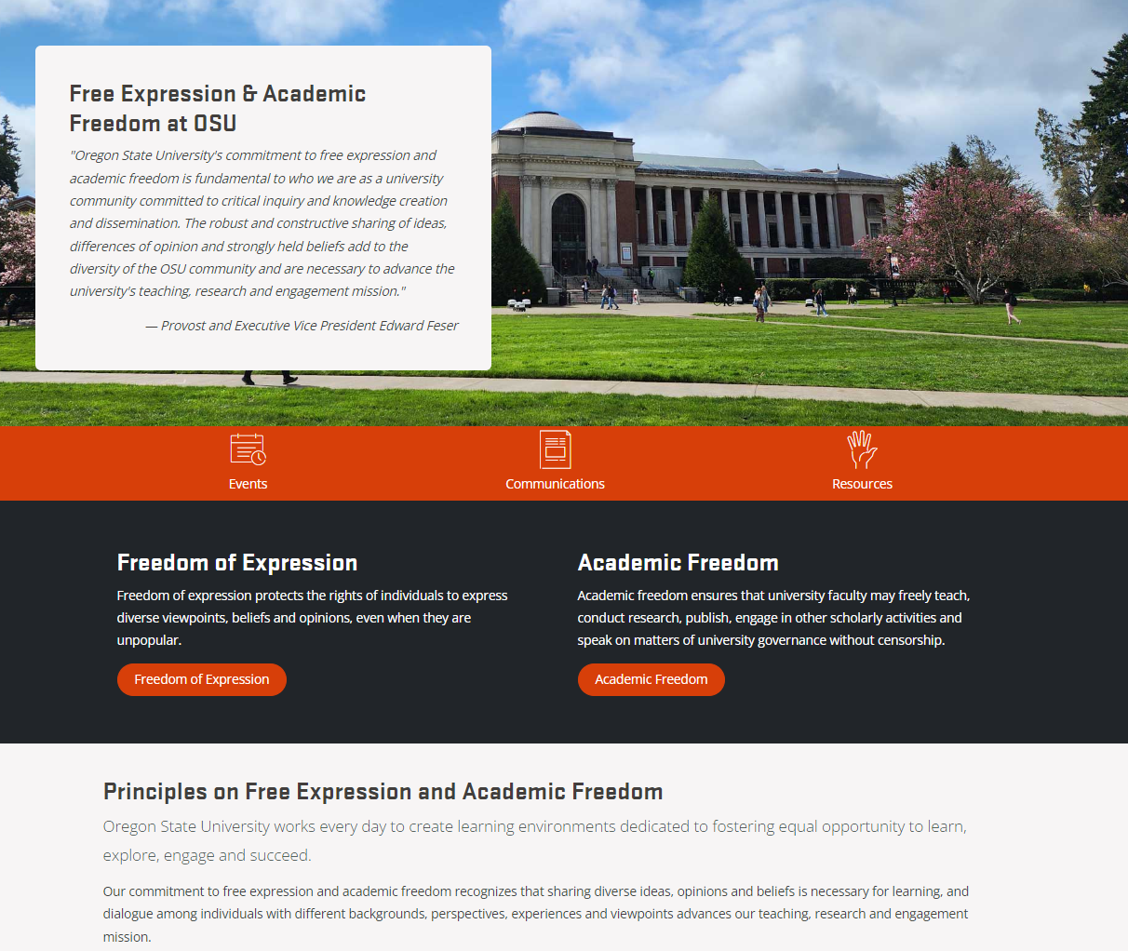
Website
Consolidated and comprehensive access to educational materials, engagement toolkits, a schedule of events for planned programs and activities.
Notes:
Scott

Slide 9
Resources
Freedom of Speech and Expression Policy
Academic Freedom Policy
Protest Response Protocol
Philosophy and Procedures of University Response to Activism
Freedom of Expression in the Educational Environment
University Principles re Communicating on Matters of Public Affairs
Notes:
Scott

Slide 10
Protest/Activism Planning & Principles

Slide 11
Planning and Principles
Expecting community engagement and activism on a variety of topics
2024 Election, Gaza/Israel/Regional violence and conflict
Protest Response Team, led by Dean of Students Office, takes lead on engagement
OSU will respond consistent with engagement principles and philosophy
Early and often advising on ways to exercise speech within broad OSU policy
Engagement before, during and after activism to ascertain desires, maintain safety
Clear communication when activities violate policy; lowest level engagement possible
Progressive accountability when required to maintain operations of university
Civil disobedience comes with an expectation of accountability; OSU’s accountability is educational and restorative
OSU does not “negotiate” when university policy is being violated
Institutional communication on matters of public affairs
OSU is a speaker, but must use its voice very carefully to avoid foreclosing dialogue and debate
More likely to communicate when impact and issue directly connected to OSU teaching, research and engagement mission: Link
Notes:
Faculty Senate Slide

Slide 12
Israel & Gaza Action Plan

Slide 13
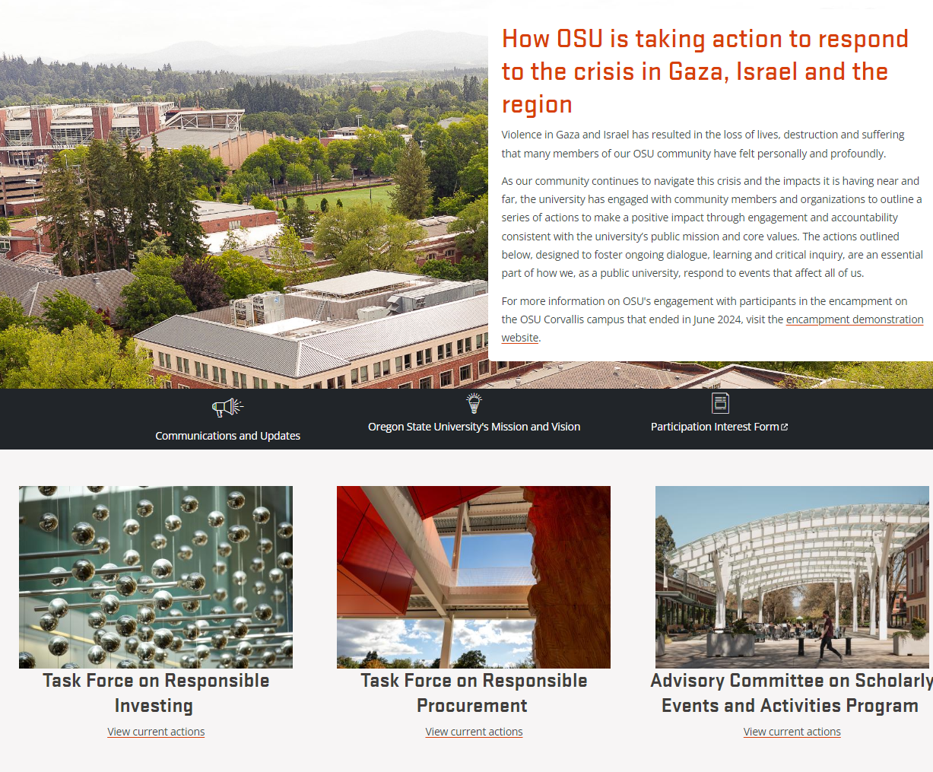
Website
Centralize Communications
Updates on Progress
Engagement Opportunities
Notes:
Scott

Slide 14
Timeline
August/September: Finalize website
September 25: Second round of invitations to indicate interest
Early October: Application/Members selection
Mid-October: Launch of taskforces/committees
Late October – May: Work development/programming
June: Taskforce reports provided
Notes:
Scott

Slide 15
Training and Resources
Resources for All OSU Employees
The Office of Institutional Diversity provides several trainings and workshops designed to assist employees in a variety of roles to support an environment that promotes the sharing diverse ideas, opinions and beliefs that are necessary for learning, and facilitating dialogue among individuals with different backgrounds, perspectives, experiences and viewpoints.
Free Expression at OSU workshops
Dialogue Facilitation Lab, special topic on free expression
Workshops, including dialogue skills, bias response, inclusive teaching, and trauma informed teaching
Individual consultation and coaching
Resources for Teaching Faculty
The Center for Teaching and Learning provides a range of programs and services to support faculty in the classroom, and in particular, in developing skills and familiarity with managing difficult educational environments.
Teaching in turbulent times series
Individual consultation and coaching
Webinar library, including inclusive teaching, trauma informed teaching
Support Resources for Employees
Through the Office of University Human Resources, OSU employees can access Lyra Health, which offers a full spectrum of care offerings, including seminars and resources on election stress. Employees can sign up for webinars here, and also access the following guides.
Coping with Election Anxiety
Dealing with Co-worker Conflict during Elections
Managing Teams during Elections
Notes:
Dan

Slide 16
Closing – our Request…
Reinforce values of curiosity, exploration, inquiry as core to our mission
Create opportunities allow time for deliberation, dialogue, conversation
Model pluralistic mindset for students and employees
Surface issues early and seek support as needed
Define what productive conflict and disagreement looks like in your classroom, team meeting, etc.
Gain a strong understanding of the university’s free expression, discrimination and harassment and reporting policies and procedures, and utilize reporting and accountability structures.
Take the first step…
Notes:
Dan

