Slide 1

Program proposalS
FOR APPROVAL BY Faculty senate
Kaplan Yalcin and Jim Coakley, Curriculum Council
November 14, 2024

Slide 2
Programs for FS Approval
College of Health
  886: Healthcare Administration: New Undergraduate Major (BS, HBS)
College of Agricultural Sciences
  858: Horticultural Therapy: New Undergraduate Certificate
College of Earth, Ocean, and Atmospheric Sciences
  729: Climate Change Solutions: New Undergraduate Certificate
College of Forestry
  864: Wood Innovation for Sustainability Graduate Major (PSM)
  867: Mass Timber Graduate Certificate
  868: Timber Circular Economy Graduate Certificate

Slide 3
Healthcare Administration
New Undergraduate Major (Ecampus)
CIM Key 886
Reviewed and approved by the following Faculty Senate Groups:
  Budgets & Fiscal Planning Committee: Oct 9, 2024
  Curriculum Council: Oct 21, 2024
  Executive Committee: Oct 25, 2024
Online degree program to prepare students for leadership roles in healthcare industry

Slide 4
Horticultural Therapy
New Undergraduate Certificate (Ecampus)
CIM Key 858
Reviewed and approved by the following Faculty Senate Groups:
  Budgets & Fiscal Planning Committee: Sep 25, 2024
  Curriculum Council: Oct 7, 2024
  Executive Committee: Oct 25, 2024
Online certificate program to prepare students for American Horticultural Therapy Association (AHTA) registration

Slide 5
Climate Change Solutions
New Undergraduate Certificate (Corvallis, Ecampus)
CIM Key 729
Reviewed and approved by the following Faculty Senate Groups:
  Budgets & Fiscal Planning Committee: Oct 9, 2024
  Curriculum Council: Oct 21, 2024
  Executive Committee: Oct 25, 2024
Provides an overview of the scientific basis of climate change, its causes, and its consequences for ecosystems and society, and provides students with the skills to create solutions that will help mitigate and adapt natural and human systems to changing climates around the world.

Slide 6
Wood Innovation for Sustainability Graduate Major (PSM)
New Graduate Major (PSM) (Ecampus)
CIM Key 864
Reviewed and approved by the following Faculty Senate Groups:
  Budgets & Fiscal Planning Committee: Oct 9, 2024
  Graduate Council: Oct 21, 2024
  Curriculum Council: Nov 4, 2024
  Executive Committee: Nov 7, 2024
Provides an international perspective on the most pressing and contemporary topics in the field, with students collaborating with world-class faculty and industry leaders

Slide 7
Mass Timber
New Graduate Certificate (Ecampus)
CIM Key 867
Reviewed and approved by the following Faculty Senate Groups:
  Budgets & Fiscal Planning Committee: Oct 9, 2024
  Graduate Council: Oct 21, 2024
  Curriculum Council: Nov 4, 2024
  Executive Committee: Nov 7, 2024
Provides a foundation in wood science and technology, with a focus on mass timber

Slide 8
Timber Circular Economy
New Graduate Certificate (Ecampus)
CIM Key 868
Reviewed and approved by the following Faculty Senate Groups:
  Budgets & Fiscal Planning Committee: Oct 9, 2024
  Graduate Council: Oct 21, 2024
  Curriculum Council: Nov 4, 2024
  Executive Committee: Nov 7, 2024
Provides a foundation in wood science and technology, with a focus on circular economy

Slide 9
Request Faculty Senate Approval
Two new majors
  886: Healthcare Administration: New Undergraduate Major (BS, HBS)
  864: Wood Innovation for Sustainability Graduate Major (PSM)
Four new certificates
  858: Horticultural Therapy: New Undergraduate Certificate
  729: Climate Change Solutions: New Undergraduate Certificate
  867: Mass Timber Graduate Certificate
  868: Timber Circular Economy Graduate Certificate

Slide 10
Information Items – Curricular Policies
Added non-credit courses for Beyond OSU
  007: Beyond OSU I
  008: Beyond OSU II
  Addition was recommended by Core Education Committee

Slide 11
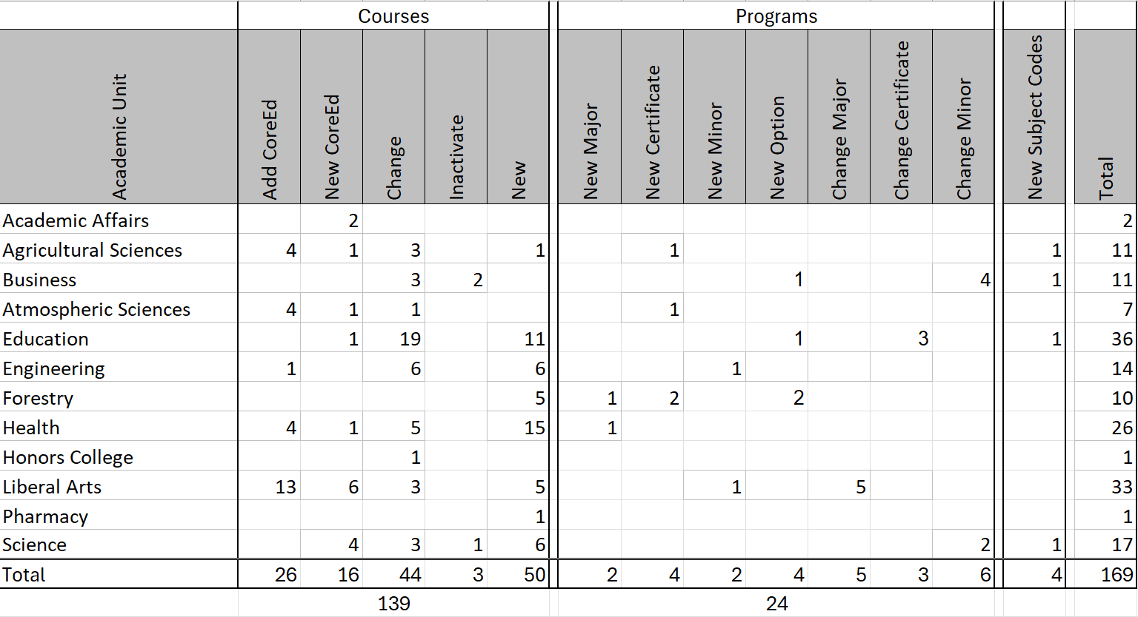
Proposals Reviewed and Approved Since July 1

