Slide 1
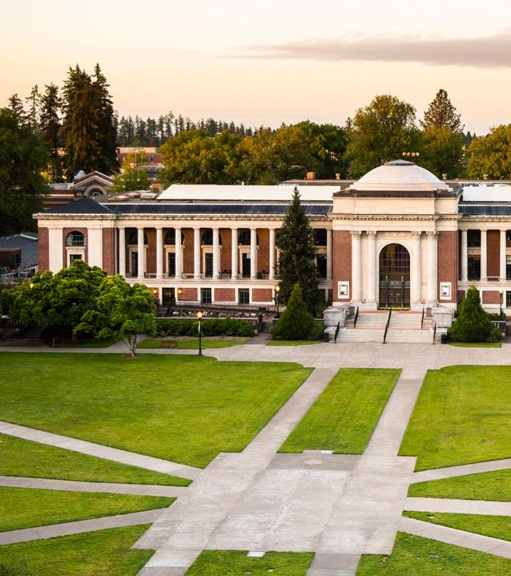

Faculty Senate Briefing
January 9, 2025

Slide 2
Administrative Modernization Program (AMP)
AMP is an effort to modernize and simplify day-to-day administrative work.
OSU will streamline processes and policies across Human Resources, Finance, Budgeting, and Post-Award Grant Administration.
Administrative staff in your units will continue to engage with AMP through demonstrations of the new technology and will have an opportunity to review the changes to HR, finance and post-award processes and policies.
Notes:
2024 Accomplishments
As a reminder, AMP is focused on modernizing our administrative processes, and the technology that underpins these systems, focused on Finance, HR and post award grant administration. At this time, we are NOT focused on the processes and technology that support our student focused processes and systems.
The AMP teams have collected over 2,400 pieces of community feedback and input that have been put into action as we design the future of our administrative processes and technology.
Speaking of redesigning, teams have started the design work by completing 423 design workshops that are informing how we are modernizing administrative work for OSU.
Adaptive Update
We have an important milestone coming up in February, when we will automate a very manual process for budget development at OSU. Not only will this reduce manual work for our staff supporting Deans and leaders in the budget development process, but it also provides us a key opportunity to learn about what is working from an organizational change management perspective, and how we can evolve.
2025
As we come into 2025, administrative staff in your units will continue to engage with AMP through system demonstrations, and will have an opportunity to review the changes to HR, finance and post-award processes and policies.

Slide 3

AMP is engaging our OSU community
797 TOTAL RESPONSES +147 from May 2024
39 UNITS REPRESENTED
+7 from May 2024
STRONG REPRESENTATION
From Community Members That Will Be Most Impacted
89%
+ .23%
11%
RESEARCH & INNOVATION
Participants
7%
STUDENT AFFAIRS
Participants
+ 2%
+ 4.5%
+ .6%
8.54%
9%
FINANCE & ADMIN
Participants
6%
CONTROLLER’S UNIT
Participants
70%
30%
Corvallis
Other location (e.g, Extension Office, Experiment Station)
-1.7%
-.48%
8%
EXTENSION OFFICES
Participants
6%
COLLEGE OF AG. SCIENCES
Participants
1.38%
.75%
Professional Faculty
Classified Staff
Cascades
Newport
Notes:
Just shy of 650 professional faculty and classified employees completed the first Change Readiness Assessment, a survey designed to understand community members' awareness of AMP and preparedness for future ways of working. We saw over 20% more respondents and 7 additional units participating in the second assessment conducted in November.
For some of you, you may be wondering if you missed an email on this. You did not – the survey is intentionally sent to classified employees and professional faculty, who are most often engaged in the processes that are changing. We have intentionally NOT sent this to academic faculty to avoid cluttering inboxes.

Slide 4
OSU will make Changes to Financial Processes starting July 2026
Centralize invoice creation with Billing & Receivables Services using Workday
Move internal billing, fee books and fee book operations to Workday
Establish standard approval rules and thresholds within Workday
Adopt Workday Projects for capital and non-capital project accounting
More information is on the AMP SharePoint site
Notes:
AMP has a clear governance structure: the AMP steering committee is made up of leaders from across OSU, who either make decisions consistent with our guiding principles –taking into account the pros and cons of the set of options – or escalate a recommended path forward to the AMP Executive Sponsors, Provost Feser and Vice President Carla Ho'a.
Within this governance structure, we recently closed 46 strategic decisions focused on ways to streamline processes, improve data for decision making and make the employee experience better.
32 of those decisions were made by UHR, finance and research administration functional leaders, as there was a clear case for the path forward aligned to our AMP guiding principles.
While decisions will not take effect for many months, aligned to the timing of technology changes, we are making and communicating decisions now so that processes can be re-designed and staff can prepare for new ways of working.
14 decisions were made at the AMP Steering level with 4 of those escalated to the AMP Executive Sponsors.
Prior to the holiday, four changes were announced to financial administration and management including accounts receiving , internal billing, approval processes and capital and non-capital project accounting. Heather Horn will talk more about upcoming decision communications in the coming months.
More information about these decisions can be found on the AMP SharePoint (intranet) site.

Slide 5
What does this mean for me? What is changing?
As an Academic Faculty, Professional Faculty, Public Safety Professional, Graduate Assistant, Student Employee, or Classified employee I will use Workday to:
View and change my personal information, e.g., paystubs, benefits, absence balance
Initiate time off and approvals
Manage grant expenditures, timelines, reports, and effort certification
If I am a supervisor,
I will also use Workday to:
Manage my team’s goals and performance
Approve time and absence requests from my team
Recruit, hire, and promote staff, manage performance, and manage separations
Plan, submit, and monitor annual budgets
Notes:
We expect that the planned changes will effect faulty in the following three ways:
You all have annual and occasional personnel activities that you engage in – such as enrolling in benefits. These processes will be done in a new system (workday) once we go live
Many of you work with staff who support you in purchasing materials for grants, hiring staff to support our academic and teaching mission – these staff will have modernized processes and policies to continue to provide this support to you.
Many of you also have federal sponsored research grants – the administrative processes you use, such as effort certification, will evolve. As we design these, we will get information to principal investigators.

Slide 6
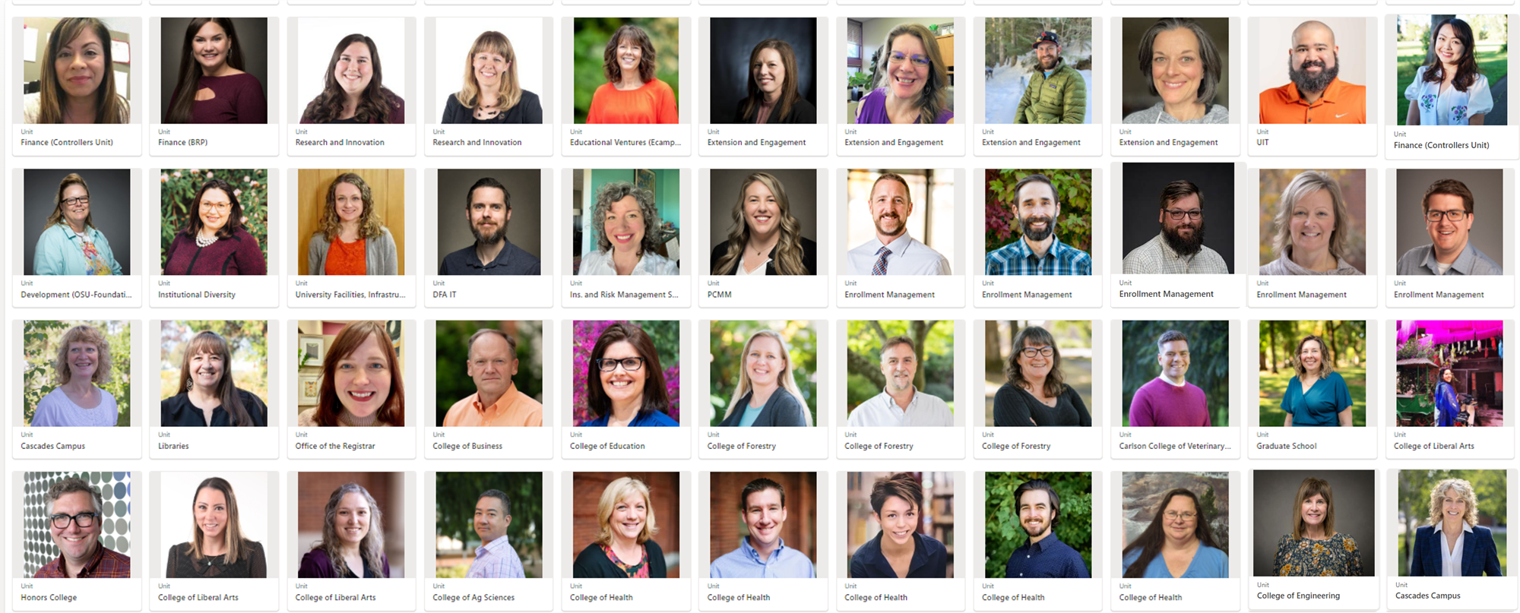



AMP is working with 56 Change Champions representing 34 colleges and units across OSU
Change Champs are actively working to:
COLLECT AND SHARE FEEDBACK
PREPARE PEERS
AMPLIFY COMMUNICATIONS
How to engage with your Change Champion:

Slide 7
What to Expect Next
Leave Feedback in AMP’s ‘always on’ survey:
beav.es/AMPfeedback
Find resources for you or your team:
beav.es/AMP-sharepoint
1
Watch for Additional “Big Rock’ Decisions
2
Encourage Your Colleagues to Participate
3
Connect with your Change Champion to provide feedback

Slide 8
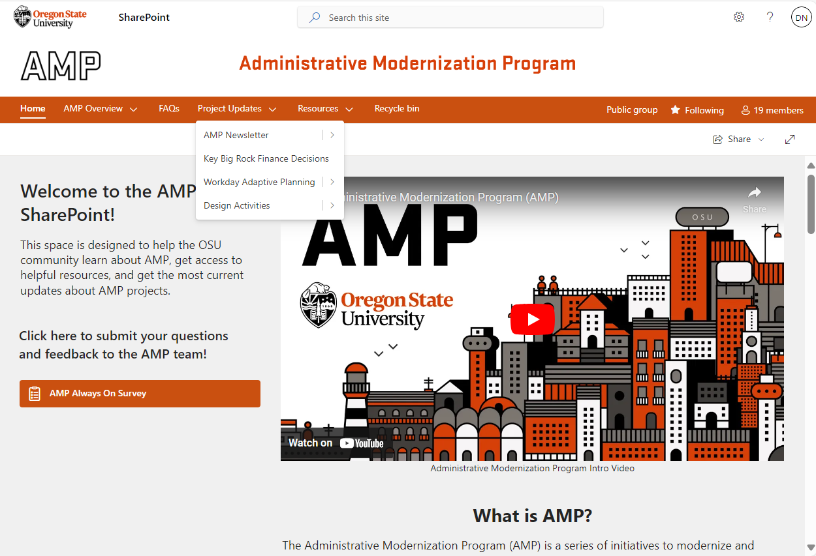
Find Out More
beav.es/AMP-sharepoint
Leave Feedback in AMP’s ‘always on’ survey:
beav.es/AMPfeedback

