Slide 1

University Ombuds Office
Waldo 116
ombuds@oregonstate.edu
Faculty Senate Presentation
January 9, 2025
Notes:
Congratulations on starting at OSU. OSU is a great employer. I started here September 5, and I have been incredibly impressed with what I have seen so far. So Ombuds, it’s a weird word. It isn’t an acronym, but it can be a helpful resource for the entire community. Please ask questions as we go along.

Slide 2
Agenda
What does an Ombuds do?
Our Principles
Examples of Issues
Resources

Slide 3
What does an Ombuds do?
Individual consultations
  Points out appropriate resources
  Addresses process issues
  Coaches on concerns
  Helps navigate bureaucracy
Facilitated and mediated conversations
Workshops and trainings
Notes:
It isn’t an acronym. It’s a Swedish word for representative. The first Ombudsman role was created in Sweden. We are organizational ombuds, which means we act in a more neutral capacity. We serve the entire OSU Campus

Slide 4
The Ombuds Office Principles
Impartial
We don’t take sides
Independent
We report directly to the President’s Office
Informal
We don’t keep records
Confidential
Everything said in the office stays in the office*
Notes:
Impartial- We aren’t advocates We don’t take sides. We do advocate for fair process, though.
Independent- We are above department politics
Informal We don’t keep records, we are not an office of notice- You aren’t telling the University something. If you are thinking about making an EOA We are “off the record” If you are considering making a Complaint, you came come talk to us without concern of it being reported.
Confidential- Unless you are going to harm yourself or someone else, or if it involves child use

Slide 5
Examples of Issues
Two members of your research group are in conflict and you as the PI feel stuck in the middle.
You, professional faculty, are concerned about inequitable treatment of employees. You want to address the issue without increasing tension.
You have a question about a policy but want to talk about it in a confidential space.

Slide 6

A Guide to a Constellation of Resources
We help you explore where to take your concerns. Resource referrals might include
Equal Opportunity & Access
Human Resources
Office of Institutional Diversity
Disability Access Services
Notes:
You don’t need to wait to come and see us. The earlier you come the better. We are also not an “or” Office. We are an “and” office. We are a supplement to all the other resources here on campus. Sometimes people come to use for ten minutes. Or a couple of hours. There is no problem too big or too small for us.

Slide 7
Be Proactive: Host an Ombuds Workshop!
Receiving and Giving Feedback: Why It’s Hard, Why It’s Important, How to Make It Better
Aligning Expectations with Your Graduate Advisor
Five Hot Tips to Cool Things Down: Effectively Working Through Workplace Conflicts
Intro to University Ombuds
Active Listening
Starting a Difficult Conversation
Moving from Conflict to Dialogue
A Manager’s Toolkit for Helping with Team Conflicts
Developing Resilience in the Workplace

Slide 8
All-Comers Workshops – Winter 2025
January 24 – FYI Friday - Developing Resilience in the Workplace
Virtual – Sign up at https://hr.oregonstate.edu/training/training-days
11:00 am—noon
January 30 – A Manager’s Toolkit for Helping with Team Conflicts
February 6 – Giving and Receiving Feedback: Why It’s Important, Why It’s Hard, How to Make It Better
February 18 – Moving from Conflict to Dialogue
February 28 – Active Listening

Slide 9

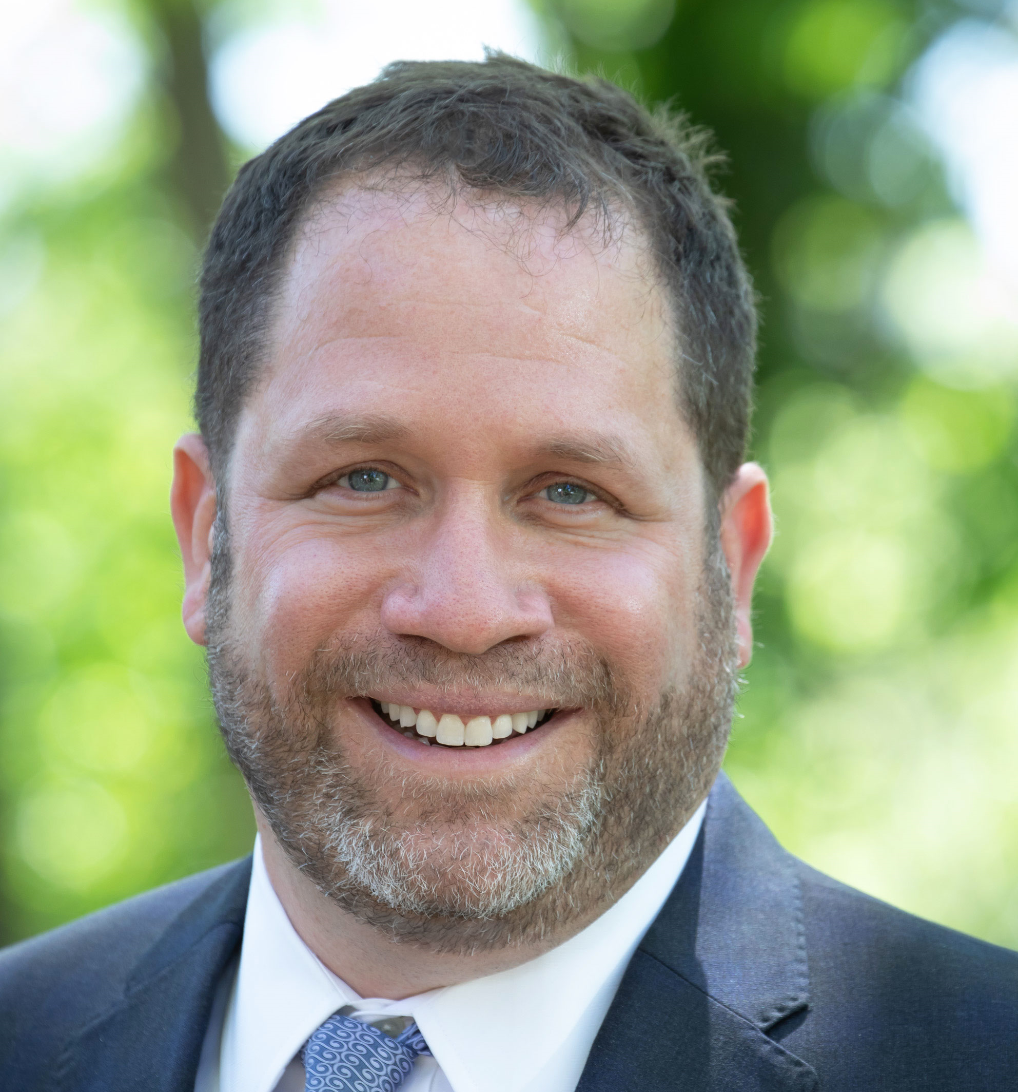
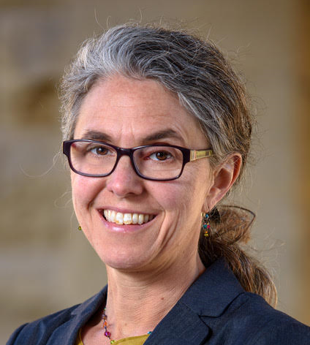
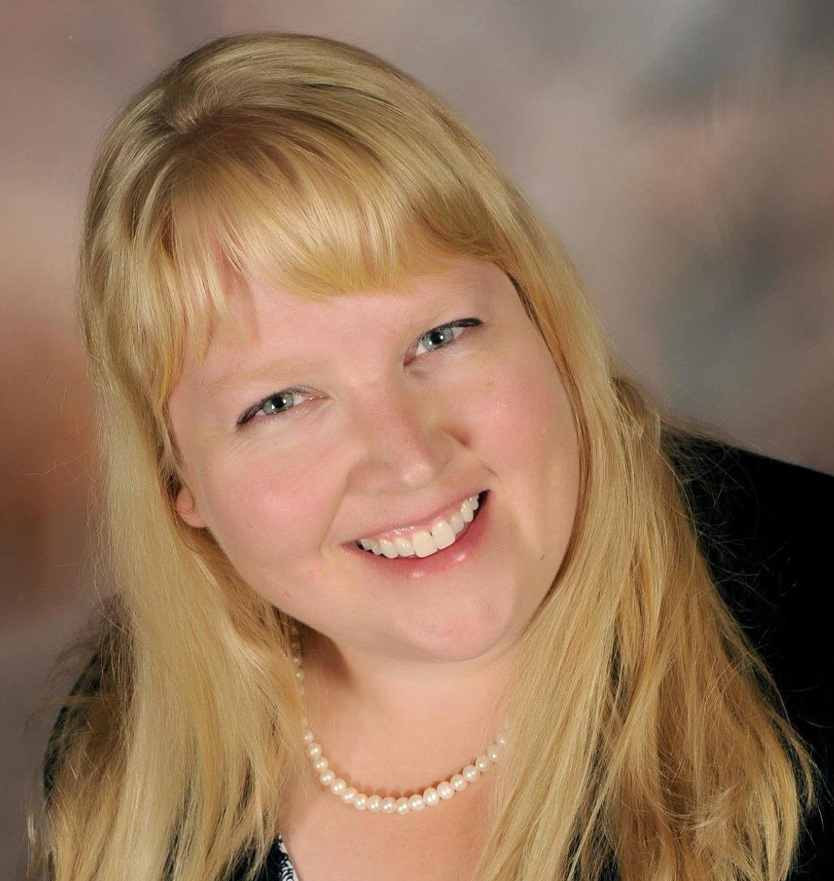
Contact us!
Location
Waldo Hall 116
Office hours
Monday – Friday 9:30 am – 12:00 pm
and 1:00 – 4:30 pm
To schedule an appointment
Call (541) 737-4537
Email ombuds@oregonstate.edu
For more information
http://ombuds.oregonstate.edu/
Promote a civil and inclusive campus community by assisting with individual concerns through service and education, as well as serving as a change agent to address group conflict and systemic concerns.
Michael Steinberg
University Ombuds
Susie Brubaker-Cole
Associate Ombuds
Jenni Allemann
Assistant Ombuds
Notes:
We have walk in hours. If we can accommodate you, we will. Or we will make an appt. Please keep e-mails brief due to our informal nature.

