Slide 1
Program proposalS FOR APPROVAL BY Faculty senate
Kaplan Yalcin and Jim Coakley, Curriculum Council
February 20, 2025

Slide 2
Nuclear Engineering Undergraduate Major (BS, HBS)
CIM Key 3 changes name to:
Nuclear Science and Engineering (BS, HBS)
Reviewed and approved by the following Faculty Senate Groups:
Budgets & Fiscal Planning Committee: Dec 19, 2024
Curriculum Council: Jan 13, 2025
Executive Committee: Jan 30, 2025
Name change associated with significant overhaul.
This will be the single undergraduate major for the School of Nuclear Science and Engineering - the Nuclear Engineering and Radiation Health Physics majors will sunset.
Adding transcript visible options
Adjusting curriculum for new CoreEd and student success initiatives

Slide 3
Request Faculty Senate Approval
Change name of:
Nuclear Engineering Undergraduate Major (BS, HBS)
To:
Nuclear Science and Engineering (BS, HBS)

Slide 4
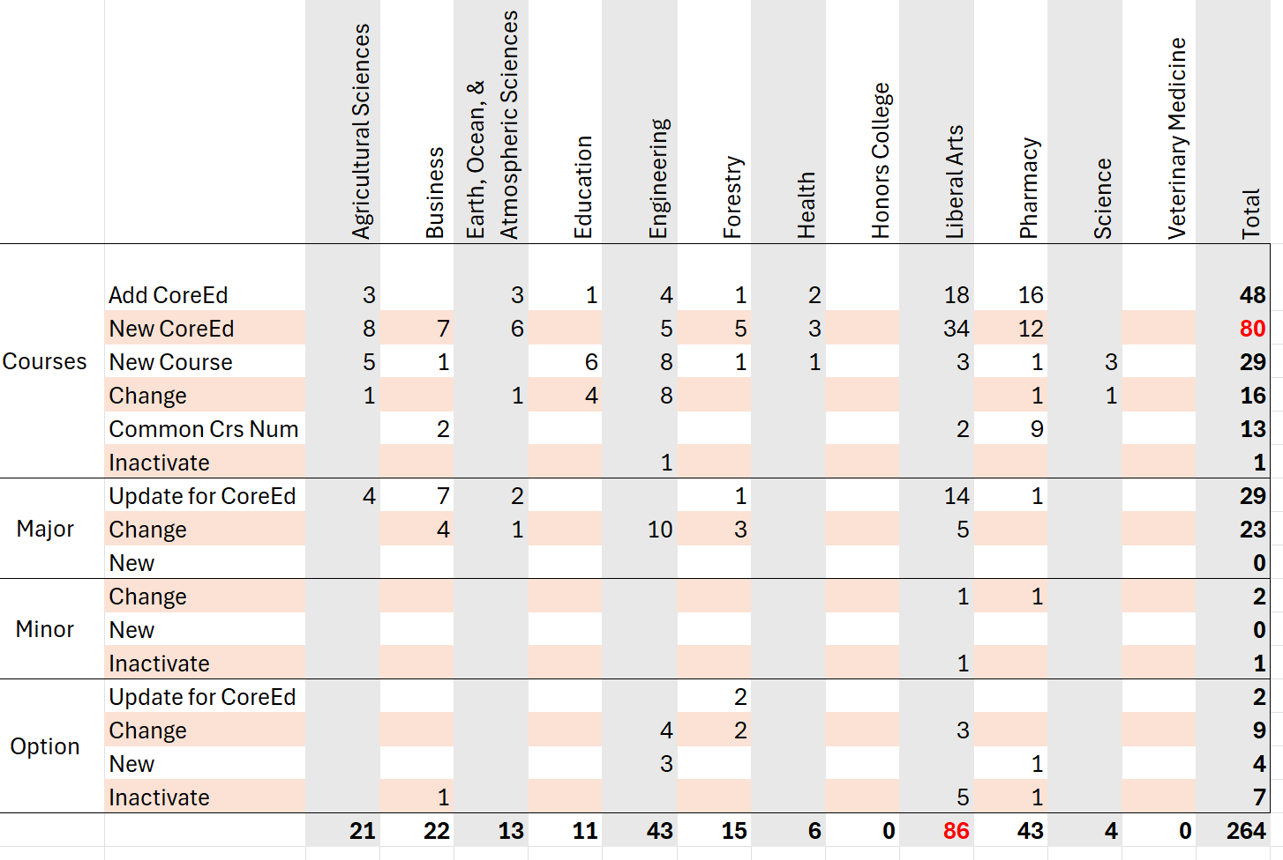
Curriculum Council Proposal Reviews and Approvals since Jan 9th Faculty Senate Meeting

