Slide 1
University Accreditation
OSU holds institutional accreditation through the
Northwest Commission on College and Universities.

Slide 2
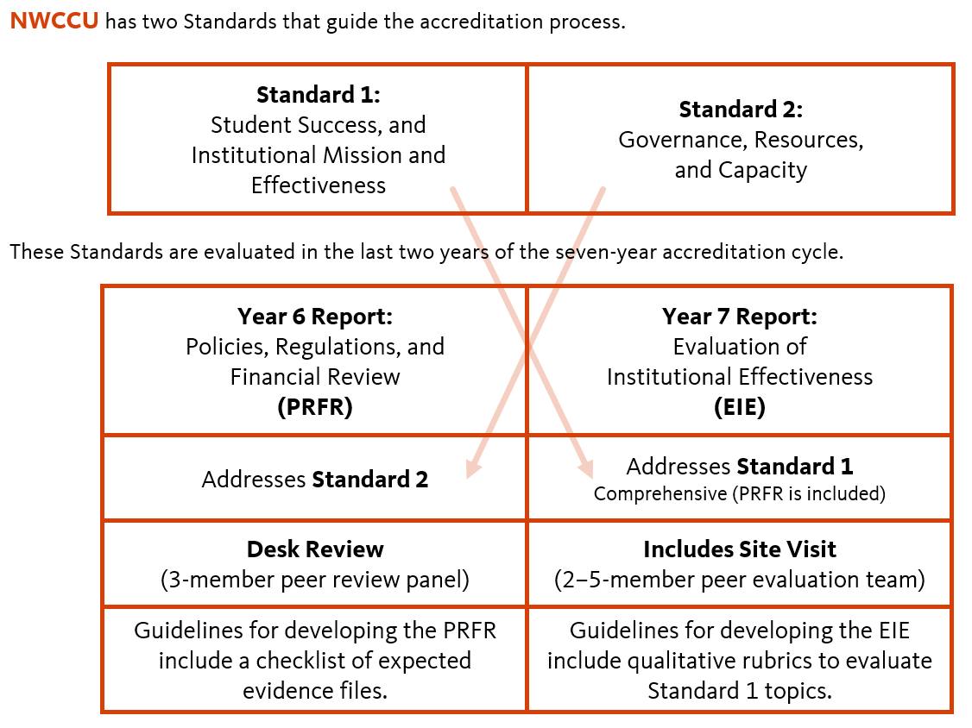

Slide 5
