Slide 1
Administrative Modernization Program
faculty senate Meeting // june 13, 2024

Slide 2
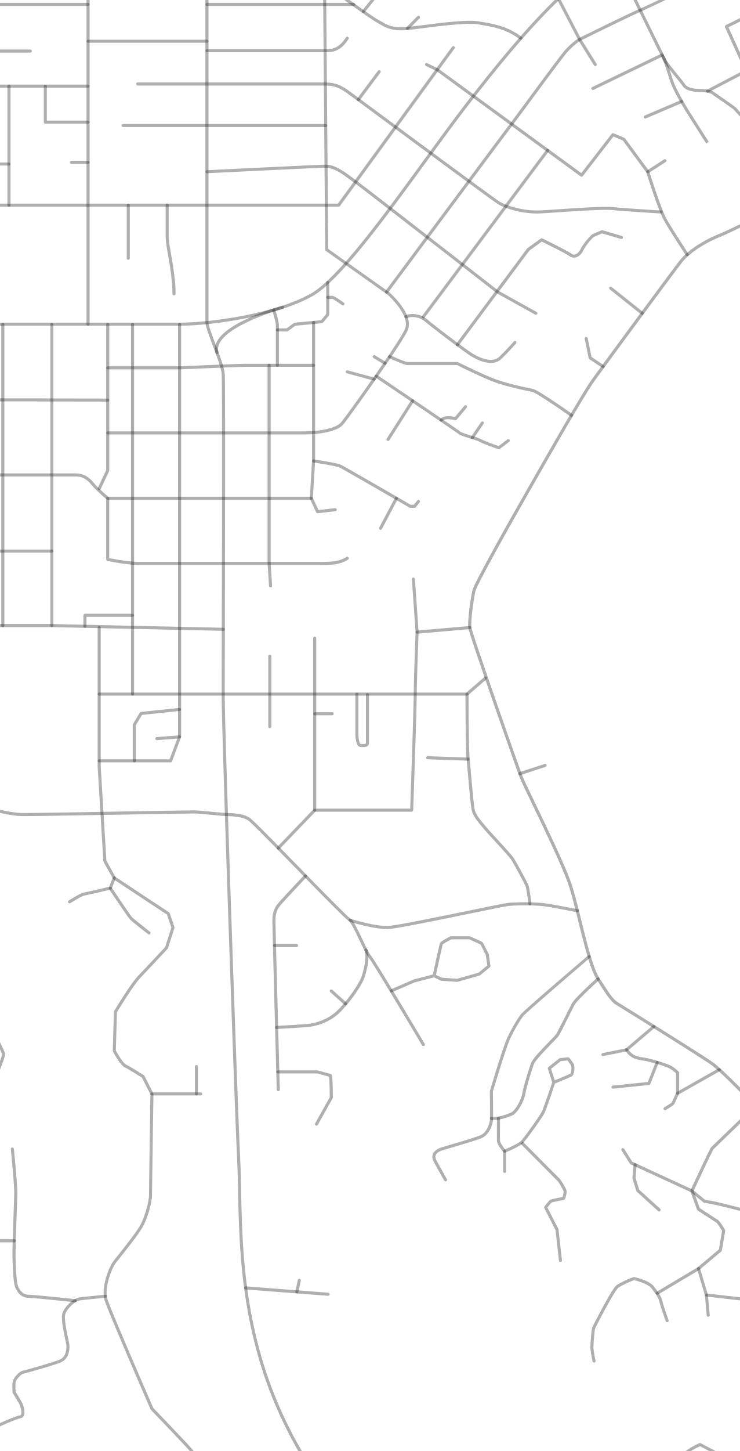
agenda
01 // amp update
02 // organizational change management
03 // amp SCOPE AND budget
04 // questions

Slide 3
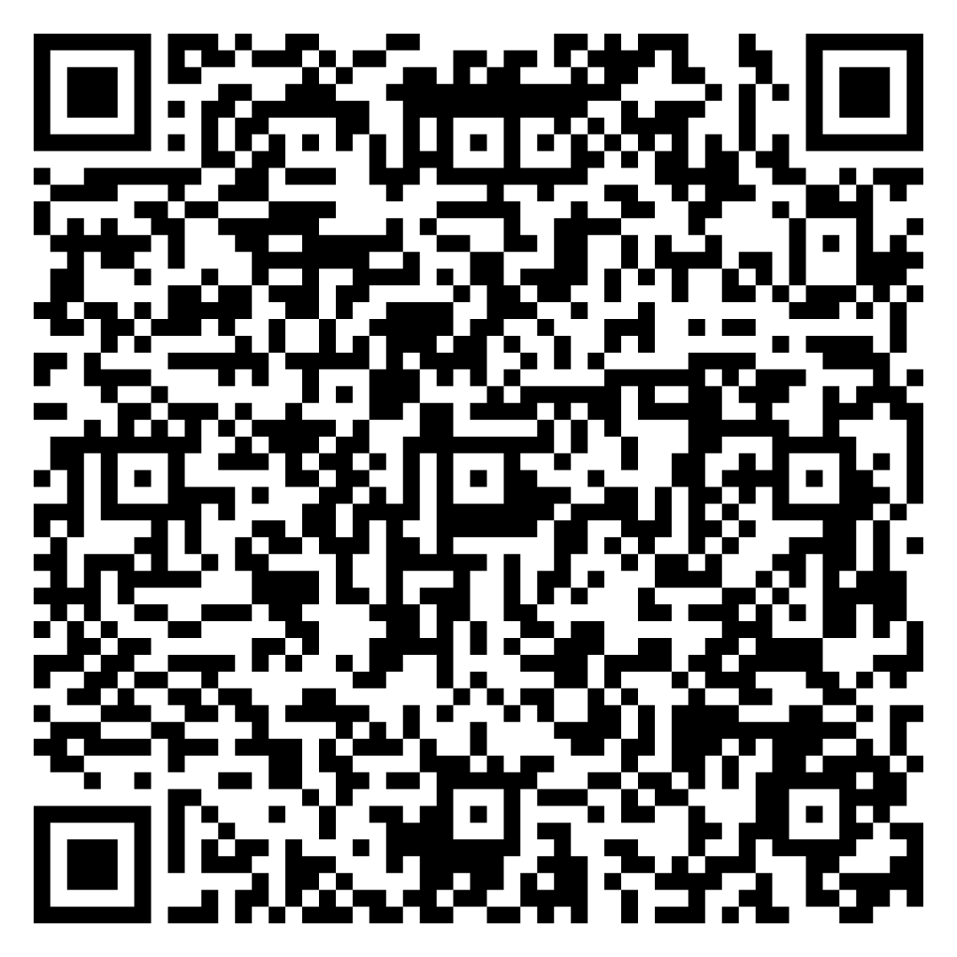
AMP UPDATES
AMP GOVERNANCE
ENGAGEMENT
BUILDING THE AMP TEAM

Slide 5
SCOPE AND BUDGET
SCOPE
EXPECTED COSTS
CONTINGENCY RESERVE

Slide 6
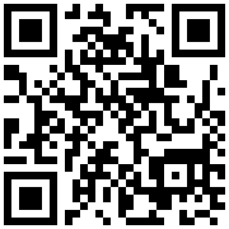
PLEASE ENGAGE WITH US!
AMP SharePoint: https://oregonstateuniversity.sharepoint.com/sites/AMP
AMP Website: amp.oregonstate.edu

