Slide 1
Materials linked from the February 11, 2021 Faculty Senate agenda.
Board of Trustees Report to the Faculty Senate
January 28-29, 2021 Meeting
Mike Bailey
mjb@cs.oregonstate.edu
2021January.pptx

Slide 2
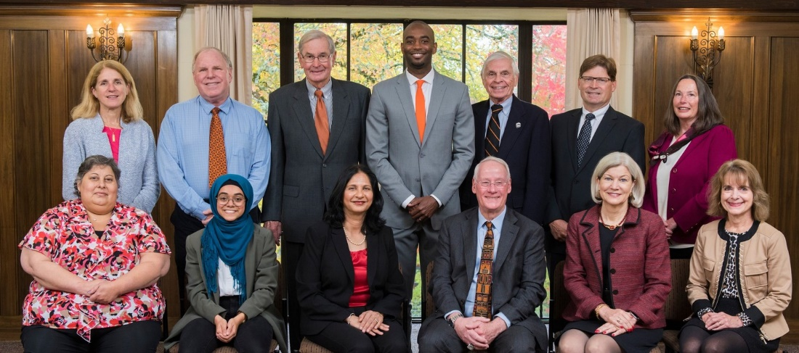
Reminder: I am the Faculty Member on the 15-member OSU Board of Trustees
Missing: Paul Kelly and Preston Pulliams
Another Reminder: I don’t speak for the Board – these are my personal observations

Slide 3
The January Board of Trustees Meetings:
Many public comments, most having to do with the Elliott State Forest acquisition and its relationship to the Common School Fund (CSF) No timber harvesting since 2013
Next round of Covid stimulus expected to provide $25M to OSU
HECC emphasizing student success and student completion in their public university budget
HECC has developed an Adult Learner Toolkit – very interesting
ASOSU reports that waiting time for CAPS appointments is now 3-5 weeks

Slide 4
The January Board of Trustees Meetings:
WQ enrollment is up ~ 1% from last year (although SCH are down ~1.7%)
Enrollment applications for next year are up ~ 44% over a year ago, mostly in non-residents
OSU joining the WUE (Western Undergraduate Exchange) might explain part of it? 160+ public colleges Tuition will be no more than 150% of in-state rate
The Board congratulated Ecampus on their USNWR #4 ranking
10-year financial forecast: OSU maintained its Aa stable rating

Slide 5
The January Board of Trustees Meetings:
Tuition scenarios: Governor’s budget calls for 4% cut in university allocations, don’t know what legislature will do with that Inflation rate assumed to be ~ 2.8% PERS expected to rise ~ 5% Three tuition scenarios: lowest just covers inflation (2.8%) Other two being considered are 3.5% and 4.1% Final recommendation coming to the BOT April meeting
BOT F&A Subcommittee approved Stage Gate 1 (move to design phase) for Reser Stadium renovation Stage Gate 2 will go to the full Board
BOT approved Stage Gate 2 for Arts and Education Complex
BOT approved Stage Gate 2 for Fairbanks Hall
BOT approved Stage Gate 2 for Graf Hall

Slide 6
Thanks!
Board of Trustees Report to the Faculty Senate
Mike Bailey
mjb@cs.oregonstate.edu
Stay Safe, Beavs!

