Slide 1
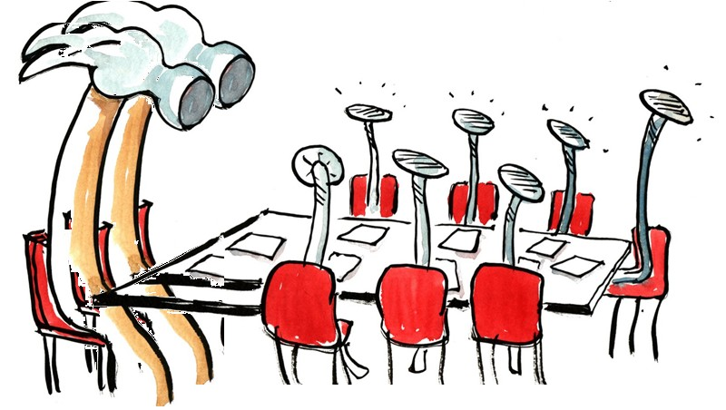
program proposalS for review by Faculty Senate
Materials linked from the November 12, 2020 Faculty Senate webcast.
Dana Sanchez, Curriculum Council
November 12, 2020
Notes:
Must be in Slide Master mode to swap out photos.

Slide 2
Elementary Education Undergraduate major
(BS/HBS) (CIM Key #342)
College of Education
Renames the major to Teaching
Notes:
https://nextcatalog.oregonstate.edu/programadmin/?key=342
Renamed to Teaching Undergraduate Major (BS, HBS); affects Cascades and ECampus majors
This major leads to professional licensure; Name change brings it into alignment with Graduate (Master of Arts – Teaching) program and nationwide disciplinary practice
No changes to course offerings, program requirements, admissions, learning outcomes, or student experiences. Also no changes to advising or advisor availability. Affected faculty have indicated no concerns with the change.
No budget implications beyond time to now make minor updates to the program handbooks and website.
Upon OSU approvals, name change will be taken to Oregon Teacher Standards and Practices commission .
Liaisons: School of Psychological Science, School of Social & Behavioral Health Sciences, College of Public Health & Human Sciences, and College of Liberal Arts
Letter of support from Cascades
REQUIRES FS VOTE

Slide 3
Informational updates:
Option and major updates approved:
General Horticulture Option Key 192
Animal BioHealth/Pre-Professional Option in Animal Science Key 657
English Undergraduate Major (BA/HBA) Key 311
Programs extended to Ecampus:
Education Graduate Major– College of Education Key 353
  Including - Science Education Graduate Option
  Including - Mathematics Education Graduate Option
History Graduate Major Option (History of Science & Technology) Key 717
User Experience Research Minor Key 704
Global Perspectives on War, Peace, and Empire Graduate Option Key 718
Graduate option in General History Community History and Civic Engagement Graduate Option Key 720
Agricultural Sciences and Natural Resources Communications Undergraduate Minor Key 677
Notes:
General Horticulture option:
Changes description to emphasize value of experiential learning
Updates list of courses available to fulfill the Option
incorporation of new Ecampus courses
minimum number of internship credits (3-12 now, was 6-12)
Animal BioHealth/Preprofessional Option in Animal Science
Corrected error in prior proposal (Calculus mistakenly added to option at that time) and updated option to include a required course and allowing choice between two other courses in the option’s area.
Liaised with Animal & Rangeland Sciences
Mathematics
Chemistry
Veterinary biomedical sciences
Veterinary clinical sciences
English Undergraduate Major (BA/HBA)
(CIM Key #311): Changed program requirements:
Greater flexibility in lower-division coursework choices
Incorporates 2 new 300-level courses

