Slide 1
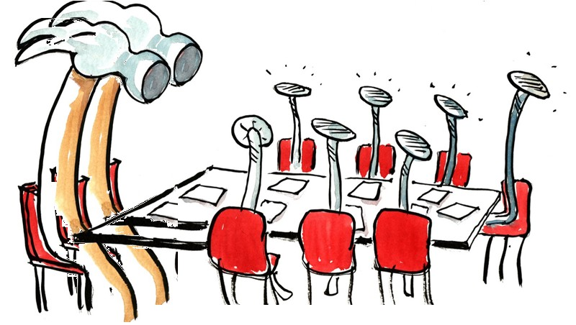
Program proposalS
FOR APPROVAL BY Faculty senate
Eric B. Ianni and Jim Coakley, Curriculum Council
February 8, 2024

Slide 2
Program Changes for FS Approval
Reorganization and Name Change: College of Public Health and Human Sciences
Informational Items
New Policies
  Advertising of New Programs
  Change Liaison timeline in CIM process
New/Changed Academic Programs (Majors/Minors/Options)

Slide 3
Reorganization and Name Change: College of Public Health and Human Sciences
Reviewed and approved by the following Faculty Senate Groups:
  Budgets & Fiscal Planning Committee Feb 23, 2023
  Graduate Council Mar 9, 2023
  Curriculum Council Mar 23, 2023
  Executive Committee Apr 6, 2023
  Faculty Senate Apr 17, 2023
  Approved to send to NWCCU on Apr 17, 2023, but not sent.

Slide 4
Reorganization and Name Change: College of Public Health and Human Sciences
Rolled back on Nov 29, 2023 to change school names
  School of Exercise and Sport Sciences → School of Exercise, Sport, and Health Sciences
  School of Public Health → School of Nutrition and Public Health
Graduate Council Dec 4, 2023
Curriculum Council Jan 18, 2024
Executive Committee Feb 1, 2024
Voting to approve changes to school names

Slide 5
Informational Item: Policy Change
Timing of Advertisement for New Programs Policy
  URL: Advertising - Timing of Advertisement for New Programs Policy | Curriculum Management/Assessment and Accreditation | Oregon State University
  Old policy allowed advertising of new majors once approved by Faculty Senate
  Policy was in violation of NWCCU guidelines
  New policy restricts advertising of new majors until after approval by NWCCU
    New majors can be advertised as "Submitted to NWCCU for review” after they are approved by Faculty Senate
  Policy for advertising minors, options, certificates did not change
    After Faculty Senate approval

Slide 6
Informational Item: Policy Change
Liaison Process with CIM
  URL: Liaison | Curriculum Management/Assessment and Accreditation | Oregon State University
  Old policy allowed two weeks for liaison with academic units across campus
    Proposal cannot advance until after two-week period even if all liaison units respond
  Goal is to reduce time required to approve academic proposals
    Reduced liaison timeline to one week
  Reviewer, Graduate Council, Curriculum Council and Executive Committee all have authority to request additional reviews and require originator response before advancing in CIM

Slide 7
Information Items - Academic Programs
Change Undergraduate Major
414 -- Environmental Sciences Undergraduate Major (BS, HBS)
Adds courses to requirements and electives
Change Undergraduate Options
376 -- Merchandising Management Option
Program Inactivation -- replace with minor
407 -- Environmental Agriculture Option
Add AG 311 as elective to align credits with other options
412 -- Applied Ecology Option
Add courses available for categories in option, remove discontinued course
746 -- Elementary Education Option
Change program requirements to align Corvallis and Cascades campuses
Course Approvals
New courses: 4
Changes to courses: 22
Common Course Numbering: 4

