Slide 1
COVID-19 Planning
Vaccine distribution support
Update to Faculty Senate, February 11, 2021
Notes:
Must be in Slide Master mode to swap out photos.

Slide 2
Presenters
Dan Larson, Vice Provost for Student Affairs and
OSU Coronavirus Response Coordinator
Jenny Haubenreiser, Associate Vice Provost for Health & Well Being and Executive Director, Student Health Services
Anita Azarenko, Interim Vice Provost for Extension & Engagement and chair, OSU Vaccine-Vaccination Workgroup

Slide 3
Agenda
General Overview of OHA Vaccine Distribution Sequencing
OSU/Higher Education Community – placement in sequence
OSU Support of Regional Clinics
OSU Statewide Support
Frequently Asked Questions and Resources

Slide 4
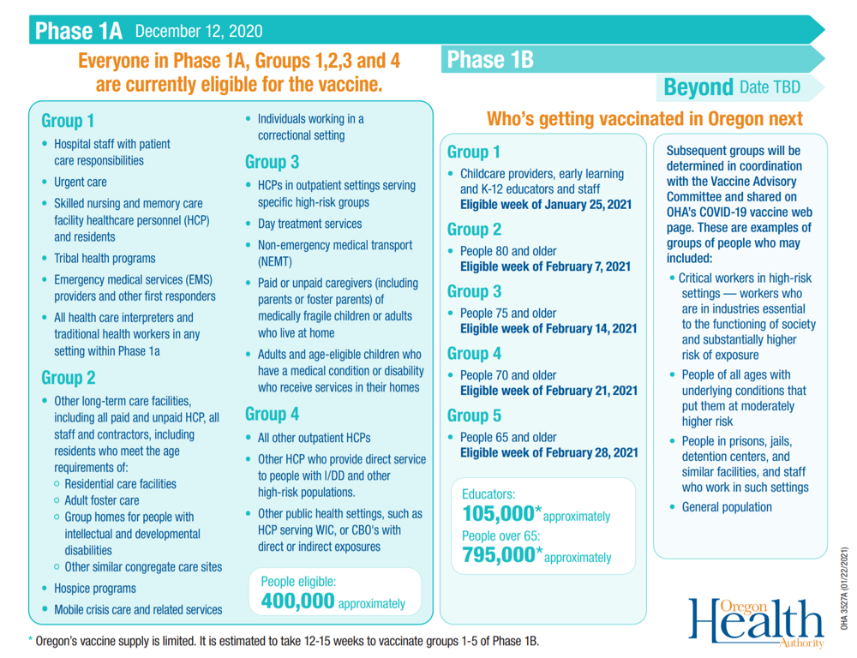
General overview of OHA vaccine distribution sequencing
In Process
Healthcare Providers
Emergency Responders
Childcare & Early Learning
K-12 Educators and Staff
Next Up (February)
People 65 and up (in sequence)
Then…(TBD)
Critical Workers and People with Underlying Conditions
Link

Slide 5
OSU/higher education community – placement in sequence
Key points
OSU does not have the discretion or authority to determine eligibility for faculty, staff and students. OHA, with the guidance from the Vaccine Advisory Committee, is in the process of adding more detail to OHA’s phased sequencing priorities to ensure access is equitable, including access for those in greatest need to be prioritized.
Vaccination status does not determine ability to return to onsite activity.
OSU community members are eligible based on OHA eligibility criteria, not on university affiliation.
OSU supports an equity-based distribution approach.

Slide 6
OSU/higher education community – placement in sequence
Defining critical workers
Statewide effort in defining critical for the purposes of anticipating demand.
Public, Private and Community College will submit counts and work with their counties on communication.
General Definition: Employees, including student employees, required to keep the essential systems running and their job required them to be on-site for current operations.

Slide 7
OSU support of regional clinics
OHA Distribution Approach
  Regional
  Each county is unique
  OSU is support – not lead
Benton/Linn/Lincoln Plan
  Samaritan Health Services is lead agency
  Linn County Fair Grounds
  Reser Stadium
Deschutes County and OSU-Cascades
Extension Support

Slide 8
OSU vaccine-vaccination workgroup
VV Workgroup and CMT
Outreach/ education (statewide)
Vaccination (campuses)
Vaccination
(statewide)
Outreach/ education (campuses)
Purpose: Coordinated university approach to assist in state/regional plans and community education, and to effectively manage operations within the university

Slide 9
OSU statewide support
Outreach - Access
Outreach - Safety/efficacy
On-site assistance
Follow OHA and
County Health Authority lead in all aspects of distribution.

Slide 10
OSU statewide support
Extension
Assess and address local needs/gaps with community partners
Share credible, trusted information with the public
Create and modify toolkits/resources for OSU employees
Provide indirect/logistics support
College of Pharmacy
Vaccinations by clinical students
Support 211 call center
Notes:
The Family and Community Health program within the Extension Service and the College of Public Health and Human Sciences will be leading the statewide OSU effort for state and campus-level messaging for vaccine readiness and in support of on-going public health measures.
In the College of Pharmacy: students are supporting the vaccination effort; students will be assisting with the 211 call service that will answer questions related to vaccine and vaccinations.

Slide 11
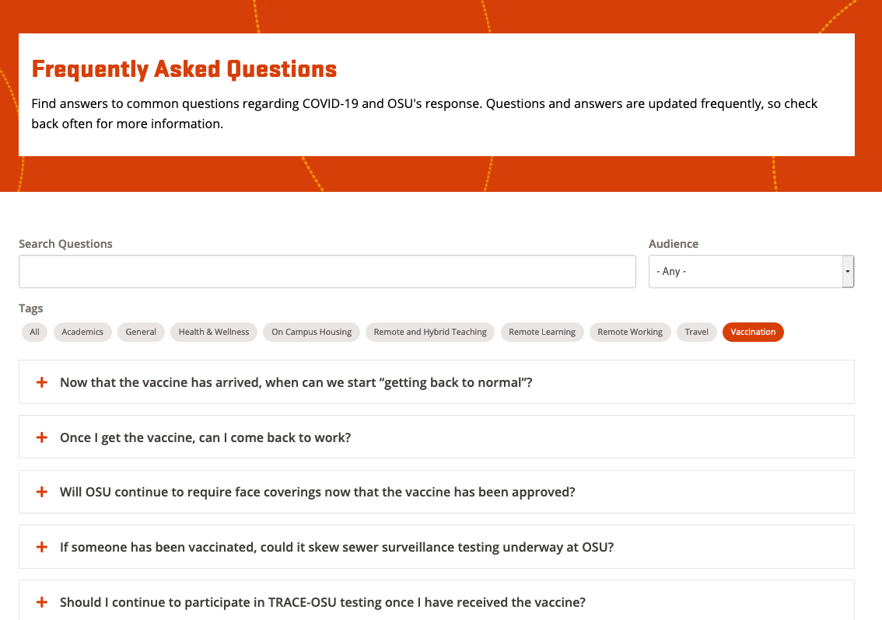
FAQs and resources
Will there be a requirement?
Can I implement a requirement in my workspace/unit/lab?
Other
See OSU COVID-19 Safety & Success FAQs

Slide 12
Questions?

