Slide 1
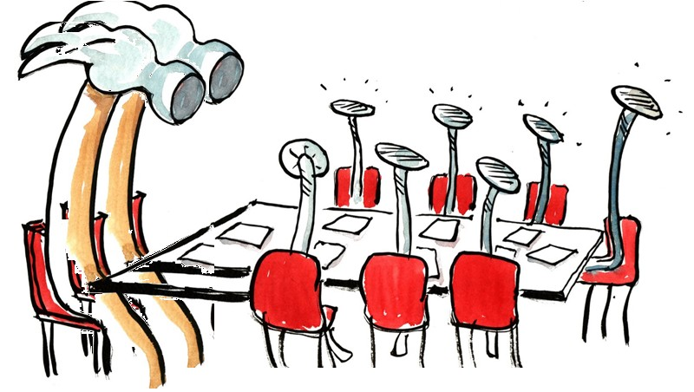
program proposalS
FOR APPROVAL BY Faculty senate
Eric B. Ianni and Jim Coakley, Curriculum Council Co-chairs
Presented by Kate MacTavish, Faculty Senate President
November 9, 2023

Slide 2
Program Changes for FS Review
Engineering Management Graduate Certificate – College of Engineering
Engineering Management Graduate Major – College of Engineering
Public Policy Analysis Graduate Certificate – College of Liberal Arts
Approved by the following Faculty Senate Groups:
Budgets & Fiscal Planning Committee
Graduate Council
Curriculum Council
Executive Committee

Slide 3
Engineering Management Graduate Certificate
CIM Key #257 – Reorganize Program
Move the Engineering Management Certificate from Mechanical, Industrial & Manufacturing Engineering to Civil and Construction Engineering (CCE).
Align the required courses with the proposed Master of Engineering in Engineering Management (currently in CIM).

Slide 4
Engineering Management Graduate Major
CIM Key #711 – Reorganize Program
Separate the degree from Industrial Engineering to create a stand-alone Engineering Management degree.
House the new degree in Civil and Construction Engineering (CCE).

Slide 5
Public Policy Analysis Graduate Certificate
CIM Key #827 – New Program Proposal
Interdisciplinary focus on sociology, economics, political science, and public policy to provide students with a comprehensive understanding of policy analysis

Slide 6
Information Items — Undergraduate Proposals
New Undergraduate Minor
Latinx/a/o Studies Minor
Change Undergraduate Minor
238 Materials Science Minor
Change Undergraduate Major
790 Food Science and Sustainable Technologies Undergraduate Major (BS, HBS)
233 Mechanical Engineering Undergraduate Major (BS, HBS) (expand to Cascades)
Change Undergraduate Option
410 Chemistry and the Environment Option
Change Undergraduate Certificate
751 Design for Social Impact Certificate
Undergraduate Courses
Changes: 15
New: 3
Inactivation: 12
Reactivation: 6

Slide 7
Information Items — Graduate Proposals
Change Graduate Major
Electrical and Computer Engineering Graduate Major (MEng, MS, PhD)
280 Computer Science Graduate Major (MEng, MS, PhD)
329 Bioengineering Graduate Major (MEng, MS, PhD)
267 Creative Writing Graduate Major (MFA)
Change Graduate Minor
281 Computer Science Graduate Minor
458 Epidemiology Graduate Minor
Suspend Graduate Option
324 Physical Activity Graduate Option
Graduate Courses
Changes: 4
New: 4
New slash courses: 4
Inactivation: 3

