Slide 1
Paul Doescher
Remembering
Father, Husband, Scholar, Teacher, Mentor, Researcher
2009 Faculty Senate President
June 3, 1953-August 2, 2017

Slide 4
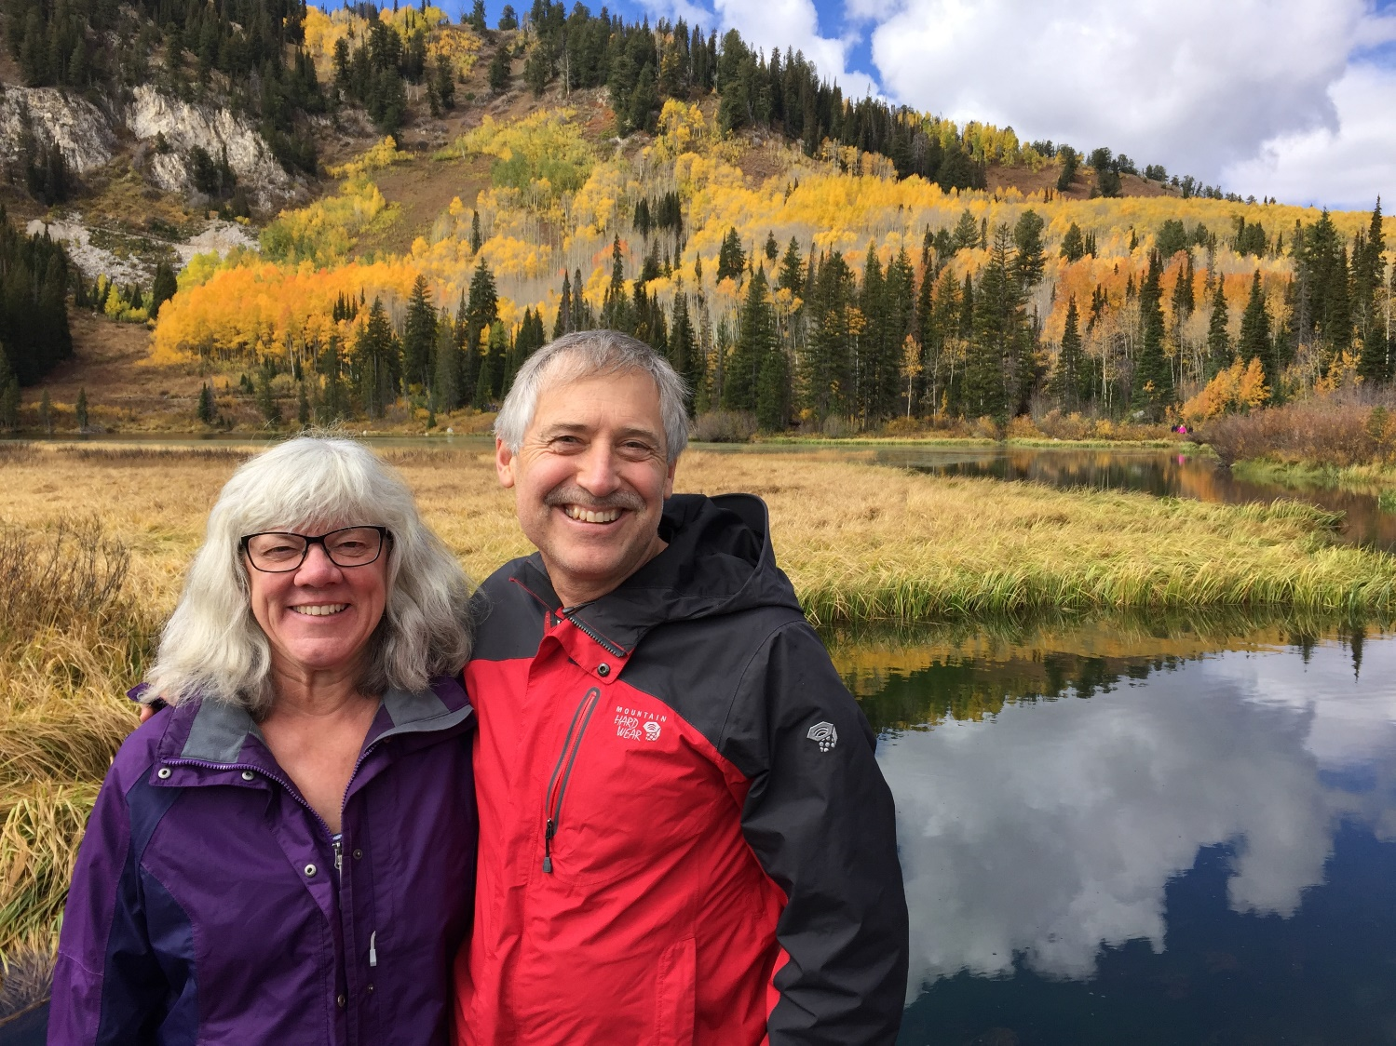

Slide 7
