Slide 1
Don Horneck
Remembering
Father, Husband & OSU Extension Agronomist
February 28, 1958-September 28, 2014

Slide 2
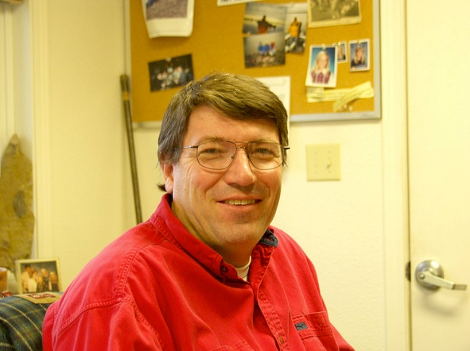

Slide 3
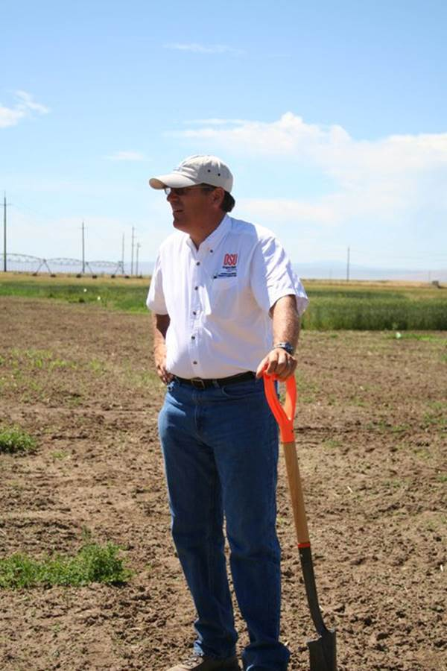

Slide 4
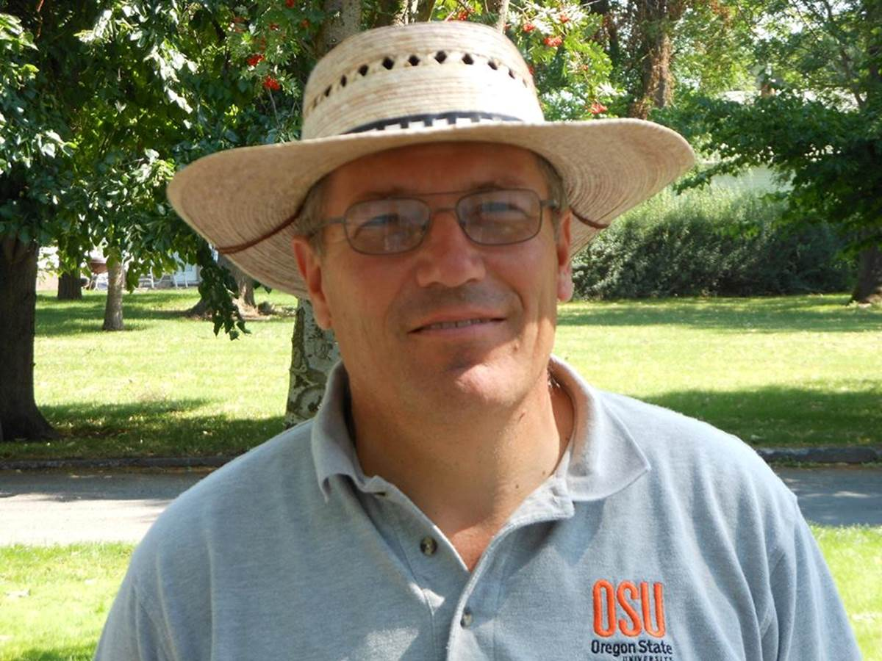

Slide 5
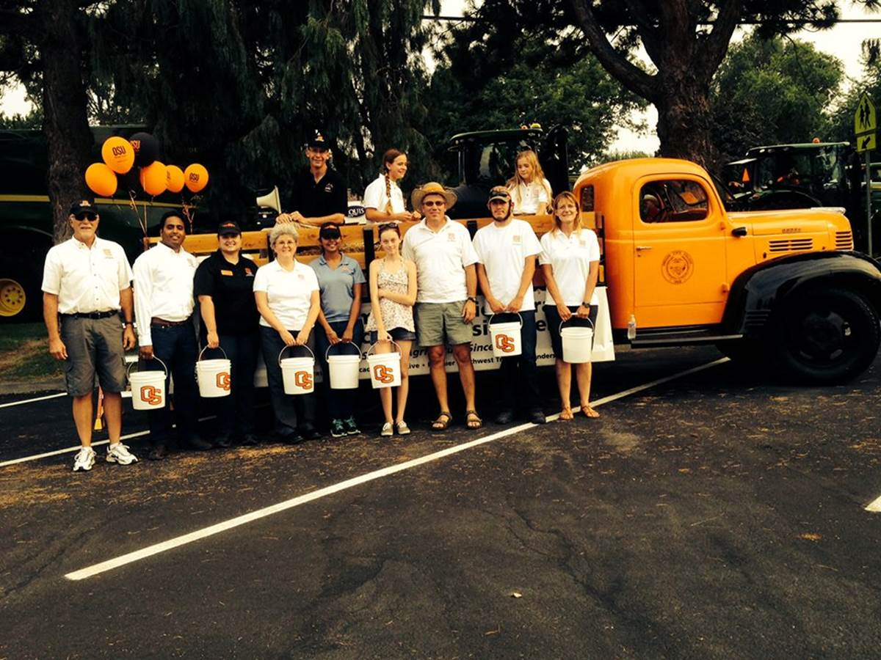

Slide 6
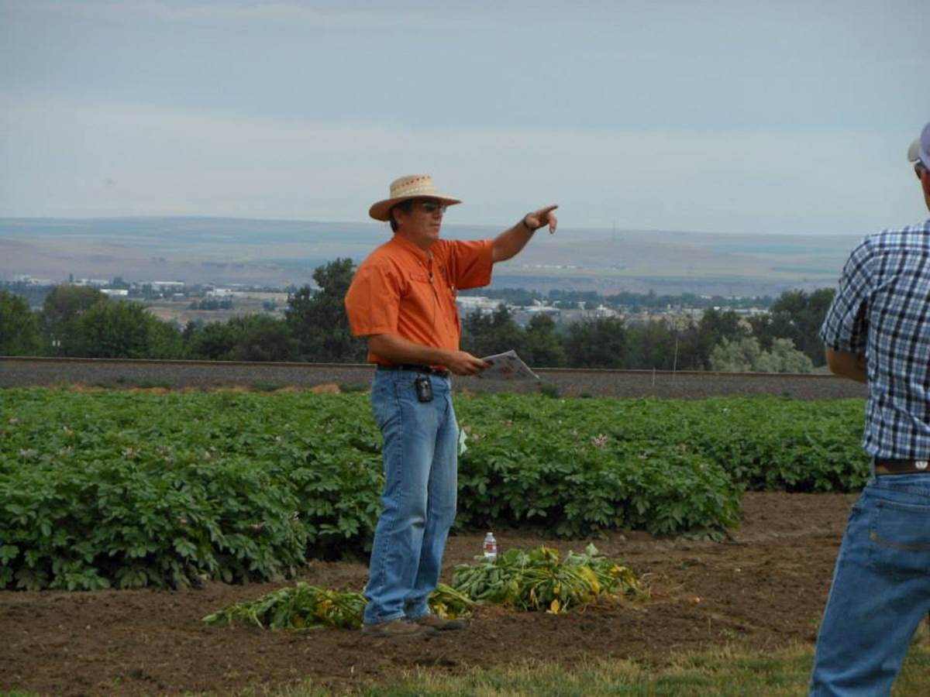

Slide 7
