Slide 1
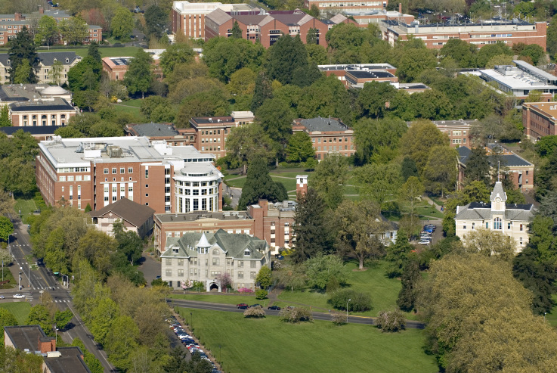
EmpCenter Timesheet Entry Overview

Slide 2
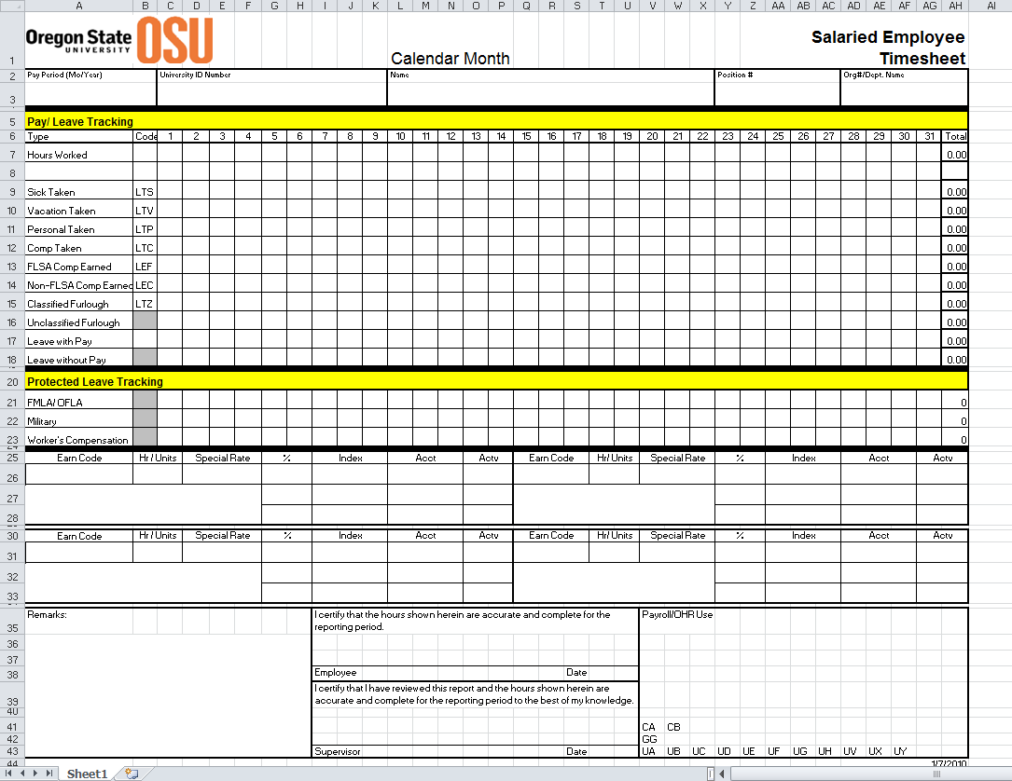

Slide 3
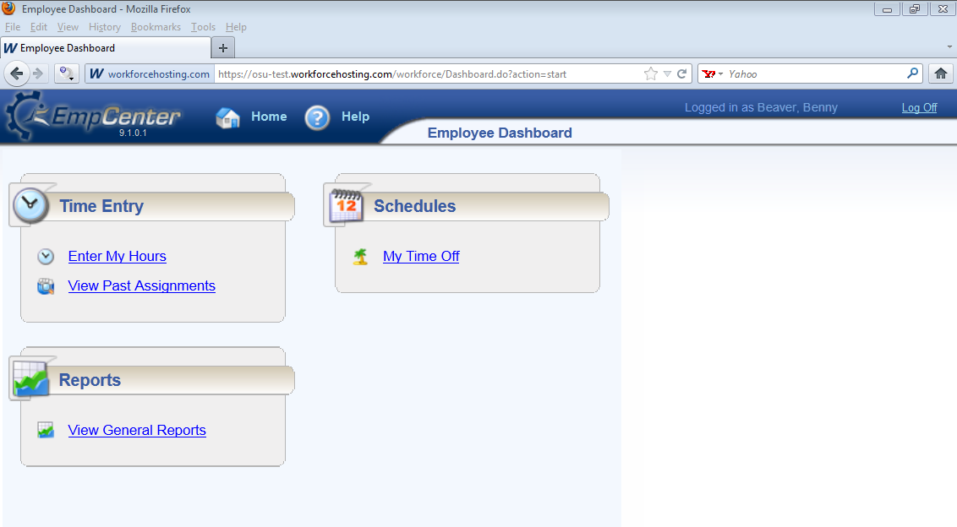

Slide 4
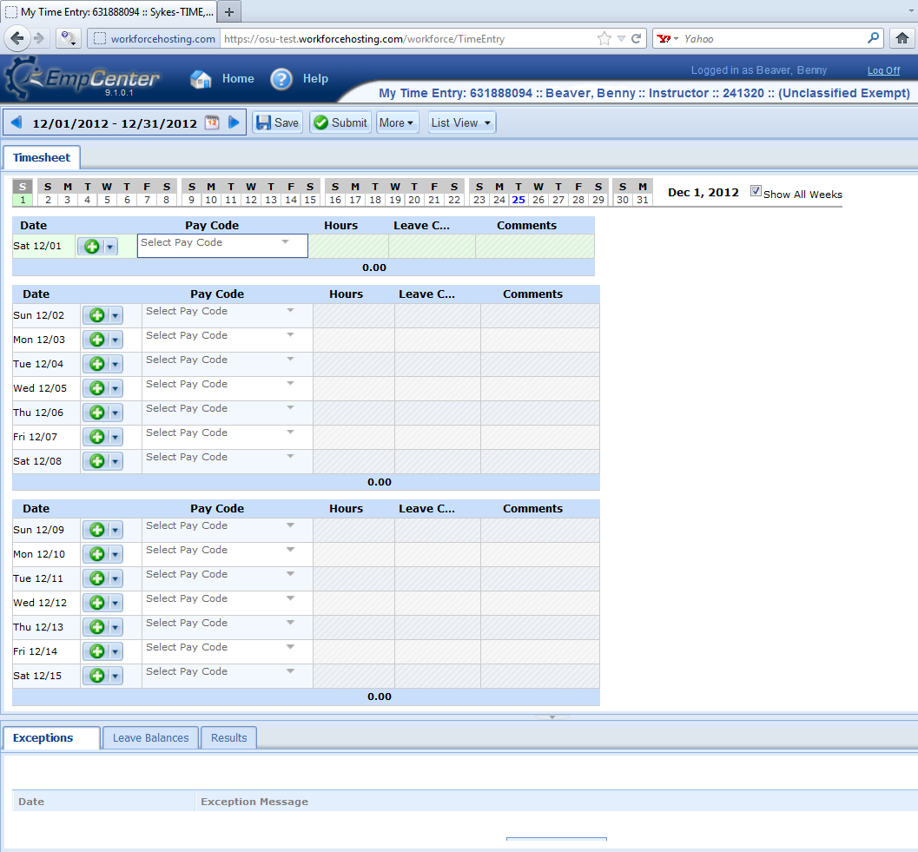

Slide 5
Training and Resources
Online
Located on the Time and Attendance Software Project website:
http://oregonstate.edu/fa/time-attendance/trainings
Open Labs
Barnard Classroom in the Valley Library:
Dates and Times TBA – will be on the Project website as well.

