Slide 1
New Senator Orientation
Faculty Senate 101
Kate MacTavish, Faculty Senate President

Slide 2
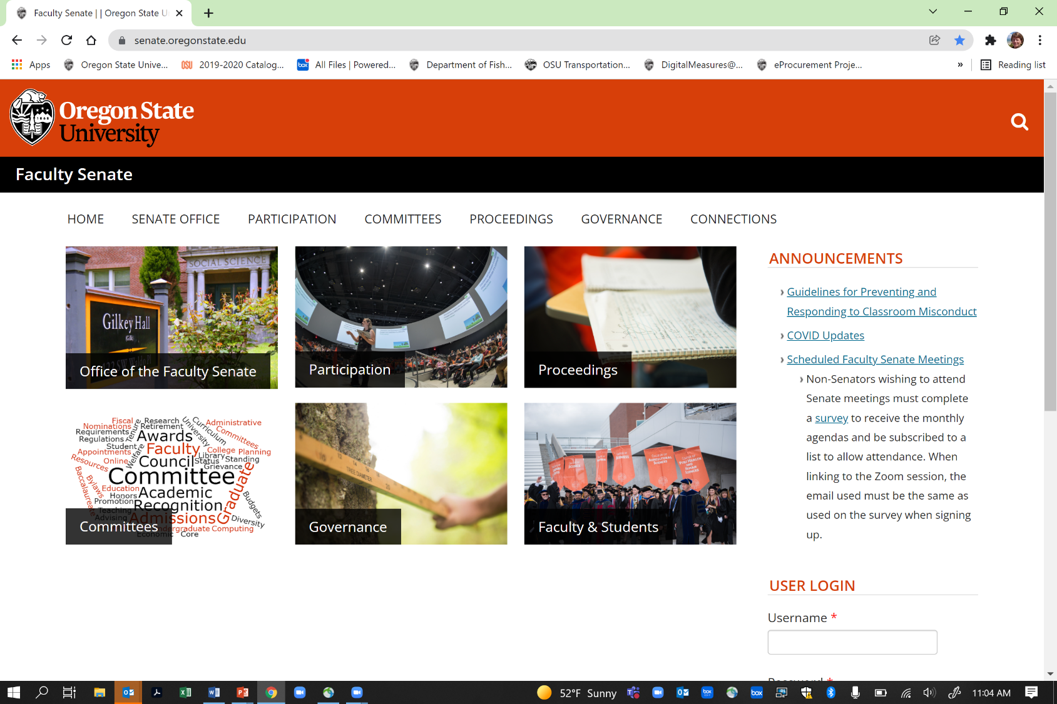

Slide 3
OSU Faculty Senate – who we are and what we do
Represent ~4800 faculty across the state
Our primary purview = curriculum and teaching, but our collective knowledge and needs can (and do) inform a wide range of processes and policies at the University
Valued partner in Shared Governance
  Shared governance ≠ shared decision-making, but does mean that Administration seeks our input, weighs it carefully, and reports back to us on their final decisions
  Primary purview = academics
  Work extensively with Office of Academic Affairs, Office of Faculty Affairs
Strong Senate = seat at many tables = opportunities for faculty input

Slide 4
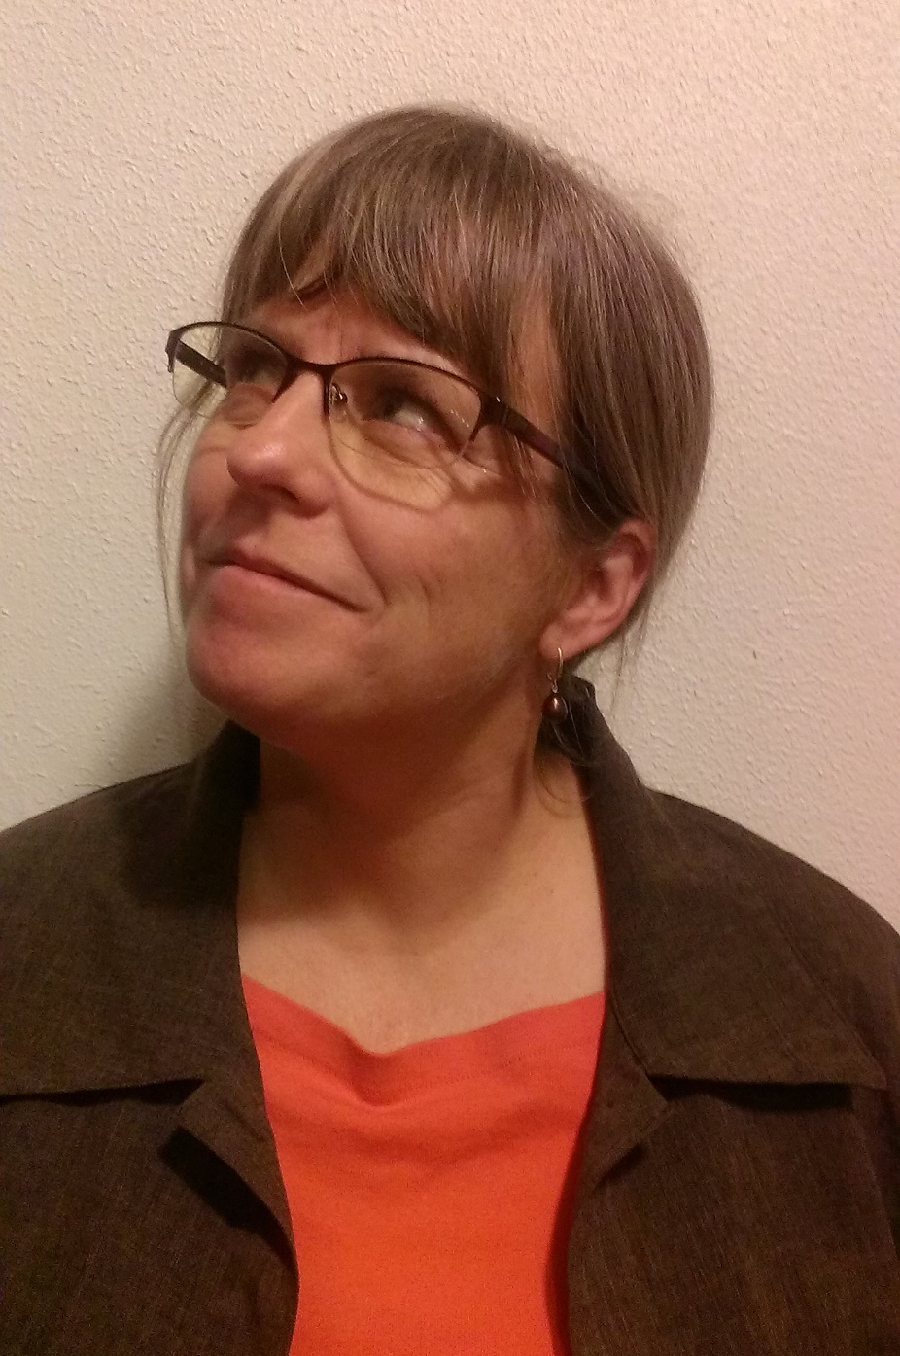
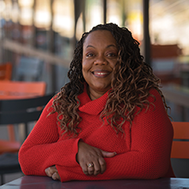
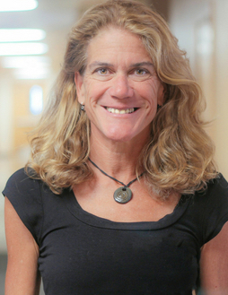
Senate Leadership – 2023
Selina Heppell, Past President Erika McCalpine, President Kate MacTavish, President-Elect
CAS OSU-Cascades, COB CPHHS

Slide 5
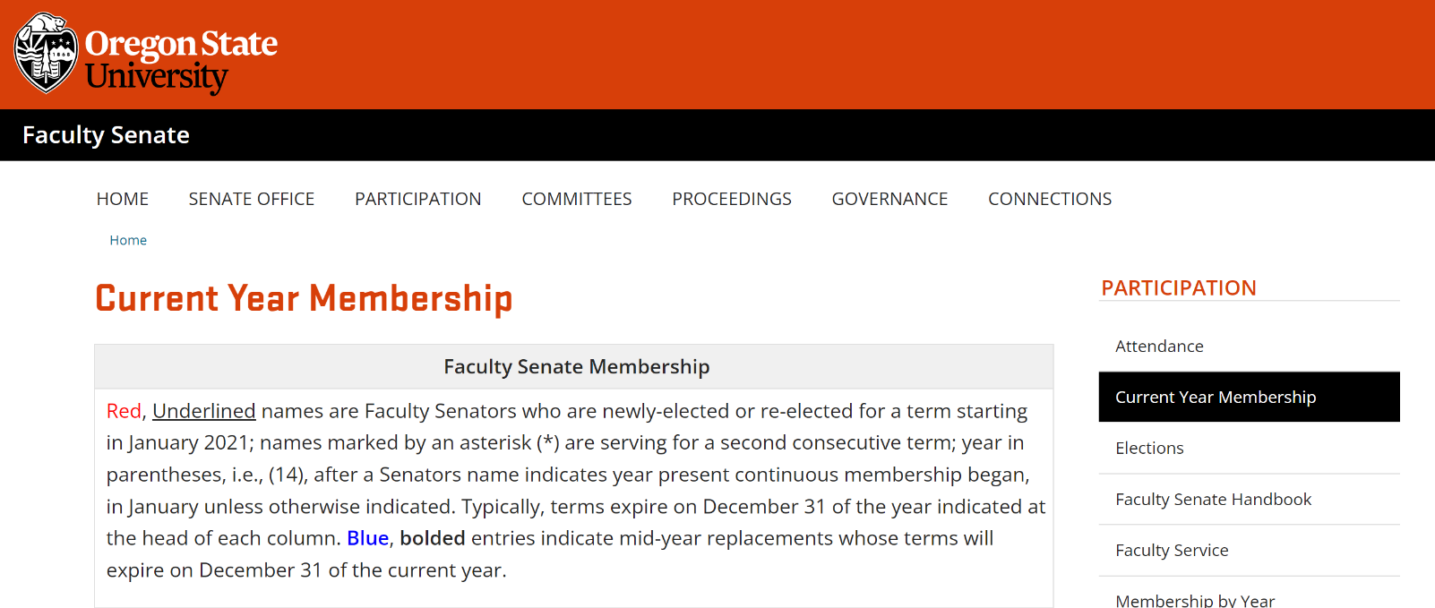
https://senate.oregonstate.edu/current-year-membership

Slide 6
How did you get here?
To facilitate equal access, ALL eligible faculty are potential Senators and are on the nomination ballot
Email sent out to provide opportunity to decline nomination, declare your apportionment unit if you have a split appointment, or move to a different unit, if appropriate
Nomination ballot sent to all faculty, by apportionment unit
Faculty are put on the election ballot based on nomination votes received, with at least twice as many on the ballot as are needed to fill vacancies
Ballots sent, tie breakers facilitated, as needed
If an elected Senator declines, goes on sabbatical, or has to leave, the next individual receiving votes is contacted to take their place

Slide 7
Your Role as a Faculty Senator
You represent your Apportionment Unit, which includes every academic College.
Meeting attendance is expected. If you can’t make it, you can appoint a proxy but you must contact the Senate Office to let us know (and for that person to get access to the Canvas site for voting).
You should be in touch with your constituents
  Talk with other Senators from your apportionment unit and/or your unit leadership about ways to do this.
Engagement is key!

Slide 8
Faculty Senate Meetings
Usually the second Thursday of each month during the academic year, 3-5pm
Information is posted on Canvas
Action Items = vote. Usually first agenda items, after opening remarks from the Senate President
  Curriculum proposals
  Changes to bylaws or standing rules
  Motions, referendums, etc. – usually discussed at prior meeting(s)
Special Reports
New Business

Slide 9
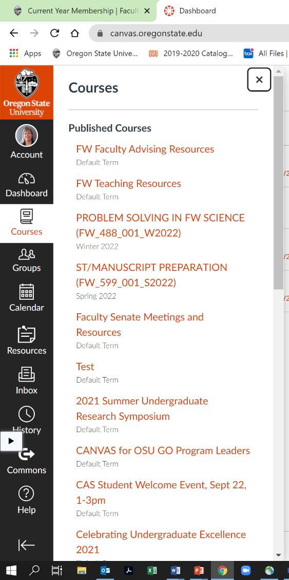
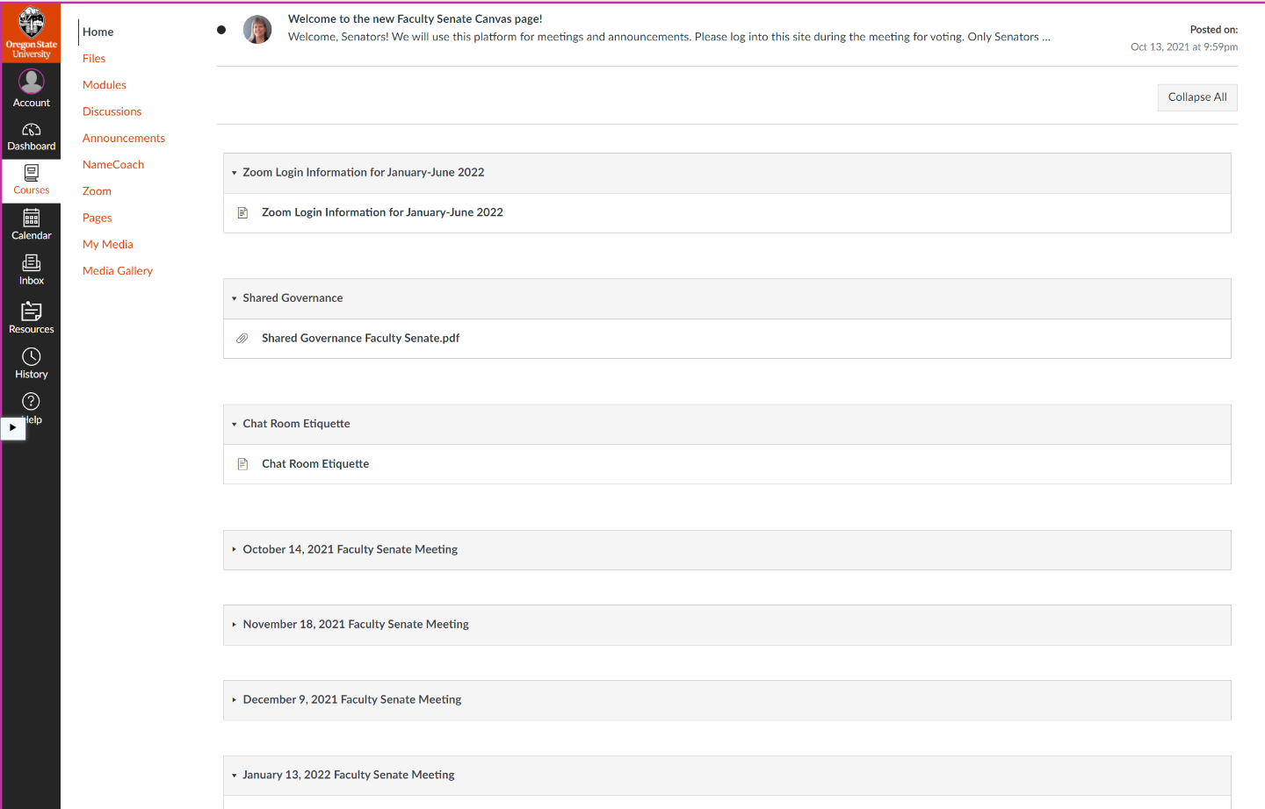
Using Canvas

Slide 10
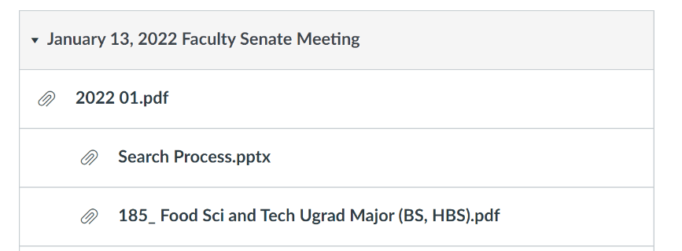
Using Canvas
Meeting information will include agenda, slide presentation(s), links, and relevant documents.

Slide 11
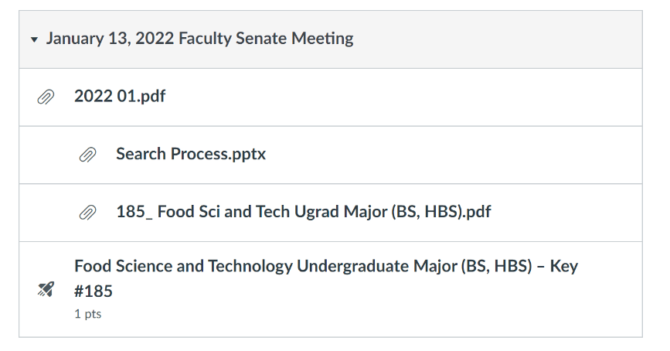
Voting in Canvas
When it is time to vote, REFRESH your browser and a “quiz” link will appear

Slide 12
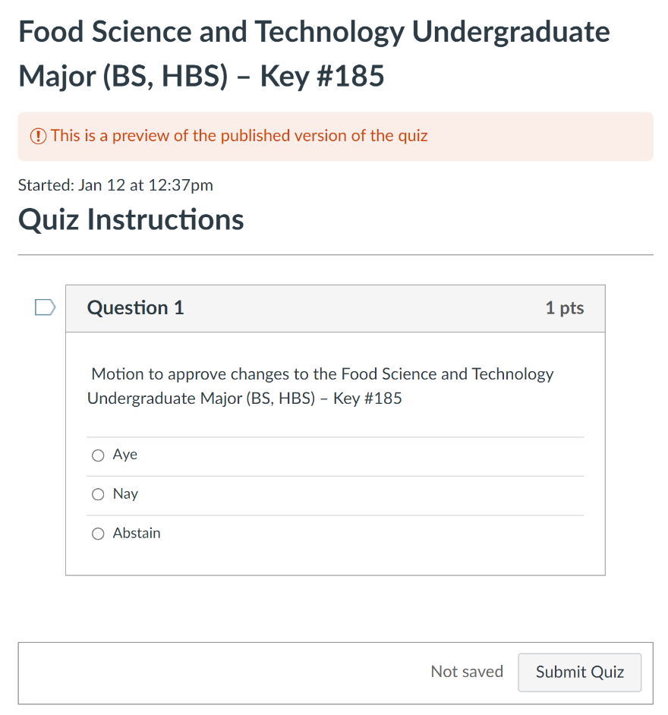
Voting in Canvas
Vote and click “submit quiz”
If you have any issues and cannot vote, email your vote to Vickie.Nunnemaker@oregonstate.edu or Caitlin.Calascibetta@oregonstate.edu
Votes at the meeting are NOT final until they’ve been checked (only Senators or their proxies can vote) and late votes are tallied
Final results are posted on the website and in the Senate Newsletter

Slide 13
Curriculum Review and Voting
Senate approves Program Proposals after review and approval by the Faculty Senate Curriculum Council
  Curriculum Council, Baccalaureate Core Committee, and/or Graduate Council review course proposals as well
Many steps, many committees, much discussion before proposals get to the Senate floor
  BUT don’t think of these votes as “rubber stamp”. Senate = last opportunity to ask questions, and not all proposals pass.
  Review proposals in advance via Canvas links
Executive Committee (EC) reviews and approves, meets with presenters

Slide 14
Motions from the floor
During discussions on Action Items, Senators can offer amendments to Motions or additional motions
New Business issues that may result in motions or resolutions should be sent to the Senate Office in advance to facilitate review and discussion
  This improves understanding of the motion by Senators and ensures proper recording

Slide 15
Chat on Zoom
New info at the end of your agenda, posted on Senate website
Chat record is saved as part of public record of this meeting, visible to all Senators and Guests online
If you have a question or comment for the speaker, please raise your hand. If you cannot ask the question yourself, it is OK to post in chat for an EC member to read
Public chats should be reserved for information pertinent to the discussion on the floor and, of course, should always be respectful
Private chats are not part of the public record and are not visible. But please share if you have a question or comment!
Concerns can always be sent directly to the Senate office

Slide 16
Committees
Interinstitutional Faculty Senate
Executive Committee
Faculty Senate Standing and Ad Hoc Committees

Slide 17

An Overview of the Interinstitutional Faculty Senate
Members of the Interinstitutional Faculty Senate (IFS) are made up of elected Senator representatives from each of the eight Oregon public institutions. The Faculty Senate Bylaws state:
Interinstitutional Faculty Senators shall be responsible for seeking opinions of
the OSU Faculty and the OSU Faculty Senate as a body.
OSU IFS representatives are elected to three-year terms in a university-wide election each fall, and are ex-officio, voting members, of the OSU Faculty Senate. The senior IFS Senator is also a member of the Faculty Senate Executive Committee.

Slide 18
Interinstitutional Faculty Senate Membership
Oregon State University (3 representatives)
JoAnne Bunnage
Gloria Crisp(newly elected)
John Edwards (senior IFS representative)
Eastern Oregon University (2 representatives)
Oregon Health & Science University (3 representatives)
Oregon Institute of Technology (3 representatives)
Portland State University (3 representatives)
Southern Oregon University (2 representatives)
University of Oregon (3 representatives)
Western Oregon University (2 representatives)

Slide 19
Interinstitutional Faculty Senate Typical Activities
Group Meets on average once every two months.
During meetings there are guests from the Higher Education Coordinating Commission, Ben Cannon and State Legislators such as Senator Dembrow.
A majority of our conversations have focused on COVID protocols and procedures among the institutions. OSU has been a leader in these conversations.

Slide 20
Interinstitutional Faculty Senate Duties
The IFS has come to be a main body that connects all the campuses – this has replaced the OUS role.
The IFS President spends time in Salem when the legislature is in session and provides testimony (represents faculty).
A member of the IFS is also on the state-wide Provost’s Council, and they report back to the IFS.
The IFS President meets with the Higher Education Coordinating Commission (HECC) on a regular basis.
The IFS members keep the communication going between the bigger and smaller institutions.

Slide 21
Interinstitutional Faculty Senate Issues
COVID-19 safety protocols
There is an advising problem for students in college. Poor information about transferable credits to universities.
Cost for textbooks for students. Open-Source Textbooks being developed for adoption.
Various Oregon universities moving into Portland metro area to offer programs.
House Bill 2998, a bill designed to streamline transfer between Oregon’s community colleges and public universities.
Campus safety issues – Policing and gun policies. Sexual violence survivor and support issues across all campuses. Mental health issues on all campuses.
Senate Bill 233 Common Course Numbering System in the State of Oregon between all Oregon Public Institutions.

Slide 22

Thanks for Listening
McKenzie Huber
Director of the Baccalaureate Core
Mckenzie.huber@oregonstate.edu

Slide 23
Key Functions of the Executive Committee (EC)
Who serves on the EC?
Voting members:
Six faculty members. Three are elected each year from current Senators, for a term of service of two years.
One member representing OSU-Cascades faculty.
The Senate president, immediate past president, and president-elect.
OSU’s senior Interinstitutional Faculty Senator.
Non-voting member:
Provost and Executive Vice President, or designee
The EC meets weekly during the academic year.

Slide 24
Key Functions of the Executive Committee (EC)
What role does the EC Play?
The EC sets the agenda for Faculty Senate meetings and brings action items to the floor of the Faculty Senate for debate.
The EC guides curricular actions (which are the purview of the faculty).
Frequently, the EC will request attendance at meetings of various individuals on campus who might contribute to the understanding of a particular problem or concern on campus.
The EC works on many important issues in the operation of the university and advises the university administration on topics such as curriculum, budget, hiring, restructuring, and athletics.
The EC supports and has oversight of the committees and councils under Faculty Senate jurisdiction. Each of the 24 Faculty Senate committees has an EC member who serves as a liaison.
Members of the EC facilitate Small Group Sessions with the OSU President. These small groups are self-selected, or may be individuals from a specific group.

Slide 25
Key Functions of the Executive Committee (EC)
Why is the EC important?
The EC serves as the interface between the faculty of OSU, Faculty Senate, and the administration of the university.
The EC fosters interactions with upper administration that truly embraces shared governance and the opportunity to provide faculty perspectives.
The EC fosters debate on and facilitates solutions, in coordination with the Office of Academic Affairs, related to important academic issues such as Baccalaureate Core revision and student evaluations of teaching. The EC also works with the Office of Faculty Affairs on issues regarding Promotion and Tenure and academic freedom.
The EC helps draft university policy and is often called on by senior administration to be part of the decision-making process.
The EC is the highest university body to which a faculty member can ask to review their tenure and promotion process at the department or college level.
The EC adopts a university-wide advocacy role.

Slide 26

Thanks for Listening

Slide 27
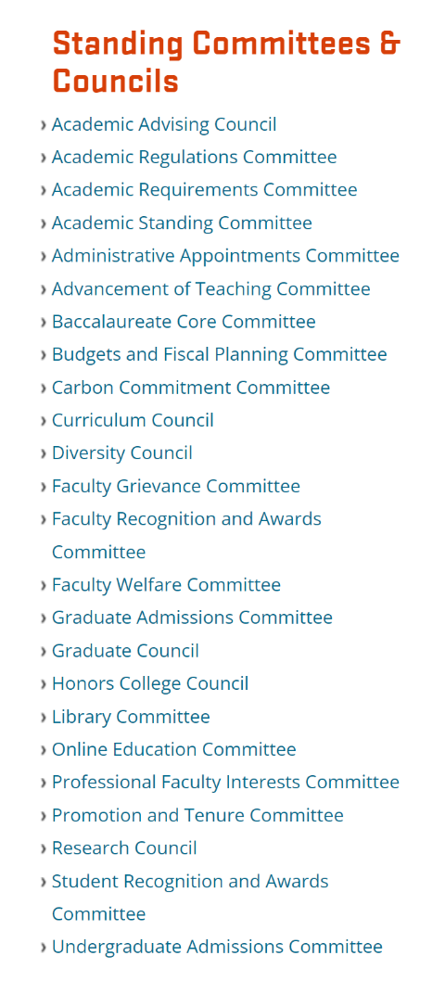
Standing Committees
Do most of the Senate’s work!
EC liaisons facilitate communication and decision-making
Committee Interest Form sent in the spring to identify new members
EC meets to work out committee assignments and leadership changes
  Careful consideration of representation and diversity

Slide 28
Ad hoc Committees and Task Forces
Appointed by Faculty Senate leadership, often in partnership with the Provosts’ Office
Examples: Bacc Core Reform Committee, Anti-Racism Task Force, Professional Faculty Review Committee, Professor of Teaching Task Force
Specific tasks, deadlines

Slide 29
Faculty Senate President serves on MANY university committees
University Cabinet
Provosts’ Council
COVID response committees
Compliance Executive Committee
Campus Planning Committee
Culture of Care Committee
Executive Policy and Standards Committee
Athletics Admissions Committee
Public Safety Advisory Committee
Academic Calendar Committee
Architectural Naming Committee
Reports to the Board of Trustees

