Slide 1
Public Engagement @ OSU
Marina Denny
Associate Vice Provost for Engagement

Slide 2
Challenges to Institutionalizing Public Engagement (PE)
Ambiguity in definition of engagement
No framework to assess engagement activity and scholarship
No formal incentives for faculty and staff

Slide 3
Public engagement at Oregon State University is collaboration between OSU and its larger community* for the mutually beneficial exchange of knowledge and resources in a context of partnership and reciprocity.

Slide 4
“…to enrich scholarship, research, and creative activity;
enhance curriculum, teaching and learning;
prepare educated, engaged citizens;
strengthen democratic values and civic responsibility;
address critical societal issues;
and contribute to the public good.”
(Carnegie Foundation)
Big discoveries that drive big solutions
Every student graduates
Fuel a thriving world

Slide 5
OSU Public Engagement Framework
Shared aspirations
Environments for change
High-leverage activities
Partnerships
Pedagogy
Authentic community engagement
Practice
Publishing
Strategic learning and shared metrics
Broader impacts

Slide 6
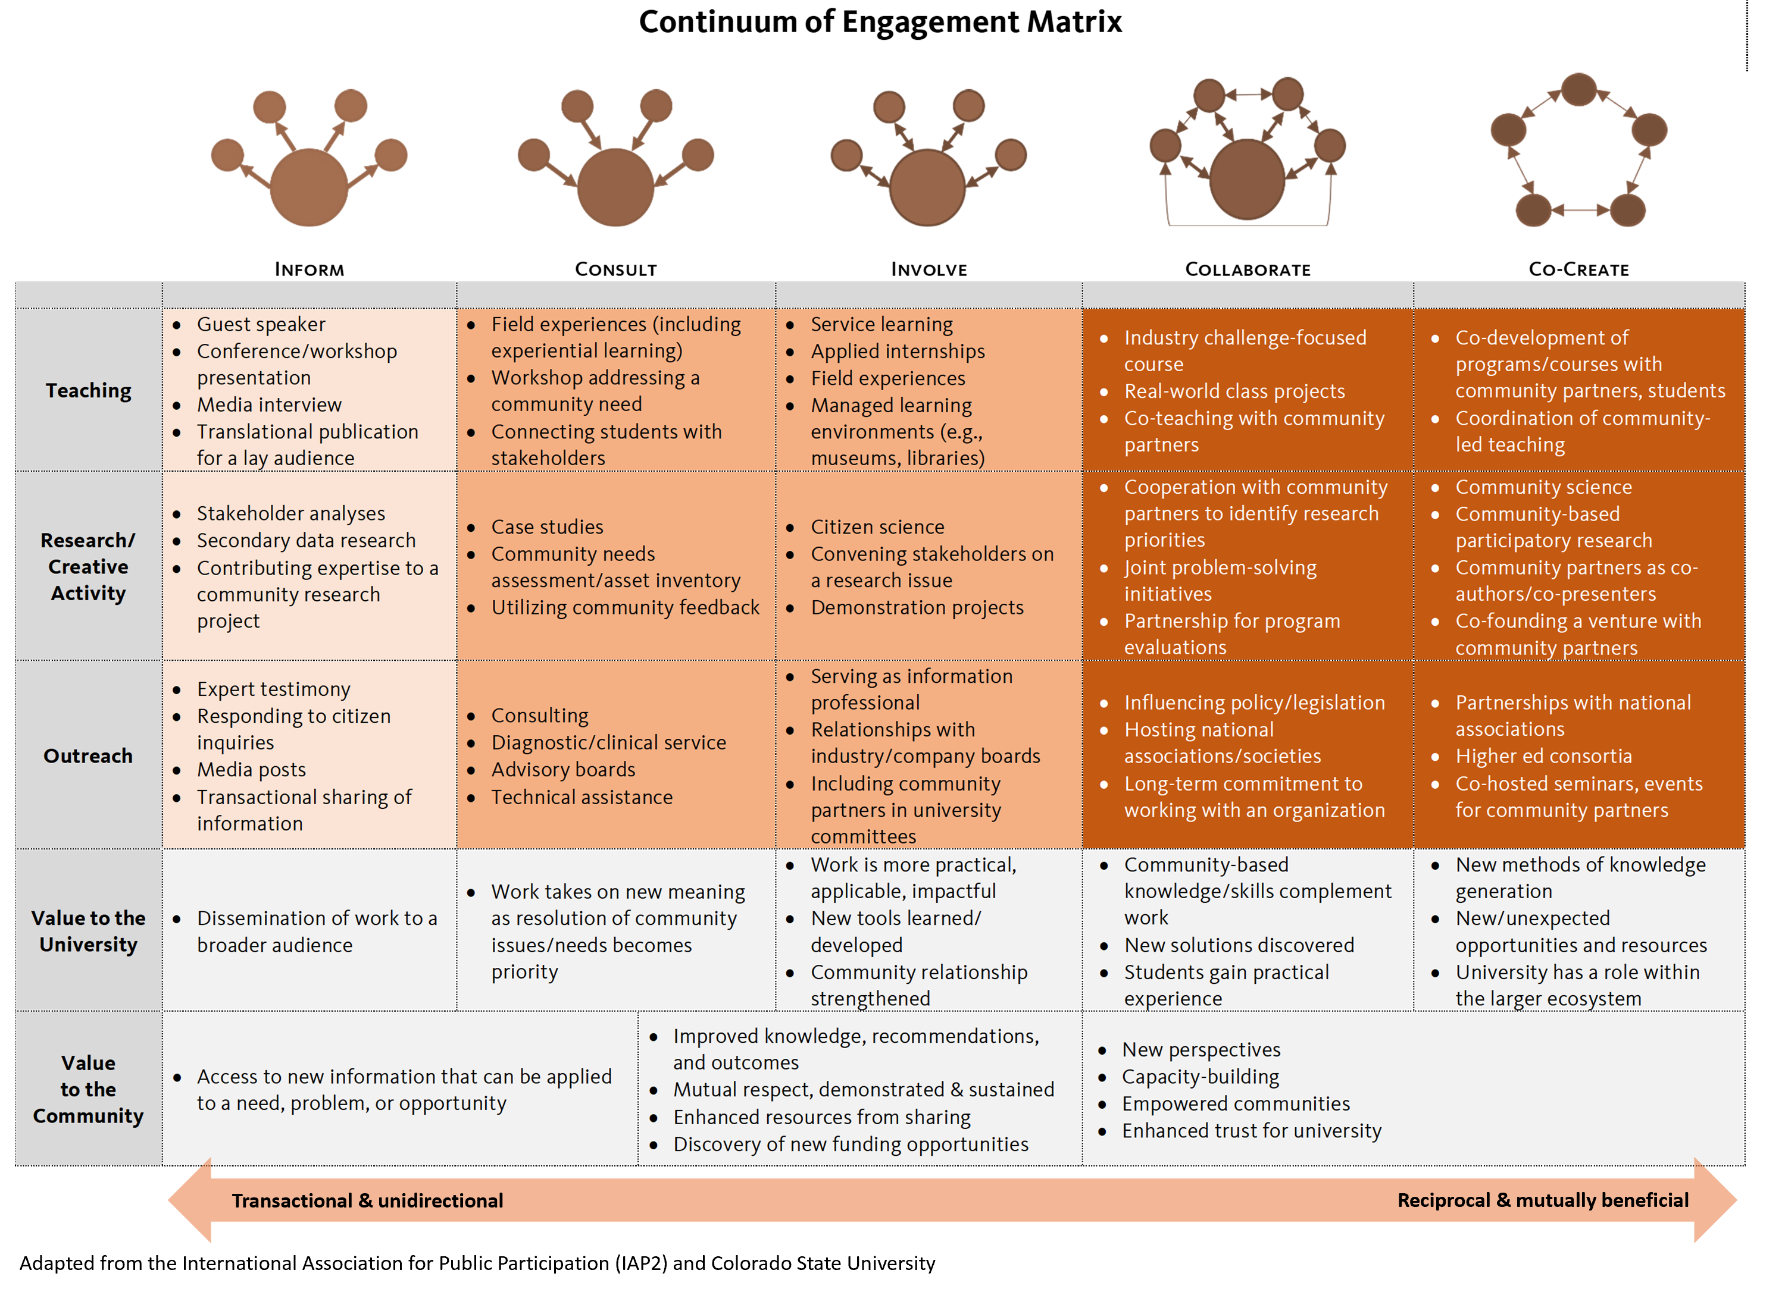

Slide 7
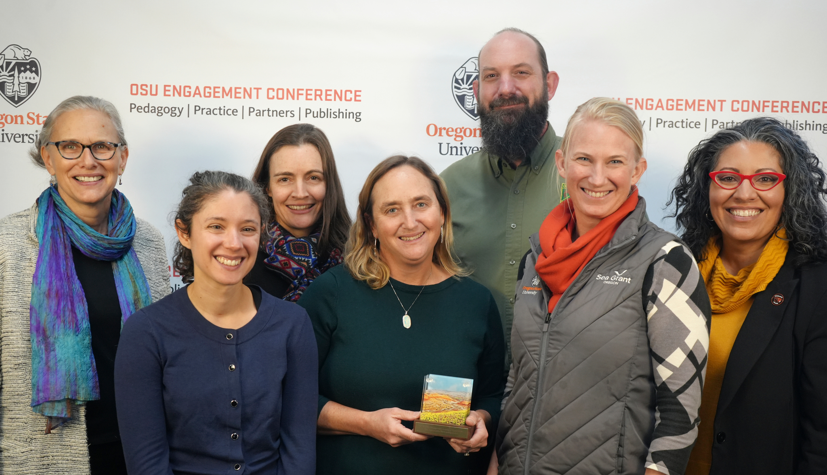
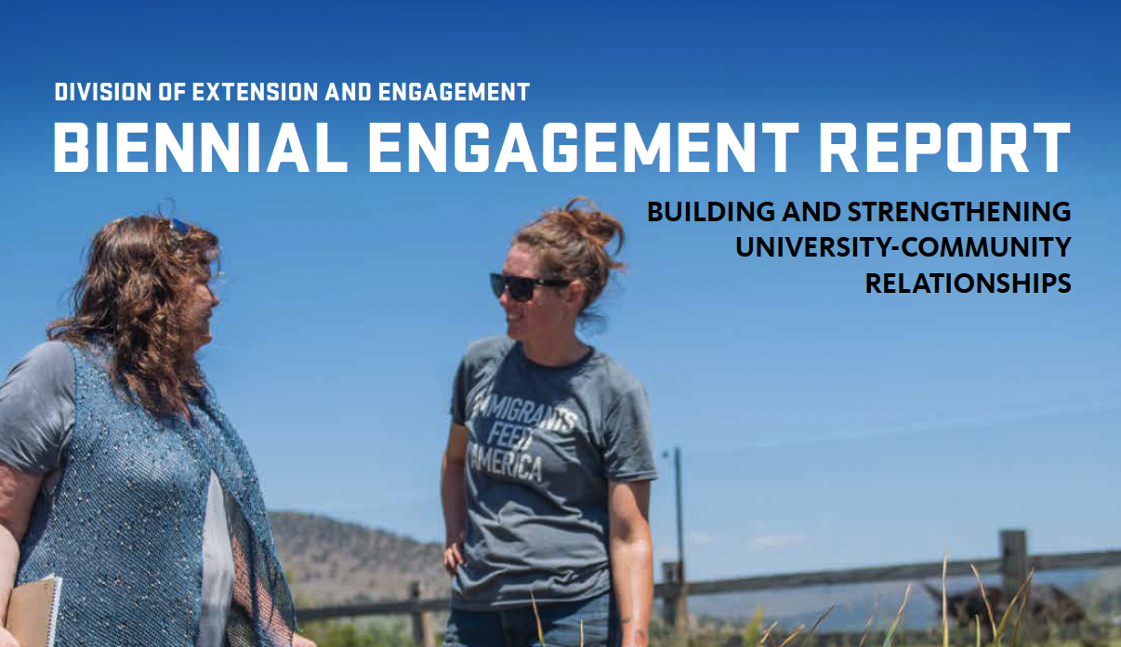
Milestones Reached
Associate Vice Provost for Engagement position
OSU Engagement Council
Biennial Engagement Report
OSU Engagement Conference
Engagement Awards of Excellence
Kellogg Regional Award winner (Oregon Coastal Futures - 2024)
Notes:
Faculty Development – OSU Engagement Conference (2 years); Community Engagement @ OSU certificate (soft launch)

Slide 8
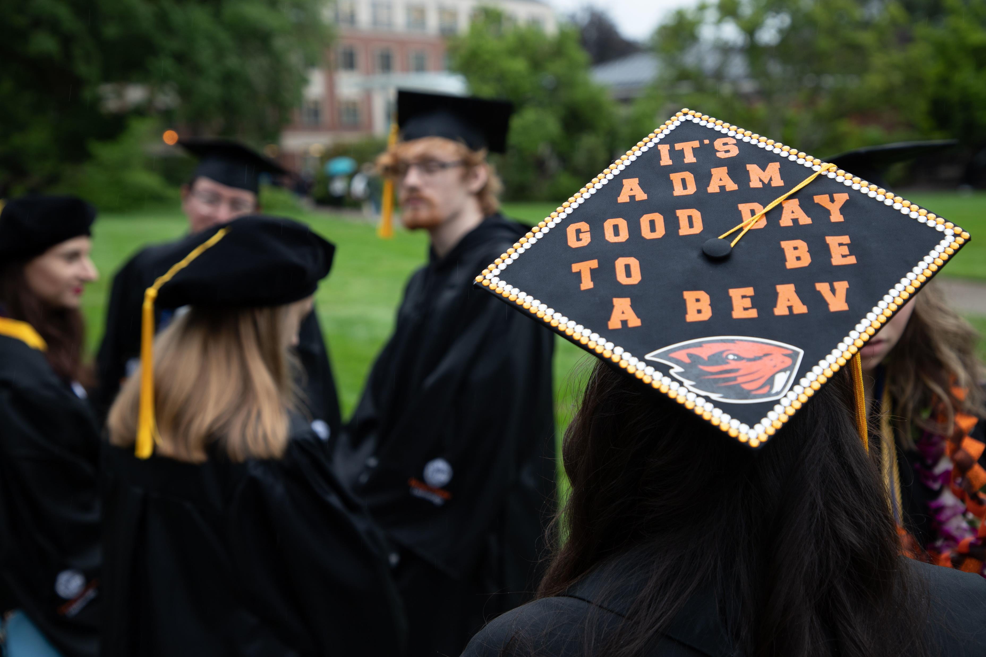
Future Goals
Maintain Carnegie Community Engagement status
Ongoing faculty development
Community-Engaged Learning (CEL) course designation
Support IEP status application process
Formal integration of Public Engagement Framework in teaching, research, and outreach/engagement efforts
Promotion & Tenure guidelines
Position descriptions
Reporting metrics
Transdisciplinary teams, projects, grants, etc.

Slide 9
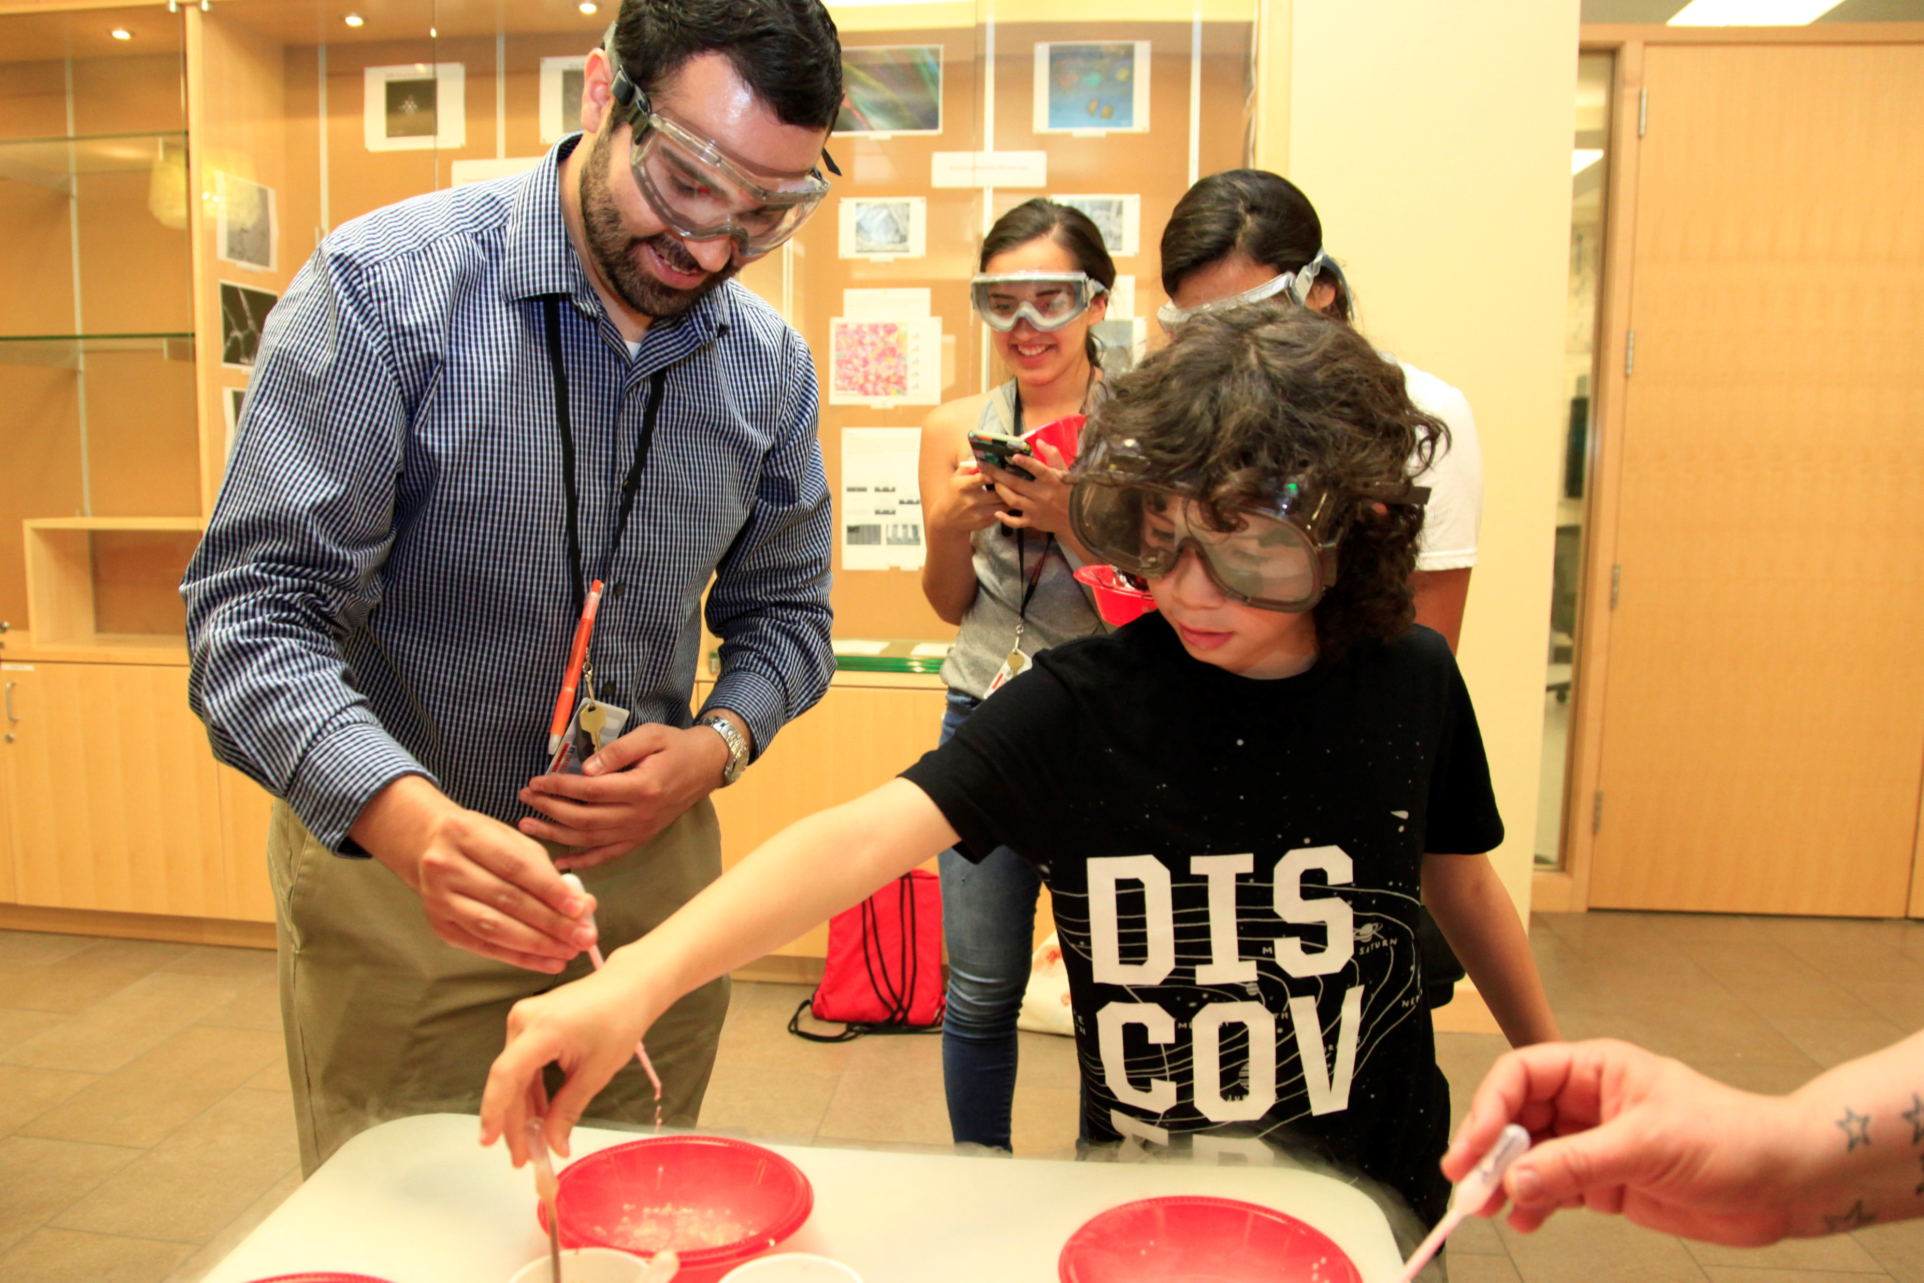
How Can You Participate/Contribute?
Attend events; visit the engagement website
Complete the Community Engagement @ OSU Certificate
Share feedback on framework and continuum
Share your projects and stories with supervisors
Consider partnering with Extension and with other colleges
Submit relevant data for Carnegie application
Stay curious!

Slide 10
https://beav.es/engagement
Marina.Denny@oregonstate.edu

