Slide 1
Proposed Improvements in Graduate Program Assessment and Review Guidelines
Joint Initiative: Graduate Council and Graduate School
Program
Review Data
Assessment Plan
Table 1. Summary of core metrics required and those provided centrally (unless noted otherwise) by the Graduate School, in support of Graduate Program Reviews.
Metric | Provided centrally (Y/N)
Table A. Characteristics of applicants, and admitted and matriculated students
Total no. of applicants, admitted and matriculated students, and by gender (male, female), citizenship (domestic, international), race/ethnicity (Asian/Pacific Islander, Hispanic, White, Black, American Indian/Alaskan Native, Persons reporting two or more races, unknown), and degree type (master’s, doctoral) | Y
Average incoming GPA and range (high, low) for applicants, admitted and matriculated students | Y
Average GREᶲ (verbal, quantitative, analytical writing, and combined scores) scores and range (high, low) for applicants, admitted and matriculated students | Y
Average TOEFL (reading, writing, speaking, listening, and combined) scores and range (high, low) for applicants, admitted and matriculated students | Y
Applicant to matriculation ratio, and by degree type (master’s, doctoral) | Y
Table B. Characteristics of enrolled students
Total no. of enrolled students, and by gender (male, female), by citizenship (domestic, international), by Oregon residency (resident, non-resident), by race/ethnicity (Asian/Pacific Islander, Hispanic, White, Black, American Indian/Alaskan Native, Persons reporting two or more races, unknown), and by degree type (master’s, doctoral.) | Y
Table C. Financial support for graduate students
Total no. of graduate research assistants and graduate teaching assistants, and by degree type (master’s, doctoral) | Y
GTA & GRA minimum salaries, maximum salaries, and average salaries by degree type (master’s, doctoral), adjusted to a .49 FTE for assistantships | Y
No. of students fully funded at .49 FTE for all three academic terms (fall, winter, spring) | N
No. of students funded at below a .49 FTE for all three academic terms (fall, winter, spring) | N
No. of students self-funded (i.e. – not supported by an assistantship or fellowship) | N
Total no. of fellowship appointments awarded by the Graduate School, and by degree type (master’s, doctoral); Total stipend $ paid and total tuition waiver $ paid in fiscal year | Y
Total no. of fellowship appointments awarded by the Program, and by degree type (master’s, doctoral); Total stipend $ paid and total tuition waiver $ paid in fiscal year | N
Total no. of scholarships/fellowships awarded by the Graduate School, and by degree type (master’s, doctoral); Total scholarship/fellowship $ paid in fiscal year | Y
Total no. of scholarships/fellowships awarded by the Program, and by degree type (master’s, doctoral); Total scholarship/fellowship $ paid in fiscal year | N
Other sources of funding for students (narrative and/or additional tables) | N
Table D. Characteristics of graduate courses
No. of stand-alone, combined undergraduate and graduate (slash), and total graduate courses offered | Y
Table E. Student credit hours generated by graduate program faculty in other graduate programs
No. of student credit hours generated in other graduate programs by individual graduate program faculty; total No. of student credit hours generated in other graduate programs by aggregate graduate program faculty | Y
Table F: Assessment plans for graduate learning outcomes for 1) master’s or 2) doctoral degrees | N
Table G. Characteristics of programmatic graduate faculty
Total no. of graduate faculty, and by gender (male, female), citizenship (domestic, international), race/ethnicity (Asian/Pacific Islander, Hispanic, White, Black, American Indian/Alaskan Native, Persons reporting two or more races, unknown), and graduate faculty type | Y
Total no. of graduate faculty approved to teach graduate courses, and by appointment type (professorial rank, instructor, post-doctoral scholar/fellow, courtesy/affiliate) | Y
Total no. of graduate faculty approved to direct non-thesis, and by appointment type | Y
Total no. of graduate faculty approved to serve on committee, and by appointment type | Y
Total no. of graduate faculty approved to direct master’s thesis (but not PhD), and by appointment type | Y
Total no. of graduate faculty approved to direct doctoral dissertations, and by appointment type | Y
Graduate student : graduate faculty ratio total, and by degree type (master’s, doctoral) | Y
Total no. of graduate faculty approved to serve as graduate faculty in other graduate programs, and by approval level type (teach, committee service, direct non-thesis, direct thesis, direct dissertation) | Y
Table H. “ScholarsArchive” data on theses and dissertations
Total no. of theses and dissertations added to ScholarsArchive per graduation year, and by degree type (master’s, doctoral) | Y
Total no. of downloads of theses/dissertations from ScholarsArchive per graduation year, and by degree type (master’s, doctoral) | Y
Top 5 most downloaded theses/dissertations in the last five years (including title, # of downloads, graduation year, product type – T/D, and url link) | Y
Table I. Faculty productivity: publications, grants/contracts/other funds, and other scholarly works
No. of publications by graduate faculty members | N
No. of publications by graduate faculty members with a graduate student co-author | N
No. of grants and contracts received by graduate faculty members | N
Total funds generated by grants and contracts | N
Total other funds generated | N
Percentage of graduate students supported by grants and contracts received | N
Percentage of total grants received that were student-initiated (i.e. – the student initiated the grant for their own research purposes, such as doctoral dissertation research) | N
No. of patents generated by graduate faculty (fiscal year used for reporting) | Y
No. of patents applied for by graduate faculty (fiscal year used for reporting) | Y
No. of patents with a graduate student as a co-applicant (fiscal year used for reporting) | Y
No. of other scholarly works (peer-refereed exhibits, performances, or other scholarly works) created by the graduate faculty | N
No. of other scholarly works (peer-refereed exhibits, performances, or other scholarly works) created with a graduate student | N
Table J. Student retention, degree completion and attrition
Total no. of graduate degrees awarded each year, and by degree type (master’s, doctoral) | Y
Total no. of graduate certificates awarded each year | Y
Average time to degree completion by degree type (master’s, doctoral) | Y
First and second year retention rates (%) total, and by degree type | Y
4-year graduation rate average (%) for master’s students, cohort-based | Y
8-year graduation rate average (%) for doctoral students, cohort-based | Y
No. of degrees awarded in other graduate programs by graduate faculty in this program (i.e. – serving as primary advisor for a graduate student in another program) | Y
Table K. Post-graduation placement and employment of respondents to survey
Total no. and percentage of graduates employed at year one in their chosen field , and by degree type (master’s, doctoral) | N
Total no. and percentage of graduates employed at year five in their chosen field , and by degree type (master’s, doctoral) | N
Total percentage passing licensure/certification exams (if applicable), and by degree type (master’s, doctoral) | N
Assessment Data
Assessment Report

Slide 2
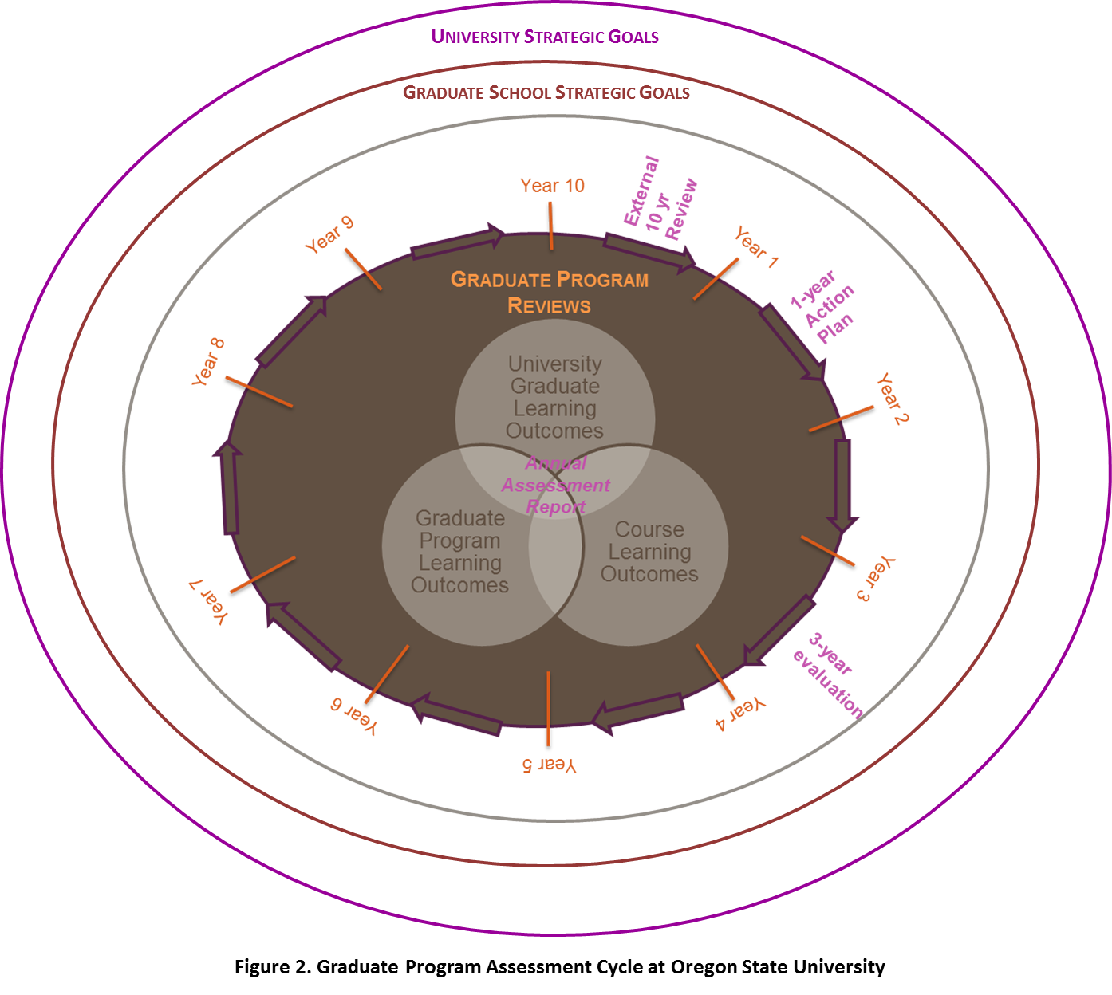
Current faculty derived and approved practices 10 year program reviews and annual assessment

Slide 3
Current faculty derived and approved practices Category 1 proposals
5. Outcomes and Quality Assessment
a. Expected learning outcomes of the program.
b. Methods by which the learning outcomes will be assessed and used to improve curriculum and instruction.
c. Program performance indicators, including prospects for success of program graduates (employment or graduate school) and consideration of licensure, if appropriate.
d. Nature and level of research and/or scholarly work expected of program faculty; indicators of success in those areas.

Slide 4
Current faculty derived and approved practices Assessment plans collected Fall 2011 - implemented January 2012

Slide 5
Current faculty derived and approved practices Annual assessment
Doctoral learning outcomes approved 13 January 2011
Produce and defend an original significant contribution to knowledge
Performed at the final oral exam
GCR is specifically required to assess this metric with the committee
Demonstrate mastery of subject material
Part of every unit's requirements for students
Assessed by course work grades, and preliminary and final examinations
Be able to conduct scholarly activities in an ethical manner
Provided on Program of Study

Slide 6
Current faculty derived and approved practices Annual assessment
Master learning outcomes approved 14 April 2011
Conduct research or produce some other form of creative work
Performed at the final oral exam
GCR is specifically required to assess this metric with the committee
Same as doctoral
Same as doctoral

Slide 7
How did we get from current practices to the proposed improvements?
Ultimate goal
Seamless and easy integration of evaluation and assessment
Concept evolved as part of strategic planning process for Graduate School in collaboration with the Graduate Council
Formed sub-committee of Graduate Council
Comprised of representatives from units that have external accreditation of their graduate programs
Started in summer of 2012
Initially presented to Graduate Council in fall 2012
Multiple iterations since then

Slide 8
Centrally provided performance indicators
Table 1. Summary of core metrics required and those provided centrally (unless noted otherwise) by the Graduate School, in support of Graduate Program Reviews.
Metric | Provided centrally (Y/N)
Table A. Characteristics of applicants, and admitted and matriculated students
Total no. of applicants, admitted and matriculated students, and by gender (male, female), citizenship (domestic, international), race/ethnicity (Asian/Pacific Islander, Hispanic, White, Black, American Indian/Alaskan Native, Persons reporting two or more races, unknown), and degree type (master’s, doctoral) | Y
Average incoming GPA and range (high, low) for applicants, admitted and matriculated students | Y
Average GREᶲ (verbal, quantitative, analytical writing, and combined scores) scores and range (high, low) for applicants, admitted and matriculated students | Y
Average TOEFL (reading, writing, speaking, listening, and combined) scores and range (high, low) for applicants, admitted and matriculated students | Y
Applicant to matriculation ratio, and by degree type (master’s, doctoral) | Y
Table B. Characteristics of enrolled students
Total no. of enrolled students, and by gender (male, female), by citizenship (domestic, international), by Oregon residency (resident, non-resident), by race/ethnicity (Asian/Pacific Islander, Hispanic, White, Black, American Indian/Alaskan Native, Persons reporting two or more races, unknown), and by degree type (master’s, doctoral.) | Y
Table C. Financial support for graduate students
Total no. of graduate research assistants and graduate teaching assistants, and by degree type (master’s, doctoral) | Y
GTA & GRA minimum salaries, maximum salaries, and average salaries by degree type (master’s, doctoral), adjusted to a .49 FTE for assistantships | Y
No. of students fully funded at .49 FTE for all three academic terms (fall, winter, spring) | N
No. of students funded at below a .49 FTE for all three academic terms (fall, winter, spring) | N
No. of students self-funded (i.e. – not supported by an assistantship or fellowship) | N
Total no. of fellowship appointments awarded by the Graduate School, and by degree type (master’s, doctoral); Total stipend $ paid and total tuition waiver $ paid in fiscal year | Y
Total no. of fellowship appointments awarded by the Program, and by degree type (master’s, doctoral); Total stipend $ paid and total tuition waiver $ paid in fiscal year | N
Total no. of scholarships/fellowships awarded by the Graduate School, and by degree type (master’s, doctoral); Total scholarship/fellowship $ paid in fiscal year | Y
Total no. of scholarships/fellowships awarded by the Program, and by degree type (master’s, doctoral); Total scholarship/fellowship $ paid in fiscal year | N
Other sources of funding for students (narrative and/or additional tables) | N
Table D. Characteristics of graduate courses
No. of stand-alone, combined undergraduate and graduate (slash), and total graduate courses offered | Y
Table E. Student credit hours generated by graduate program faculty in other graduate programs
No. of student credit hours generated in other graduate programs by individual graduate program faculty; total No. of student credit hours generated in other graduate programs by aggregate graduate program faculty | Y
Table F: Assessment plans for graduate learning outcomes for 1) master’s or 2) doctoral degrees | N
Table G. Characteristics of programmatic graduate faculty
Total no. of graduate faculty, and by gender (male, female), citizenship (domestic, international), race/ethnicity (Asian/Pacific Islander, Hispanic, White, Black, American Indian/Alaskan Native, Persons reporting two or more races, unknown), and graduate faculty type | Y
Total no. of graduate faculty approved to teach graduate courses, and by appointment type (professorial rank, instructor, post-doctoral scholar/fellow, courtesy/affiliate) | Y
Total no. of graduate faculty approved to direct non-thesis, and by appointment type | Y
Total no. of graduate faculty approved to serve on committee, and by appointment type | Y
Total no. of graduate faculty approved to direct master’s thesis (but not PhD), and by appointment type | Y
Total no. of graduate faculty approved to direct doctoral dissertations, and by appointment type | Y
Graduate student : graduate faculty ratio total, and by degree type (master’s, doctoral) | Y
Total no. of graduate faculty approved to serve as graduate faculty in other graduate programs, and by approval level type (teach, committee service, direct non-thesis, direct thesis, direct dissertation) | Y
Table H. “ScholarsArchive” data on theses and dissertations
Total no. of theses and dissertations added to ScholarsArchive per graduation year, and by degree type (master’s, doctoral) | Y
Total no. of downloads of theses/dissertations from ScholarsArchive per graduation year, and by degree type (master’s, doctoral) | Y
Top 5 most downloaded theses/dissertations in the last five years (including title, # of downloads, graduation year, product type – T/D, and url link) | Y
Table I. Faculty productivity: publications, grants/contracts/other funds, and other scholarly works
No. of publications by graduate faculty members | N
No. of publications by graduate faculty members with a graduate student co-author | N
No. of grants and contracts received by graduate faculty members | N
Total funds generated by grants and contracts | N
Total other funds generated | N
Percentage of graduate students supported by grants and contracts received | N
Percentage of total grants received that were student-initiated (i.e. – the student initiated the grant for their own research purposes, such as doctoral dissertation research) | N
No. of patents generated by graduate faculty (fiscal year used for reporting) | Y
No. of patents applied for by graduate faculty (fiscal year used for reporting) | Y
No. of patents with a graduate student as a co-applicant (fiscal year used for reporting) | Y
No. of other scholarly works (peer-refereed exhibits, performances, or other scholarly works) created by the graduate faculty | N
No. of other scholarly works (peer-refereed exhibits, performances, or other scholarly works) created with a graduate student | N
Table J. Student retention, degree completion and attrition
Total no. of graduate degrees awarded each year, and by degree type (master’s, doctoral) | Y
Total no. of graduate certificates awarded each year | Y
Average time to degree completion by degree type (master’s, doctoral) | Y
First and second year retention rates (%) total, and by degree type | Y
4-year graduation rate average (%) for master’s students, cohort-based | Y
8-year graduation rate average (%) for doctoral students, cohort-based | Y
No. of degrees awarded in other graduate programs by graduate faculty in this program (i.e. – serving as primary advisor for a graduate student in another program) | Y
Table K. Post-graduation placement and employment of respondents to survey
Total no. and percentage of graduates employed at year one in their chosen field , and by degree type (master’s, doctoral) | N
Total no. and percentage of graduates employed at year five in their chosen field , and by degree type (master’s, doctoral) | N
Total percentage passing licensure/certification exams (if applicable), and by degree type (master’s, doctoral) | N
Characteristics of applicants
Characteristics of enrolled students
GRA, GTA salaries and no.; university financial support
List of graduate courses
Student Credit Hours
Characteristics of graduate faculty
ScholarsArchive data
Student retention, degree completion and attrition

Slide 9
Program provided data performance indicators
Table 1. Summary of core metrics required and those provided centrally (unless noted otherwise) by the Graduate School, in support of Graduate Program Reviews.
Metric | Provided centrally (Y/N)
Table A. Characteristics of applicants, and admitted and matriculated students
Total no. of applicants, admitted and matriculated students, and by gender (male, female), citizenship (domestic, international), race/ethnicity (Asian/Pacific Islander, Hispanic, White, Black, American Indian/Alaskan Native, Persons reporting two or more races, unknown), and degree type (master’s, doctoral) | Y
Average incoming GPA and range (high, low) for applicants, admitted and matriculated students | Y
Average GREᶲ (verbal, quantitative, analytical writing, and combined scores) scores and range (high, low) for applicants, admitted and matriculated students | Y
Average TOEFL (reading, writing, speaking, listening, and combined) scores and range (high, low) for applicants, admitted and matriculated students | Y
Applicant to matriculation ratio, and by degree type (master’s, doctoral) | Y
Table B. Characteristics of enrolled students
Total no. of enrolled students, and by gender (male, female), by citizenship (domestic, international), by Oregon residency (resident, non-resident), by race/ethnicity (Asian/Pacific Islander, Hispanic, White, Black, American Indian/Alaskan Native, Persons reporting two or more races, unknown), and by degree type (master’s, doctoral.) | Y
Table C. Financial support for graduate students
Total no. of graduate research assistants and graduate teaching assistants, and by degree type (master’s, doctoral) | Y
GTA & GRA minimum salaries, maximum salaries, and average salaries by degree type (master’s, doctoral), adjusted to a .49 FTE for assistantships | Y
No. of students fully funded at .49 FTE for all three academic terms (fall, winter, spring) | N
No. of students funded at below a .49 FTE for all three academic terms (fall, winter, spring) | N
No. of students self-funded (i.e. – not supported by an assistantship or fellowship) | N
Total no. of fellowship appointments awarded by the Graduate School, and by degree type (master’s, doctoral); Total stipend $ paid and total tuition waiver $ paid in fiscal year | Y
Total no. of fellowship appointments awarded by the Program, and by degree type (master’s, doctoral); Total stipend $ paid and total tuition waiver $ paid in fiscal year | N
Total no. of scholarships/fellowships awarded by the Graduate School, and by degree type (master’s, doctoral); Total scholarship/fellowship $ paid in fiscal year | Y
Total no. of scholarships/fellowships awarded by the Program, and by degree type (master’s, doctoral); Total scholarship/fellowship $ paid in fiscal year | N
Other sources of funding for students (narrative and/or additional tables) | N
Table D. Characteristics of graduate courses
No. of stand-alone, combined undergraduate and graduate (slash), and total graduate courses offered | Y
Table E. Student credit hours generated by graduate program faculty in other graduate programs
No. of student credit hours generated in other graduate programs by individual graduate program faculty; total No. of student credit hours generated in other graduate programs by aggregate graduate program faculty | Y
Table F: Assessment plans for graduate learning outcomes for 1) master’s or 2) doctoral degrees | N
Table G. Characteristics of programmatic graduate faculty
Total no. of graduate faculty, and by gender (male, female), citizenship (domestic, international), race/ethnicity (Asian/Pacific Islander, Hispanic, White, Black, American Indian/Alaskan Native, Persons reporting two or more races, unknown), and graduate faculty type | Y
Total no. of graduate faculty approved to teach graduate courses, and by appointment type (professorial rank, instructor, post-doctoral scholar/fellow, courtesy/affiliate) | Y
Total no. of graduate faculty approved to direct non-thesis, and by appointment type | Y
Total no. of graduate faculty approved to serve on committee, and by appointment type | Y
Total no. of graduate faculty approved to direct master’s thesis (but not PhD), and by appointment type | Y
Total no. of graduate faculty approved to direct doctoral dissertations, and by appointment type | Y
Graduate student : graduate faculty ratio total, and by degree type (master’s, doctoral) | Y
Total no. of graduate faculty approved to serve as graduate faculty in other graduate programs, and by approval level type (teach, committee service, direct non-thesis, direct thesis, direct dissertation) | Y
Table H. “ScholarsArchive” data on theses and dissertations
Total no. of theses and dissertations added to ScholarsArchive per graduation year, and by degree type (master’s, doctoral) | Y
Total no. of downloads of theses/dissertations from ScholarsArchive per graduation year, and by degree type (master’s, doctoral) | Y
Top 5 most downloaded theses/dissertations in the last five years (including title, # of downloads, graduation year, product type – T/D, and url link) | Y
Table I. Faculty productivity: publications, grants/contracts/other funds, and other scholarly works
No. of publications by graduate faculty members | N
No. of publications by graduate faculty members with a graduate student co-author | N
No. of grants and contracts received by graduate faculty members | N
Total funds generated by grants and contracts | N
Total other funds generated | N
Percentage of graduate students supported by grants and contracts received | N
Percentage of total grants received that were student-initiated (i.e. – the student initiated the grant for their own research purposes, such as doctoral dissertation research) | N
No. of patents generated by graduate faculty (fiscal year used for reporting) | Y
No. of patents applied for by graduate faculty (fiscal year used for reporting) | Y
No. of patents with a graduate student as a co-applicant (fiscal year used for reporting) | Y
No. of other scholarly works (peer-refereed exhibits, performances, or other scholarly works) created by the graduate faculty | N
No. of other scholarly works (peer-refereed exhibits, performances, or other scholarly works) created with a graduate student | N
Table J. Student retention, degree completion and attrition
Total no. of graduate degrees awarded each year, and by degree type (master’s, doctoral) | Y
Total no. of graduate certificates awarded each year | Y
Average time to degree completion by degree type (master’s, doctoral) | Y
First and second year retention rates (%) total, and by degree type | Y
4-year graduation rate average (%) for master’s students, cohort-based | Y
8-year graduation rate average (%) for doctoral students, cohort-based | Y
No. of degrees awarded in other graduate programs by graduate faculty in this program (i.e. – serving as primary advisor for a graduate student in another program) | Y
Table K. Post-graduation placement and employment of respondents to survey
Total no. and percentage of graduates employed at year one in their chosen field , and by degree type (master’s, doctoral) | N
Total no. and percentage of graduates employed at year five in their chosen field , and by degree type (master’s, doctoral) | N
Total percentage passing licensure/certification exams (if applicable), and by degree type (master’s, doctoral) | N
Nature of the programmatic support of students
Current assessment plan
Faculty productivity: publications, grants/contracts/other funds, and other scholarly works

Slide 10
Integrated and Holistic Evaluation and Assessment
Table 1. Summary of core metrics required and those provided centrally (unless noted otherwise) by the Graduate School, in support of Graduate Program Reviews.
Metric | Provided centrally (Y/N)
Table A. Characteristics of applicants, and admitted and matriculated students
Total no. of applicants, admitted and matriculated students, and by gender (male, female), citizenship (domestic, international), race/ethnicity (Asian/Pacific Islander, Hispanic, White, Black, American Indian/Alaskan Native, Persons reporting two or more races, unknown), and degree type (master’s, doctoral) | Y
Average incoming GPA and range (high, low) for applicants, admitted and matriculated students | Y
Average GREᶲ (verbal, quantitative, analytical writing, and combined scores) scores and range (high, low) for applicants, admitted and matriculated students | Y
Average TOEFL (reading, writing, speaking, listening, and combined) scores and range (high, low) for applicants, admitted and matriculated students | Y
Applicant to matriculation ratio, and by degree type (master’s, doctoral) | Y
Table B. Characteristics of enrolled students
Total no. of enrolled students, and by gender (male, female), by citizenship (domestic, international), by Oregon residency (resident, non-resident), by race/ethnicity (Asian/Pacific Islander, Hispanic, White, Black, American Indian/Alaskan Native, Persons reporting two or more races, unknown), and by degree type (master’s, doctoral.) | Y
Table C. Financial support for graduate students
Total no. of graduate research assistants and graduate teaching assistants, and by degree type (master’s, doctoral) | Y
GTA & GRA minimum salaries, maximum salaries, and average salaries by degree type (master’s, doctoral), adjusted to a .49 FTE for assistantships | Y
No. of students fully funded at .49 FTE for all three academic terms (fall, winter, spring) | N
No. of students funded at below a .49 FTE for all three academic terms (fall, winter, spring) | N
No. of students self-funded (i.e. – not supported by an assistantship or fellowship) | N
Total no. of fellowship appointments awarded by the Graduate School, and by degree type (master’s, doctoral); Total stipend $ paid and total tuition waiver $ paid in fiscal year | Y
Total no. of fellowship appointments awarded by the Program, and by degree type (master’s, doctoral); Total stipend $ paid and total tuition waiver $ paid in fiscal year | N
Total no. of scholarships/fellowships awarded by the Graduate School, and by degree type (master’s, doctoral); Total scholarship/fellowship $ paid in fiscal year | Y
Total no. of scholarships/fellowships awarded by the Program, and by degree type (master’s, doctoral); Total scholarship/fellowship $ paid in fiscal year | N
Other sources of funding for students (narrative and/or additional tables) | N
Table D. Characteristics of graduate courses
No. of stand-alone, combined undergraduate and graduate (slash), and total graduate courses offered | Y
Table E. Student credit hours generated by graduate program faculty in other graduate programs
No. of student credit hours generated in other graduate programs by individual graduate program faculty; total No. of student credit hours generated in other graduate programs by aggregate graduate program faculty | Y
Table F: Assessment plans for graduate learning outcomes for 1) master’s or 2) doctoral degrees | N
Table G. Characteristics of programmatic graduate faculty
Total no. of graduate faculty, and by gender (male, female), citizenship (domestic, international), race/ethnicity (Asian/Pacific Islander, Hispanic, White, Black, American Indian/Alaskan Native, Persons reporting two or more races, unknown), and graduate faculty type | Y
Total no. of graduate faculty approved to teach graduate courses, and by appointment type (professorial rank, instructor, post-doctoral scholar/fellow, courtesy/affiliate) | Y
Total no. of graduate faculty approved to direct non-thesis, and by appointment type | Y
Total no. of graduate faculty approved to serve on committee, and by appointment type | Y
Total no. of graduate faculty approved to direct master’s thesis (but not PhD), and by appointment type | Y
Total no. of graduate faculty approved to direct doctoral dissertations, and by appointment type | Y
Graduate student : graduate faculty ratio total, and by degree type (master’s, doctoral) | Y
Total no. of graduate faculty approved to serve as graduate faculty in other graduate programs, and by approval level type (teach, committee service, direct non-thesis, direct thesis, direct dissertation) | Y
Table H. “ScholarsArchive” data on theses and dissertations
Total no. of theses and dissertations added to ScholarsArchive per graduation year, and by degree type (master’s, doctoral) | Y
Total no. of downloads of theses/dissertations from ScholarsArchive per graduation year, and by degree type (master’s, doctoral) | Y
Top 5 most downloaded theses/dissertations in the last five years (including title, # of downloads, graduation year, product type – T/D, and url link) | Y
Table I. Faculty productivity: publications, grants/contracts/other funds, and other scholarly works
No. of publications by graduate faculty members | N
No. of publications by graduate faculty members with a graduate student co-author | N
No. of grants and contracts received by graduate faculty members | N
Total funds generated by grants and contracts | N
Total other funds generated | N
Percentage of graduate students supported by grants and contracts received | N
Percentage of total grants received that were student-initiated (i.e. – the student initiated the grant for their own research purposes, such as doctoral dissertation research) | N
No. of patents generated by graduate faculty (fiscal year used for reporting) | Y
No. of patents applied for by graduate faculty (fiscal year used for reporting) | Y
No. of patents with a graduate student as a co-applicant (fiscal year used for reporting) | Y
No. of other scholarly works (peer-refereed exhibits, performances, or other scholarly works) created by the graduate faculty | N
No. of other scholarly works (peer-refereed exhibits, performances, or other scholarly works) created with a graduate student | N
Table J. Student retention, degree completion and attrition
Total no. of graduate degrees awarded each year, and by degree type (master’s, doctoral) | Y
Total no. of graduate certificates awarded each year | Y
Average time to degree completion by degree type (master’s, doctoral) | Y
First and second year retention rates (%) total, and by degree type | Y
4-year graduation rate average (%) for master’s students, cohort-based | Y
8-year graduation rate average (%) for doctoral students, cohort-based | Y
No. of degrees awarded in other graduate programs by graduate faculty in this program (i.e. – serving as primary advisor for a graduate student in another program) | Y
Table K. Post-graduation placement and employment of respondents to survey
Total no. and percentage of graduates employed at year one in their chosen field , and by degree type (master’s, doctoral) | N
Total no. and percentage of graduates employed at year five in their chosen field , and by degree type (master’s, doctoral) | N
Total percentage passing licensure/certification exams (if applicable), and by degree type (master’s, doctoral) | N
Graduate-level Category 1 curriculum approval process
Provide assessment plan template
Link to performance indicator table
Performance indicator
table
Assessment plan template

Slide 11
Integrated and Holistic Evaluation and Assessment
Existing graduate programs
Revise assessment plan
Due Winter 2014
Assessment plan template

Slide 12
Integrated and Holistic Evaluation and Assessment Graduate Council Rep completes the University GLO assessment

Slide 13
Integrated and Holistic Evaluation and Assessment
Assess and evaluate annually for
progress towards learning outcomes

Slide 14
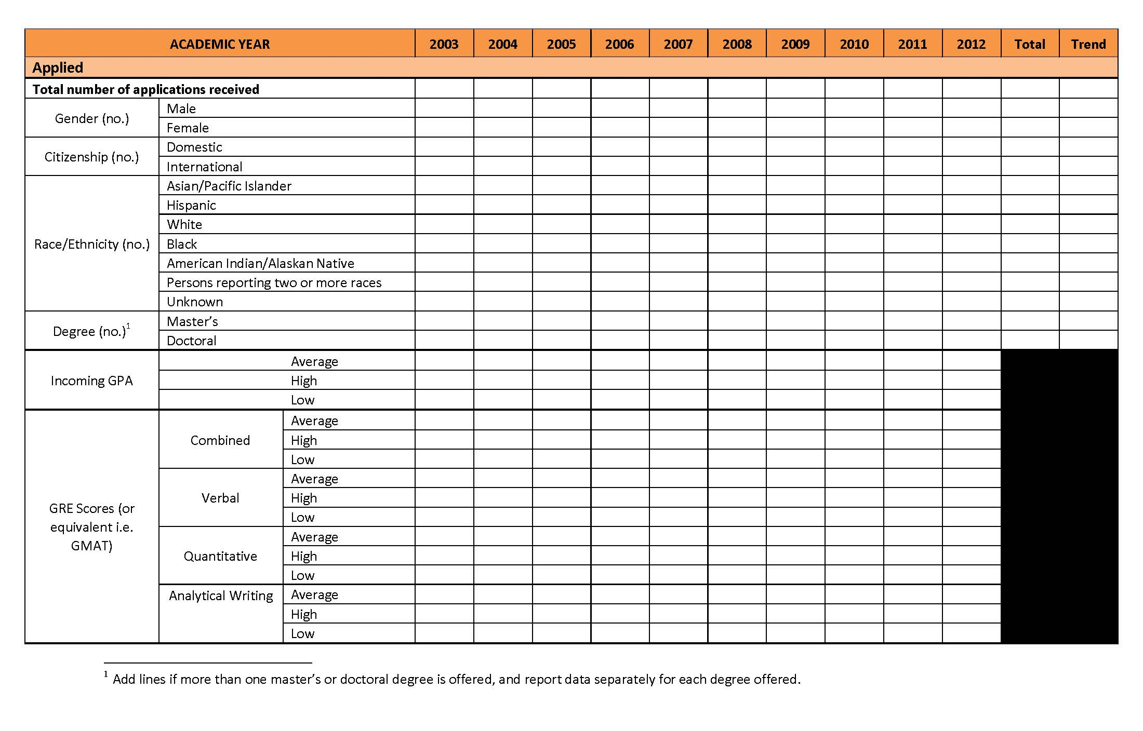
Integrated and Holistic Evaluation and Assessment
Assess and evaluate annually programmatic goals
(e.g. student characteristics)

Slide 15
Summary of Improvements for Graduate Program Evaluation and Assessment
Provide new assessment plan template and essential performance indicator data for CAT1 proposals (centralized and decentralized data)
Provide assessment plan document to existing programs (revisions due 15 Nov 2013)
Provide annual report form
Provide centralized performance indicator data on an annual basis before the end of fall term (including performance indicators, university-level learning outcomes data, and list of graduate faculty), university learning outcomes data, and list of graduate faculty

Slide 16
Summary of Improvements for Graduate Program Evaluation and Assessment
Receive annual reports (Graduate Council and Graduate School) by 15 March on assessment and performance indicators
interpret the annual data provided by the Graduate School and collected by the unit
assess and document successes related to learning outcomes, and identify areas for improvement
assess and document successes, challenges and changes that will be made to allow for continual improvements to the overall graduate program.
Annual reports should be formative and will not be disclosed to the public.
Annual analysis and reports will allow for a more robust analysis in the self-study at the end of 10 years.

Slide 17
Graduate Program Review Guidelines Other
Clarify the postponement policy – must be extraordinary circumstances to postpone (pg 7)
Submitted self-studies are reviewed for adequacy – changed reviewer from a member of the Graduate Council to the Dean/Associate Dean of the Graduate School (pg 8)
Included the Graduate Program Assessment Plan as part of the review document (pg 37)
Programs required to summarize annual reports

Slide 18
Next Steps
Prototype new guidelines with Chemistry Graduate Program Review (GPR) – May ‘13
Implement revised GPR guidelines
Set up meetings with program directors to explain new process and get feedback – spring, summer and fall
Provide data to units fall term and templates
Require submission of assessment plans from units by 15 Nov. ‘13
First assessment and evaluation reports due 15 March ‘14

Slide 19
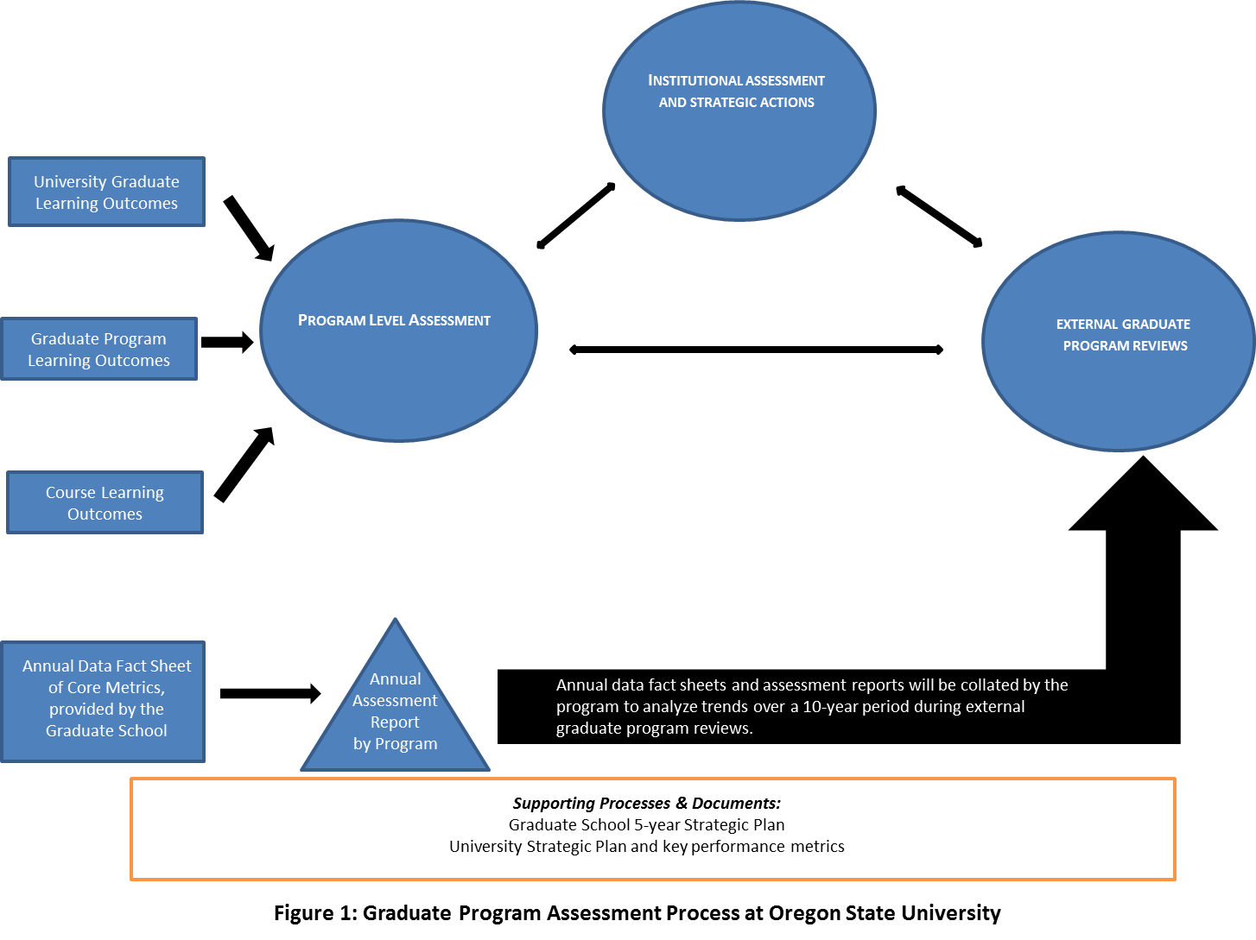
Evaluation life cycle

Slide 20
Holistic assessment achieved!

Slide 21
1) Assessment Plan & Annual Report
Similar to template created by APAA for undergraduate programs
University-level outcomes
UG are Bac-Core
Distinct university-level Graduate Learning Outcomes
How LOs are communicated to students removed
Removed reference to student success-related outcomes
Plan describes intended process – vs process that was used.
Separated Plan from Report

Slide 22
1) Assessment Plan & Annual Report
Why separate?
Intent is to require submission of assessment plan with all future Cat I proposals.
Becomes confusing when reporting is part of plan
Assessment Plans should be relatively stable
Reporting is an addendum to the Assessment Plan

Slide 23
1) Proposed changes to Curriculum Proposal Approval Process
Robust assessment plans for university and program learning outcomes are required for all graduate-level academic degree programs.
For new academic graduate programs, assessment plans are submitted and evaluated as part of the Cat I process for approval (attach plan to Cat I)
For existing graduate academic programs, assessment plans are submitted to and collected by the Graduate School.
Deadline of Sept 15 2013 to submit assessment plans
All changes to existing academic programs must address the impact of those changes on the assessment plan, and the assessment plan is updated as appropriate (attach document)
All new course proposals, and changes to existing courses, must address course learning outcomes and the impact of the courses on the associated program’s assessment plans (attach document)

