Slide 1
Faculty Handbook revision Presented by bob Mason Associate vice provost for FACULTY development
Presentation to Faculty Senate
February 10, 2022

Slide 2
Faculty Handbook Revision
Background
Who “owns” the Faculty Handbook in terms of its content, upkeep, revisions, updates, etc.?
The ultimate university authority is the Board of Trustees. They in turn delegate to the President, who delegates authority to the Provost, and they in turn delegate it to others. Oregon State University Policies and Procedures are mandated by the OSU Board of Trustees. For example:
Political Campaigning by University Employees
Applicability: Faculty and Classified
Section: 0200 Faculty Appointments and Service
Policy Number: 264
Human Resources Manual
Policies, Guidelines and Reference Material: Restrictions on Political Campaigning by Public Employees (State of Oregon)
Statutory Authority: ORS 260.432
Office of Faculty Affairs (OFA) is ultimately the final authority on the Faculty Handbook but engages others in decision-making, most notably the Faculty Senate. The Faculty Senate is a shared governance partner for many issues, e.g. academic regulations.
Additional information for the Faculty Handbook is provided by offices across the campus such as Academic Affairs, Office of Institutional Diversity, Equal Opportunity and Access, the Graduate School, Human Resources, etc.
Office of Faculty Affairs

Slide 3
Faculty Handbook Revision
Why revise the Faculty Handbook and why now?
Office of Faculty Affairs

Slide 4
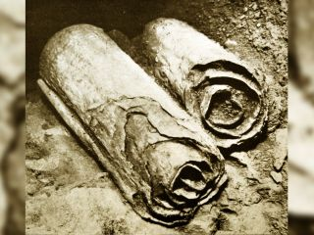
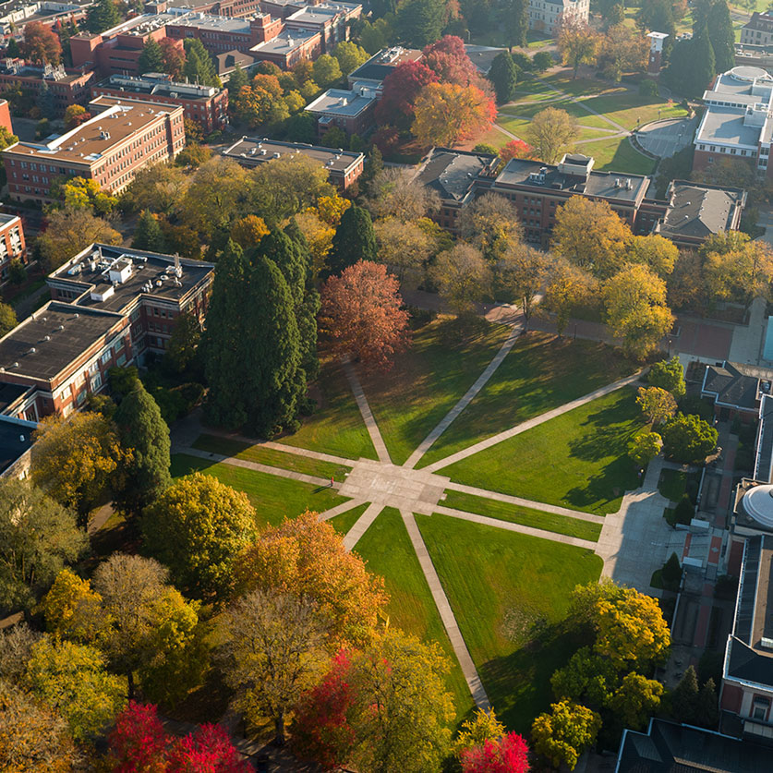
Faculty Handbook Revision
Office of Faculty Affairs

Slide 5
Faculty Handbook Revision
Why revise the Faculty Handbook and why now?
Portions of the FH are seriously out of date (some references go back to 1940!)
References to policies and procedures from the State Board of Higher Education.
Updates need to recognize the authority of the OSU Board of Trustees.
United Academics of Oregon State University (UAOSU).
Changes to the Faculty Handbook are mandated to comply with the Collective Bargaining Agreement (CBA).
Rick Settersten, Vice Provost for Faculty Affairs, has charged me to lead this revision of the Faculty Handbook. He is actively involved and a participant in all our committee and subcommittee work.
Office of Faculty Affairs

Slide 6
Faculty Handbook Revision
What is the process?
A joint Faculty Handbook Revision Committee (FHRC) has been formed with representation from both Faculty Senate (President and Past President; Chair of FS P&T Committee) and Faculty Affairs.
Subcommittees of the FHRC have been formed to address specific topics in the handbook, e.g.:
Innovation & Entrepreneurship (PTIE) (Rich Carter and Tuba Ozkan-Haller co-chairs).
Student Learning Experience (SLE) instrument and assessment of teaching, represented by Faculty Senate AOT committee (Devon Quick and Regan Gurung).
Periodic updates to Faculty Senate Executive Committee and the Faculty Senate.
Office of Faculty Affairs

Slide 7
Faculty Handbook Revision
What are the range of issues being addressed?
Required new language due to the CBA.
Development of new criteria and policies for new job titles/ranks, e.g., Research Associate.
Use of new Student Learning Experience (SLE) instrument in annual reviews and P&T.
Treatment of issues related to Innovation & Entrepreneurship (PTIE).
Promotion & Tenure guidelines that need clarity:
scores of specific questions posed to the Office of Faculty Affairs from previous P&T committee members and chairs; unit Heads and Associate Deans; feedback from previous P&T workshops
years of collective redundancies, policy conflicts, and ambiguity have remained unaddressed
Modernization of language throughout, e.g., “his or her” to “their”.
Broadening Emeritus/Emerita to include a third gender-neutral option.
Make the entire Faculty Handbook more user-friendly and more adapted to online use (e.g., cross-linking and referencing, searchable).
Office of Faculty Affairs

Slide 8
Faculty Handbook Revision
Timeline
Some of these changes need to be implemented for the next round; others require a longer time-frame.
Some require a more involved set of stakeholders and deliberations; others are straightforward.
Goal: A semi-revised version available this spring in time for the next P&T cycle.
Longer-term Goal: The Faculty Handbook becomes a living document updated annually as needed.
Office of Faculty Affairs

