Slide 1
Enhancements to the OSU Background Check Program
University Human Resources
Faculty Senate Presentation
January 12, 2023
11/07/2022

Slide 2
Agenda
Reasons for Updates
Current State
Future State
Questions

Slide 3
Catalysts for Change
Recognize OSU’s responsibility for the safety and security of OSU students and the people of Oregon
Minimize chilling effect on potential applicants and volunteers via increased transparency about process
Provide opportunity for outreach and tools that encourage understanding of why we check
Participate in “don’t pass the harasser” efforts
Timing coincides with new recruitment/sourcing resource in HR and launch of search committee training that emphasizes shared responsibility to mitigate bias and hire based on qualifications

Slide 4
Rationale
Access to protected, confidential or
non-public data
May involve stewardship of
public funds
May involve access
to minors or vulnerable individuals
May provide sensitive services to university community members
Background Check
Contribute to the safety and security of our university community and resources
Upholds commitment to students and the people of Oregon

Slide 5
Priority: Advancing a Safe and Inclusive Environment
Safe Environment
Inclusive Environment
Managing Priority Tensions
Risk: Negligent Hire
Risk: Disparate impact and/or chilling effect
Strategy
Require criminal records and a sex offender registry check for those employees and volunteers with access to protected data, stewardship of public funds, access to minors, or who provide sensitive services to members of the community.
Strategy
Delay background checks
until individuals receive a contingent offer for the position; clarify that information discovered through background checks are not automatic exclusions; transparently describe individualized assessment criteria.
OREGON STATE UNIVERSITY
4

Slide 6
Current State
January 2021 to October 25, 2022

Slide 7
Future State
January 2023

Slide 8
Program Details
Criminal History Check
Maintain criminal records checks for new hires and volunteers when the position involves some level of access to protected, confidential or non-public data, stewardship of public funds, access to minors, and/or providing sensitive services to members of the university community
Conduct a check when an existing employee is a finalist for a new job/opportunity
Conduct a check when an existing employee has significant change in work responsibilities
Appointment-Specific Check
Sexual misconduct reference check for high-level administrator positions
Additional
Check of all new hires against the Registered Sex Offender national list, which includes level 3 violations
Unchanged Operational Details:
Checks initiated only after an individual is a finalist
Results are compared against duties only for the specific position
Details are not released to hiring managers
Candidate has opportunity to provide additional information
Commitment to hiring based on qualifications

Slide 9
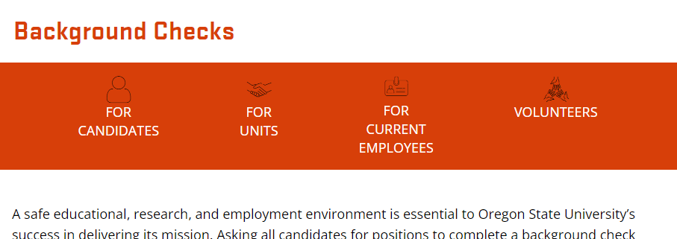
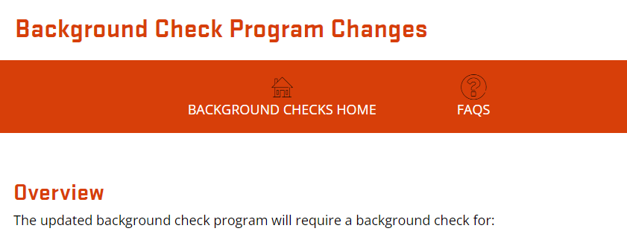
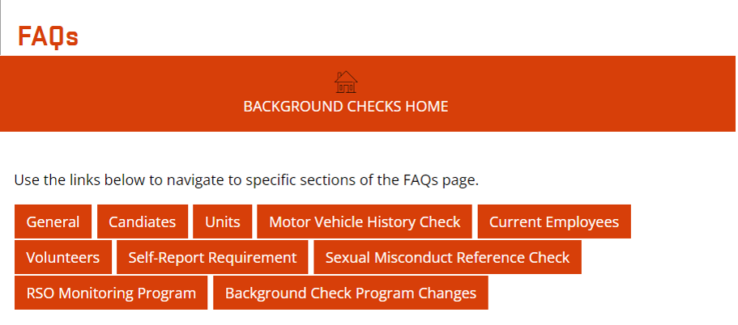
Project Focus: Improve Transparency
Delivered: Updated website
Process transparency
User-centered design
Approximately 130 FAQs (and growing!)
Available at beav.es/5kd

Slide 10
Deeper Dive – Improved Transparency

Slide 11
Additional Project Deliverables
Consolidated policy, including updates and expansions
Background check vendor review and implementation
End of calendar year 2023:
Centralize all administrative functions related to volunteers within HR Compliance
Continue research of best practices related to background checks

