Slide 1
Welcome to the January Meeting
of the 107th OSU Faculty Senate
January 14, 2016
xkcd.com

Slide 3
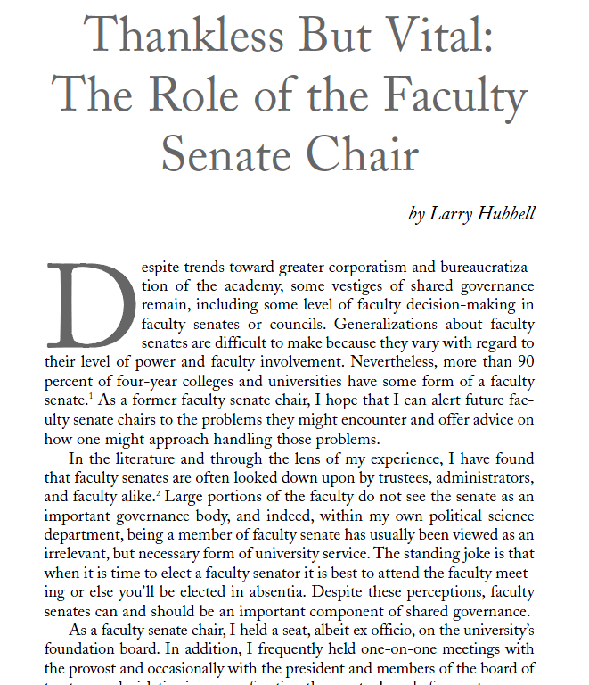

Slide 9
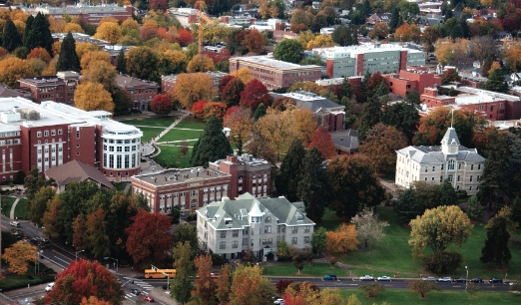
Oregon State University:
Leadership, Innovation, Excellence
Every Dam Day.
Thank You.

