Slide 1
Merge a Department/School with another Department/School (School of Life Sciences)
Executive Summary:
This proposal seeks to create the School of Life Sciences under the College of Science with three departments: Biochemistry and Biophysics, Microbiology, and Integrative Biology.
There are no changes in majors, degrees, or curricular structure.
Rationale: This is consistent with other creation of Schools within Colleges at OSU. The COS feels that this is necessary to create a structure to better manage their operation.
Impacts to Students: The name change will not affect majors, degrees, or course offerings.

Slide 2
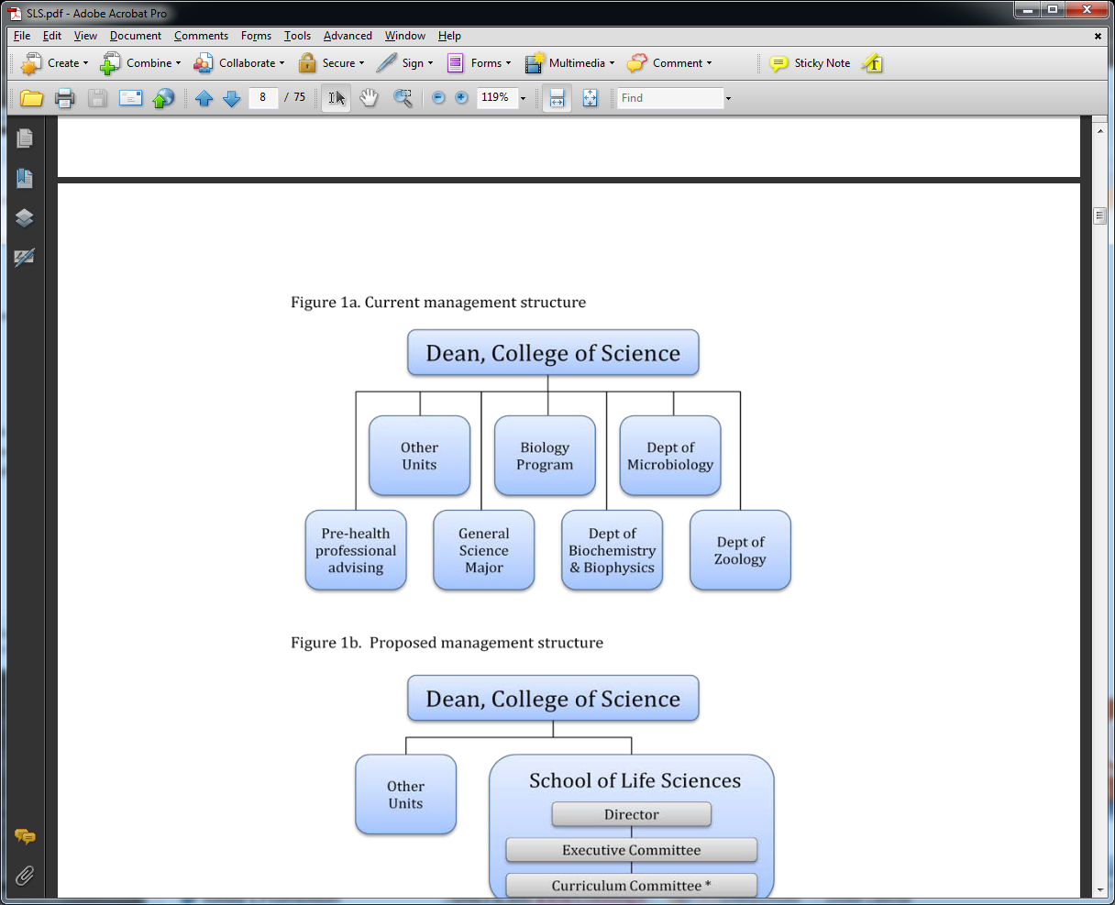
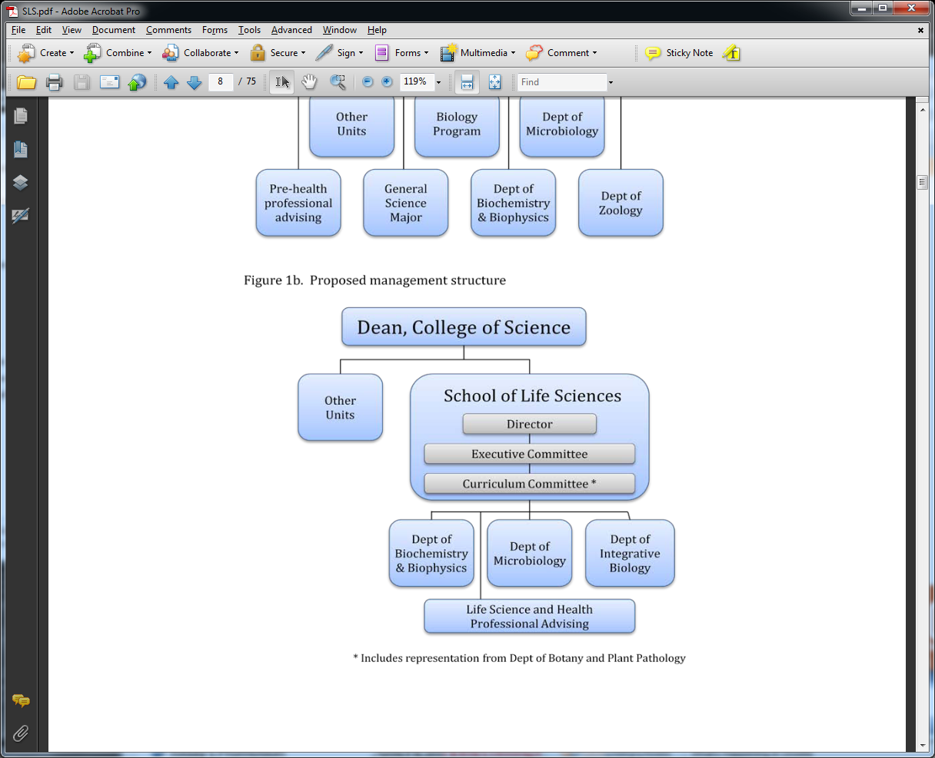
Merge a Department/School with another Department/School (School of Life Sciences)
Before:
After:
**
*
** The School Director position will be rotated among the chairs.
* The Curriculum Committee will coordinate and review curricular changes in the SLS. It will be composed of two representatives from each department and two from the Department of Botany and Plant Pathology (in the CAS).

Slide 3
Senate Leadership (President + EC) Action Since June
June 13: Senate postpones further discussion and action to
October 10 Senate meeting
June 13-27: Consultation with originators, deans, other
interested parties
June 28: Request for Input distributed
October 1: Deadline for Receipt
October 2: All senators receive compiled feedback, plus
originators’ response to input
October 1-8: Consultation with originators, deans, other
interested parties
October 10: Senate returns to consideration & action

