Slide 1
Game Day – Thursday, Oct. 16
Achieving positive outcomes for faculty, staff, students and fans on a very busy day

Slide 2
Weekday Pac-12 Conference football games
OSU hosts Utah in a nationally televised game at 7 p.m. on Oct. 16.
Weeknight games will occur at each conference university two out of every three years.
National games showcase our campus and student-athletes.
National games showcase the top-tier excellence of OSU.
We recognize challenges will occur.
Our priorities are:
  ­-- safety
  -- maintaining the mission of the university
  -- positive experience for all
  -- capturing this national spotlight

Slide 3
Options for commuting and parking on Oct. 16
Parking flexibility. OSU parking permit holders can park in any zone on campus on Oct. 16.
Phased approach. Parking lots will convert to fan usage beginning at noon through 6 p.m.

Slide 4
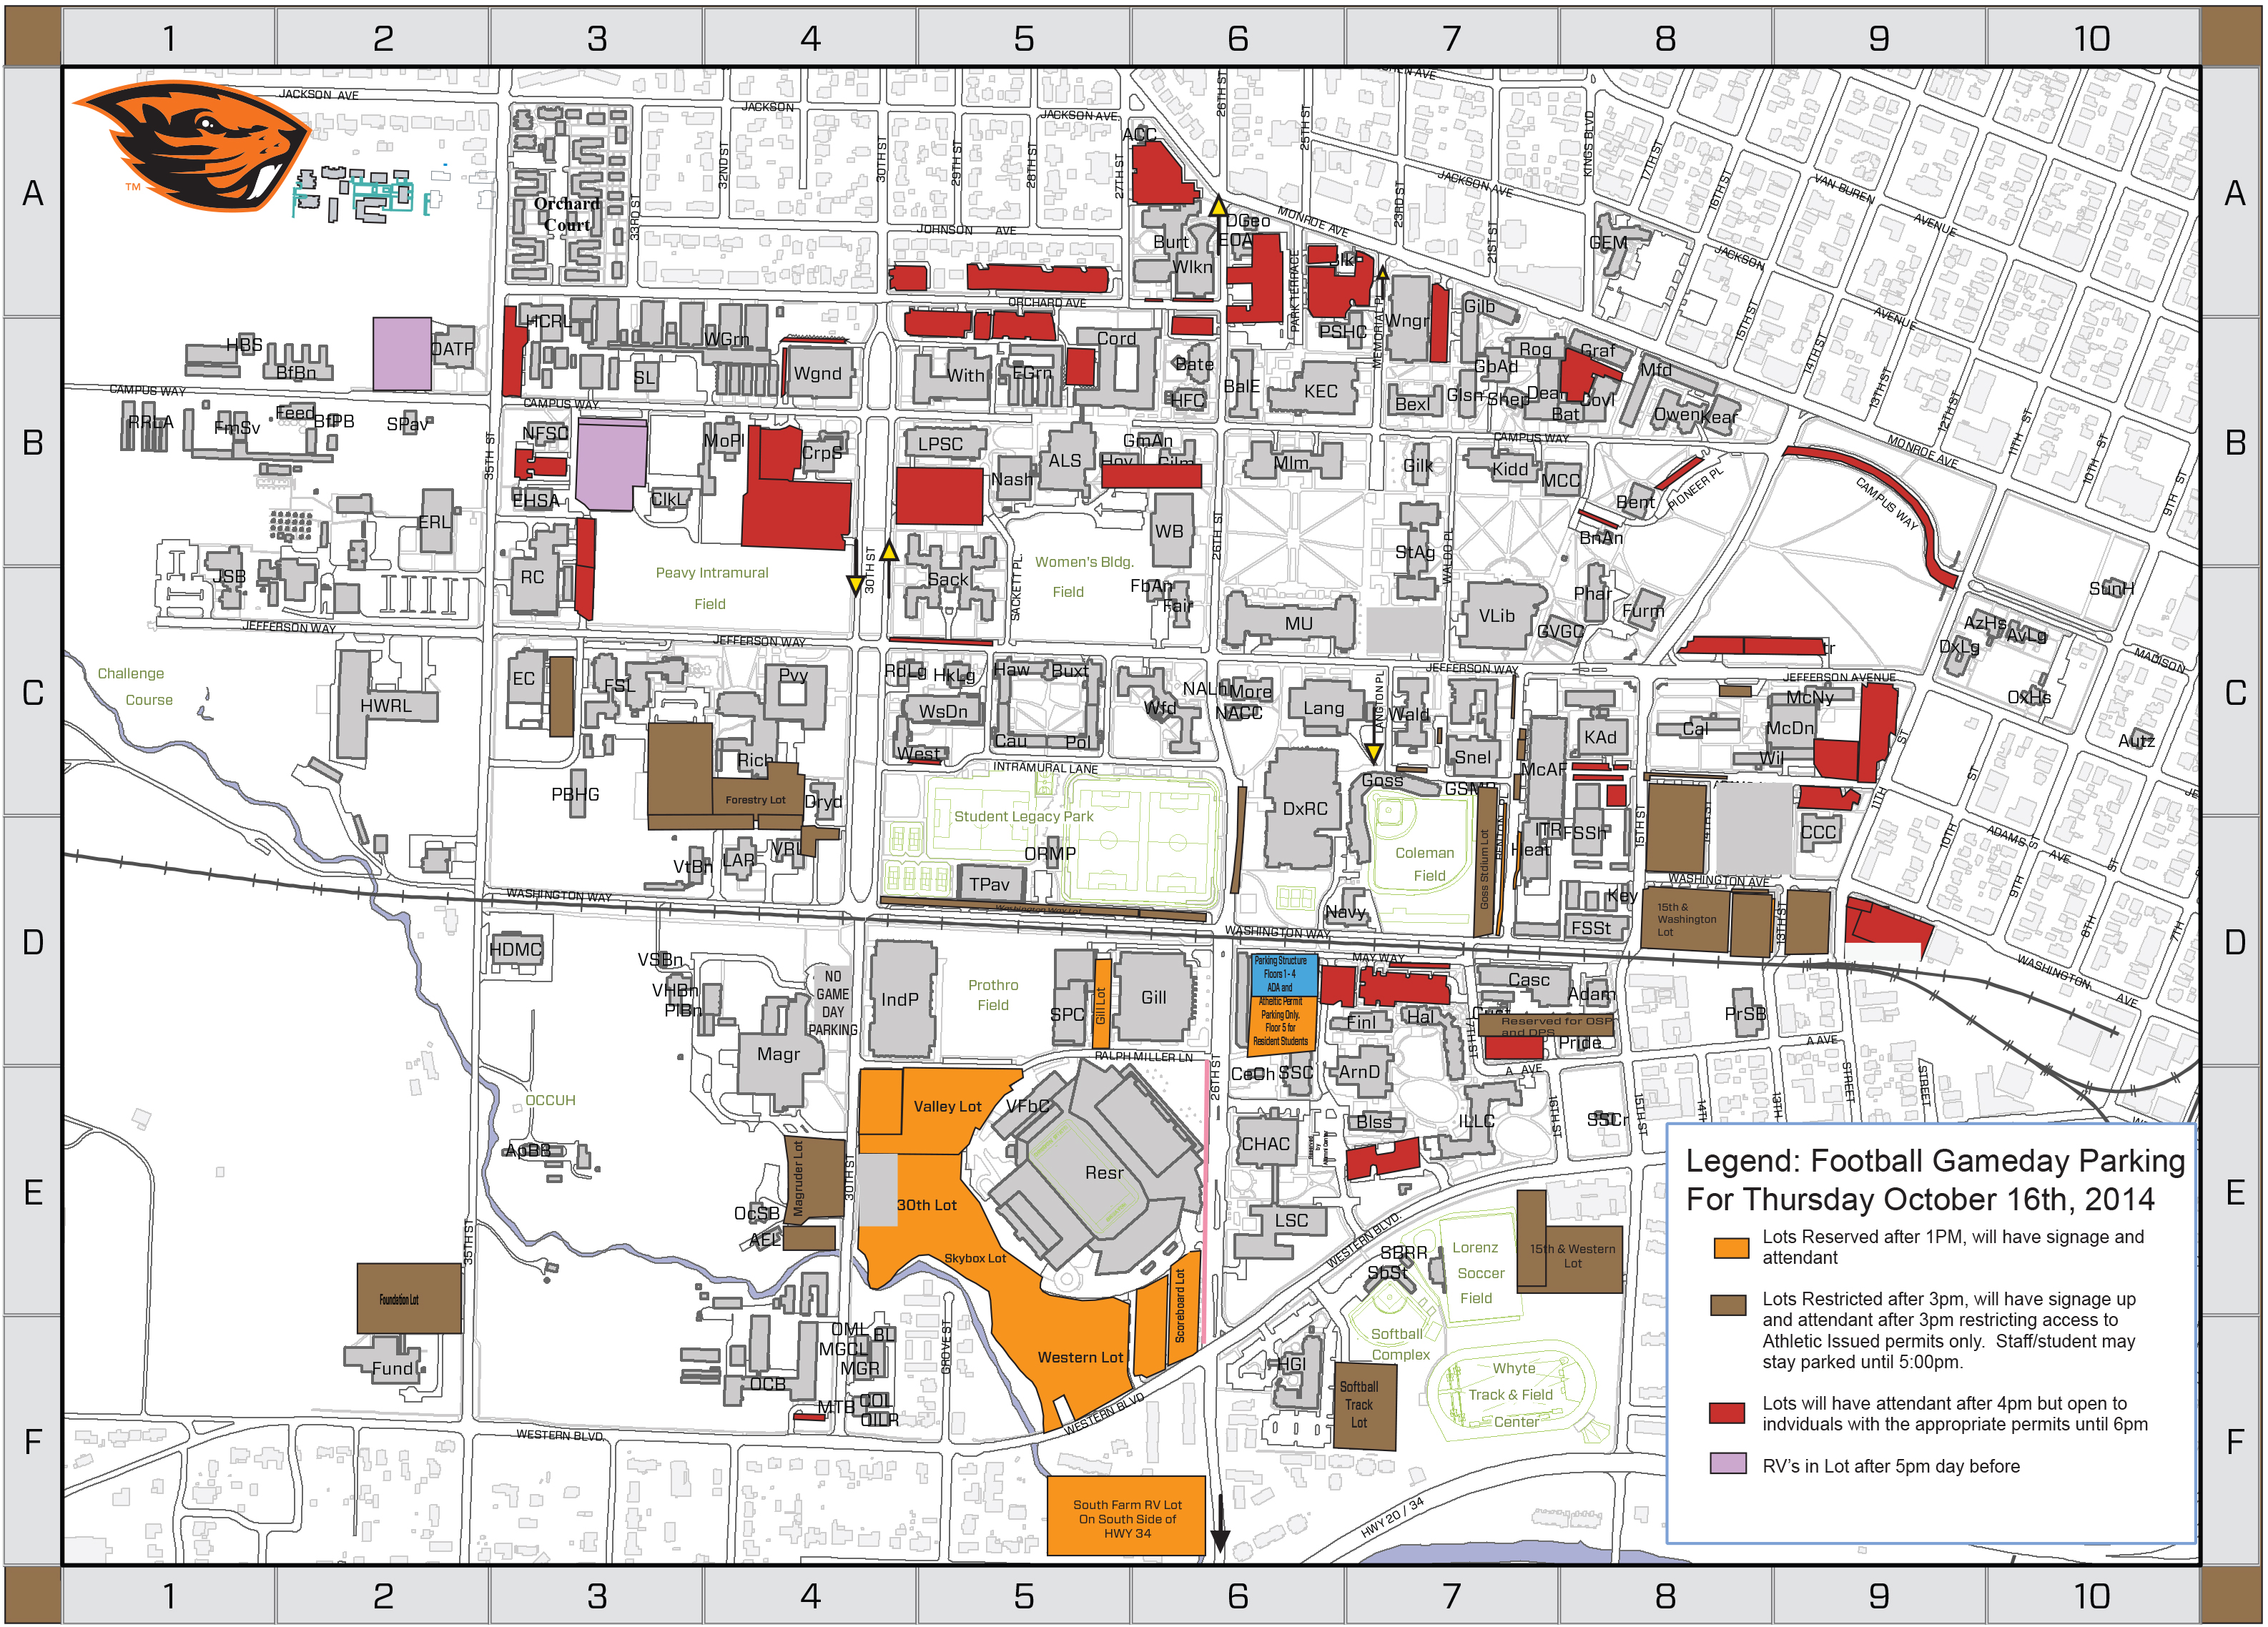

Slide 5
Options for commuting and parking on Oct. 16
Public transit. Travel across campus via new Beaver Bus and travel to campus on community transit.
Fairgrounds shuttle service. Utilize free parking and travel back and forth to campus in a courtesy shuttle on game day and morning of Oct. 17.

Slide 6
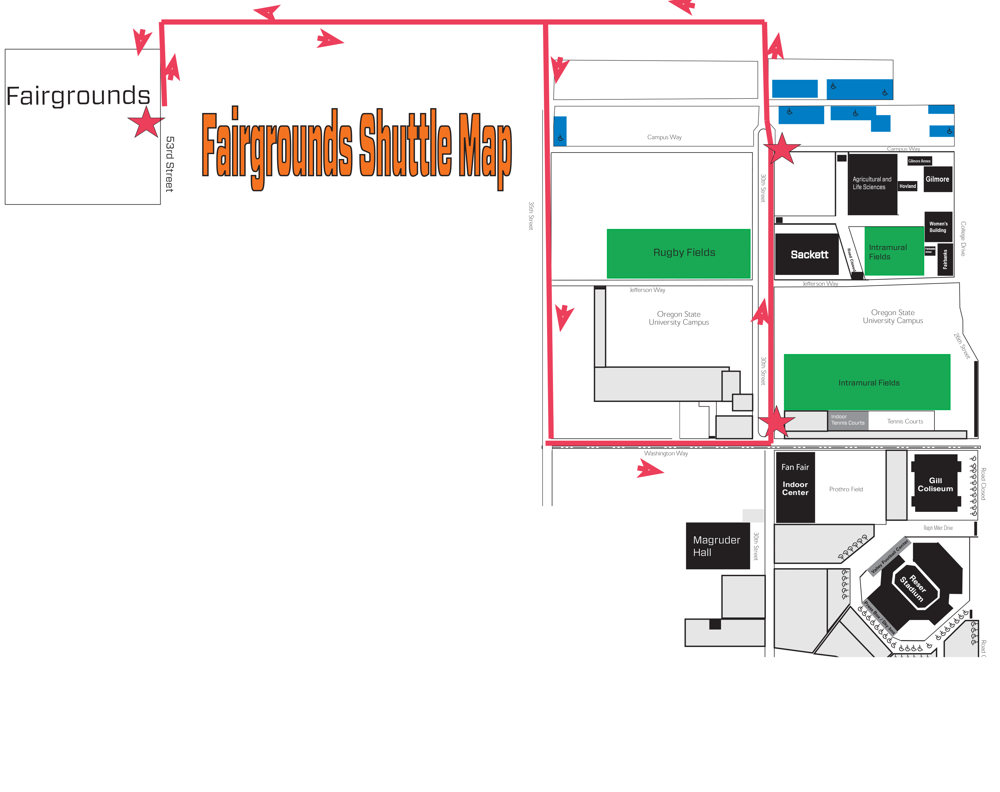

Slide 7
Options for commuting and parking on Oct. 16
Walk, bike or carpool to campus.
Experiential learning and on-line instructional opportunities. Consider off-campus experiential and online instructional opportunities appropriate for afternoon and evening classes.
Telecommute if you are an unclassified employee. Receive advance approval to work remotely on Oct. 16.
Evening exam and lab shuttle service. Shuttle service for faculty and TA’s conducting exams or labs on the evening of Oct. 16.

Slide 8
Communications
Communication sent Oct. 3 to all deans, academic department heads and business unit heads.
E-mail sent Oct. 6 to 30,000 faculty, staff and students.
Reminders to be included in Life@OSU; MyOSU; OSU Today.
News releases.
Faculty Senate communication.
Websites promotion: Oregon State homepage; OSU Athletics.
Barometer advertisements; posters throughout campus.

Slide 9
Appreciation
Special $20 ticket for the Utah game for faculty and staff who don’t already have a ticket.
Call 1-800-GO BEAVS

