Slide 1
Mandatory Syllabus Elements
Materials linked from the March 1, 2021 Curriculum Council agenda.
Four compulsory University-wide course policies:
Academic Calendar All students are subject to the registration and refund deadlines as stated in the Academic Calendar: https://registrar.oregonstate.edu/osu-academic-calendar
Statement Regarding Students with Disabilities Accommodations for students with disabilities are determined and approved by Disability Access Services (DAS). If you, as a student, believe you are eligible for accommodations but have not obtained approval please contact DAS immediately at 541-737-4098 or at http://ds.oregonstate.edu. DAS notifies students and faculty members of approved academic accommodations and coordinates implementation of those accommodations. While not required, students and faculty members are encouraged to discuss details of the implementation of individual accommodations."
Student Conduct Expectations link: https://beav.es/codeofconduct (URL must be shown)
Reach Out for Success* University students encounter setbacks from time to time. If you encounter difficulties and need assistance, it’s important to reach out. Consider discussing the situation with an instructor or academic advisor. Learn about resources that assist with wellness and academic success at oregonstate.edu/ReachOut. If you are in immediate crisis, please contact the Crisis Text Line by texting OREGON to 741-741 or call the National Suicide Prevention Lifeline at 1-800-273-TALK (8255)
*For online or hybrid courses, use the Ecampus Reach Out for Success statement instead.

Slide 2
Optional Syllabus Elements
Student Evaluation of Courses During Fall, Winter, and Spring term the online Student Evaluation of Teaching system opens to students the Wednesday of week 8 and closes the Sunday before Finals Week. Students will receive notification, instructions and the link through their ONID email. They may also log into the system via Online Services. Course evaluation results are extremely important and used to help improve courses and the learning experience of future students. Responses are anonymous (unless a student chooses to “sign” their comments, agreeing to relinquish anonymity) and unavailable to instructors until after grades have been posted. The results of scaled questions and signed comments go to both the instructor and their unit head/supervisor. Anonymous (unsigned) comments go to the instructor only.

Slide 3
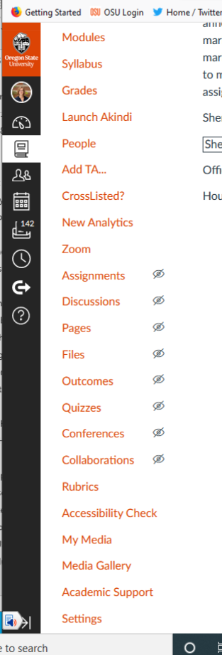
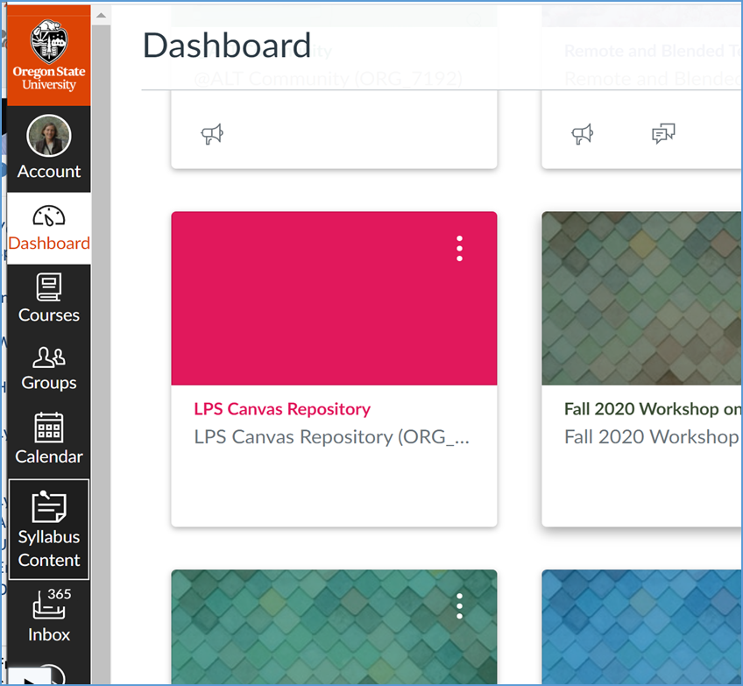
Options for Adding to Canvas

Slide 4
Option: Academic Policies Link
Create a landing page that would be maintained by APA
Would include the mandatory syllabus statements, plus information about eSETs, plus links to OSU Academic Regulations
What to do to make sure Reach for Success is still highlighted for students?

