Slide 1
Upper and Lower Division Courses
Materials linked from the April 12, 2021 Curriculum Council agenda.
Lower-division courses (100- and 200-level) offer survey or introductory-level content intended to equip students with the fundamental theories, concepts, perspectives, principles, methods, and procedures of critical thinking needed to advance to upper-division courses. They may also broaden students’ interdisciplinary knowledge by exposing them to courses in a variety of disciplines. Lower-division courses have one or more of the following characteristics:
Assume, in general, no college-level prerequisites aside from precedent in a sequential course.
Course learning outcomes introduce students to fundamental theories, concepts, perspectives, and principles in preparation for more advanced coursework.
Introduce essential language skills (oral communication and comprehension), data literacy (e.g., information gathering, reading, and writing), numeracy, and/or theories of metacognition to help students to become independent learners and receive the benefits of a well-rounded education.
Introduce and expose students to principles and skills necessary for comprehension, analysis, synthesis, interpretation, and critical thinking.
Upper-division courses (300- and 400-level) are specialized and advanced courses. They build upon and integrate knowledge and/or skills developed in lower division courses and general education curriculum. They emphasize comprehension, analysis, synthesis, interpretation, and critical thinking.
Upper-division courses have one or more of the following characteristics:
Students are assessed on the ability to apply, integrate, and/or transfer knowledge or methods, rather than their comprehension and understanding of the subject.
Course learning outcomes reflect mostly higher order cognitive processes that promote deeper understanding of concepts related to the discipline and/or field.
Presume greater responsibility and independence in students for their own learning.
Develop specific intellectual and professional skills inherent in post-baccalaureate employment, graduate study, or professional school.
Upper division courses require specific background knowledge or skills as indicated by:
Specifying OSU courses as prerequisites and/or corequisites
Specifying course-level registration restriction (e.g., junior or senior class standing)
Specifying competencies or skills necessary for engagement with and success in the course content (e.g., critical thinking, problem-solving, analytical skills, synthesis skills, theoretical applications, advanced writing skills)
Other individual experiences, upon approval of the instructor or academic advisor.

Slide 2
General Policy Goals
  Differentiate between upper and lower division courses
  Provide guidance to originators
  Provide guidance to CC reviewers
  Create more uniformity
  Make expectations transparent for students

Slide 3
Goals for Administration of Policy in CIM
  Streamlined and easy to navigate
  Present information in a way that CC can easily review
  Require some thought by originators as to why their course is upper division BUT…
  Not be overly burdensome for originators
  Make expectations transparent to students
  Apply going forward (no expectation of grandfathering)

Slide 4
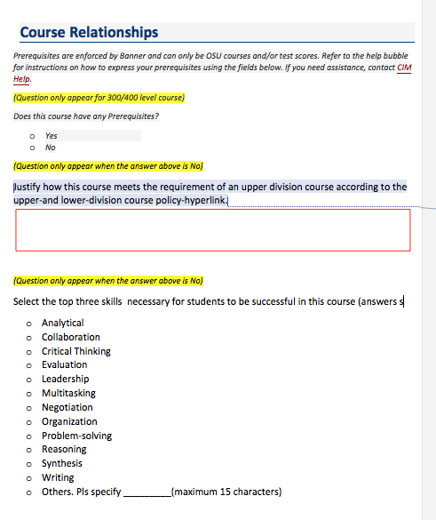
Issues
Vote to approve or not approve new policy
Administration on CIM:
  Issue one: how to designate skills for courses without prerequisites or class standing limitations?
  Proposal: originator fills in a narrative (not visible to students) and checks up to three skills (visible to students as recommended)

Slide 5
Issue: Class standing limitations
  Class standing limitation is one way in the policy to designate course as upper division.
  Currently, class standing limitations may be applied (and removed) at the scheduler level
  Issue: do we want to remove that discretion from schedulers?
  Data: currently, 138 sections apply some form of class standing limitation.

