Slide 1
Senior II Promotion Level Professor of Practice
In December 2011, OAR 580-020-0005 was revised to create the Professor of Practice faculty rank and the Senior II promotion level
Adoption of the new rank and promotion level was approved by the OSU Faculty Senate, May 10, 2012
Subsequently, the Faculty Senate’s Faculty Status & Promotion and Tenure Committees have drafted polices and criteria for implementation for consideration by the Faculty Senate

Slide 2
Committee Membership
Faculty Status
Tony Wilcox, Co-Chair '13
Evan Gottlieb, Co-Chair '14
Shirley Dodsworth '13
Brian Haley '13
Armelle Denis '14
Albrecht Jander '14
Vidyasagar Sathuvalli '15
Wendy Hein '15
Cheryl Middleton '15
Promotion & Tenure
Henri Jansen, Chair '13
Donna Champeau '13
David Trejo '14
Nicole von Germeten '14
Gary Delander '15
Russ Karow '15

Slide 3
Proposed Revised Criteria for Promotion of Instructors and Faculty Research Assistants
Key features of revision:
Criteria for promotion to Senior II level
Extend eligibility for promotion to part-time instructors/FRAs
Set the minimum length of time at Senior level before being eligible for promotion to Senior II
Include reference to eligibility for extended fixed-term contracts

Slide 4
Proposed Revised Criteria for Promotion of Instructors
Promotion from the rank of Instructor to Senior Instructor may be considered after four years of full-time service, calculated from the hire date to December 31 of the calendar year prior to the promotion decision (promotion decisions are made in June of the following year). For part-time instructors at 0.50 FTE or greater, promotion to Senior Instructor may be considered after accumulating the equivalent of four years of full-time service in relation to the type of appointment (9 or 12-month). For fixed-term instructors with extended prior service, promotion to the rank of Senior Instructor cannot be made effective before the end of the third year of full-time service or the accumulation of its equivalent for part-time instructors at 0.50 FTE or greater.
(continued)

Slide 5
Proposed Revised Criteria for Promotion of Instructors
To be promoted, a candidate must:
have a graduate degree appropriate to the assigned duties, or comparable educational or professional experience;
have special skills or experience needed in the unit;
have an exceptional record of achievement in the assigned duties.
Promotion to the rank of Senior II Instructor may be considered after four years of full-time service at the rank of Senior Instructor or the accumulation of its equivalent for part-time Senior Instructors at 0.50 FTE or greater. To be promoted, a candidate must have a sustained record of exceptional achievement and evidence of professional growth and innovation in assigned duties. Senior Instructors and Senior II Instructors are eligible for extended fixed-term contracts (see http://oregonstate.edu/admin/hr/sites/default/files/documents/general/fixed_term_contract.pdf).
The criteria for Teaching, Advising, and Other Assignments in this document can provide guidelines for documenting and evaluating the level of achievement. Promotions cannot be made from non-professorial to professorial ranks.

Slide 6
Proposed Revised Criteria for Promotion of Faculty Research Assistants
Faculty with non-professorial rank are hired in positions to meet units' specific needs. Criteria for promotion will therefore be specific to the candidate's position description.
Promotion from Faculty Research Assistant to Senior Faculty Research Assistant may be considered after four years of full-time service, calculated from the hire date to December 31 of the calendar year prior to the promotion decision (promotion decisions are made in June of the following year). For part-time Faculty Research Assistants at 0.50 FTE or greater, promotion to Senior Faculty Research Assistant may be considered after accumulating the equivalent of four years of full-time service in relation to the type of appointment (9 or 12-month). For Faculty Research Assistants with extended prior service, promotion to the rank of Senior Faculty Research Assistant cannot be made effective before the end of the third year of full-time service or the accumulation of its equivalent for part-time Faculty Research Assistants at 0.50 FTE or greater.

Slide 7
Proposed Revised Criteria for Promotion of Faculty Research Assistants
To be promoted, a candidate must:
have a graduate degree appropriate to the field in which the research activities are performed, or comparable educational or professional experience;
demonstrate a high level of competence, achievement, and potential in research, or serve effectively in a position requiring high individual responsibility or special professional expertise;
demonstrate a high degree of initiative in research and leadership among research colleagues in the department, as documented in authorship, management responsibilities, and creative approaches to research.
Promotion to the rank of Senior II Faculty Research Assistant may be considered after four years of full-time service at the rank of Senior Faculty Research Assistant or the accumulation of its equivalent for part-time Senior Faculty Research Assistants at 0.50 FTE or greater. To be promoted, a candidate must have a sustained record of exceptional achievement and evidence of professional growth and innovation in assigned duties. Senior Faculty Research Assistants and Senior II Faculty Research Assistants are eligible for extended fixed-term contracts (see http://oregonstate.edu/admin/hr/sites/default/files/documents/general/fixed_term_contract.pdf).

Slide 8
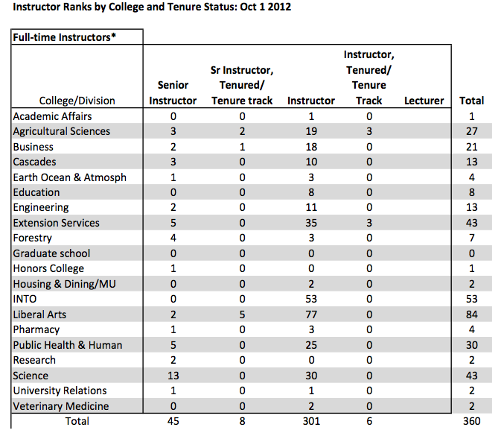

Slide 9
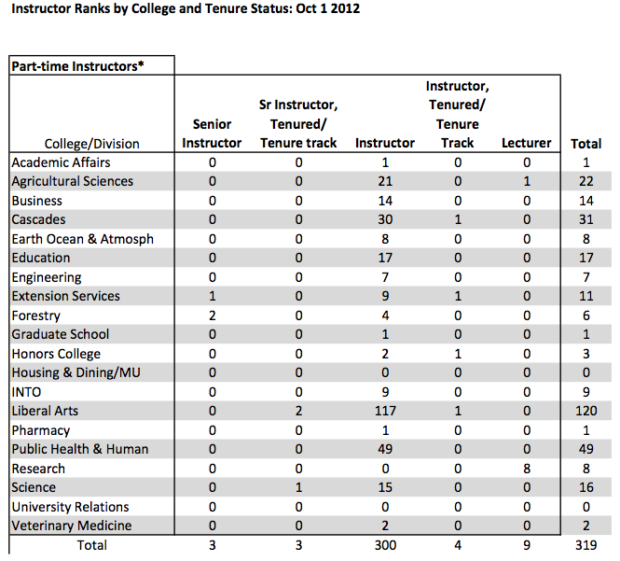

Slide 10
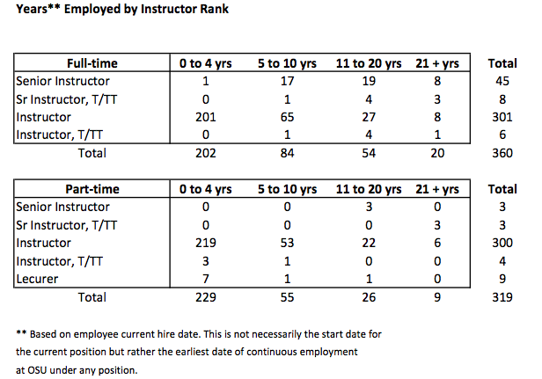

Slide 11
Professor of Practice
OAR 580-020-0005
Academic Rank
(3)(b) CLINICAL FACULTY OR PROFESSOR OF PRACTICES:
A NTTF (Non-Tenure Track Faculty) appointment for individuals with primary duties in the area of clinical instruction or professionally related community education/service. Clinical faculty or professor of practice members are licensed or certified professionals, or individuals in professional fields. The major responsibility involves the education of students/learners in academic and clinical settings, supervising clinical experiences, and/or engaging in professionally related community service. Scholarly activity may or may not be required. Ranks in this
category in ascending order are assistant clinical professor,
associate clinical professor, and clinical professor; or assistant professor of practice, associate professor of practice, and professor of practice.

Slide 12
From the Faculty Handbook:
Guidelines for Clinical Faculty Appointments and Promotion
http://oregonstate.edu/admin/aa/faculty-handbook-post–tenure-review#clinical
Position used in several colleges.
Gives a detailed description of the position, which we adapted for application to Professor of Practice.
Left out: dossier preparation guide-lines, which are expected to be similar.

Slide 13
Professor of Practice Track Faculty
As a Land Grant university, Oregon State University has as part of its mission the conduct of locally/regionally meaningful education, research, and community outreach and engagement. OSU’s deep collaboration with the communities it serves has earned it the Community Engagement designation by the Carnegie Foundation for the Advancement of Teaching. Achieving the land-grant mission requires that some faculty be excellent educators and practitioners who can also effectively translate research to application in or with communities. Faculty members with significant responsibility for non-traditional education or community outcomes may be defined as professors of practice, and position titles include Assistant Professor of Practice, Associate Professor of Practice, and Professor of Practice. (continued…)

Slide 14
Professor of Practice Track Faculty
The practice-track classification is not limited to faculty members with an Extension assignment, nor should all Extension assignments be in this track. It is to be used only for faculty members whose primary work assignments are in professionally related community education and service, though scholarship and university service are also expected. Development of an independent research program is not essential though this may be appropriate in some instances, and most scholarship activities are expected to contribute to effective educational program delivery and research application at local or regional levels. Professor of Practice faculty members are not eligible for tenure, but are eligible for multi-year, rolling contracts at the Associate and Full Professor ranks.

Slide 15
Professor of Practice Scholarship and Creative Work
… ( 5-15% ) ……
The appropriateness and importance of the type of scholarship will vary with the expectations of the position. The principle of peer review and recognition becomes increasingly important as the faculty member progresses through academic ranks. In the case of Professor of Practice faculty, emphasis is placed on peer recognition as a professional practitioner in community settings. Peer recognition results from scholarly accomplishments that can take many forms. The order of examples is not intended to rank importance. Publication in peer-reviewed journals is the most traditional form of scholarship, but professor of practice-track publications might more commonly encompass description and evaluation of novel community-based professional practice or research application, program development and innovation, outcomes of innovative programs and/or services, definitive professional practice reviews, or case reports among others.
(continued)

Slide 16
Professor of Practice Scholarship and Creative Work
Authorship of extension publications, local or regional “practice” publications, book chapters, videotapes, other educational materials and electronic information delivery media is considered scholarly if it is either peer reviewed before dissemination or if there is evidence of its adoption and use by peers. Invited presentations, poster and podium presentations, and published abstracts at state and national levels are other examples of scholarship, provided that evidence of peer validation is provided. Documented impact due to local or regional adoption of practices developed through research activities is considered scholarship. Advising government agencies, industry, or professional groups are all considered evidence of scholarship. Authorship of a patent in the faculty member’s field is considered as evidence of creative scholarship.

Slide 17
Comments???
Tony Wilcox: anthony.wilcox@oregonstate.edu
Henri Jansen: physchair@science.oregonstate.edu

