Slide 1
Academic Integrity and Plagiarism Prevention at OSU
Notes:
Title Slide. Note: Need Soho Std font installed for title and closing slide to display properly. Install files can be found on the GEM server in Media\OSU Brand Identity\font files to install.

Slide 2
Academic Integrity Resources
TAC and Office of Student Conduct are partnering on an academic integrity and plagiarism prevention initiative:
Tutorials
Teaching resources
Webinars
Quick reference docs
Notes:
What is happening – TAC and Office of Student Conduct partnering on academic integrity and plagiarism prevention
Why – to provide consistent, widely-available information and resources for instructors and students on understanding and preventing plagiarism at OSU
What – tutorials, teaching resources, webinars and quick reference docs in one convenient place
Legal
Office of Equity and Inclusion
Disability Access Services
ASOSU
Writing Program
WIC
Writing Center
INTO
Blackboard Steering Committee

Slide 3
Tutorials
For Students
Understanding Plagiarism
How Oregon State Deals with Plagiarism
Preventing Plagiarism
A Brief History of Plagiarism
Academic Integrity Resources
For Instructors
Understanding Plagiarism
How Oregon State Deals with Plagiarism
Preventing Plagiarism
A Brief History of Plagiarism
Cultural Considerations
Academic Integrity Resources

Slide 4

You are Invited
Seeking Faculty input on training materials and teaching resources
Notes:
We invite OSU faculty to share feedback and ideas on the material we are developing
And, in addition, TAC is responding to requests from faculty for a way to identify and prevent potential plagiarism.

Slide 5

Introducing SafeAssign
A tool to help students and instructors identify unoriginal content in student papers.
Students’ papers are compared to content in websites, online journals and other student papers in the SafeAssign system.
A report highlights passages in the paper that match the SafeAssign sources.
Notes:
SafeAssign is a tool within Blackboard that helps students and instructors identify unoriginal content in student papers.
Students submit their papers to a SafeAssignment in Blackboard, and the content is compared to websites, online journals and other student papers in the SafeAssign system.
The software generates a report that highlights passages in the paper that match the online sources

Slide 6

Why SafeAssign?
Integrated with Blackboard
Reviewed by Legal and multiple stakeholders
SafeAssign is entirely optional for instructors
Best used as a teaching tool to improve writing, not a “smoking gun”
Notes:
SafeAssign is one tool in a comprehensive suite of plagiarism prevention resources at OSU for students and instructors. Using SafeAssign is entirely optional for instructors.
We recommend that instructors use SafeAssign as a teaching tool to improve writing, not as a ‘smoking gun’ to catch students plagiarizing.

Slide 7
SafeAssign Databases
The Internet
ProQuest ABI/Inform Database
Global Reference Database
hosted by Blackboard
Institutional Database
hosted here at OSU
Notes:
As students submit papers they are checked against
The Internet
ProQuest’s ABI/Inform database of publications and journal articles
A Global Reference database hosted by Blackboard, which contains papers that were volunteered by students from Blackboard client institutions
The Institutional database hosted here at OSU, which contains all papers submitted to SafeAssign by OSU users. This is the only database that OSU student papers are uploaded to. It is not searchable by any user.

Slide 8
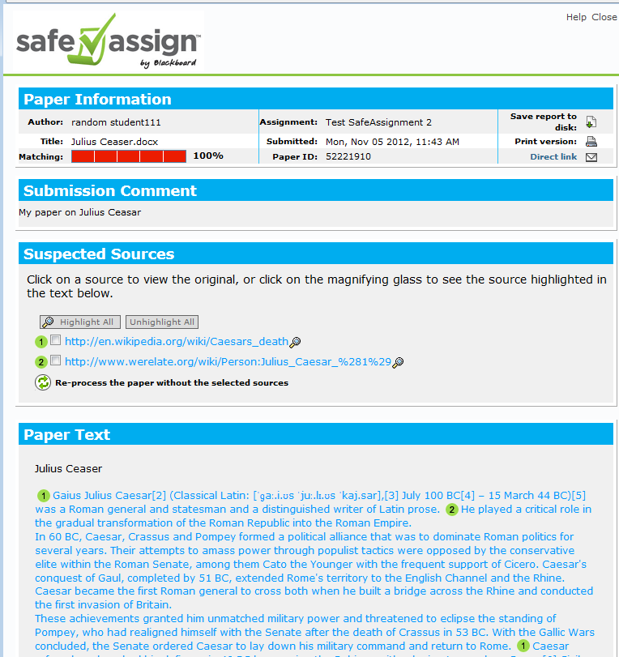
SafeAssign Originality Report
Originality report highlights text in the student document that matches any text found in the databases.
Notes:
At the end of the matching process SafeAssign creates an Originality Report. The report highlights text in the student document that matches any text found in the database and websites.
A percentage of the amount of student content that matches database content is included in the report
IMPORTANT NOTE: Please refer to trainings on SafeAssign Originality Reports to understand how to read them

Slide 9
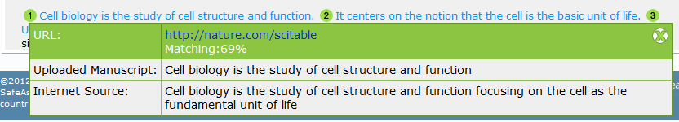
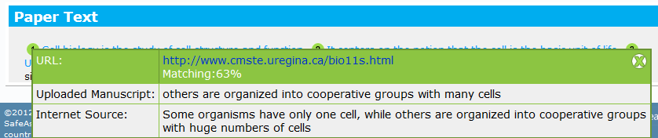
Plagiarism and/or Paraphrasing
Word-for-word:
Paraphrasing:
Notes:
In this slide you can see how SA flags word-for-word matches in the top example, and below that, passages that are poorly paraphrased
After reviewing the paper you can identify whether the student has understood the source, and cited it properly.

Slide 10

Timeline
Academic honesty policies and procedures already in place
Tutorials and webinars rolling out in early March
Week 9 W2013 - SafeAssign will be live in Blackboard
Notes:
Training material will be updated and added to over time

Slide 11
Questions?

Slide 12
Notes:
Outro slide showing old joomla page.

Slide 13
Notes:
Outro slide showing new drupal page.

