Slide 1
Faculty Senate Meeting
Selina Heppell, FS President
April 2021
Faculty Senate

Slide 2
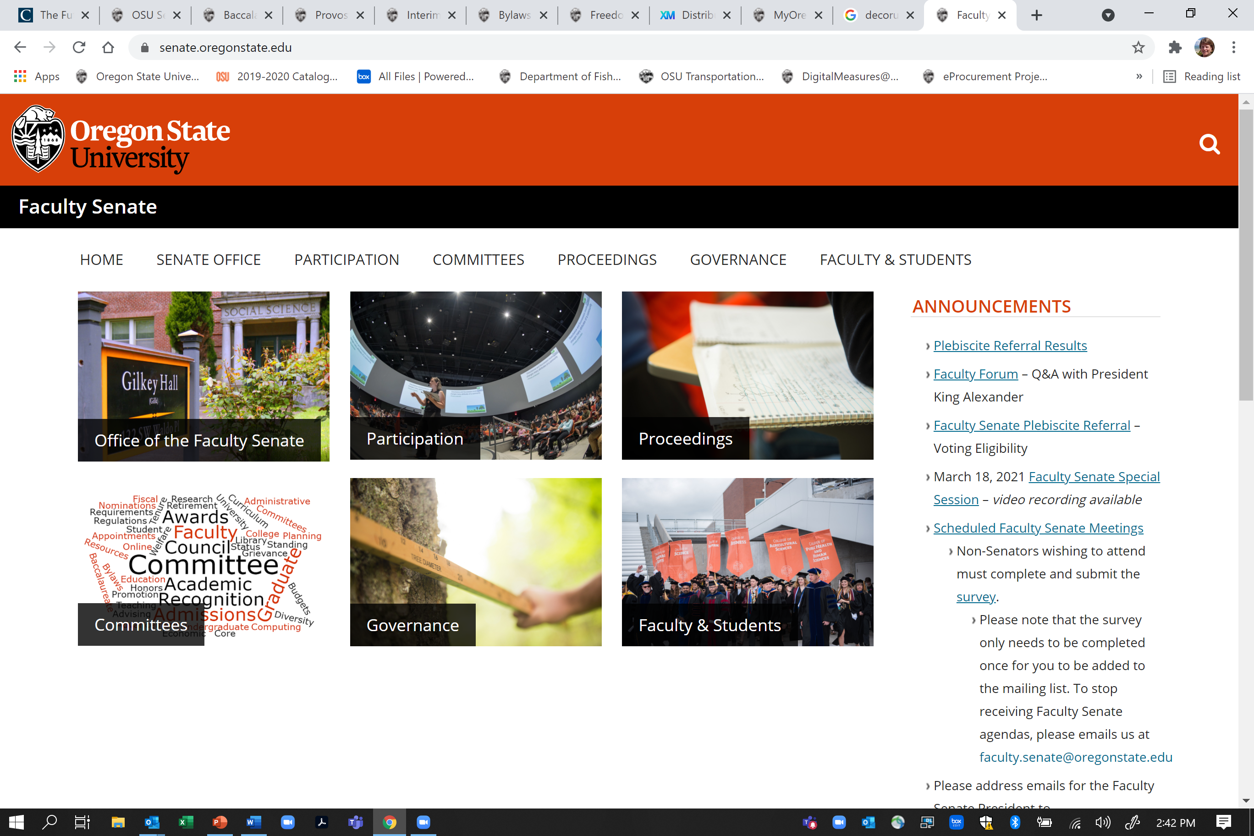

Slide 3
Plebiscite Referral results
We received a total of 1,864 votes of 4,735 ballots successfully sent (39.4% response rate).
The motion: The Faculty of Oregon State University has no confidence in President Alexander’s ability to lead OSU in a way that is consistent with our values, and calls upon him to resign.
Passed with 1,548 Aye (83%), 218 Nay (11.7%), and 98 (5.3%) Abstentions.
No identifying information was collected for the vote, although IP addresses can be checked, if necessary. Requests for duplicate ballots or new ballots were denied unless the request was from a faculty member with appropriate status who definitely did not receive a ballot.

Slide 4
Hearing all voices
Last month, our collective voices were heard. My emphasis was on providing opportunity for all to be heard through oral and written comments and testimony. All written comments received were forwarded, verbatim, to appropriate parties.
It was a difficult week. Thank you to all who participated and shared.
We need to ensure that the Faculty Senate’s voice in shared governance at OSU continues to be effective and powerful.
To do this, we need to turn our collective rally against a common cause into positive energy for a common cause – an inclusive institution that supports its faculty, staff and students, fostering a culture of care and accountability.
This is not only makes a better OSU, it serves as a model for other public universities.

Slide 5
“Our culture of care and cooperation has not crumbled because of this crisis – in fact, we are a stronger community now, one that came together to reinforce our values and demand strong leadership. OSU has upheld its support of shared governance through this crisis.
We have been heard – and this is the first step of rebuilding trust.”
-Selina Heppell, The Oregonian, April 4, 2021
https://www.oregonlive.com/opinion/2021/04/opinion-osu-president-debacle-shows-need-for-trust-and-accountability.html

Slide 6
Upcoming events
Comments to Board of Trustees on the interim presidential search are due TOMORROW at NOON https://leadership.oregonstate.edu/interim-president-appointment
Provost’s Lecture – April 14 5:00-6:00
An Evening with Ibram Kendi, in Conversation About How To Be an Anti-Racist
https://leadership.oregonstate.edu/provost/provosts-lecture-series
Baccalaureate Core Director search is underway, applications due April 12 (MONDAY)
https://jobs.oregonstate.edu/postings/99513
Faculty Pulse Survey 6.0 headed your way soon!

Slide 7
Today’s agenda
Update on Interim Presidential Search
Curricular Proposal Approvals
Special Report - Student Learning Experience Pilot: Winter 2021 Updates
Report from Acting President Ed Feser, Q&A
New Business
Breakout rooms – work on Call for Commitment to Action document
Watch for email announcements!

Slide 8
Chat
Please remember that public comments to the Chat are part of the Senate meeting records
Personal chats are not recorded
Respect and decorum are expected!
Helpful comments, resources, and ideas are always encouraged.

Slide 9
Voicing your Concerns
Faculty Senate meetings are just one way to connect
Faculty.senate@oregonstate.edu
FSPresident@oregonstate.edu
Forums and discussions
Faculty Senate committees
Consider a Zoom meeting with your apportionment unit and/or constituents

Slide 10
Voting
Only Senators and their proxies are permitted to vote.
Zoom polls for today’s votes will appear on your screen. If you are on the phone or don’t see the poll pop up, you can email your vote by the end of the meeting to: Vickie.Nunnemaker@oregonstate.edu
Results that are announced are preliminary, as emailed votes will need to be added and there will be a post-meeting check by Senate Staff to ensure all votes are valid.
Only the FS staff will have access to the records of who voted

Slide 11
Selection of an Interim President of OSU
Trustee Patty Bedient appointed to run the search
Internal candidates nominated through website, also opportunity for comment
Trustee Bedient has met with over 50 stakeholders across campus
Committee to review nominees tomorrow afternoon (Selina is on the committee)

Slide 12
Timeline for Interim President search and appointment
Board Announcement & Webpage Launch March 29, 2021 | Community website launched to gather input on the scope and focus for the position and to accept nominations.
Close of Nomination Period April 9, 2021 | Nomination period closes.
Identify Subset of Nominees and Conduct Outreach Week of April 12 | Identify subset of nominees based on nominations received and position needs. Conduct outreach to determine willingness to serve.
Announce Recommended Nominee Week of April 12 | Recommendation based on input received, position needs and willingness to serve.
Open University Forum with Nominee Week of April 12 | Board holds an open forum where the nominee provides remarks and responds to questions. Community feedback will be solicited following the forum.
Board of Trustees Considers Appointment Week of April 12 | Board considers appointment of interim president. Written and public comment taken at meeting.
https://leadership.oregonstate.edu/interim-president-appointment

Slide 14
On-going discussions – process for Presidential Search
Continued emphasis on need for a transparent process that engages the OSU community
Faculty Senate Executive Committee working on a list of recommendations, will present next month
Additional comments and suggestions can be submitted to the Faculty Senate comment link, here: https://beav.es/Jtc

Slide 15
Curricular Proposals

Slide 16
Breakout rooms
By apportionment Unit, with a few small units combined
Room names will appear on your screen
An EC member will join you to help facilitate. EC members have access to all folders.
You received an email with a link to a shared folder for your apportionment breakout group
Feel free to create new documents, use the shared folder for other Senate work
Today’s topic: Call for Commitment to Action document; comments due April 19

