Slide 1
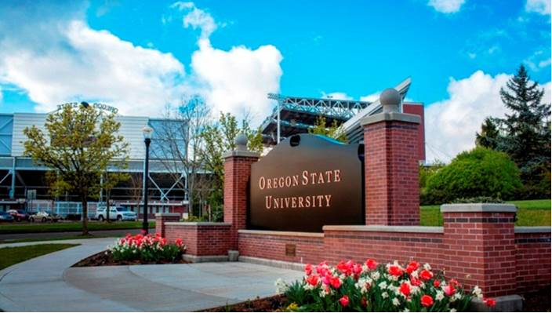
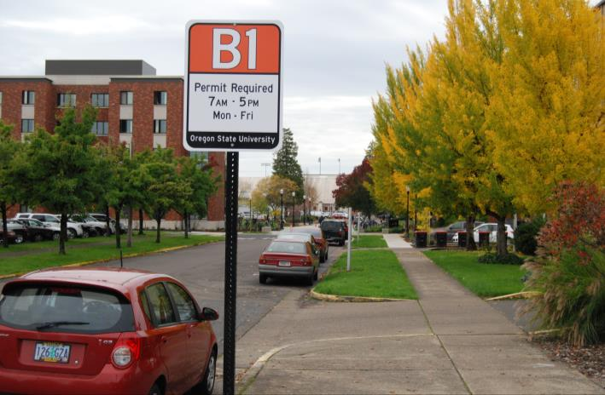
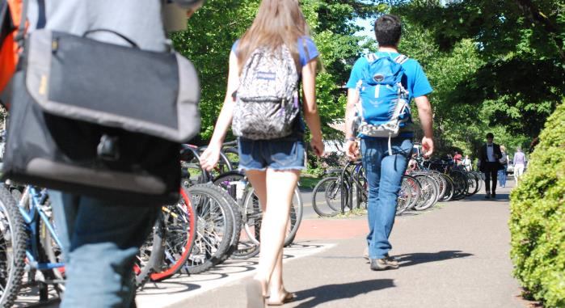
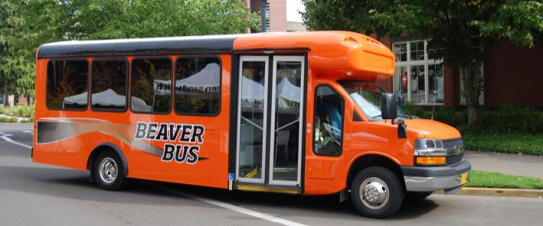
Transportation Services Update Faculty Senate - December 11, 2014

Slide 2
Transportation Services Department
Mission
To support the University’s academic and research mission by providing faculty, staff, students, and visitors with safe, sustainable, customer-focused, and fiscally sound transportation programs and services.
Motor Pool
Parking Services
Beaver Bus Shuttle
Bicycle and pedestrian commuter support
Local transit service coordination
Carpool/Vanpool support
transportation.oregonstate.edu

Slide 3
Transportation Services Update
Transportation Solutions
Zonal Parking Update (72 days in)
Beaver Bus Shuttle Update
Transportation Options Investments
Looking Ahead

Slide 4
Transportation Services Update
Previous System
Frustration
Unlimited Permits Sold
Price not connected to location and demand
Campus core parking lots >90% occupied, while others were <25%
Lacked incentives to not drive alone
Solutions
University-driven and supported plan
Transportation Solutions Task Force
High level of participation in public outreach

Slide 5
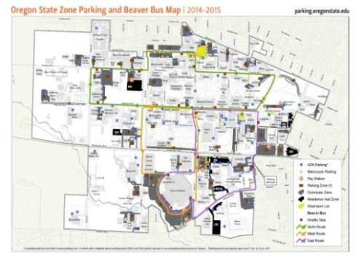
Transportation Services Update
Goals for New System
Choices for price and location
Distribute parking across campus
Increased probability of finding a space
Expand shuttle service, connecting lots to campus core
Accessible and safe
Integrated with transportation options

Slide 6
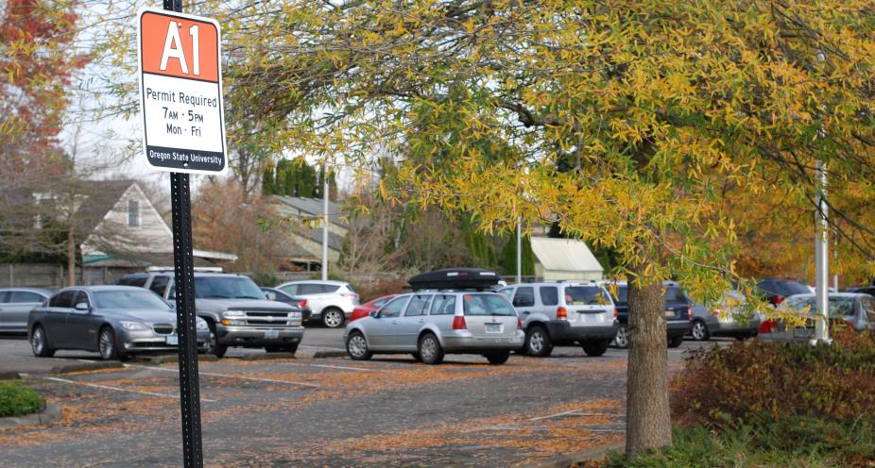
Transportation Services Update: Zonal Parking
Observations from the field
Usage of lots
A zones use ranges from 70-80%
B zone use ranges from 70-75%
C zone use ranges from 82-88%
Previously lot use counted only once a year
Lot use counted 13 times this year already
Tues/Wed 9-11 AM and 2-4 PM
Largely positive feedback regarding availability
Better data & understanding of parking patterns

Slide 7
Transportation Services Update: Zonal Parking
Annual Permit Sales So Far
~7,000 permits sold; similar to last 2 years
Conservative number of permits initially sold
6 zones sold out, waitlists formed
Minor zone adjustments made
More permits sold to waitlists, then online
5 zones now sold out
50 carpool permits sold out
Share parking permit
35% discount
Priority parking spaces

Slide 8
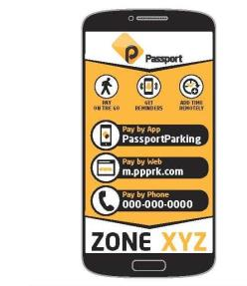
Transportation Services Update: Zonal Parking
Short-Term Permits
Online daily, monthly
Infrequent Driver Discounts
Pay stations
Pay by Phone for meters
Visitors
Prospective students
Conferences and events
Support Athletic events

Slide 9
Transportation Services Update: Zonal Parking
Remainder of 2014-15
Listen to feedback
Improve visitors’ ability to navigate campus transportation and parking
Continue to count lot usage weekly, ridership daily
Continue to sell parking permits as space allows
Make zone adjustments to improve the system
Assess best practices for parking during breaks
Install additional safety features in garage

Slide 10
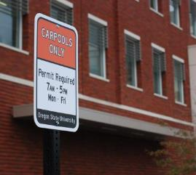
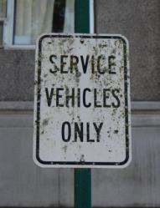
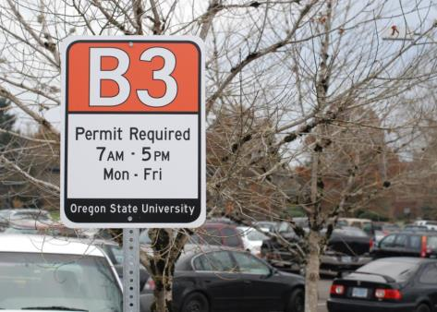
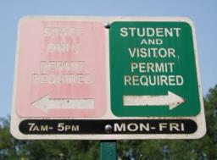
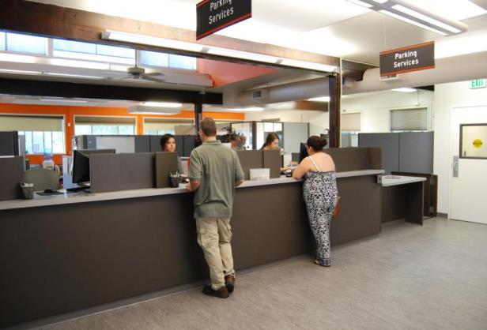
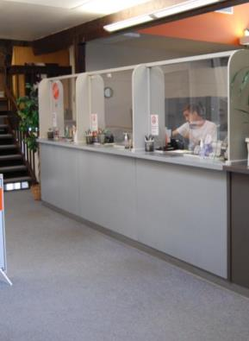
Transportation Services Update: Parking Services Improvements
Notes:
Coordinated sign package not only looks better, but help with navigating the campus

Slide 11
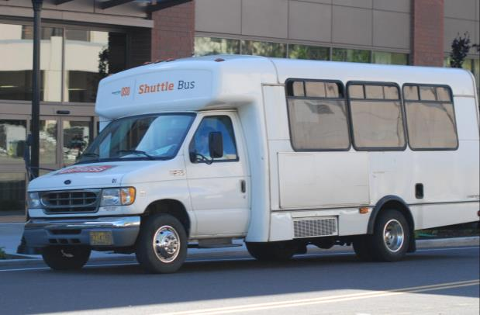
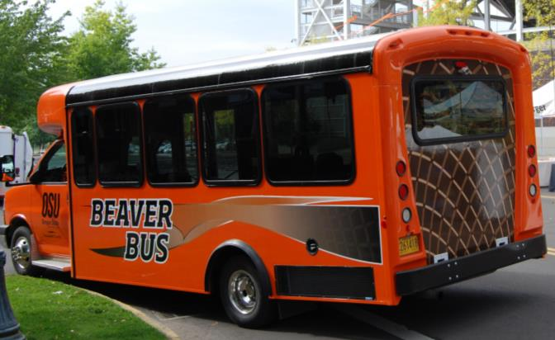
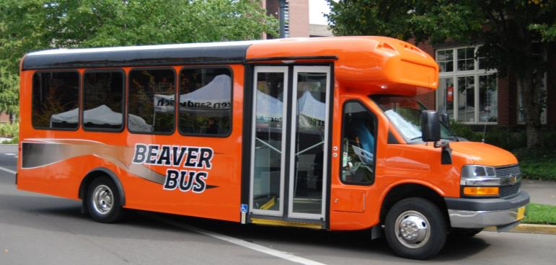
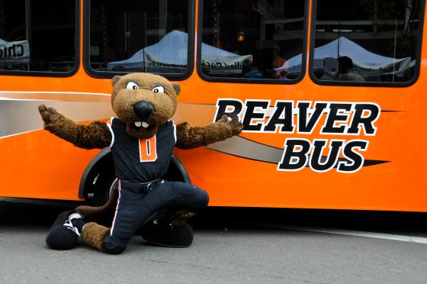
Transportation Services Update: Shuttle Improvements

Slide 12
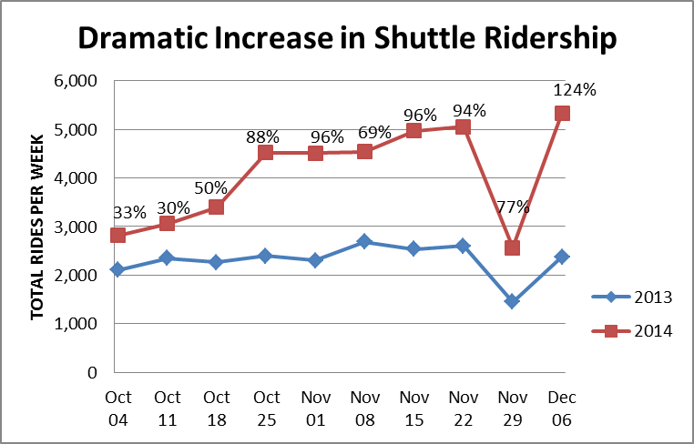
Transportation Services Update: Shuttle Then and Now
Expanded hours to 7am – 7pm, M-F
Added a fourth bus; three routes
Most use of West and East routes
Thanksgiving Week
Notes:
People like the tail!

Slide 13
Transportation Services Update: Transportation Options Investment
Annual funding from the University & Parking Services
2015 investment in bike parking
Additional capacity in 10 locations
Carpool support
Identifying carpool partners
Offering rewards
Coordinate over $400,000 in annual payments from OSU to local transit services
Success with additional bus on C1R Route
CTS overall ridership up 8.5% Nov 2013 to 2014

Slide 14
Transportation Services Update: Looking Ahead, Parking
Permit Sales for 2015-16
First 2 weeks in May - Existing permit holders may renew
Last 2 weeks in May - Existing permit holders may exchange zones, as supplies allow
Fall 2015 - New annual permit sales continue
Option to add a hangtag for your decal

Slide 15
Transportation Services: Looking Ahead
Additional Plans
Explore additional incentives/rewards for not driving alone
Explore the provision of new services at the motor pool
Additional bike lockers, expand bike share/loan
Form new partnerships on and off campus
City of Corvallis Transportation Plan participation
Explore ways to provide better customer service

Slide 16
Thank you for your collaboration and constructive feedback.
Questions?
Observations?
Happy Holidays!

