Slide 1
Core Education
Faculty Senate Update
June 13, 2024
McKenzie Huber, Director of Core Education

Slide 2
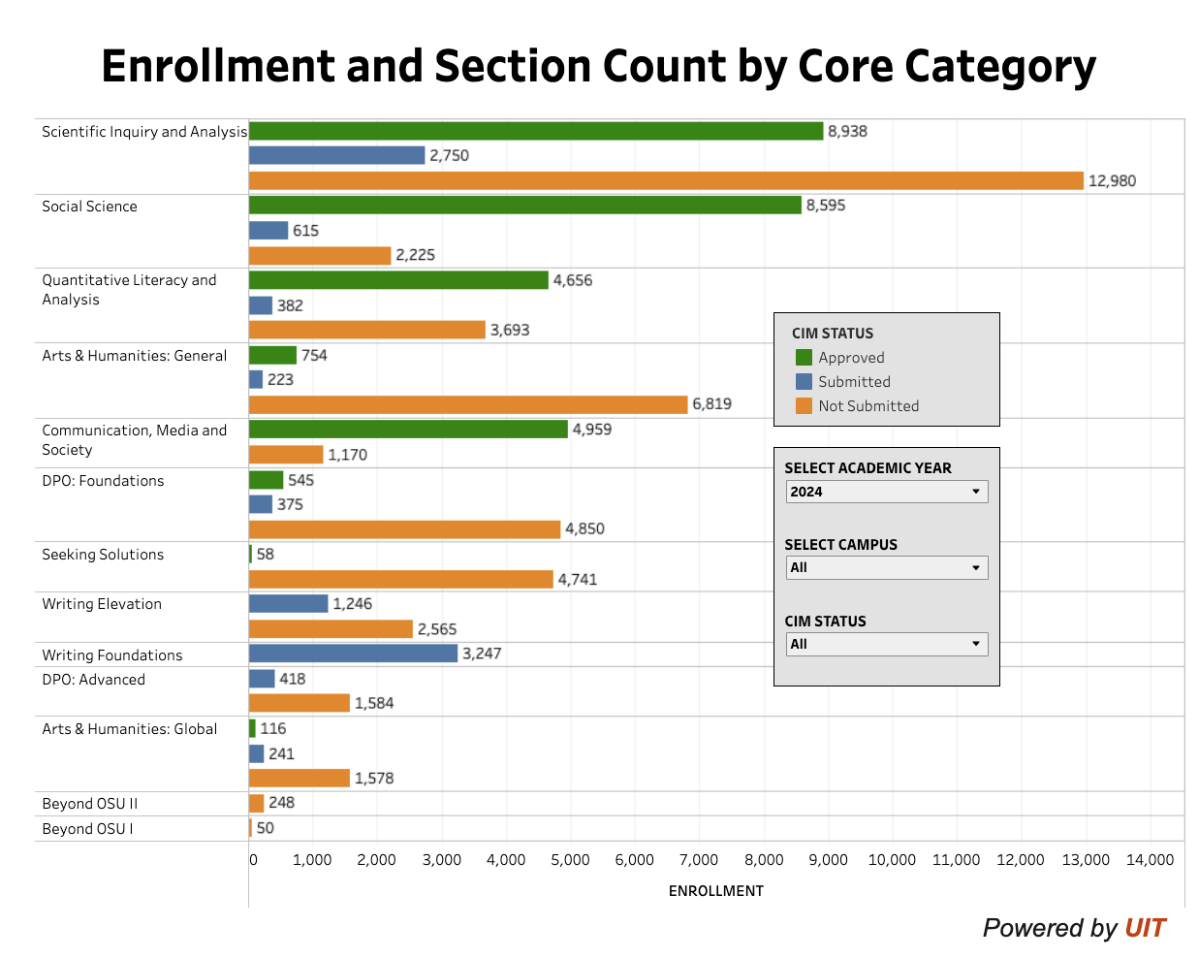
Core Education CIM Status
Dashboard
Data reflects the Academic Year 2024. The image reflects the dashboard as of 6/12/2024 at 3:30 pm.

Slide 3
CIM Submission Deadlines
NOVEMBER 1, 2024
Submit to CIM to Meet March Deadline:
MARCH 1, 2025
Catalog Approved Deadline:
SUMMER 2025
CORE EDUCATION goes LIVE!!!
JUNE 13, 2024
We are here.
Core Education Course Proposals & Core Education-related program change proposals.
Core Education Course Proposals & Core Education-related program change proposals.
JULY 1, 2024
Statement of Intent Due for September CADIs
SEPTEMBER 2024
Last set of CADIs before Catalog deadlines
> June 26 CADI
> September 16, 19, 25
Submissions must be fully approved in CIM
For Questions or support, please contact cim.help@oregonstate.edu

Slide 4
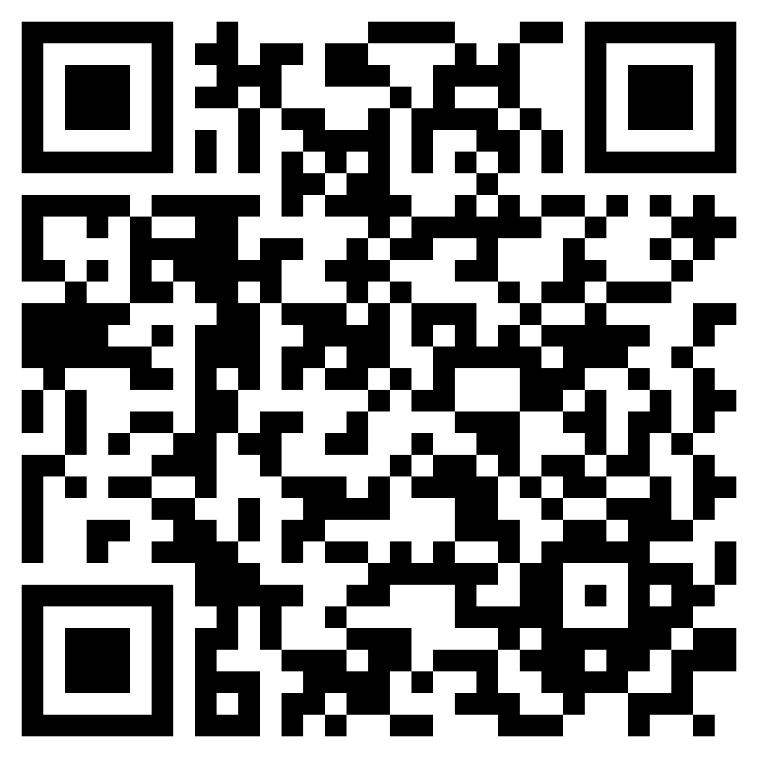
DPO Academies
Schedule & Registration
Academy Structure
Foundations: 15 hours
Advanced: 6 hours
Summer 2024 – Full!
Foundations: June 17-18; 20-21
Advanced: June 17-18
Fall 2024 – Space Still Available!
Foundations: Fridays, 9am-Noon, Weeks 2, 4, 6, 8, 10
Advanced: Fridays, 10am-Noon, Weeks 0, 1, 3

Slide 5
Seeking Solutions
Introducing Seeking Solutions Faculty Fellows - Dr. Troy Hall and Dr. Meg Mobley
Available for:
Consultations
Course proposals support
Teaching Seeking Solutions courses
Resources and FAQs added to the
Core Education website
https://beav.es/pqW

Slide 6
Call to Action
Submit courses to CIM by November 1, 2024
Attend June and September CADIs specifically for:
Seeking Solutions
DPO Foundations and Advanced
Beyond OSU I and II
Writing Elevation

